Slide 1
Structure of the Principal-Agent Problem
Chapter 1
Peter Kuhn, Personnel Economics
Copyright © 2018 Oxford University Press

Slide 2
Figures and Tables
Peter Kuhn, Personnel Economics
Copyright © 2018 Oxford University Press

Slide 3
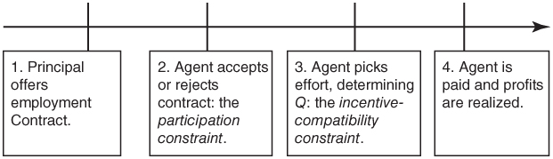
FIGURE 1.1
Timeline of Actions in the Principal–Agent Problem
Peter Kuhn, Personnel Economics
Copyright © 2018 Oxford University Press

Slide 4
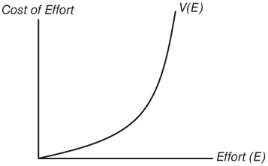
FIGURE 1.2
The Cost-of-Effort Function, V(E)
Peter Kuhn, Personnel Economics
Copyright © 2018 Oxford University Press

Slide 5
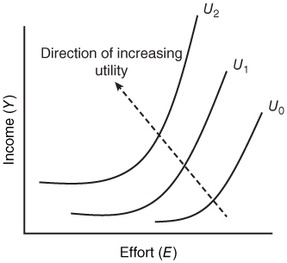
FIGURE 1.3
Indifference Curves between Effort and Income
Peter Kuhn, Personnel Economics
Copyright © 2018 Oxford University Press

