Slide 1
Solving the Agent’s Problem
Chapter Two
Peter Kuhn, Personnel Economics
Copyright © 2018 Oxford University Press

Slide 2
Figures and Tables
Peter Kuhn, Personnel Economics
Copyright © 2018 Oxford University Press

Slide 3
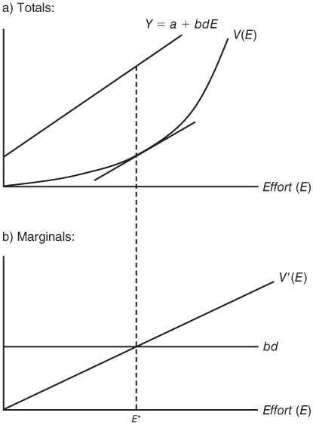
FIGURE 2.1
The Agent’s Optimal Effort Decision
Peter Kuhn, Personnel Economics
Copyright © 2018 Oxford University Press

Slide 4
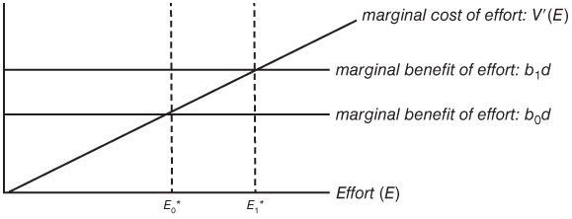
FIGURE 2.2
Effects of Increases in b on the Agent’s Effort Choice
Peter Kuhn, Personnel Economics
Copyright © 2018 Oxford University Press

Slide 5
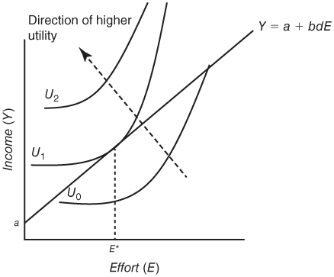
FIGURE 2.3
Illustrating the Agent’s Optimal Effort Using Indifference Curves
Peter Kuhn, Personnel Economics
Copyright © 2018 Oxford University Press

