Slide 1
Solving the Principal’s Problem
Chapter Three
Peter Kuhn, Personnel Economics
Copyright © 2018 Oxford University Press

Slide 2
Figures and Tables
Peter Kuhn, Personnel Economics
Copyright © 2018 Oxford University Press

Slide 3
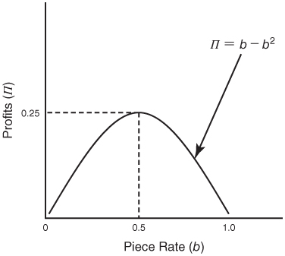
FIGURE 3.1
Profits as a Function of the Piece Rate (b) when a Is Fixed at Zero
Peter Kuhn, Personnel Economics
Copyright © 2018 Oxford University Press

Slide 4
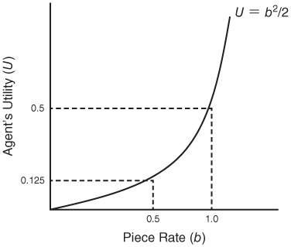
FIGURE 3.2
The Agent’s Utility as a Function of b
Peter Kuhn, Personnel Economics
Copyright © 2018 Oxford University Press

Slide 5
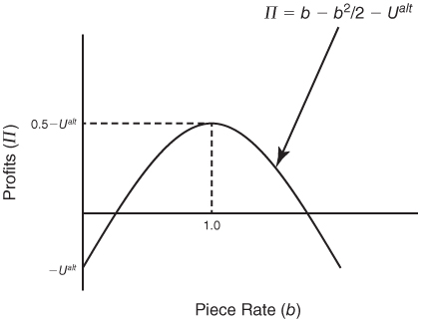
FIGURE 3.3
Profits as a Function of b in the Full Principal–Agent Problem
Peter Kuhn, Personnel Economics
Copyright © 2018 Oxford University Press

Slide 6
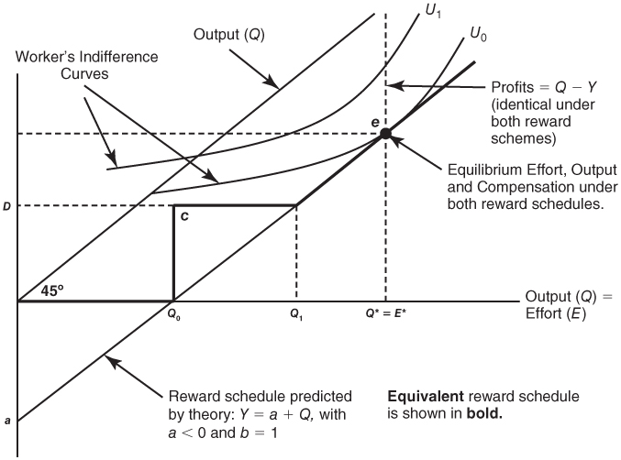
FIGURE 3.4
Charging the Agent for the Job
Peter Kuhn, Personnel Economics
Copyright © 2018 Oxford University Press

Slide 7
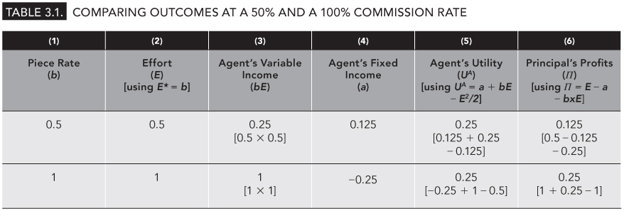
Table 3.1
Comparing Outcomes at a 50% and a 100% Commission Rate
Peter Kuhn, Personnel Economics
Copyright © 2018 Oxford University Press

