Slide 1
Extensions: Uncertainty, Risk Aversion, and Multiple Tasks
Chapter Five
Peter Kuhn, Personnel Economics
Copyright © 2018 Oxford University Press

Slide 2
Figures and Tables
Peter Kuhn, Personnel Economics
Copyright © 2018 Oxford University Press

Slide 3
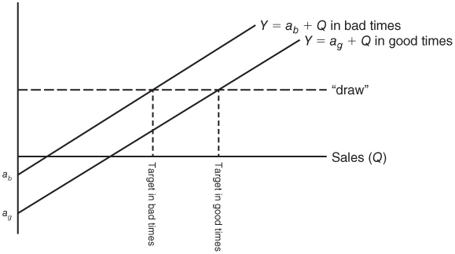
FIGURE 5.1
The Optimal State-Contingent Contract for Risk-Averse Workers
Peter Kuhn, Personnel Economics
Copyright © 2018 Oxford University Press

Slide 4
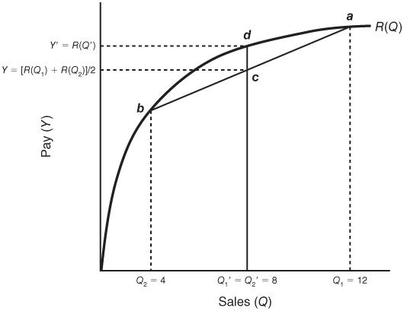
FIGURE 5.2
Timing Gaming with a Concave Reward Schedule
Peter Kuhn, Personnel Economics
Copyright © 2018 Oxford University Press

Slide 5
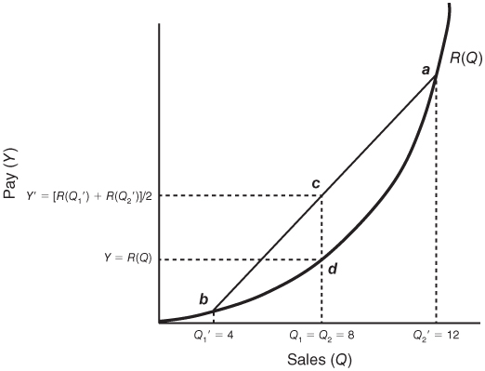
FIGURE 5.3
Timing Gaming with a Convex Reward Schedule
Peter Kuhn, Personnel Economics
Copyright © 2018 Oxford University Press

