Slide 1
Empirical Methods in Personnel Economics
Chapter Seven
Peter Kuhn, Personnel Economics
Copyright © 2018 Oxford University Press

Slide 2
Figures and Tables
Peter Kuhn, Personnel Economics
Copyright © 2018 Oxford University Press

Slide 3
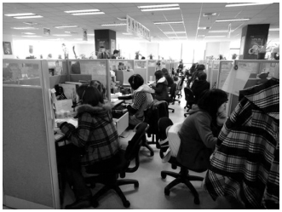
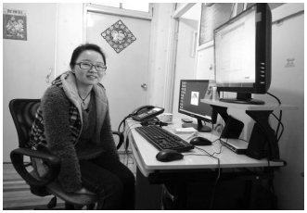
Source: From “Does Working From Home Work? Evidence from a Chinese Experiment,” by Nicholas Bloom, James Liang, John Roberts, and Zhichun Jenny Ying, The Quarterly Journal of Economics, Volume 130, Issue 1, 2015; by permission of Oxford University Press.
FIGURE 7.1
CTrip’s Call Center and a Typical Home Worker
Peter Kuhn, Personnel Economics
Copyright © 2018 Oxford University Press

Slide 4
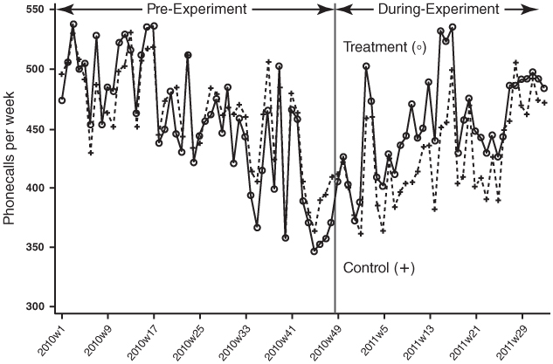
Source: From “Does Working From Home Work? Evidence from a Chinese Experiment,” by Nicholas Bloom, James Liang, John Roberts, and Zhichun Jenny Ying, The Quarterly Journal of Economics, Volume 130, Issue 1, 2015; by permission of Oxford University Press.
FIGURE 7.2
Employee Performance at CTrip Before and During the Working-From-Home Experiment
Peter Kuhn, Personnel Economics
Copyright © 2018 Oxford University Press

Slide 5
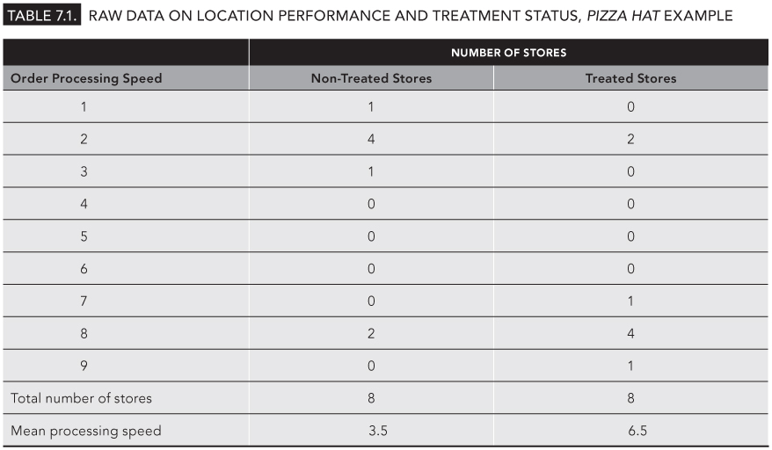
TABLE 7.1
Raw Data on Location Performance and Treatment Status, Pizza Hat Example
Peter Kuhn, Personnel Economics
Copyright © 2018 Oxford University Press

Slide 6
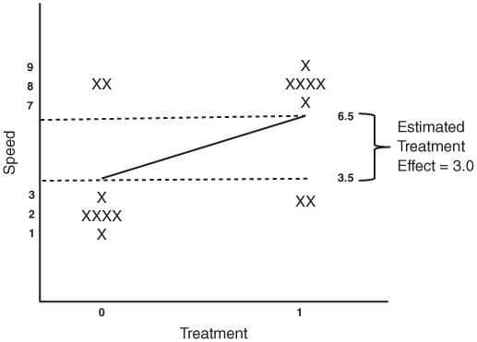
FIGURE 7.3
Scatter Plot and Simple Regression Line, Pizza Hat Example
Peter Kuhn, Personnel Economics
Copyright © 2018 Oxford University Press

Slide 7
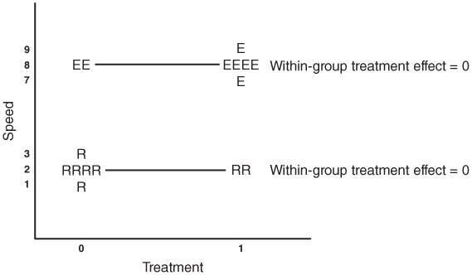
FIGURE 7.4
Scatter Plot and Within-Group Regression Lines, Pizza Hat Example
Peter Kuhn, Personnel Economics
Copyright © 2018 Oxford University Press

