Slide 1
Performance Pay at Safelight Glass. Higher Productivity, Pay, and Profits
Chapter Eight
Peter Kuhn, Personnel Economics
Copyright © 2018 Oxford University Press

Slide 2
Figures and Tables
Peter Kuhn, Personnel Economics
Copyright © 2018 Oxford University Press

Slide 3
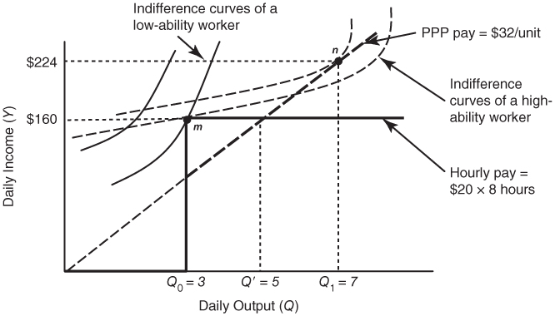
FIGURE 8.1
Predicted Effects of Safelite’s Incentive Pay Plan
Peter Kuhn, Personnel Economics
Copyright © 2018 Oxford University Press

Slide 4
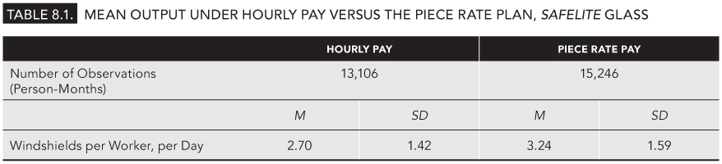
TABLE 8.1
Mean Output Under Hourly Pay Versus the Piece Rate Plan, Safelite Glass
Peter Kuhn, Personnel Economics
Copyright © 2018 Oxford University Press

