Slide 1
Some “Non-Classical” Motivators
Chapter Nine
Peter Kuhn, Personnel Economics
Copyright © 2018 Oxford University Press

Slide 2
Figures and Tables
Peter Kuhn, Personnel Economics
Copyright © 2018 Oxford University Press

Slide 3
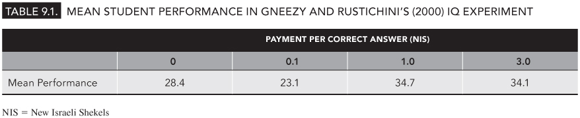
TABLE 9.1
Mean Student Performance in Gneezy and Rustichini’s (2000) IQ Experiment
Peter Kuhn, Personnel Economics
Copyright © 2018 Oxford University Press

Slide 4
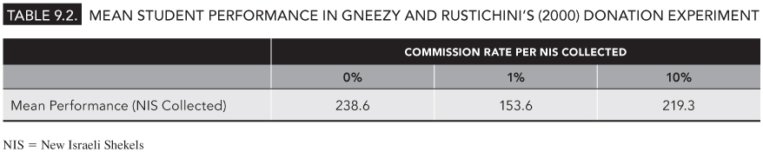
TABLE 9.2
Mean Student Performance in Gneezy and Rustichini’s (2000) Donation Experiment
Peter Kuhn, Personnel Economics
Copyright © 2018 Oxford University Press

Slide 5
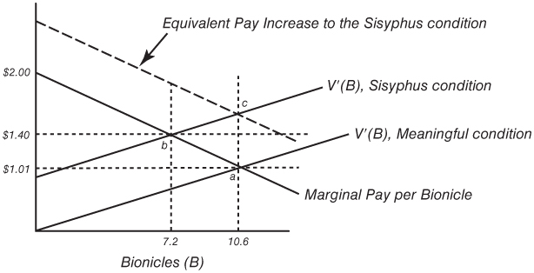
FIGURE 9.1
Implications of the Bionicles Experiment for the Disutility of Effort Function
Peter Kuhn, Personnel Economics
Copyright © 2018 Oxford University Press

Slide 6
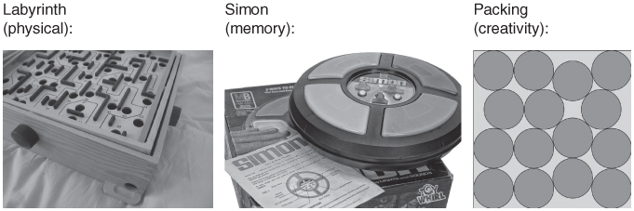
FIGURE 9.2
Some of the Tasks in AGL’s “High-Stakes” Experiments
Source: From Rosmarie Voegtll/Attribution 2.0 Generic (CC BY 2.0). Taylor Wilton/Attribution 2.0 Generic (CC BY 2.0). Toby Hudson/Creative Commons CC by SA 3.0 license. Sources: Voegtli, R. (2011). Labyrinth. Flickr Photo made available under a Creative Commons CC by 2.0 Generic license; Taylor, W. (2012). Simon Says Memory Game. Flickr Photo made available under a Creative Commons CC by 2.0 Generic license; Hudson, T. (2010). Fifteen equal circles packed within the smallest possible square. Wikipedia image made available under a Creative Commons CC by SA 3.0 license.
Peter Kuhn, Personnel Economics
Copyright © 2018 Oxford University Press

Slide 7
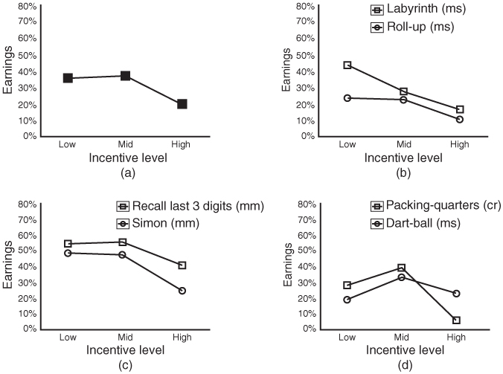
FIGURE 9.3
Performance in AGLM’s “High-Stakes” Experiments
Source: Figure 1 in AGLM (2009) figures show means of the share of earnings relative to the maximum possible earnings for the three payment levels for all six games combined (a), and plotted separately by game (b–d). Games are indicated by their category: motor skills (ms), memory(mm), and creativity (cr).
Republished with permission of Blackwell Publishing Limited, from “Large Stakes and Big Mistakes,” by Dan Ariely, Uri Gneezy, George Loewenstein, Nina Mazar, Review of Economic Studies, Vol. 76, No. 2, April 2009, pp. 451–469, Figure 1; permission conveyed through Copyright Clearance Center, Inc.
Peter Kuhn, Personnel Economics
Copyright © 2018 Oxford University Press

Slide 8
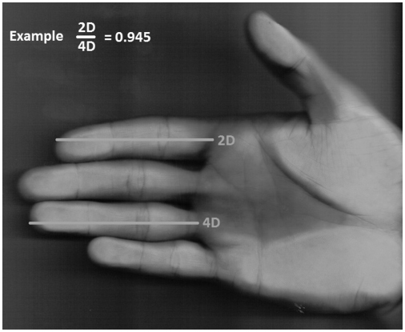
FIGURE 9.4
A Low 2D:4D Ratio
A low 2D:4D ratio is associated with success in noise trading and with high prenatal androgen exposure.
Source: Wikimedia Commons. 2011. “Hand_zur_Abmessung 2D4D.jpg” Public domain image.
Peter Kuhn, Personnel Economics
Copyright © 2018 Oxford University Press

Slide 9
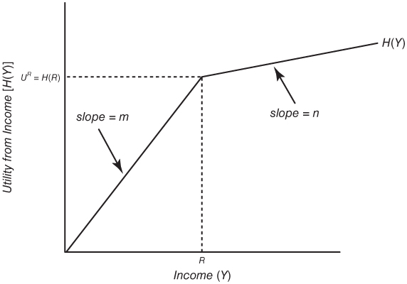
FIGURE 9.5
Utility from Income in Prospect Theory
Peter Kuhn, Personnel Economics
Copyright © 2018 Oxford University Press

Slide 10
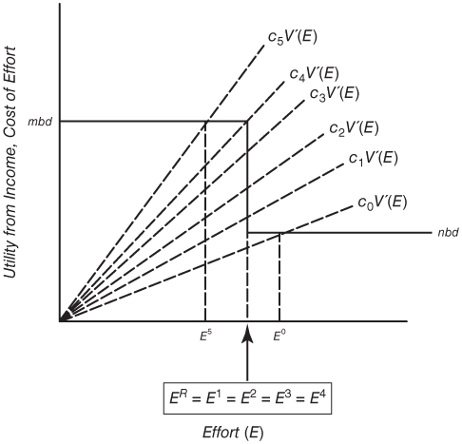
FIGURE 9.6
Optimal Effort Choices with a Reference Point
Peter Kuhn, Personnel Economics
Copyright © 2018 Oxford University Press

Slide 11
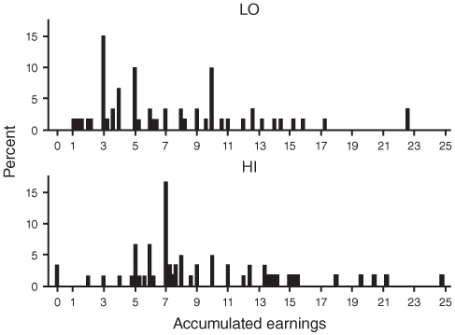
FIGURE 9.7
Accumulated Earnings (in Euros) in Abeler, Falk, Goette, and Huffman’s (2011) Experiment
The top panel (LO) is a histogram of the subjects’ accumulated earnings when the fixed payment was 3 euros; the bottom panel (HI) is when the fixed payment was 7 euros.
Source: Figure 1 in Abeler et al. (2011). Copyright © 2002, Rights Managed by nature Publishing Group. “Altruistic Punishment in Humans,” by Ernst Fehr and Simon Gachter, Nature, January 2002. Reproduced with permission.
Peter Kuhn, Personnel Economics
Copyright © 2018 Oxford University Press

Slide 12
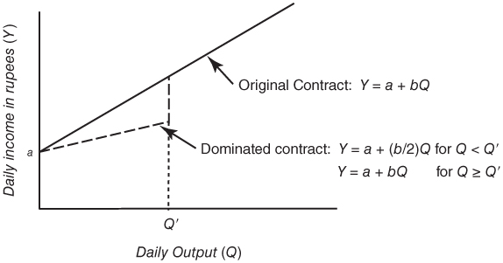
FIGURE 9.8
The Dominated Contracts Used in Kaur, Kremer, and Mullainathan (KKM’s; 2015) Data Entry Experiment
In KKM’s experiment, a was 15 rupees and b was 0.03 rupees per completed field.
Peter Kuhn, Personnel Economics
Copyright © 2018 Oxford University Press

