Slide 1
Pigeons and Pecks: Incentives and Income Effects
Chapter Eleven
Peter Kuhn, Personnel Economics
Copyright © 2018 Oxford University Press

Slide 2
Figures and Tables
Peter Kuhn, Personnel Economics
Copyright © 2018 Oxford University Press

Slide 3
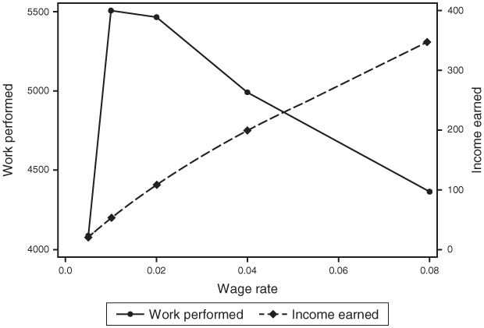
FIGURE 11.1
Pigeons’ Work Effort and Income as a Function of Incentives (b)
Peter Kuhn, Personnel Economics
Copyright © 2018 Oxford University Press

Slide 4
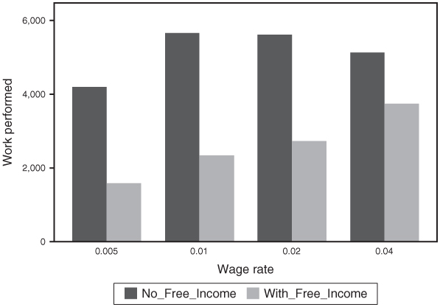
FIGURE 11.2
Pigeons’ Work Effort by Wage Rate, With and Without Free Income
Peter Kuhn, Personnel Economics
Copyright © 2018 Oxford University Press

Slide 5
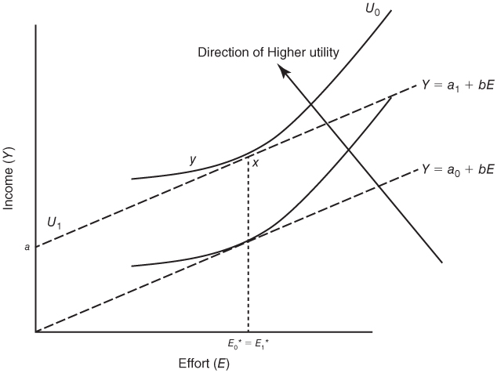
FIGURE 11.3
Vertically Parallel Indifference Curves and the Absence of Income Effects
Peter Kuhn, Personnel Economics
Copyright © 2018 Oxford University Press

