Slide 1
Choosing Qualifications
Chapter Twelve
Peter Kuhn, Personnel Economics
Copyright © 2018 Oxford University Press

Slide 2
Figures and Tables
Peter Kuhn, Personnel Economics
Copyright © 2018 Oxford University Press

Slide 3
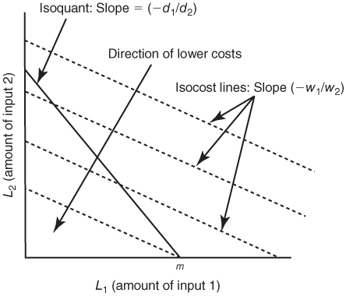
FIGURE 12.1
Optimal Input Mix with a Linear Production Function, Case 1 (d₁/d₂ > w₁/w₂)
Peter Kuhn, Personnel Economics
Copyright © 2018 Oxford University Press

Slide 4
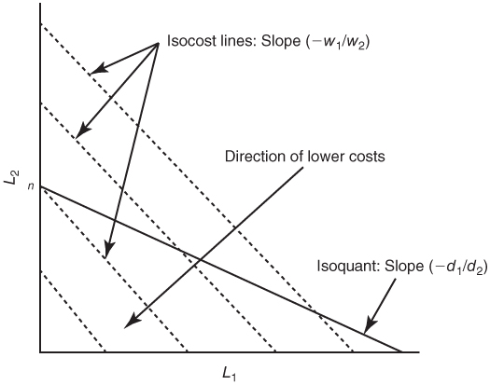
FIGURE 12.2
Optimal Input Mix with a Linear Production Function, Case 2 (d₁/d₂ < w₁/w₂)
Peter Kuhn, Personnel Economics
Copyright © 2018 Oxford University Press

Slide 5
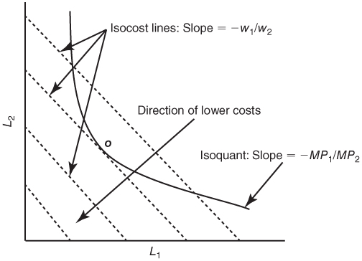
FIGURE 12.3
Optimal Input Mix When Worker Types Are Imperfect Substitutes in Production
Peter Kuhn, Personnel Economics
Copyright © 2018 Oxford University Press

Slide 6
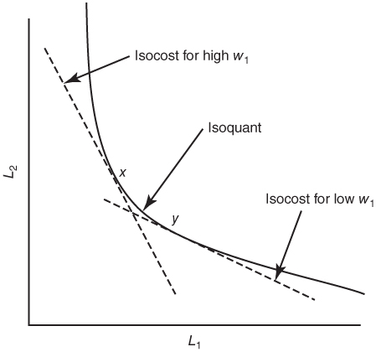
FIGURE 12.4
Effects of Wage Changes on Optimal Input Mix
Peter Kuhn, Personnel Economics
Copyright © 2018 Oxford University Press

