Slide 1
Recruitment: Formal versus Informal? Broad versus Narrow?
Chapter Fourteen
Peter Kuhn, Personnel Economics
Copyright © 2018 Oxford University Press

Slide 2
Figures and Tables
Peter Kuhn, Personnel Economics
Copyright © 2018 Oxford University Press

Slide 3
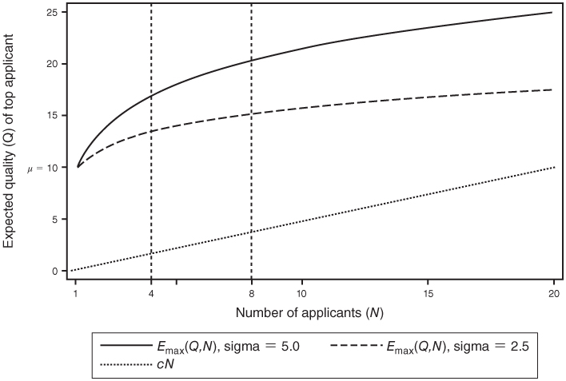
FIGURE 14.1
Expected Quality of the Best Applicant and Screening Costs as a Function of Sample Size
Peter Kuhn, Personnel Economics
Copyright © 2018 Oxford University Press

Slide 4
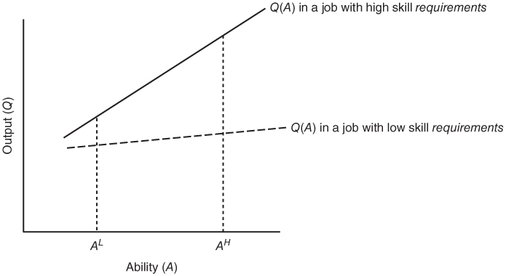
FIGURE 14.2
Output as a Function of Ability in Jobs with High versus Low Skill Requirements When Ability Matters More in Skilled Jobs
Peter Kuhn, Personnel Economics
Copyright © 2018 Oxford University Press

