Slide 1
Setting Pay Levels: Monopsony Models
Chapter Seventeen
Peter Kuhn, Personnel Economics
Copyright © 2018 Oxford University Press

Slide 2
Figures and Tables
Peter Kuhn, Personnel Economics
Copyright © 2018 Oxford University Press

Slide 3
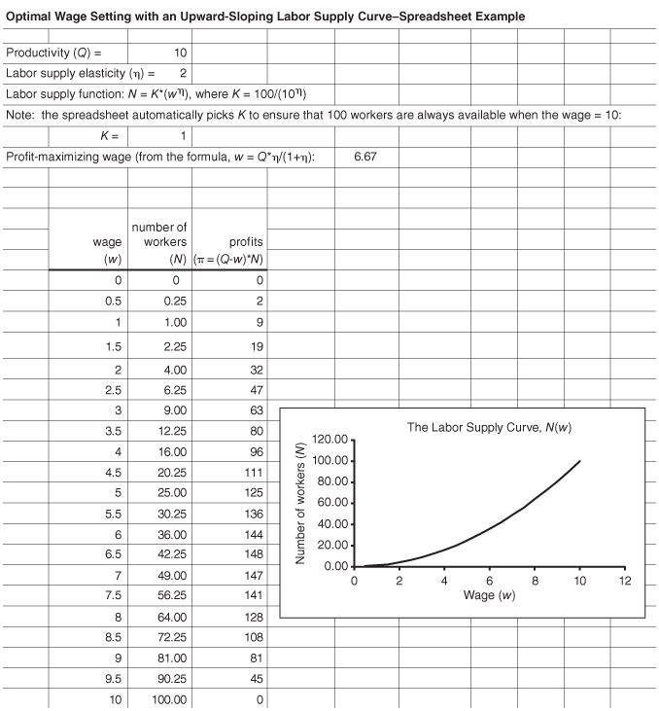
FIGURE 17.1
Effects of Labor Supply Elasticity on the Profit-Maximizing Wage
Peter Kuhn, Personnel Economics
Copyright © 2018 Oxford University Press

Slide 4
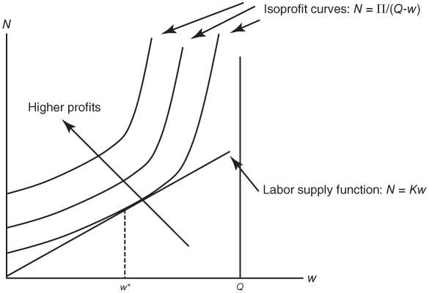
FIGURE 17.2
Profit-Maximizing Pay Generosity: example with η = 1
Peter Kuhn, Personnel Economics
Copyright © 2018 Oxford University Press

Slide 5
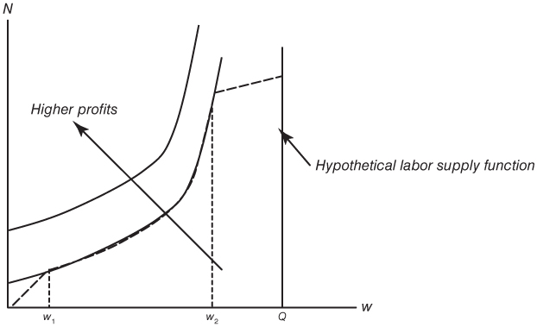
FIGURE 17.3
An example where “pay doesn’t matter”: any wage between w1 and w2 yields the same level of profits.
Peter Kuhn, Personnel Economics
Copyright © 2018 Oxford University Press

