Slide 1
Setting Pay Levels: Efficiency Wage Models
Chapter Eighteen
Peter Kuhn, Personnel Economics
Copyright © 2018 Oxford University Press

Slide 2
Figures and Tables
Peter Kuhn, Personnel Economics
Copyright © 2018 Oxford University Press

Slide 3
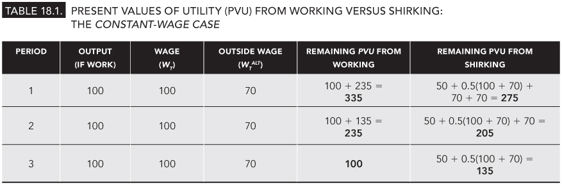
TABLE 18.1
Present Values of Utility (PVU) from Working Versus Shirking: The Constant-Wage Case
Peter Kuhn, Personnel Economics
Copyright © 2018 Oxford University Press

Slide 4
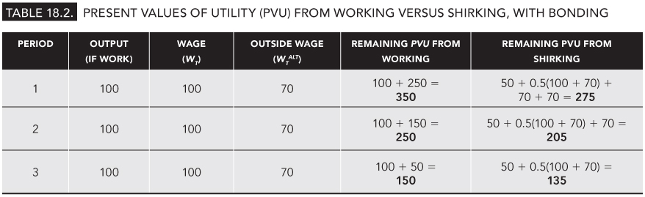
TABLE 18.2
Present Values of Utility (PVU) from Working Versus Shirking, With Bonding
Peter Kuhn, Personnel Economics
Copyright © 2018 Oxford University Press

Slide 5
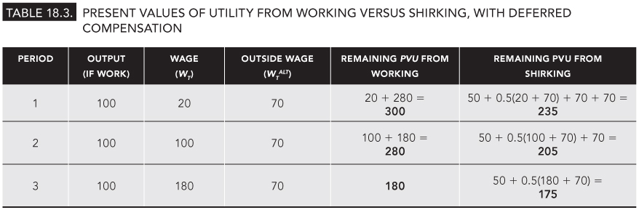
TABLE 18.3
Present Values of Utility from Working Versus Shirking, with Deferred Compensation
Peter Kuhn, Personnel Economics
Copyright © 2018 Oxford University Press

Slide 6
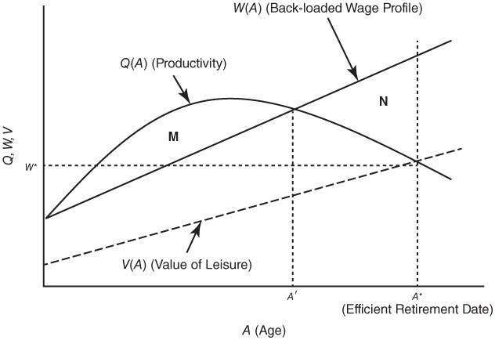
TABLE 18.1
Deferred Compensation and Retirement Incentives
Peter Kuhn, Personnel Economics
Copyright © 2018 Oxford University Press

