Slide 1
Training
Chapter Nineteen
Peter Kuhn, Personnel Economics
Copyright © 2018 Oxford University Press

Slide 2
Figures and Tables
Peter Kuhn, Personnel Economics
Copyright © 2018 Oxford University Press

Slide 3
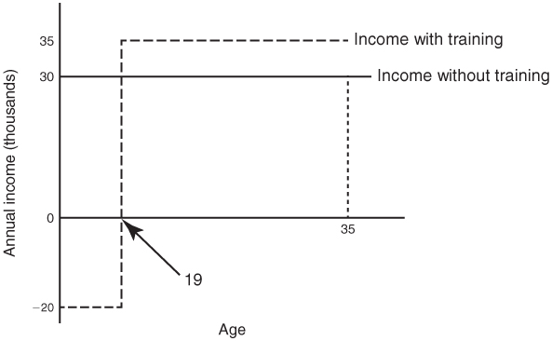
FIGURE 19.1
Hypothetical Income Streams with and without Training
Peter Kuhn, Personnel Economics
Copyright © 2018 Oxford University Press

Slide 4
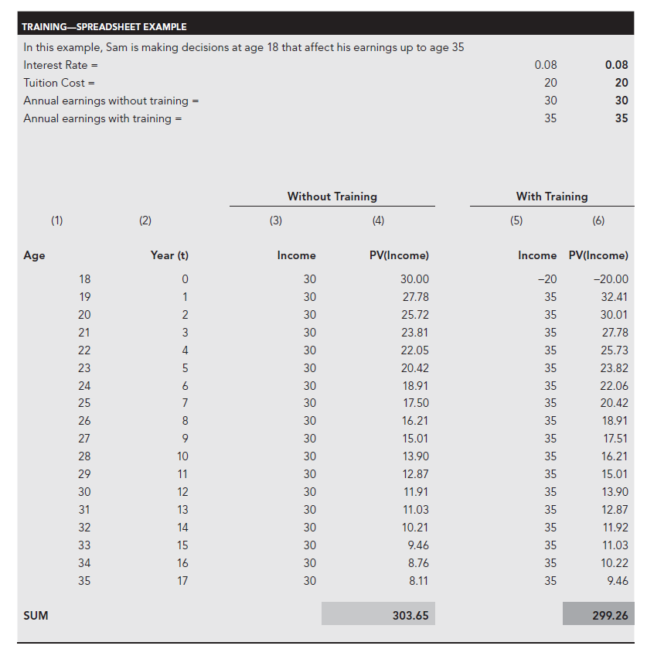
FIGURE 19.2
Present Value of Income with and without Training
Notes: All earnings and tuition costs are measured in thousands of dollars. Base case parameter values indicated in bold.
Peter Kuhn, Personnel Economics
Copyright © 2018 Oxford University Press

Slide 5
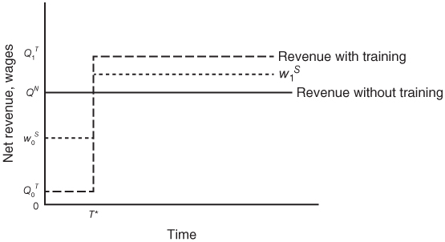
FIGURE 19.3
Hypothetical revenue and wage streams with and without training
Note: The dashed blue line is a wage profile with 50-50 sharing of the costs and benefits of training.
Peter Kuhn, Personnel Economics
Copyright © 2018 Oxford University Press

Slide 6
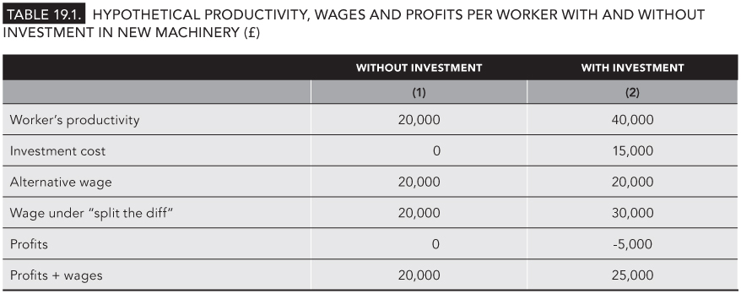
TABLE 19.1
Hypothetical Productivity, Wages and Profits Per Worker With and Without Investment in New Machinery (£)
Peter Kuhn, Personnel Economics
Copyright © 2018 Oxford University Press

