Slide 1
A Simple Model of Tournaments
Chapter Twenty
Peter Kuhn, Personnel Economics
Copyright © 2018 Oxford University Press

Slide 2
Figures and Tables
Peter Kuhn, Personnel Economics
Copyright © 2018 Oxford University Press

Slide 3
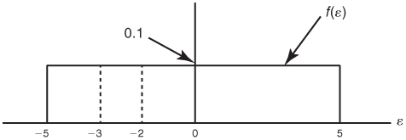
FIGURE 20.1
The Probability Density Function (pdf), f(ε), of a Uniform Distribution on the Interval [ -5, 5]
Notes: The area under a pdf between any two values of ε gives the probability that nature picks a number between those two values. For example, the chances of picking a number between -3 and -2 are given by 1 (the base of the rectangle) times 0.1 (its height) = 0.1, or 1 in 10.
Peter Kuhn, Personnel Economics
Copyright © 2018 Oxford University Press

Slide 4
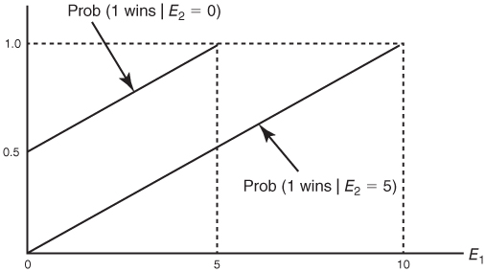
FIGURE 20.2
The Probability That Worker 1 Wins, as a Function of Both Workers’ Effort Levels (Example of d = 1)
Notes: Using Equation 20.7, when Worker 2 does nothing (E2 = 0), Worker 1 has a 50% chance of winning if Worker 1 does nothing also. As Worker 1 raises the effort to above 0 (keeping E2 at 0), Worker 1’s chances of winning rise above 50%. When Worker 2 chooses E2 = 5, Worker 1 has no chance of winning if Worker 1 picks E1 = 0. If Worker 1 raises the effort to 5 (keeping E2 at 5), Worker 1 achieves an even chance of winning; choosing E1 > 5 raises Worker 1’s chances of winning above 50%.
Peter Kuhn, Personnel Economics
Copyright © 2018 Oxford University Press

Slide 5
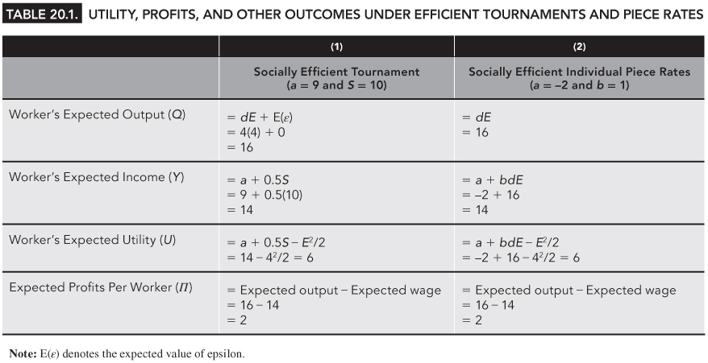
TABLE 20.1
Utility, Profits, and Other Outcomes Under Efficient Tournaments and Piece Rates
Peter Kuhn, Personnel Economics
Copyright © 2018 Oxford University Press

Slide 6
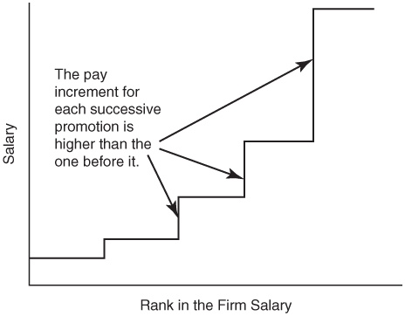
FIGURE 20.3
A Large Corporation’s Typical Salary Scale
Peter Kuhn, Personnel Economics
Copyright © 2018 Oxford University Press

Slide 7
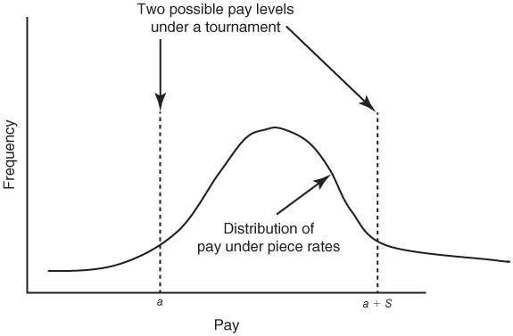
FIGURE 20.4
The Distribution of Pay Under Tournaments versus Piece Rates
Peter Kuhn, Personnel Economics
Copyright © 2018 Oxford University Press

Slide 8
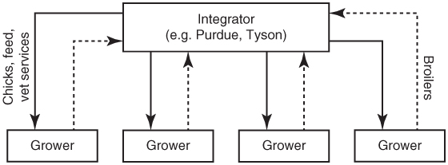
FIGURE 20.5
Organization of the Broiler Market
Peter Kuhn, Personnel Economics
Copyright © 2018 Oxford University Press

