Slide 1
Some Caveats: Sabotage, Collusion, and Risk Taking in Tournaments
Chapter Twenty-One
Peter Kuhn, Personnel Economics
Copyright © 2018 Oxford University Press

Slide 2
Figures and Tables
Peter Kuhn, Personnel Economics
Copyright © 2018 Oxford University Press

Slide 3
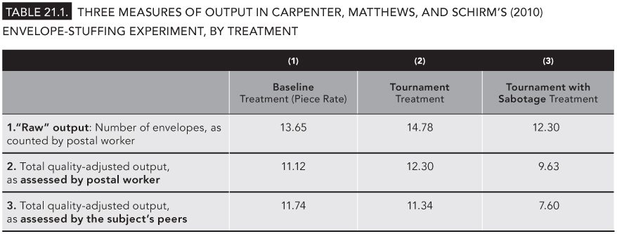
TABLE 21.1
Three Measures of Output in Carpenter, Matthews, and Schirm’s (2010) Envelope-Stuffing Experiment, by Treatment
Peter Kuhn, Personnel Economics
Copyright © 2018 Oxford University Press

Slide 4
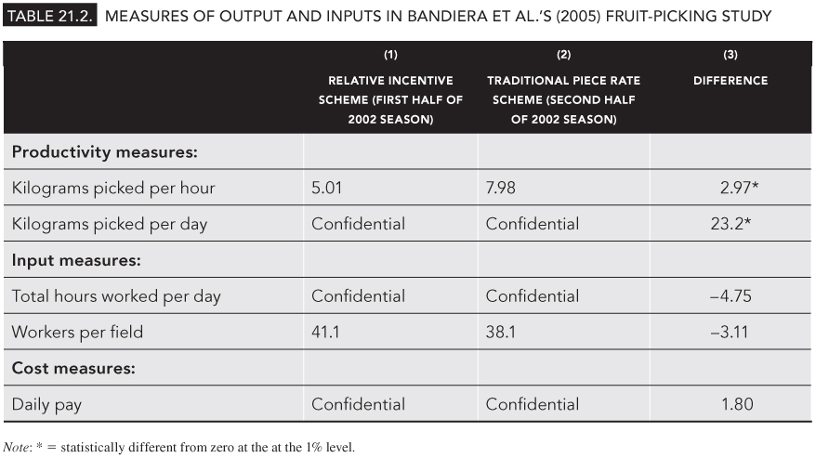
TABLE 21.2
Measures of Output and Inputs in Bandiera et al.’s (2005) Fruit-Picking Study
Peter Kuhn, Personnel Economics
Copyright © 2018 Oxford University Press

