Slide 1
Unfair and Uneven Tournaments
Chapter Twenty-Two
Peter Kuhn, Personnel Economics
Copyright © 2018 Oxford University Press

Slide 2
Figures and Tables
Peter Kuhn, Personnel Economics
Copyright © 2018 Oxford University Press

Slide 3
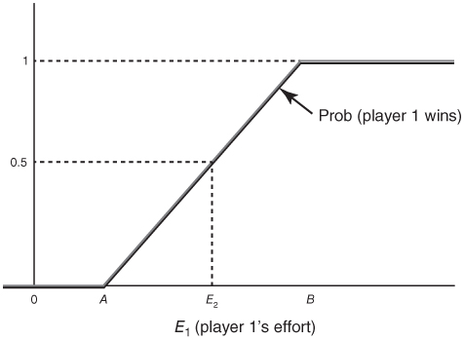
FIGURE 22.1
Effort and the Probability of Tournament Victory for a Uniform Relative Luck Distribution
Peter Kuhn, Personnel Economics
Copyright © 2018 Oxford University Press

Slide 4
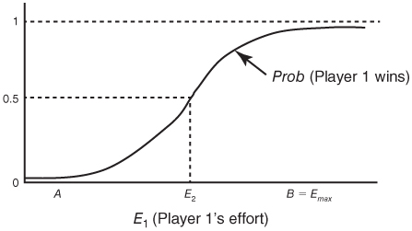
FIGURE 22.2
Effort and the Probability of Tournament Victory for a More Typical Luck Distribution, Such as a Normal Distribution (Symmetric Tournament)
Peter Kuhn, Personnel Economics
Copyright © 2018 Oxford University Press

Slide 5
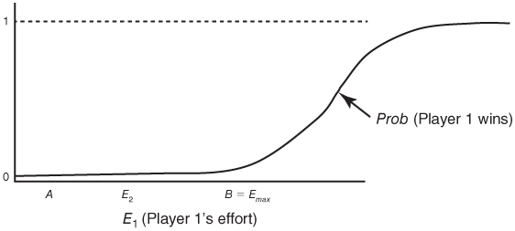
FIGURE 22.3
Effort and the Probability of Tournament Victory for a More Typical Luck Distribution, Such as a Normal Distribution (Player 1 Is Much Less Able)
Peter Kuhn, Personnel Economics
Copyright © 2018 Oxford University Press

Slide 6
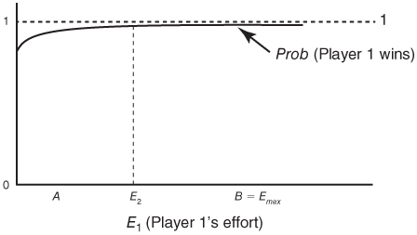
FIGURE 22.4
Effort and the Probability of Tournament Victory for a More Typical Luck Distribution, Such as a Normal Distribution (Player 1 Is Much More Able)
Peter Kuhn, Personnel Economics
Copyright © 2018 Oxford University Press

Slide 7
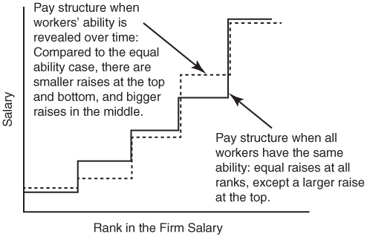
FIGURE 22.5
Effort-Maintaining Wage Structures in Rosen’s (1986) “‘Symmetric Ignorance”’ Model
Peter Kuhn, Personnel Economics
Copyright © 2018 Oxford University Press

