Slide 1
Incentives in Teams and the Free-Rider Problem
Chapter Twenty-Four
Peter Kuhn, Personnel Economics
Copyright © 2018 Oxford University Press

Slide 2
Figures and Tables
Peter Kuhn, Personnel Economics
Copyright © 2018 Oxford University Press

Slide 3
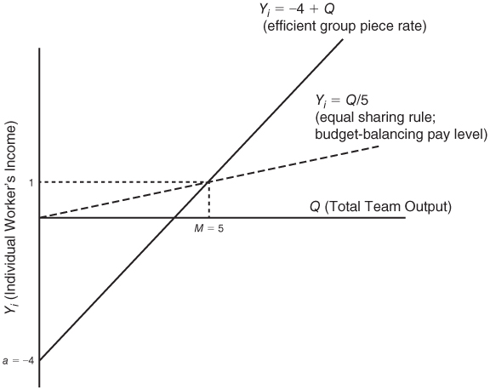
FIGURE 24.1
The economically efficient group piece rate when N = 5 (baseline case)
Peter Kuhn, Personnel Economics
Copyright © 2018 Oxford University Press

Slide 4
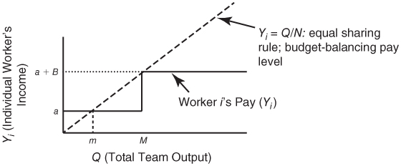
FIGURE 24.2
A Group Bonus Scheme
Peter Kuhn, Personnel Economics
Copyright © 2018 Oxford University Press

