Slide 1
Team Production in Practice
Chapter Twenty-Five
Peter Kuhn, Personnel Economics
Copyright © 2018 Oxford University Press

Slide 2
Figures and Tables
Peter Kuhn, Personnel Economics
Copyright © 2018 Oxford University Press

Slide 3
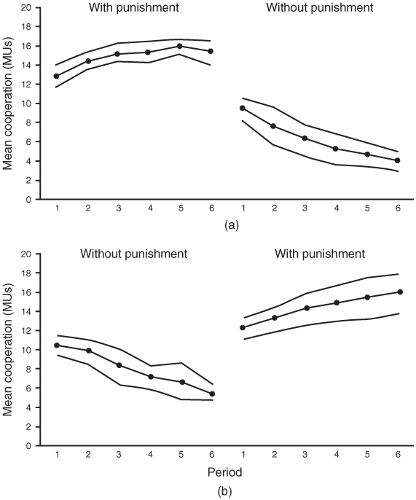
FIGURE 25.1
Group Account Contributions in Fehr and Gächter’s (2002) VCM Experiment
Vertical axis shows the subjects’ mean contributions to the group account, with the 95% confidence interval. In the (a) sessions, punishment options were available to subjects for the first six periods, then unavailable in the next six. In the (b) sessions, this order was reversed.
Copyright © 2002, Rights Managed by Nature Publishing Group. “Altruistic Punishment in Humans,” by Ernst Fehr and Simon Gächter, Nature, January 2002. Reproduced with permission.
Peter Kuhn, Personnel Economics
Copyright © 2018 Oxford University Press

Slide 4
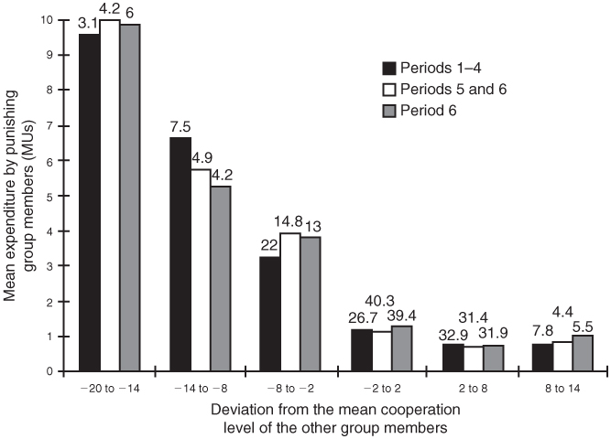
FIGURE 25.2
Expenditures on Punishment in Fehr and Gächter’s (2002) VCM Experiment
Vertical axis shows the mean expenditure on punishment as a function of the difference between the punishee’s contribution to the group account and the mean contribution of the other group members. The numbers above the bars indicate the share of the observations on which each bar is based. For example, in Periods 1–4, 3.1% of subjects contributed between 20 and 14 lab dollars less than the average of the others in their group.
Copyright © 2002, Rights Managed by Nature Publishing Group. “Altruistic Punishment in Humans,” by Ernst Fehr and Simon Gächter, Nature, January 2002. Reproduced with permission.
Peter Kuhn, Personnel Economics
Copyright © 2018 Oxford University Press

Slide 5
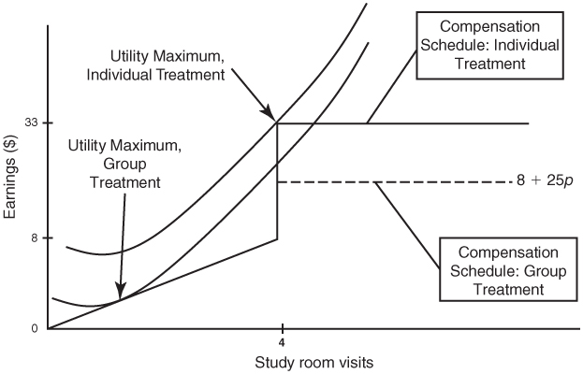
FIGURE 25.3
Pay Schedules and Indifference Curves in Babcock et al.’s (2015) Pay-for-Study Experiment
Kelly Bedard, Philip Babcock, Gary Charness, John Hartman, and Heather Royer. “Letting Down the Team? Evidence of Social Effects of Teams,” Journal of the European Economic Association, 2015: 841–870. Reproduced with permission Oxford University Press.
Peter Kuhn, Personnel Economics
Copyright © 2018 Oxford University Press

Slide 6
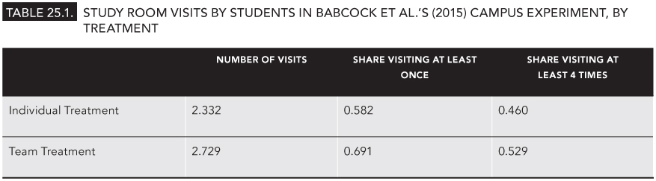
TABLE 25.1
Study Room Visits by Students in Babcock et al.’s (2015) Campus Experiment, by Treatment
Peter Kuhn, Personnel Economics
Copyright © 2018 Oxford University Press

