Slide 1
Complementarity, Substitutability, and Ability Differences in Teams
Chapter Twenty-Six
Peter Kuhn, Personnel Economics
Copyright © 2018 Oxford University Press

Slide 2
Figures and Tables
Peter Kuhn, Personnel Economics
Copyright © 2018 Oxford University Press

Slide 3
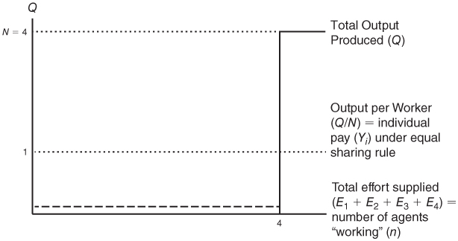
FIGURE 26.1
Output and Pay under the Baseline Weakest-Link Production Function, with D = N = 4
Note: Both total output and output per worker equal zero when n < 4.
Peter Kuhn, Personnel Economics
Copyright © 2018 Oxford University Press

Slide 4
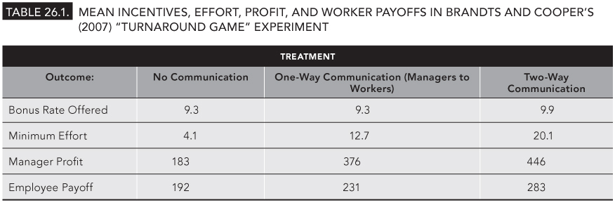
TABLE 26.1
Mean Incentives, Effort, Profit, and Worker Payoffs in Brandts and Cooper’s (2007) “Turnaround Game” Experiment
Peter Kuhn, Personnel Economics
Copyright © 2018 Oxford University Press

Slide 5
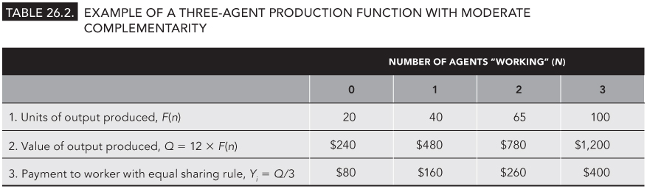
TABLE 26.2
Example of a Three-Agent Production Function with Moderate Complementarity
Peter Kuhn, Personnel Economics
Copyright © 2018 Oxford University Press

Slide 6
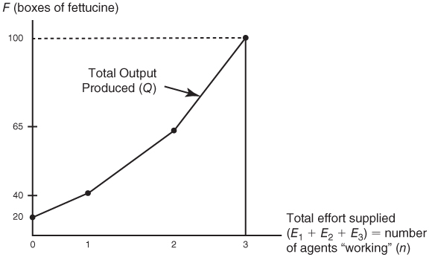
FIGURE 26.2
Team Output with Moderate Complementarity Between Workers: An Example with N = 3
Peter Kuhn, Personnel Economics
Copyright © 2018 Oxford University Press

Slide 7
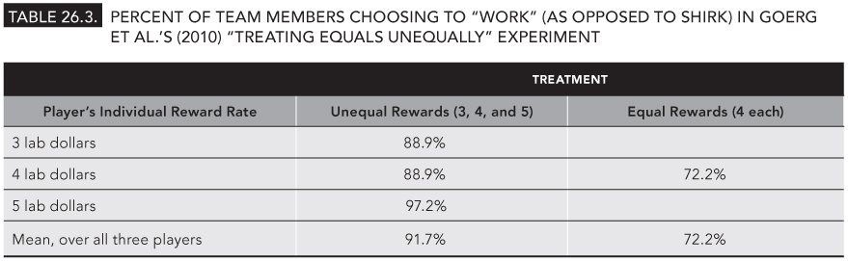
TABLE 26.3
Percent of Team Members Choosing to “Work” (as Opposed to Shirk) in Goerg et al.’s (2010) “Treating Equals Unequally” Experiment
Peter Kuhn, Personnel Economics
Copyright © 2018 Oxford University Press

Slide 8
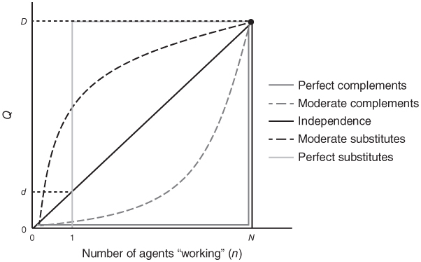
FIGURE 26.3
Team Output with Varying Degrees of Substitutability and Complementarity
Peter Kuhn, Personnel Economics
Copyright © 2018 Oxford University Press

Slide 9
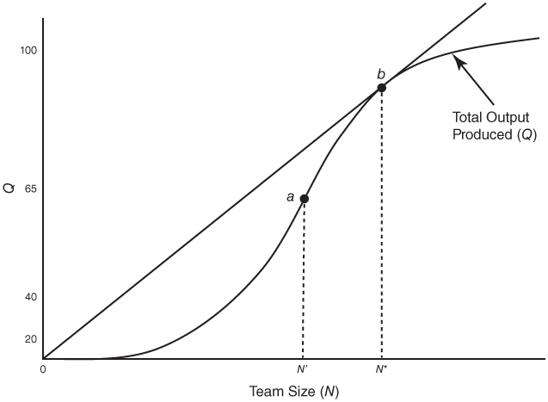
FIGURE 26.4
Economically Efficient Team Size with Identical Workers
Peter Kuhn, Personnel Economics
Copyright © 2018 Oxford University Press

