Slide 1
Choosing Teams: Self-Selection and Team Assignment
Chapter Twenty-Seven
Peter Kuhn, Personnel Economics
Copyright © 2018 Oxford University Press

Slide 2
Figures and Tables
Peter Kuhn, Personnel Economics
Copyright © 2018 Oxford University Press

Slide 3
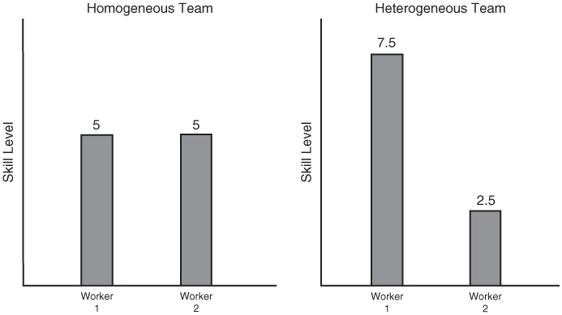
FIGURE 27.1
Homogeneous and Heterogeneous Teams when Workers Differ in Skill Levels
Peter Kuhn, Personnel Economics
Copyright © 2018 Oxford University Press

Slide 4
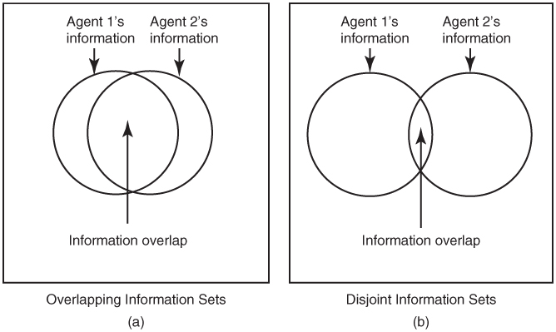
FIGURE 27.2
Teams with Overlapping vs. Disjoint Information Sets
Peter Kuhn, Personnel Economics
Copyright © 2018 Oxford University Press

Slide 5
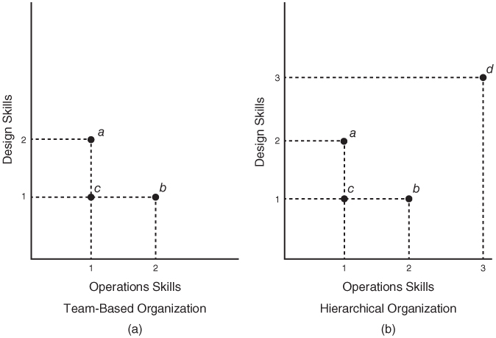
FIGURE 27.3
Team-Based versus Hierarchical Organizations
Peter Kuhn, Personnel Economics
Copyright © 2018 Oxford University Press

