Slide 1
Capitalism Shakes the World
Chapter 1
Samuel Bowles, Frank Roosevelt, Richard Edwards, Mehrene Larudee
Understanding Capitalism, Fourth Edition, Copyright © 2018 Oxford University Press

Slide 2
Figures and Tables
Samuel Bowles, Frank Roosevelt, Richard Edwards, Mehrene Larudee
Understanding Capitalism, Fourth Edition, Copyright © 2018 Oxford University Press

Slide 3
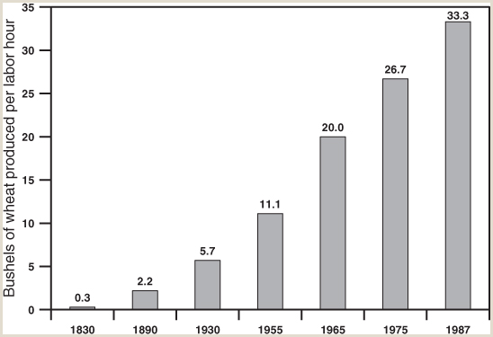
FIGURE 1.1
Productivity increases in U.S. agriculture, 1830-1987
Focusing specifically on wheat production, this figure shows how labor productivity in U.S. agriculture has risen during the past two centuries. In the eighteenth century American farmers used crude wooden plows, sometimes drawn by horses or oxen. They sowed seeds by hand, cultivated them with hoes, cut the wheat with sickles, and harvested their grain from the wheat using manual threshing devices called flails. Iron plows were introduced early in the nineteenth century, but as late as 1830 it still took about three hundred hours of labor to produce one hundred bushels of wheat on a five-acre farm. In the mid-nineteenth century farmers began to use chemical fertilizers, and soon came to rely more and more on factory-made agricultural tools and later machinery. Over the next century agricultural productivity rose dramatically. By 1987, on a large, highly mechanized American farm, one hundred bushels of wheat could be produced with only three hours of labor on three acres of land, one hundred times more output per hour than could be produced in 1830.
Source: U.S. Department of Agriculture, Economic Research Service, “A History of American Agriculture 1776–1990” (Washington, DC: US Department of Agriculture, Economic Research Service, 1993).
Samuel Bowles, Frank Roosevelt, Richard Edwards, Mehrene Larudee
Understanding Capitalism, Fourth Edition, Copyright © 2018 Oxford University Press

Slide 4
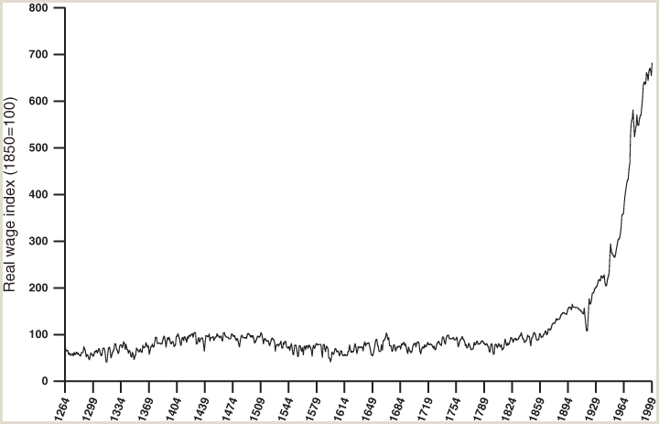
FIGURE 1.2
Real wages in London over seven centuries
This figure shows the average real daily wage of skilled construction workers in London between 1264 and 1999. The term “real” means that the monetary wage in each year has been corrected for price inflation, so that it measures the buying power of the wage in that year. The data are presented here as an index. They show what the average real wage was in each year relative to what it was in 1850, the arbitrarily chosen base year for which the index is set at 100. For example, if the real wage in the 1930s was twice what it was in 1850, it is shown here as 200; if in the mid-fourteenth century it was half of its 1850 level, it is shown as 50 in that period. While the data are subject to error, they do make clear that real wages did not rise consistently prior to the full development of capitalism. Variations in the real wage before 1800 often resulted from sudden population changes. For example, the Black Death (bubonic plague) killed many in Great Britain and elsewhere in the mid-fourteenth century, creating a labor shortage in Great Britain and driving up wages. Gains made between 1300 and 1500 were eroded after 1500 by rapid price increases caused by the sudden inflow of gold to Europe from the Americas. Inflation often reduces real wages, at least if workers lack organization and bargaining power. But after 1800, and particularly after 1900, increased labor productivity and greater bargaining power of some workers led to dramatic increases in real wages for people like the skilled construction workers represented in this figure.
Source: Robert Allen, “Wages, Prices and Living Standards: The World Historical Perspective,” available at https://www.nuffield.ox.ac.uk/People/sites/Allen/SitePages/Biography.
Samuel Bowles, Frank Roosevelt, Richard Edwards, Mehrene Larudee
Understanding Capitalism, Fourth Edition, Copyright © 2018 Oxford University Press

Slide 5
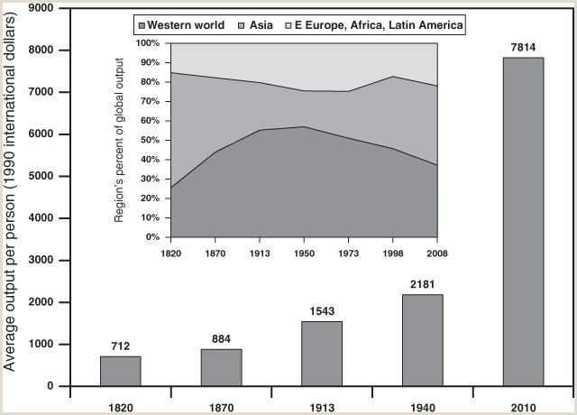
FIGURE 1.3
Two centuries of world GDP per capita
The larger chart presents inflation-adjusted estimates of output per person (GDP per capita) for the whole world during the last two hundred years. These estimates come from over half a century of research by the late Angus Maddison, an eminent scholar of global population size, technical change, and productivity growth, and his fellow economic historians, who are continuing the project. Maddison estimated that world output per person rose only slightly from the year AD 0 to 1820; his successors agree, estimating it at $600–$700 in AD 0 and $712 in 1820 (in 1990 international G-K dollars). For 1820, among countries for which data exist and have been analyzed, average incomes are estimated from over $300 in Korea to over $2,000 in the UK. For eighteen centuries, global output rose about as fast as global population. But since 1820, technical changes accompanying the rise of capitalism have greatly expanded output per person. The smaller (inset) chart shows how in the past two centuries the share of world output produced by each region has changed. These changes have many causes, including diverse population growth rates, technology, war or peace, and the organization of production and exchange.
Sources: The Maddison-Project, http://www.ggdc.net/maddison/maddison-project/home.htm, 2013 version; Angus Maddison, Monitoring the World Economy, 1820–1992 (Paris: OECD, 1995), 19, Table 1-1(a); Angus Maddison, The World Economy: A Millennial Perspective (Paris: OECD, 2001), 28, Table 1-2, available at http://www.oecd-library.org/development/the-world-economy_9789264104143-en; World Economics: Measuring Global Activity, Maddison Historical GDP Data, Downloadable Data (to 2008); http://www.worldeconomics.com/Data/MadisonHistoricalGDP/Madison%20Historical%20GDP%20Data.efp.
Samuel Bowles, Frank Roosevelt, Richard Edwards, Mehrene Larudee
Understanding Capitalism, Fourth Edition, Copyright © 2018 Oxford University Press

Slide 6
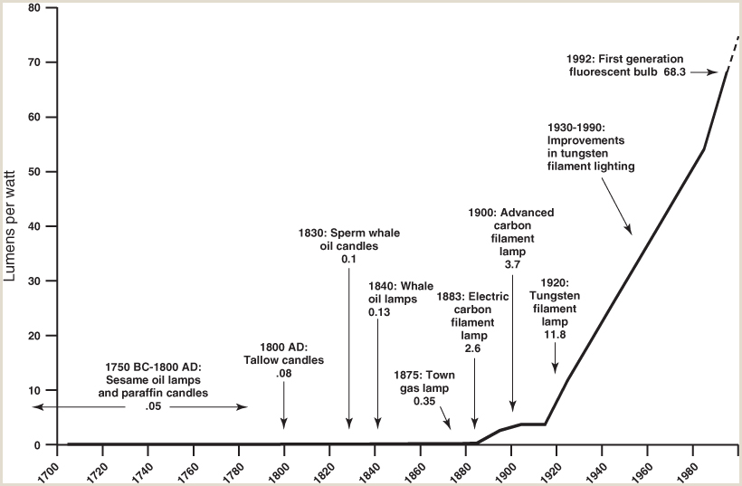
FIGURE 1.4
Improvements in lighting technology, 1700-1992
This figure shows how the efficiency of lighting technology, measured in lumens per watt on the vertical axis, has increased over the past three centuries. A “lumen” is a unit indicating a certain intensity of light, and a “watt” is a unit measuring the power of a source of energy.
Source: William D. Nordhaus, “Do Real-Output and Real-Wage Measures Capture Reality? The History of Lighting Suggests Not,” in Timothy F. Bresnahan and Robert J. Gordon, eds., The Economics of New Goods, National Bureau of Economic Research Studies in Income and Wealth, vol. 58 (Chicago: University of Chicago Press, 1996), 29–66.
Samuel Bowles, Frank Roosevelt, Richard Edwards, Mehrene Larudee
Understanding Capitalism, Fourth Edition, Copyright © 2018 Oxford University Press

Slide 7
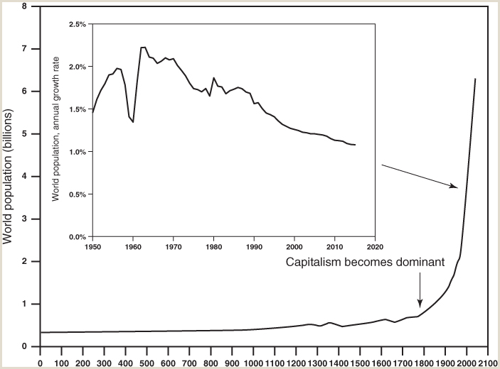
FIGURE 1.5
Capitalism and the population explosion
This figure charts the population of the world from AD 0 to 2015. For most of the last 12,000 years, including most of the 2,000 years shown in this figure, the total population of the world grew slowly, if at all, with periods of increase in good years followed by intervals of decline in response to bad weather, disease, and other calamities. There are about twenty cities in the world today whose populations exceed the entire population of the world 11,000 years ago (less than 10 million persons), when agriculture began displacing hunting and gathering. Population started growing rapidly in a few countries two centuries ago, but the world’s population really exploded in the twentieth century due to the spread of modern medicine, especially public health practices. The world’s population is still growing, but at a declining rate (see inset chart).
Sources: U.S. Bureau of the Census, Historical Estimates of World Population (updated 2013) available at https://www.census.gov/population/international/data/worldpop/table_history.php; U.S. Bureau of the Census, “Total Midyear Population for the World: 1950–2050” (updated July 9, 2015), available at http://www.census.gov/population/international/data/idb/worldpoptotal.php.
Samuel Bowles, Frank Roosevelt, Richard Edwards, Mehrene Larudee
Understanding Capitalism, Fourth Edition, Copyright © 2018 Oxford University Press

Slide 8
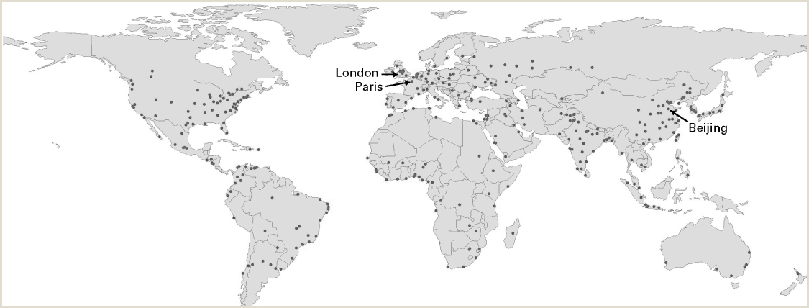
FIGURE 1.6
Cities of the world with more than a million inhabitants in 2014
Each of the dots in this figure represents a city of more than 1 million people (but not all cities of more than a million people are represented in the figure). Increasing concentration of people in cities—urbanization—has all along been an important consequence of the spread of capitalism. By 1850, three cities had grown to a size of more than 1 million people: London, Paris, and Beijing (the three arrows in this map pinpoint their locations). By 2014, as a result of rapid population growth and the expansion of capitalism throughout the world, there were 498 such cities (only some of which are shown in this figure).
Source: Tertius Chandler, Four Thousand Years of Urban Growth: An Historical Census (Lampeter, Wales, UK: St. David’s University Press, 1987). Map generated by Deepta Sateesh.
Samuel Bowles, Frank Roosevelt, Richard Edwards, Mehrene Larudee
Understanding Capitalism, Fourth Edition, Copyright © 2018 Oxford University Press

Slide 9
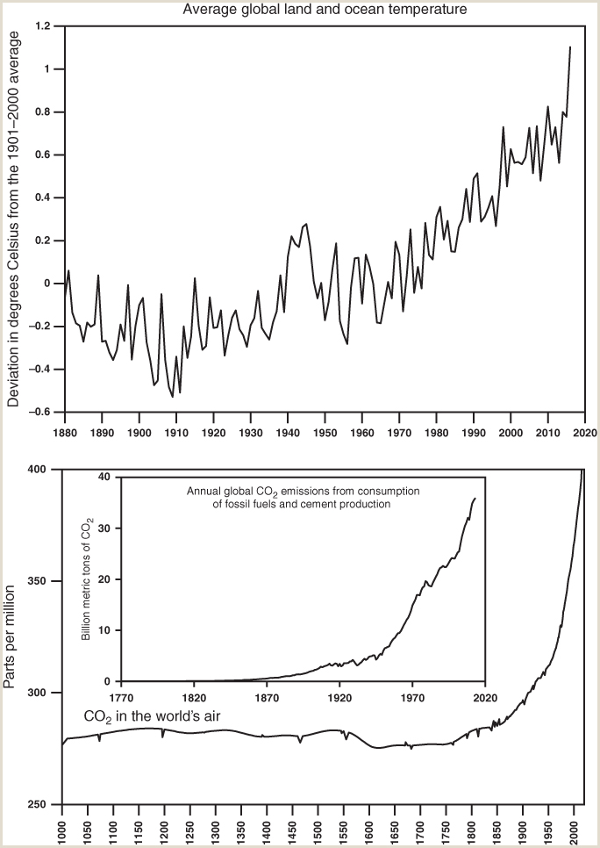
FIGURE 1.7
Global warming, CO₂ emissions, and CO₂, in the air
For most of the past 1,000 years Northern Hemisphere temperatures and amounts of CO2 in the world’s air remained more or less constant. However, the growing use of fossil fuels such as coal and petroleum products in the twentieth and twenty-first centuries is associated with rising CO2 emissions and therefore more intense concentrations of CO2 in the world’s air. The smallest (inset) chart shows that CO2 emissions from fossil fuel consumption and cement production have risen exponentially over at least the last century and a half. Greenhouse gases—gases that trap heat and prevent it from escaping—have also risen, causing global temperatures to rise. The result is global warming. Past temperatures are estimated from studies of tree fossils, centuries-old ice, and other phenomena.
Sources: Top: National Oceanic and Atmospheric Administration (NOAA), National Climate Data Center, Climate at a Glance, Global Land and Ocean Temperature Anomalies, April, Base Period: 1901–2000. Available at http://www.ncdc.noaa.gov/cag/time-series/global/globe/land_ocean/1/4/1880-2016.csv. Bottom, main and inset: T. A. Boden, G. Marland, and R. J. Andres, “Global, Regional, and National Fossil-Fuel CO2 Emissions.” Carbon Dioxide Information Analysis Center, Oak Ridge National Laboratory, U.S. Department of Energy, Oak Ridge, TN, 2016. Available at http://doi.org/10.3334/CDIAC/00001_V2016.
Samuel Bowles, Frank Roosevelt, Richard Edwards, Mehrene Larudee
Understanding Capitalism, Fourth Edition, Copyright © 2018 Oxford University Press

Slide 10
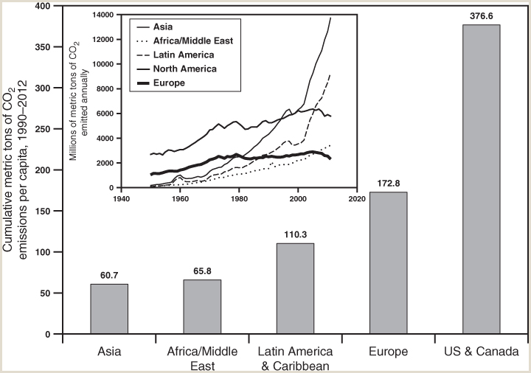
FIGURE 1.8
Cumulative CO₂ emissions per capita, 1990-2012, by region, and trends in total emissions by region, 1950-2012
Changes in (net) CO2 emissions result from changes in the amount of fossil fuels burned, but also from changes in cement production, from changes in forests that affect carbon absorption and emission, and other factors.
Sources: CAIT Climate Data Explorer, (Washington, DC: World Resources Institute, 2015), available at http://cait.wri.org and at http://www.wri.org/resources/data-sets/cait-historical-emissions-data-countries-us-states-unfccc. Data incorporate land use and forestry data from FAO 2014, FAOSTAT Emissions Database. Data were calculated and compiled by T. A. Boden, G. Marland, and R. J. Andres, in “Global, Regional, and National Fossil-Fuel CO2 Emissions,” Carbon Dioxide Information Analysis Center, Oak Ridge National Laboratory, U.S. Department of Energy, Oak Ridge, TN, 2016. Available at http://doi.org/10.3334/CDIAC/00001_V2016. Data in metric tons of carbon were converted to metric tons of carbon dioxide by multiplying by 3.667.
Samuel Bowles, Frank Roosevelt, Richard Edwards, Mehrene Larudee
Understanding Capitalism, Fourth Edition, Copyright © 2018 Oxford University Press

