Slide 1
A Three-Dimensional Approach to Economics
Chapter 3
Samuel Bowles, Frank Roosevelt, Richard Edwards, Mehrene Larudee
Understanding Capitalism, Fourth Edition, Copyright © 2018 Oxford University Press

Slide 2
Figures and Tables
Samuel Bowles, Frank Roosevelt, Richard Edwards, Mehrene Larudee
Understanding Capitalism, Fourth Edition, Copyright © 2018 Oxford University Press

Slide 3
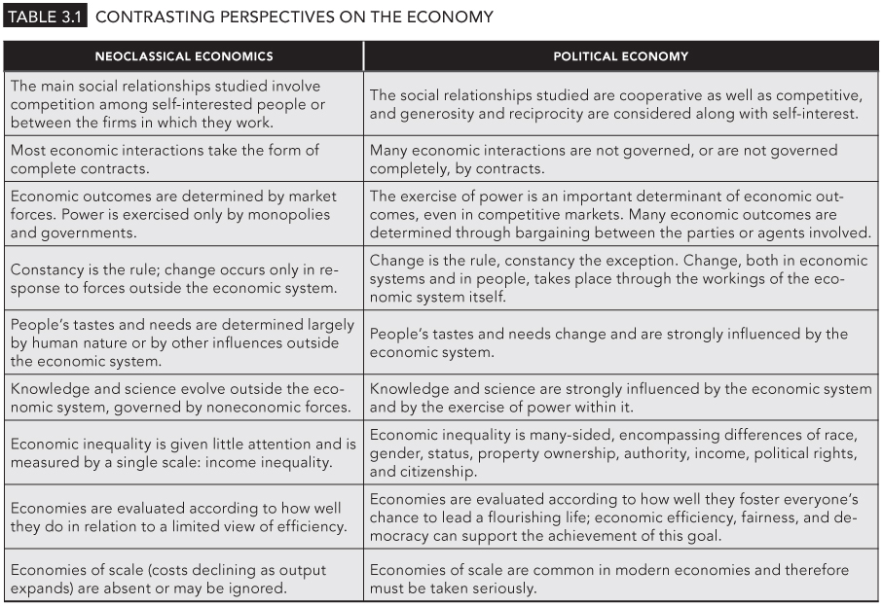
TABLE 3.1
Contrasting Perspectives on the Economy
Samuel Bowles, Frank Roosevelt, Richard Edwards, Mehrene Larudee
Understanding Capitalism, Fourth Edition, Copyright © 2018 Oxford University Press

