Slide 1
The Surplus Product: Conflict and Change
Chapter 4
Samuel Bowles, Frank Roosevelt, Richard Edwards, Mehrene Larudee
Understanding Capitalism, Fourth Edition, Copyright © 2018 Oxford University Press

Slide 2
Figures and Tables
Samuel Bowles, Frank Roosevelt, Richard Edwards, Mehrene Larudee
Understanding Capitalism, Fourth Edition, Copyright © 2018 Oxford University Press

Slide 3
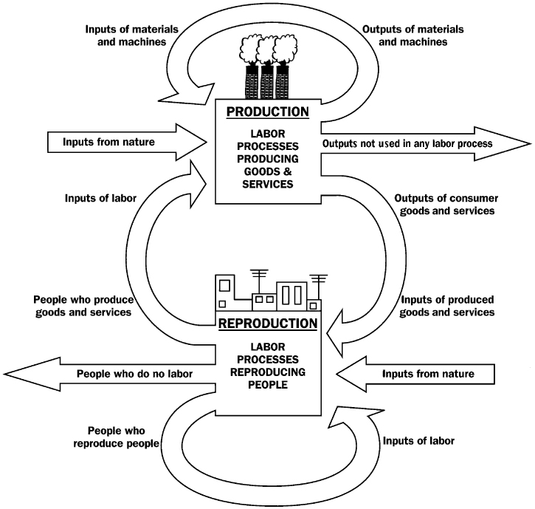
FIGURE 4.1
The production-reproduction cloverleaf
The economy is composed of two interdependent sectors, one producing goods and services and the other reproducing people. The arrows represent the movement of goods or people from one sector to the other or back into the same sector. Each sector uses three types of inputs: inputs produced elsewhere in the economy, inputs produced in the same sector, and inputs from nature. Each sector also produces three different types of outputs: outputs used in the same sector, outputs used as inputs in the other sector, and outputs rarely used as inputs anywhere in the economy.
Samuel Bowles, Frank Roosevelt, Richard Edwards, Mehrene Larudee
Understanding Capitalism, Fourth Edition, Copyright © 2018 Oxford University Press

Slide 4
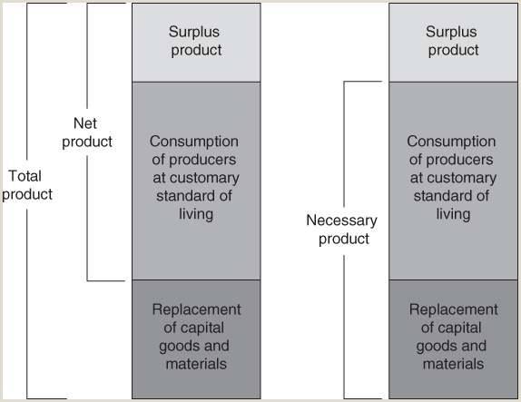
FIGURE 4.2
Total, net, necessary, and surplus product
This figure shows how the total product of an economy (whatever its specific form) is allocated among various uses, and illustrates how key concepts are defined in the text. The components of the total product can be combined in two different ways. The bottom two segments combined are the necessary product (right hand side), while the top two segments combined are the net product (left hand side). We talk about the necessary product when we are interested in how much of the total product needs to be used just to maintain the previous level of production, by maintaining the workforce, the material inputs, and the equipment at the same level or in the same condition. The surplus product is then the remainder of the total product, and is available for investment in expanding the level of production, or for capitalist consumption or other purposes. On the other hand, if we are mainly interested in how much the value of the total product exceeds the value of the material inputs into it during a given year we use the net product (or value added) to measure this concept.
Samuel Bowles, Frank Roosevelt, Richard Edwards, Mehrene Larudee
Understanding Capitalism, Fourth Edition, Copyright © 2018 Oxford University Press

Slide 5
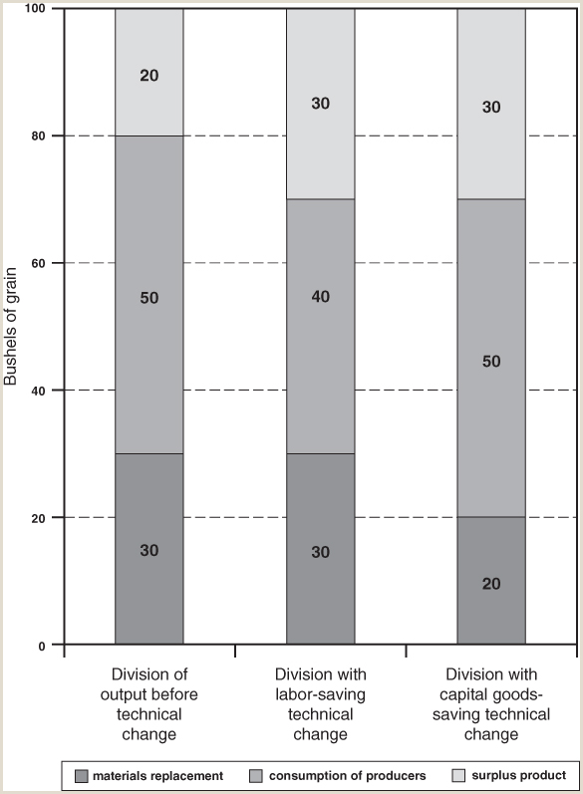
FIGURE 4.3
Division of the representative farm family’s total output
The left-hand bar represents the division of total output as set forth in the original example in the text: total output is 100 bushels, with 30 used for replacing the material inputs to the production process (capital goods depreciation as well as materials used up), 50 allocated for the consumption of the producers, and 20 remaining as the surplus product. The middle bar shows the division of total output after there has been a labor-saving technical change. Since there has been an increase in labor productivity, the same total output (100 bushels) can now be produced with less labor (800 rather than 1,000 hours) so only 40 bushels (rather than 50) need be allocated for the consumption of the producers. The right-hand bar shows what happens when there is a capital goods-saving technical change. In this case, both the total output (100 bushels) and the consumption of the producers (50 bushels) are unchanged from the original example, but the reduction in replacement costs from 30 to 20 bushels allows the surplus to be enlarged to 30 bushels.
Samuel Bowles, Frank Roosevelt, Richard Edwards, Mehrene Larudee
Understanding Capitalism, Fourth Edition, Copyright © 2018 Oxford University Press

Slide 6
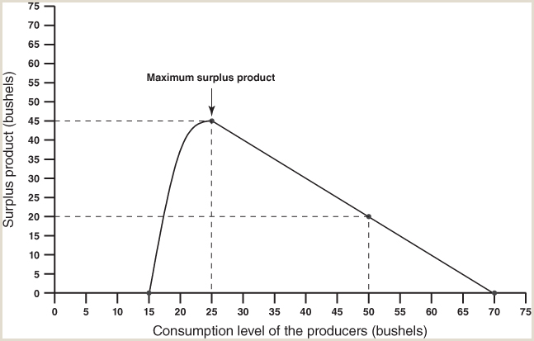
FIGURE 4.4
Conflict over the consumption level of the producers
This figure shows a hypothetical relationship between the level of consumption of the producers and the size of the surplus product. Each point on the line in the graph is an answer to the hypothetical question: for each level of consumption by the producers, how large will the surplus product be? If the producers’ consumption level is 50 bushels, for example, the surplus product will be 20 bushels (as it was in our presentation of the grain model). If the producers’ consumption increased to a level of 70 bushels, the surplus product would be zero. Reducing the level of consumption will increase the surplus, but only to a point. The surplus reaches a maximum of 45 bushels when the consumption level is 25 bushels. Consumption levels below 25 bushels actually reduce the surplus product. If the consumption level were to fall to 15 bushels, the workers would be so impoverished that they would not be able to produce more than 15 bushels of net product a year, leaving no surplus product
Samuel Bowles, Frank Roosevelt, Richard Edwards, Mehrene Larudee
Understanding Capitalism, Fourth Edition, Copyright © 2018 Oxford University Press

