Slide 1
Capitalism as an Economic System
Chapter 5
Samuel Bowles, Frank Roosevelt, Richard Edwards, Mehrene Larudee
Understanding Capitalism, Fourth Edition, Copyright © 2018 Oxford University Press

Slide 2
Figures and Tables
Samuel Bowles, Frank Roosevelt, Richard Edwards, Mehrene Larudee
Understanding Capitalism, Fourth Edition, Copyright © 2018 Oxford University Press

Slide 3
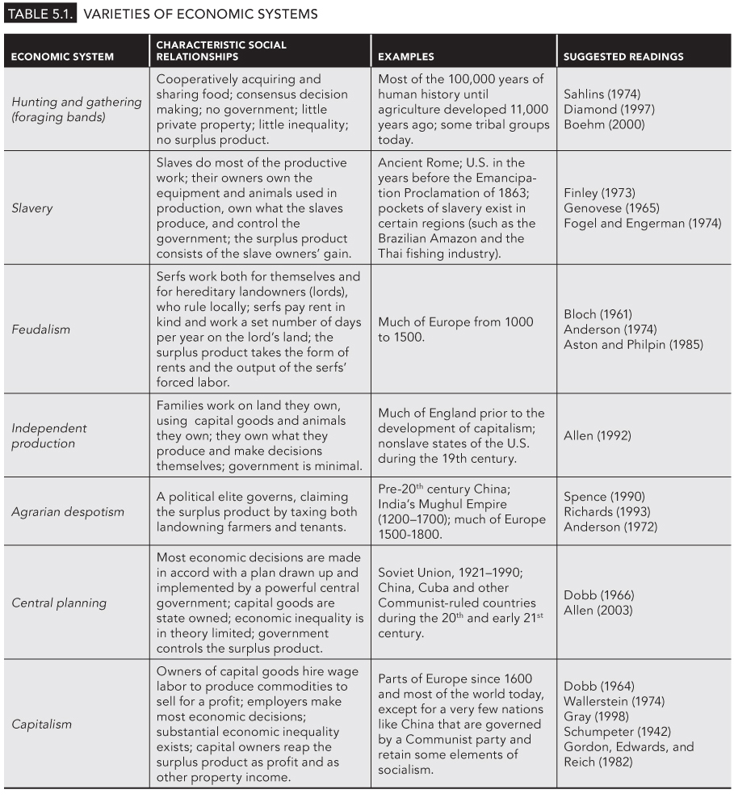
TABLE 5.1
Varieties of Economic Systems
Samuel Bowles, Frank Roosevelt, Richard Edwards, Mehrene Larudee
Understanding Capitalism, Fourth Edition, Copyright © 2018 Oxford University Press

Slide 4
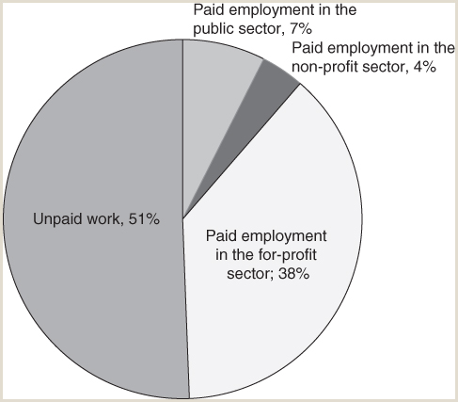
FIGURE 5.1
Percent of All U.S. Labor Performed that is Unpaid, Paid Commodity-Producing, and Paid Non-Commodity Producing, 2013.
This pie chart shows how much of all labor is household labor and other nonmarket work, how much is paid employment that produces commodities (in for-profit enterprises), and how much is paid employment that does not produce commodities (divided into government work at all levels and work for nonprofit organizations). Approximately 12.5 billion hours of labor were performed in a typical week in the U.S. in 2013, and the percentages in this figure represent shares of this total number of hours. The data are presented in terms of hours of labor rather than numbers of workers because most people participate in both household labor and paid employment. Based on the American Time Use Survey and other government data, about half the work performed in the U.S. is nonmarket (unpaid) labor.
Sources: U.S. Department of Labor, Bureau of Labor Statistics, “American Time Use Survey, Table A-1 for 2013,” available at https://www.bls.gov/tus/tables/a1_all_years.xlsx; BLS, “Total civilian labor force in the U.S. in 2013,” news release, available at http://www.bls.gov/news.release/archives/empsit_01102014.pdf; U.S. Census Bureau, “Annual Survey of Public Employment and Payroll Summary Report, 2013,” available at http://www2.census.gov/govs/apes/2013_summary_report.pdf; BLS, “Nonprofits account for 11.4 million jobs, 10.3 percent of all private sector employment,” The Economic Daily (TED), October 21, 2014, available at http://www.bls.gov/opub/ted/2014/ted_20141021.htm.
Samuel Bowles, Frank Roosevelt, Richard Edwards, Mehrene Larudee
Understanding Capitalism, Fourth Edition, Copyright © 2018 Oxford University Press

Slide 5
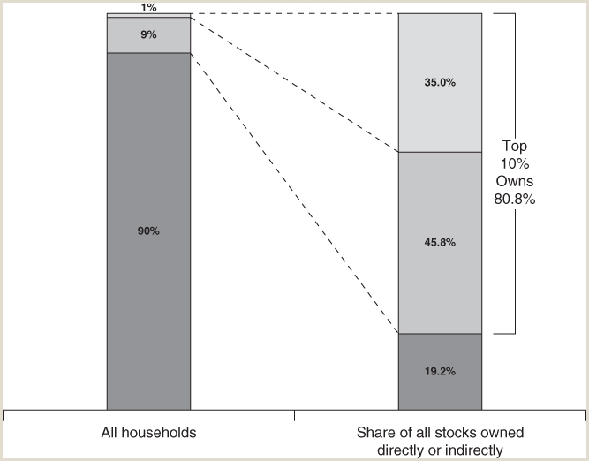
FIGURE 5.2
The concentration of ownership of capital goods
The bar on the left represents the 117.6 million households (families and individuals) that made up the U.S. population in 2010. The bar on the right represents the value of all the publicly traded stocks of corporations in the same year, and it shows the proportions of stocks that were owned—whether directly or indirectly through mutual funds, trusts, and retirement accounts—by the various wealth groups. The figure shows that the wealthiest 1 percent of households owned 35.0 percent of the corporate stock, that the top 10 percent (which includes the top 1 percent) owned 80.8 percent of such wealth, and that the bottom 90 percent of American households owned 19.2 percent.
Source: Data from Edward N. Wolff, “The Asset Price Meltdown and the Wealth of the Middle Class,” NBER Working Paper 18559, 2012, 57, Table 9, available at http://www.nber.org/papers/w18559.
Samuel Bowles, Frank Roosevelt, Richard Edwards, Mehrene Larudee
Understanding Capitalism, Fourth Edition, Copyright © 2018 Oxford University Press

Slide 6
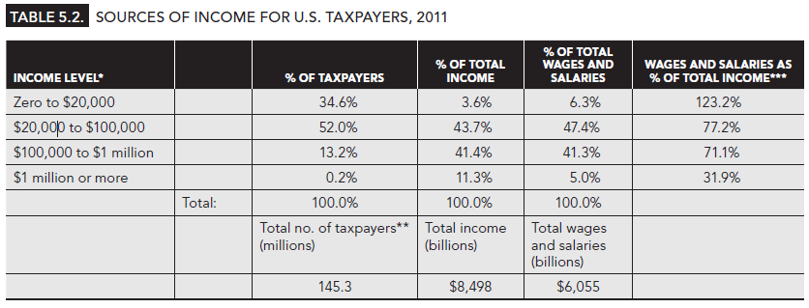
TABLE 5.2
Sources of Income for U.S. Taxpayers, 2011
Note: Wages and salaries as a percent of total income can exceed 100% because deductions on tax returns can make Adjusted Gross Income lower than wages and salaries. The data on individual tax returns also include S-corporation returns, which are filed by individuals whose businesses are not incorporated.
* “Income level” refers to the “adjusted gross income” reported on the tax returns filed with the IRS in 2011.
** No. of “taxpayers” is the number of tax returns filed with the IRS in 2011. Since many multiple-earner families file “joint” tax returns, the number of returns is less than the number of income-earners. The data in this table are based on tax returns.
*** Total income includes, in addition to wage and salary income: interest, dividends, rent, royalties, and capital gains, all of which are forms of property income; and many types of nonwage income (generally smaller amounts than those derived from property), including business and professional income, social security benefits, alimony, and unemployment insurance.
Source: U.S. Treasury Department, Internal Revenue Service, Statistics of Income: Individual Income Tax, All Returns: Sources of Income, Adjustments, Deductions, and Exemptions, 2011, Table 1.4. Available at https://www.irs.gov/uac/SOI-Tax-Stats-Individual-Income-Tax-Returns.
Samuel Bowles, Frank Roosevelt, Richard Edwards, Mehrene Larudee
Understanding Capitalism, Fourth Edition, Copyright © 2018 Oxford University Press

