Slide 1
Government and the Economy
Chapter 6
Samuel Bowles, Frank Roosevelt, Richard Edwards, Mehrene Larudee
Understanding Capitalism, Fourth Edition, Copyright © 2018 Oxford University Press

Slide 2
Figures and Tables
Samuel Bowles, Frank Roosevelt, Richard Edwards, Mehrene Larudee
Understanding Capitalism, Fourth Edition, Copyright © 2018 Oxford University Press

Slide 3
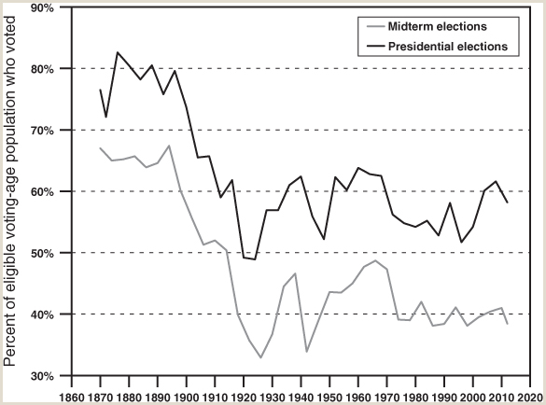
FIGURE 6.1
The American voter: An endangered species?
The data are for the percentage of all eligible voters who actually voted. Note that these figures may be inconsistent with other reported voter turnout data because of differing definitions of voters (did they cast a ballot at all? or: did they cast a vote for president?) and of the group of which they are a share (the whole voting age population? only voting age citizens? or only those voting age citizens who have registered to vote?).
Sources: Michael P. McDonald, “National General Election VEP Turnout Rates, 1789–Present,” United States Elections Project. Accessed June 24, 2017, available at http://www.electproject.org/national-1789-present.
Samuel Bowles, Frank Roosevelt, Richard Edwards, Mehrene Larudee
Understanding Capitalism, Fourth Edition, Copyright © 2018 Oxford University Press

Slide 4
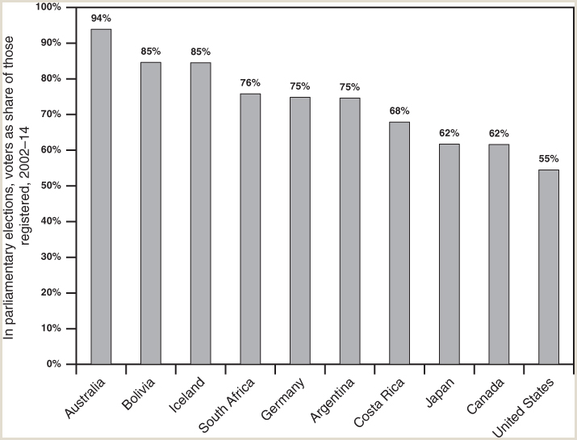
FIGURE 6.2
Voter turnouts around the world.
For selected countries, voter turnouts for parliamentary elections are averaged over 2002–2014, including all parliamentary elections, whether or not they coincided with election of a president or other chief executive. Voters are counted as a percent of all those registered to vote. Both Argentina and Australia have compulsory voting laws, and enforce them; the other countries shown do not.
Source: Data from International Institute for Democracy and Electoral Assistance, “Voter Turnout,” available at http://www.idea.int/data-tools/data/voter-turnout
Samuel Bowles, Frank Roosevelt, Richard Edwards, Mehrene Larudee
Understanding Capitalism, Fourth Edition, Copyright © 2018 Oxford University Press

Slide 5
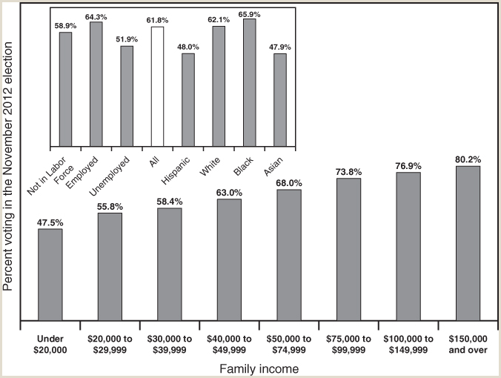
FIGURE 6.3
Who votes? U.S. voting patterns in the presidential election of 2012
This figure shows the fraction of citizens in various segments of the population, by family income, employment status, race, and ethnicity, reported to have voted in the U.S. presidential election of November 2012. Voter turnout can be measured in various ways: by the number voting as a percent of the voting age population (some of whom are noncitizens, or not registered to vote), or as a percent of the number of citizens of voting age who actually voted (although those citizens who have not registered could not actually vote), or as a percent of the number who are registered to vote (a smaller group still). The numbers in this figure are based on the second method: for each category, the number in that category who self-reported having voted in the November 2012 election, divided by the number of citizens of voting age in that category. Some of those surveyed did not answer the question either yes or no, and so they were not counted.
Source: U.S. Bureau of the Census, Current Population Survey, November 2012 and November 2014, Tables 4b, 6, and 7; available at https://www.census.gov/data/tables/2012/demo/voting-and-registration/p20-568.html
Samuel Bowles, Frank Roosevelt, Richard Edwards, Mehrene Larudee
Understanding Capitalism, Fourth Edition, Copyright © 2018 Oxford University Press

