Slide 1
U.S. Capitalism: Accumulation and Change
Chapter 7
Samuel Bowles, Frank Roosevelt, Richard Edwards, Mehrene Larudee
Understanding Capitalism, Fourth Edition, Copyright © 2018 Oxford University Press

Slide 2
Figures and Tables
Samuel Bowles, Frank Roosevelt, Richard Edwards, Mehrene Larudee
Understanding Capitalism, Fourth Edition, Copyright © 2018 Oxford University Press

Slide 3
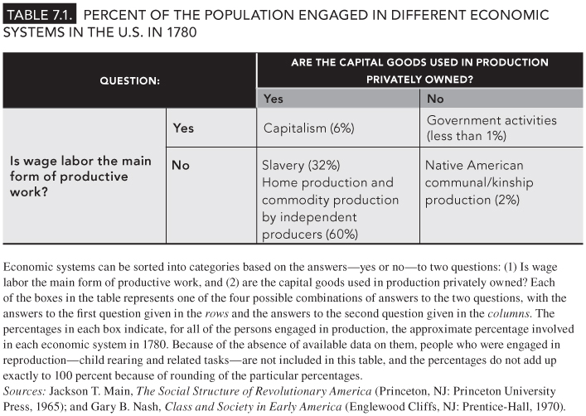
TABLE 7.1
Percent of the Population Engaged in Different Economic Systems in the U.S. in 1780
Samuel Bowles, Frank Roosevelt, Richard Edwards, Mehrene Larudee
Understanding Capitalism, Fourth Edition, Copyright © 2018 Oxford University Press

Slide 4
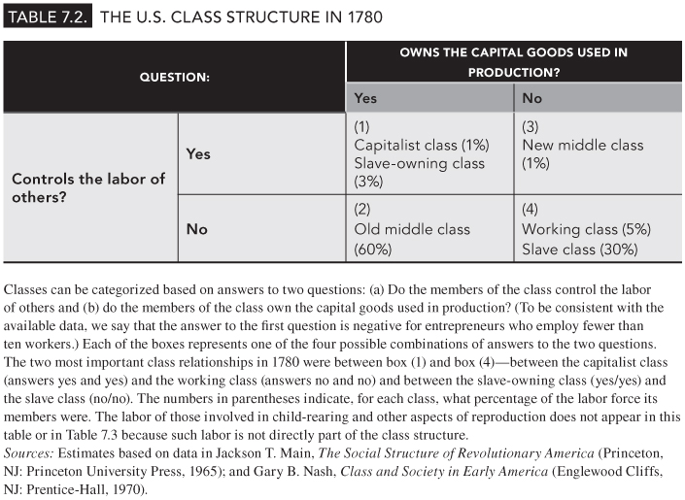
TABLE 7.2
The U.S. Class Structure in 1780
Samuel Bowles, Frank Roosevelt, Richard Edwards, Mehrene Larudee
Understanding Capitalism, Fourth Edition, Copyright © 2018 Oxford University Press

Slide 5
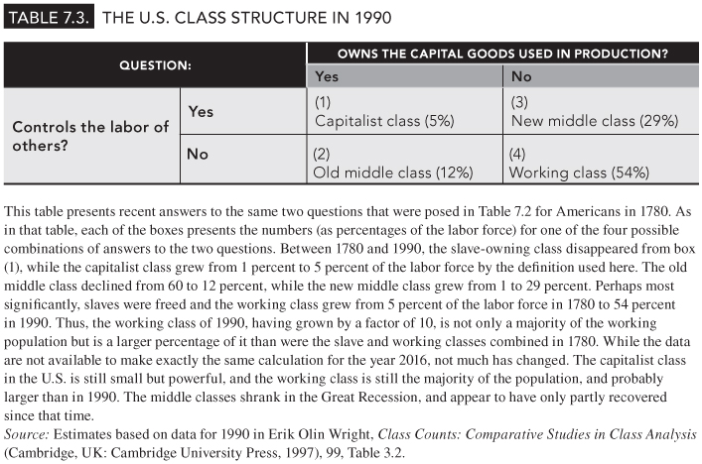
TABLE 7.3
The U.S. Class Structure in 1990
Samuel Bowles, Frank Roosevelt, Richard Edwards, Mehrene Larudee
Understanding Capitalism, Fourth Edition, Copyright © 2018 Oxford University Press

Slide 6
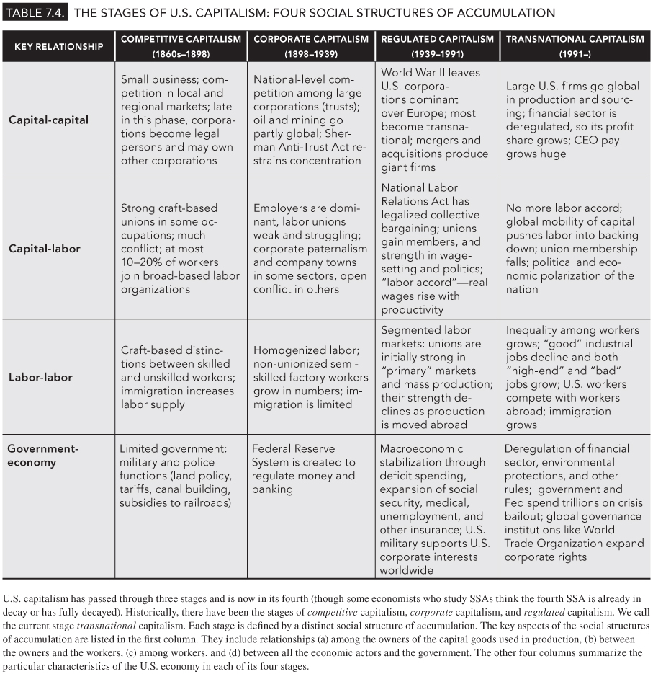
TABLE 7.4
The Stages of U.S. Capitalism: Four Social Structures of Accumulation
Samuel Bowles, Frank Roosevelt, Richard Edwards, Mehrene Larudee
Understanding Capitalism, Fourth Edition, Copyright © 2018 Oxford University Press

Slide 7
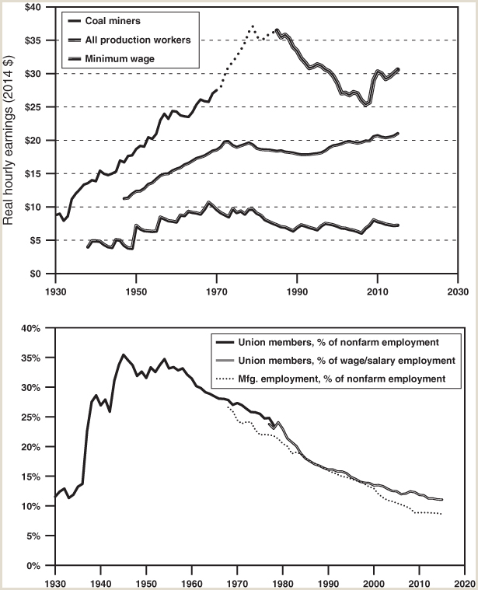
FIGURE 7.1
U.S. wages and union membership, 1930-2015.
The bottom graph shows that union membership in the United States grew in the 1930s (after the Wagner Act) and during World War II, but soon began a long decline that paralleled a fall in manufacturing’s share of total employment (dotted line). The top graph shows that real wages rose along with union power through the 1970s, but generally stagnated or declined thereafter. The top line shows coal miners’ wages. “Real” means that nominal wages are adjusted for inflation using the Consumer Price Index. Data for coal miners’ hourly earnings come from three partially overlapping series which are not entirely consistent because of changes in which groups of miners were included; the dotted line imputes the likely trend for coal miners’ wages in years for which data cover a broader group of miners. The middle line shows hourly earnings of production and nonsupervisory workers, about 80 percent of all those employed. In the upper graph, the lowest line shows the real (inflation-adjusted) value of the federal minimum wage.
Sources: Mining wages: U.S. Bureau of the Census, Historical Statistics of the United States: Colonial Times to 1970 (Washington, DC: US GPO, 1975), p. 170: Series D 811-817, Earnings and Hours for Bituminous Coal-Lignite Mining and Class 1 Steam Railroads: 1890 to 1970; U.S. Bureau of Labor Statistics (BLS) Current Employment Statistics, Series SIC 10-14 (EEU10000006): Average hourly earnings of production workers, mining, 1947–2003; BLS, CES NAICS 2121 (CEU1021210008), Average hourly earnings of production and nonsupervisory workers, coal mining, 1985–2015; deflated using the CPI-U from bls.gov. Production workers’ hourly earnings: Lawrence Mishel et al., The State of Working America, 12th edition, Economic Policy Institute, Ithaca, NY: ILR Press, Tables for p. 185, Figure 4B: Real hourly earnings and compensation of private production and nonsupervisory workers, 1947–2011. Real federal minimum wage: “History of Federal Minimum Wage Rates Under the Fair Labor Standards Act, 1938–2009,” https://www.dol.gov/whd/minwage/chart.htm; deflated with the CPI-U. Union density (membership): Barry T. Hirsch and David A. MacPherson, unionstats.com. Manufacturing employment share of total employment: BLS series CES0000000001 (total nonfarm employment) and CES30000000001 (manufacturing employment), 1968–2015, www.bls.gov.
Samuel Bowles, Frank Roosevelt, Richard Edwards, Mehrene Larudee
Understanding Capitalism, Fourth Edition, Copyright © 2018 Oxford University Press

Slide 8
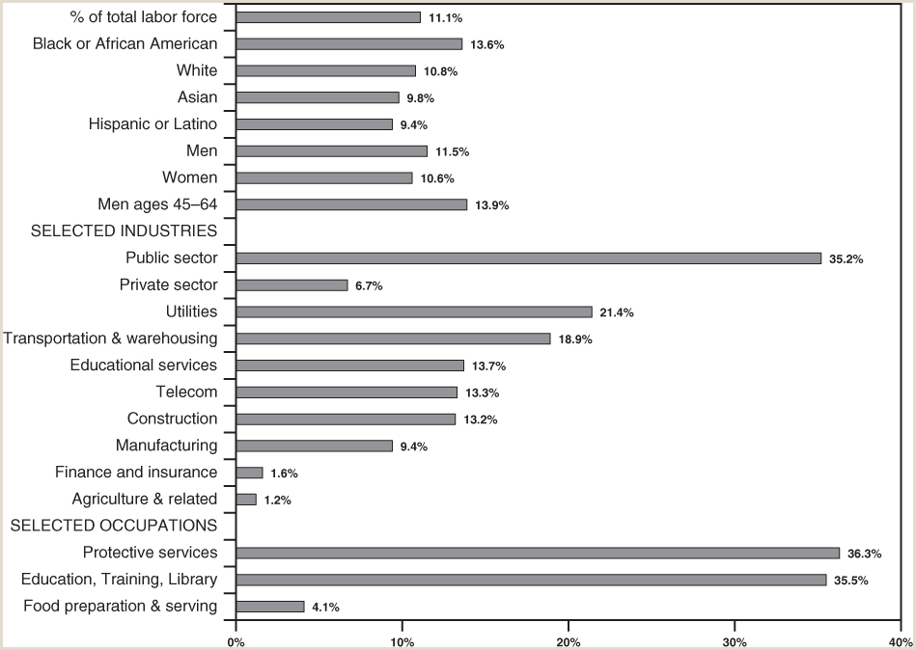
FIGURE 7.2
Who belongs to unions in the U.S.?
This figure shows the unionization rates for various categories of American workers in 2015. Each bar represents the number of union members, or members of an employee association similar to a union, as a percent of the total number of wage and salary workers employed in each group, industry, or occupation.
Sources: U.S. Bureau of Labor Statistics, “Union Members Summary: Union Members–2015,” available at http://www.bls.gov/news.release/union2. nr0.htm; “Table 1: Union Affiliation of Employed Wage and Salary Workers by Selected Characteristics, 2014–2015 Annual Averages,” available at http://www.bls.gov/news.release/union2.t01.htm; and Table 3: Union Affiliation of Employed Wage and Salary Workers by Occupation and Industry,” available at http://www.bls.gov/news.release/union2.t03.htm.
Samuel Bowles, Frank Roosevelt, Richard Edwards, Mehrene Larudee
Understanding Capitalism, Fourth Edition, Copyright © 2018 Oxford University Press

Slide 9
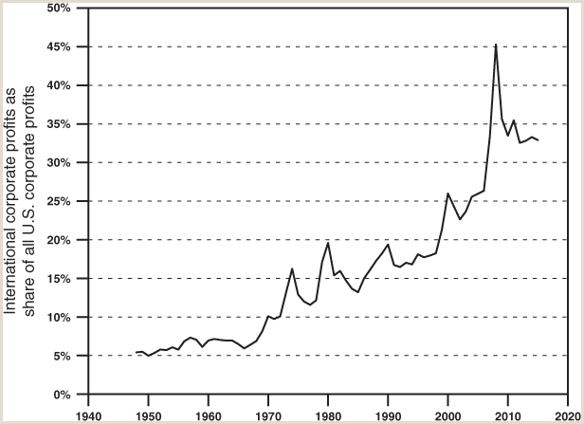
FIGURE 7.3
The growing importance of international profits, 1948-2015.
This figure charts the profits received by U.S. corporations from economic activity in other countries as a percent of all U.S. corporate profits. U.S. corporate profits coming from abroad include: (a) dividends (which include distributed earnings and other private receipts) and (b) undistributed profits (which include reinvested earnings and income of U.S. commonwealths and territories, for example, Puerto Rico and the U.S. Virgin Islands). These are before-tax corporate profits. This means that corporate profits coming from abroad are figured after payment of taxes to foreign governments, but before payment of U.S. taxes.
Source: U.S. Department of Commerce, Bureau of Economic Analysis, National Income and Product Accounts, Tables 6.16B, 6.16C, and 6.16D: Corporate Profits by Industry, Line 6: Receipts From the Rest of the World, Divided by Line 1: Corporate Profits with Inventory Valuation and Capital Consumption Adjustments.
Samuel Bowles, Frank Roosevelt, Richard Edwards, Mehrene Larudee
Understanding Capitalism, Fourth Edition, Copyright © 2018 Oxford University Press

Slide 10
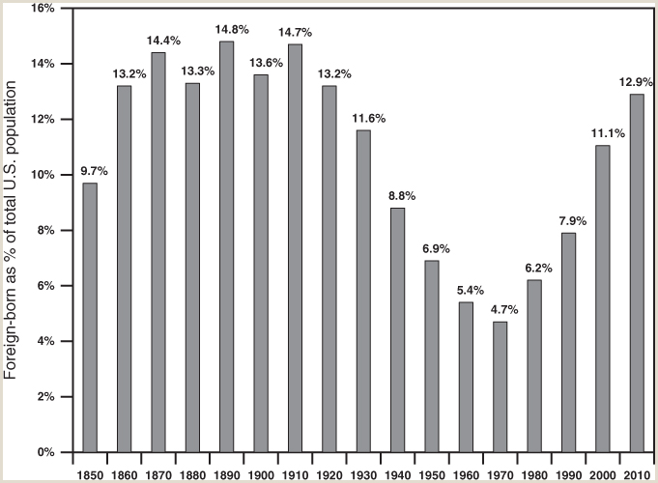
FIGURE 7.4
Percent of U.S. population born in other countries, 1850-2010.
This figure shows, in each year, what percent of the U.S. population was born outside the U.S. From 1860 to 1920, the percent of the whole population that was foreign-born hovered between 13 and 15 percent, reflecting the large flow of immigrants from Europe in that period. After 1920, immigration into the U.S. was restricted, and the percent of foreign-born Americans declined. U.S. immigration laws began to be relaxed again in the 1960s. As a result, immigration increased and the percentage of Americans born in other countries rose from 4.7 percent in 1970 to 12.9 percent in 2010, with most immigrants coming from Latin America and Asia.
Sources: Campbell J. Gibson and Emily Lennon, “Historical Census Statistics on the Foreign-Born Population of the United States: 1850–1990,” Table 1, “Nativity of the Population and Place of Birth of the Native Population, 1850 to 2000,” http://www.census.gov/population/www/documentation/twps0029/twps0029.html; U.S. Bureau of the Census, Profile of the Foreign-Born Population in the United States: 2000, Current Population Reports, Special Studies; available at http://www.census.gov/prod/2002pubs/p23-206.pdf; Current Population Survey, March 2012 Detailed Tables: “Table 1.1: Population by Sex, Age, Nativity, and U.S. Citizenship Status: 2012,” https://www.census.gov/data/tables/2012/demo/foreign-born/cps-2012.html
Samuel Bowles, Frank Roosevelt, Richard Edwards, Mehrene Larudee
Understanding Capitalism, Fourth Edition, Copyright © 2018 Oxford University Press

Slide 11
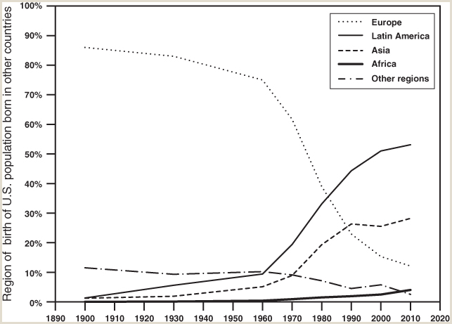
FIGURE 7.5
Region of origin of U.S. Population born in other countries.
Where do the foreign-born in the U.S. come from? This figure traces trends from 1900 to 2010, a period over which the composition of the foreign-born changed significantly. In 1850 more than 90 percent of the first-generation U.S. immigrant population were European-born, and they remained the majority of the foreign-born population in the U.S. until 1980. In 2010, however, the European-born U.S. population was barely 12 percent, mostly not recent immigrants. Since 1930 there has been a rapid growth in the number of immigrants coming from Latin America and Asia, so Europeans are now in third place, far behind people from these two areas.
Sources: U.S. Bureau of the Census, “Table 2: Region of Birth of the Foreign-Born Population: 1850 to 1930 and 1960 to 1990,” Internet release date March 9, 1999, http://www.census.gov/population/www/documentation/twps0029/tab02.html, based on Campbell J. Gibson and Emily Lennon, “Historical Census Statistics on the Foreign-born Population of the United States: 1850–1990”; U.S. Bureau of the Census, Profile of the Foreign-Born Population in the United States: 2000, Current Population Reports, Special Studies, P23-206, December 2001, p. 11,Figure 2-2, “Foreign-Born Population by Region of Birth: Selected Years, 1850 to 2000,” and p. 19, Figure 6-2; Elizabeth M. Grieco et al., “The Foreign-Born Population in the United States: 2010,” American Community Survey reports, ACS-19, May 2012, https://www.census.gov/prod/2012pubs/acs-19.pdf.
Samuel Bowles, Frank Roosevelt, Richard Edwards, Mehrene Larudee
Understanding Capitalism, Fourth Edition, Copyright © 2018 Oxford University Press

Slide 12
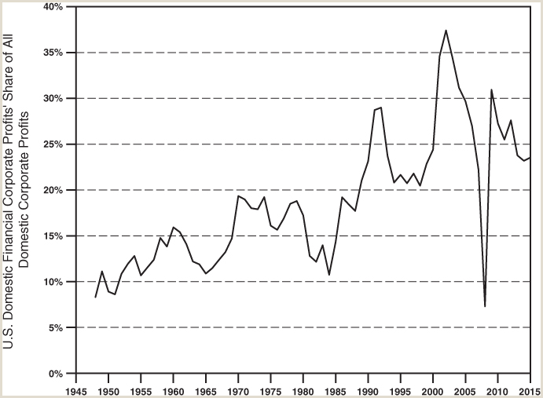
FIGURE 7.7
The financial sector’s share of all reported U.S. domestic corporate profits, 1948-2015
Financial profits have become an increasing share of all corporate profits in the U.S., rising from about 10 percent after World War II to over 30 percent in some years in recent decades, with a dip in 2008 due to the financial crisis that year. Some part of this trend may be explained by nonfinancial transnational firms using accounting devices to shift their reported profits from the U.S. to overseas affiliates to reduce their tax liability. Shifting reported profits abroad also reduces the taxes they actually pay in any given year, because as long as their earnings abroad are kept outside the United States, they can legally defer (postpone) payment of the taxes for which these firms have already declared they are liable. If Congress declares another tax holiday for repatriated profits (as happened in 2004), it is possible that firms can also escape much of even those deferred taxes.
Source: U.S. Bureau of Economic Analysis National Income and Product Accounts Table 6.16B: Corporate Profits by Industry, Line 3: Corporate profits (with IV and CCAdj), Domestic Industries, Financial, divided by Line 2: Domestic Industries (last revised August 6, 2015).
Samuel Bowles, Frank Roosevelt, Richard Edwards, Mehrene Larudee
Understanding Capitalism, Fourth Edition, Copyright © 2018 Oxford University Press

