Slide 1
Supply and Demand: How Markets Work
Chapter 8
Samuel Bowles, Frank Roosevelt, Richard Edwards, Mehrene Larudee
Understanding Capitalism, Fourth Edition, Copyright © 2018 Oxford University Press

Slide 2
Figures and Tables
Samuel Bowles, Frank Roosevelt, Richard Edwards, Mehrene Larudee
Understanding Capitalism, Fourth Edition, Copyright © 2018 Oxford University Press

Slide 3
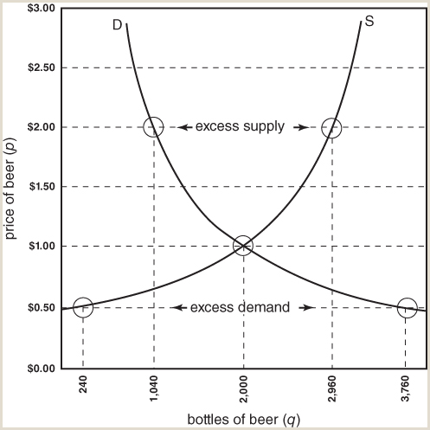
FIGURE 8.1
The demand curve and the supply curve.
The demand curve D provides the following information. If the price of beer per bottle is p dollars, the amount demanded by consumers will be q bottles a day. For example, if the price is $2 a bottle, consumers will buy 1,040 bottles a day. The supply curve S provides similar information about what producers will offer on the market. If the price is p dollars per bottle, suppliers will offer q bottles per day on the market. For example, if the price is $2 a bottle, beer suppliers will want to sell 2,960 bottles a day. Normally, demand curves slope downward (to the right) and supply curves slope upward
Samuel Bowles, Frank Roosevelt, Richard Edwards, Mehrene Larudee
Understanding Capitalism, Fourth Edition, Copyright © 2018 Oxford University Press

Slide 4
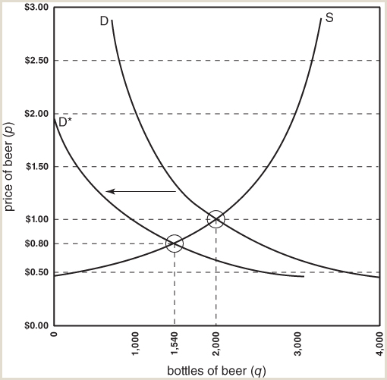
FIGURE 8.2
A shift of the demand curve
When something other than the price changes, there will be a shift of the demand curve, either to the right or to the left. A shift of the demand curve is different from a movement along the curve, which is what happens when only the price changes. In this figure, D* shows the position of the demand curve after it has shifted to the left, indicating that there is now less demand for beer at every price. It is also possible that, with a different change in one of the influences on the demand curve, it would shift to the right.
Samuel Bowles, Frank Roosevelt, Richard Edwards, Mehrene Larudee
Understanding Capitalism, Fourth Edition, Copyright © 2018 Oxford University Press

Slide 5
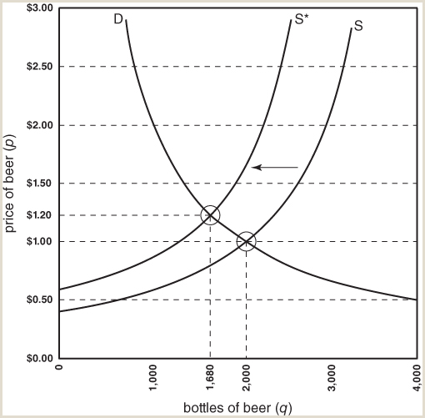
FIGURE 8.3
A shift of the supply curve
When something other than the price changes, there will be a shift of the supply curve, either to the right or to the left. A shift of the supply curve is different from a movement along the curve, which is what happens when only the price changes. In this figure, S* shows the position of the supply curve after it has shifted to the left, indicating that there will now be a smaller amount of beer supplied at every price. It is also possible that, with other changes in one of the influences on the supply curve, it would shift to the right.
Samuel Bowles, Frank Roosevelt, Richard Edwards, Mehrene Larudee
Understanding Capitalism, Fourth Edition, Copyright © 2018 Oxford University Press

Slide 6
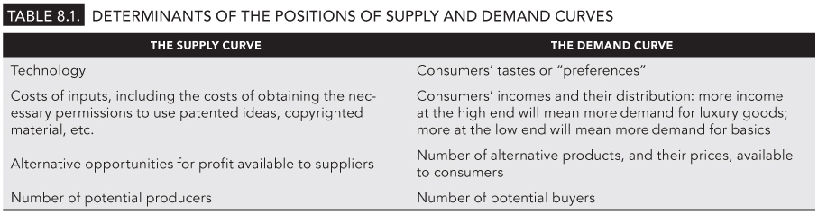
TABLE 8.1
Determinants of the positions of supply and demand curves
Samuel Bowles, Frank Roosevelt, Richard Edwards, Mehrene Larudee
Understanding Capitalism, Fourth Edition, Copyright © 2018 Oxford University Press

