Slide 1
Competition and Coordination: The Invisible Hand
Chapter 9
Samuel Bowles, Frank Roosevelt, Richard Edwards, Mehrene Larudee
Understanding Capitalism, Fourth Edition, Copyright © 2018 Oxford University Press

Slide 2
Figures and Tables
Samuel Bowles, Frank Roosevelt, Richard Edwards, Mehrene Larudee
Understanding Capitalism, Fourth Edition, Copyright © 2018 Oxford University Press

Slide 3
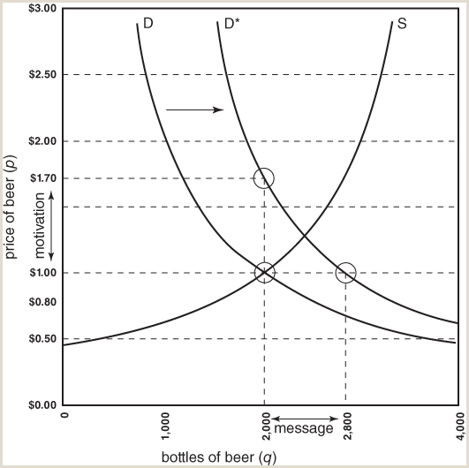
FIGURE 9.1
Market messages and market motivation.
The shift of the demand curve to the right (from D to D*) initially creates excess demand in the hypothetical Iowa City beer market (see Chapter 8). As long as the price per bottle remains at $1.00, excess demand of 800 bottles will now exist because the supply is only 2,000 bottles while the demand is for 2,800. The 800 disappointed customers will be willing to pay more for a bottle of beer, and the suppliers will be willing to produce more if the price rises. As the price rises, the market is sending the message: “More beer!” Suppliers can increase their total profits by selling more beer than before, so they will be motivated to supply more beer. Thus, the rising price is the motivation provided by the market.
Samuel Bowles, Frank Roosevelt, Richard Edwards, Mehrene Larudee
Understanding Capitalism, Fourth Edition, Copyright © 2018 Oxford University Press

Slide 4
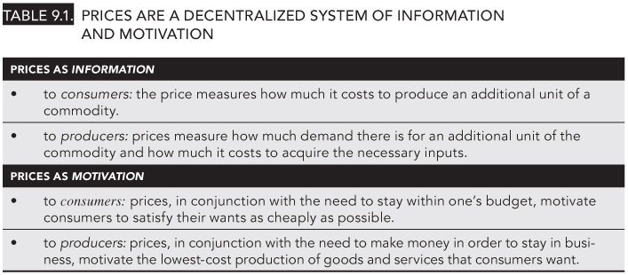
TABLE 9.1
Prices are a decentralized system of information and motivation
Samuel Bowles, Frank Roosevelt, Richard Edwards, Mehrene Larudee
Understanding Capitalism, Fourth Edition, Copyright © 2018 Oxford University Press

Slide 5
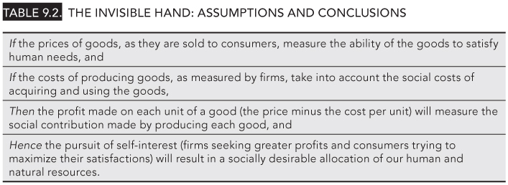
TABLE 9.2
The Invisible Hand: Assumptions and Conclusions
Samuel Bowles, Frank Roosevelt, Richard Edwards, Mehrene Larudee
Understanding Capitalism, Fourth Edition, Copyright © 2018 Oxford University Press

Slide 6
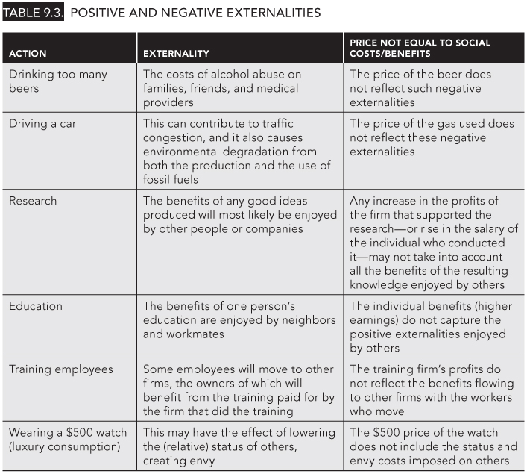
TABLE 9.3
Positive and Negative Externalities
Samuel Bowles, Frank Roosevelt, Richard Edwards, Mehrene Larudee
Understanding Capitalism, Fourth Edition, Copyright © 2018 Oxford University Press

Slide 7
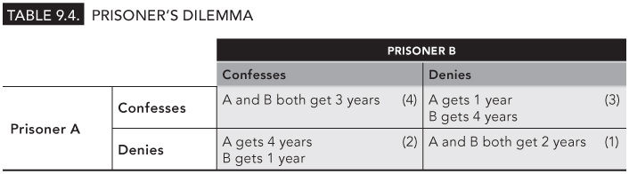
TABLE 9.4
Prisoner’s Dilemma
Samuel Bowles, Frank Roosevelt, Richard Edwards, Mehrene Larudee
Understanding Capitalism, Fourth Edition, Copyright © 2018 Oxford University Press

Slide 8
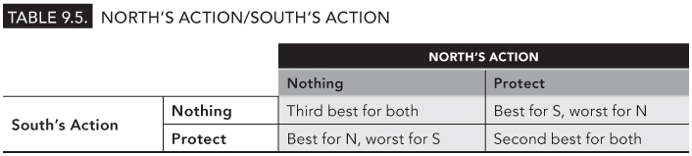
TABLE 9.5
North’s Action/South Action
Samuel Bowles, Frank Roosevelt, Richard Edwards, Mehrene Larudee
Understanding Capitalism, Fourth Edition, Copyright © 2018 Oxford University Press

