Slide 1
Capitalist Production and Profits
Chapter 10
Samuel Bowles, Frank Roosevelt, Richard Edwards, Mehrene Larudee
Understanding Capitalism, Fourth Edition, Copyright © 2018 Oxford University Press

Slide 2
Figures and Tables
Samuel Bowles, Frank Roosevelt, Richard Edwards, Mehrene Larudee
Understanding Capitalism, Fourth Edition, Copyright © 2018 Oxford University Press

Slide 3
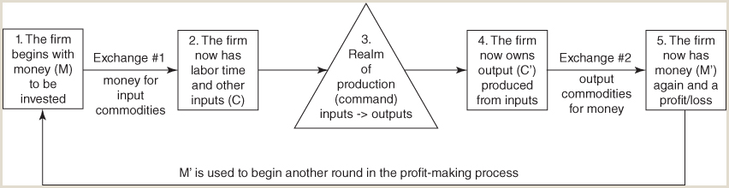
FIGURE 10.1
Exchange and command in the profit-making process.
This figure shows that profit making is a process involving five stages. In stage 1, a firm has a certain amount of money (M) to be invested. To get to stage 2, it carries out the exchange (#1) shown in the figure: It purchases the labor time, materials, and machines (capital goods)—the commodities (C)—required for production. The next move is from stage 2 (where the firm has the necessary inputs) to stage 3, the process of production itself (P). Production results in commodities (C′) that the firm now owns (stage 4). To get from stage 4 to stage 5, the output must be sold (exchange #2). Assuming that it is sold, the firm gets a sum of money (M′) that is either larger or smaller than the original amount of money (M). If it is larger the firm will have made a profit—if smaller, a loss. Whichever it is, at least a part of the proceeds from the sale of C′ is likely to be reinvested, and the entire process will begin again.
Samuel Bowles, Frank Roosevelt, Richard Edwards, Mehrene Larudee
Understanding Capitalism, Fourth Edition, Copyright © 2018 Oxford University Press

Slide 4
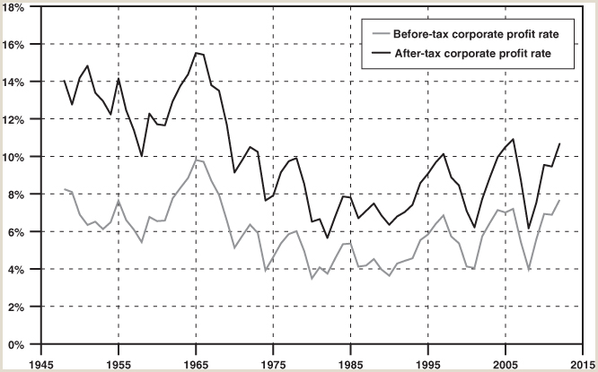
FIGURE 10.2
The U.S. corporate profit rate, 1948-2014.
This figure traces the rate of profit, before and after taxes, from 1948 to 2014. In each year, it is the total profit made by the corporation in the U.S., divided by dollar value of the capital stock in the same year. This includes both nonfinancial and financial corporate businesses in the United States. Excluded from the data are profits received by U.S. corporations on their foreign operations, as well as the value of capital stock owned outside the U.S. There is some evidence that corporate profits recorded by U.S. firms on foreign operations have often been higher than the profits they have reported on domestic operations. This is evidently in part because corporate accountants are able, within limits, to shift reported profits to countries or jurisdictions where they will be less heavily taxed. The drop in reported profit rates after the mid-1960s may therefore be at least partly due to the increase in the foreign operations of U.S. corporations, and the use of such accounting practices.
Sources: U.S. Department of Commerce, Bureau of Economic Analysis, National Income and Product Accounts (NIPA), https://www.bea.gov/iTable/index_nipa.cfm; profit data from Table 1.14: “Gross Value Added of Domestic Corporate Business in Current Dollars and Gross Value Added of Nonfinancial Domestic Corporate Business in Current and Chained Dollars,” lines 11 and 13, May 29, 2015 release; capital stock data from Table 4.1: “Foreign Transactions in the National Income and Product Accounts,” line 9, May 29, 2015 release.
Samuel Bowles, Frank Roosevelt, Richard Edwards, Mehrene Larudee
Understanding Capitalism, Fourth Edition, Copyright © 2018 Oxford University Press

Slide 5
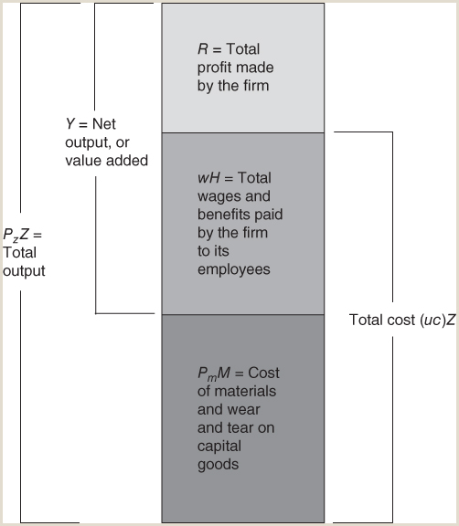
FIGURE 10.3
Division of a firm’s total output into material inout costs P_{m}M, wage cost wH, and total profit R.
This shows the case in which the only kind of cost is costs per unit of output produced. Chapter 11 analyzes the case in which another category of cost, called fixed cost, is added, and this will change the picture somewhat. The diagram also shows that net output Y is total output minus the materials and portion of capital goods used up in production, and that total cost (uc)Z is the sum of labor and materials costs, which equals the unit cost uc times the number of units produced Z.
Samuel Bowles, Frank Roosevelt, Richard Edwards, Mehrene Larudee
Understanding Capitalism, Fourth Edition, Copyright © 2018 Oxford University Press

Slide 6
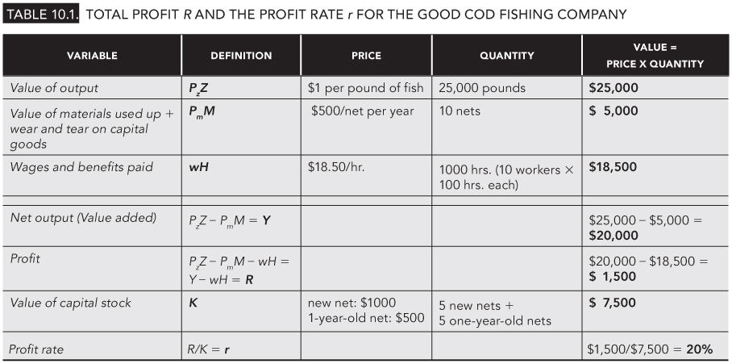
TABLE 10.1
Total profit R and the profit rate r for the Good Cod Fishing Company
Samuel Bowles, Frank Roosevelt, Richard Edwards, Mehrene Larudee
Understanding Capitalism, Fourth Edition, Copyright © 2018 Oxford University Press

Slide 7
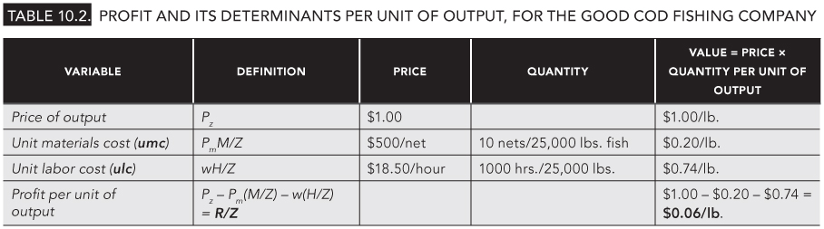
TABLE 10.2
Profit and its determinants per unit of output, for the Good Cod Fishing Company
Samuel Bowles, Frank Roosevelt, Richard Edwards, Mehrene Larudee
Understanding Capitalism, Fourth Edition, Copyright © 2018 Oxford University Press

Slide 8
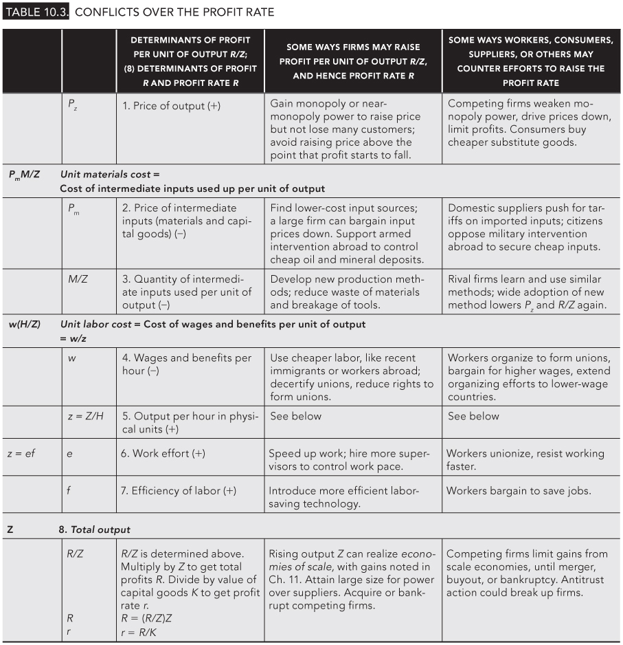
TABLE 10.3
Conflicts over the profit rate
Samuel Bowles, Frank Roosevelt, Richard Edwards, Mehrene Larudee
Understanding Capitalism, Fourth Edition, Copyright © 2018 Oxford University Press

