Slide 1
Competition and Concentration
Chapter 11
Samuel Bowles, Frank Roosevelt, Richard Edwards, Mehrene Larudee
Understanding Capitalism, Fourth Edition, Copyright © 2018 Oxford University Press

Slide 2
Figures and Tables
Samuel Bowles, Frank Roosevelt, Richard Edwards, Mehrene Larudee
Understanding Capitalism, Fourth Edition, Copyright © 2018 Oxford University Press

Slide 3
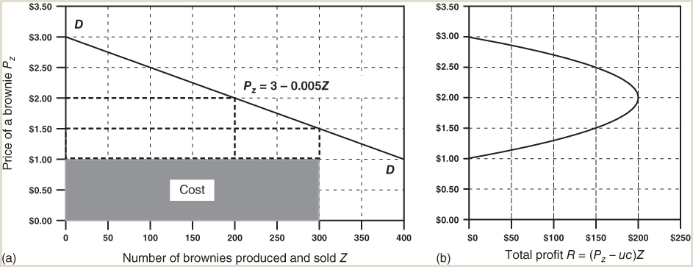
FIGURE 11.1
Finding the selling price at which profit is highest.
A business faces a downward-sloping demand curve for its output if when it raises its price it loses some, but not all, of its customers. This figure shows (a) the quantity of output (brownies) a bakery can sell per day at each price, as well as (b) the total profit, measured along the horizontal axis, that the bakery expects to make at each price level it could set for its brownies. The demand curve facing the firm may change constantly, though, as rivals offer new products, set new prices, or open new stores. In practice, setting prices often involves trial and error.
Samuel Bowles, Frank Roosevelt, Richard Edwards, Mehrene Larudee
Understanding Capitalism, Fourth Edition, Copyright © 2018 Oxford University Press

Slide 4
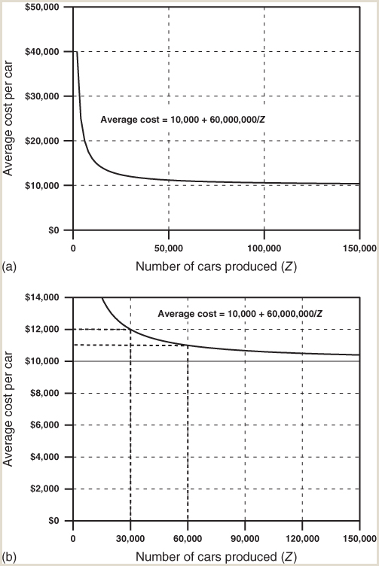
FIGURE 11.2
Average cost curve for an auto plant with marginal cost $10,000 per car and fixed cost $60 million per year.
There are large economies of scale in the auto industry, which result in decreasing average cost as the number of cars produced (Z) increases, as panel (a) shows. Panel (b) shows a close-up of the exact same average cost curve, highlighting the fact that if the plant produces 30,000 cars a year its average cost will be $12,000 per car, but if it produces 60,000 cars, its average cost will be only $11,000. With 100,000 cars produced per year or more, the average cost falls to $10,600 or less. This allows a large-scale producer either to charge the same price as its competitors producing in smaller plants, but make more profit per car sold, or else to charge a lower price, sell more cars, and gain larger market share.
Samuel Bowles, Frank Roosevelt, Richard Edwards, Mehrene Larudee
Understanding Capitalism, Fourth Edition, Copyright © 2018 Oxford University Press

Slide 5
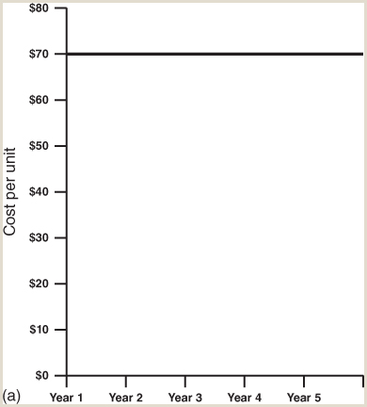
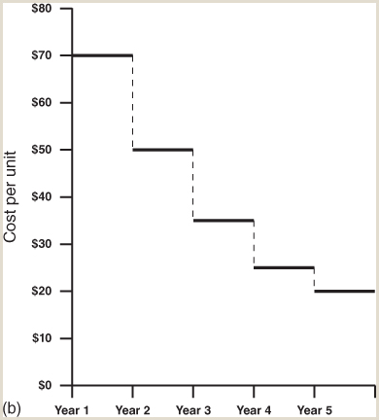
FIGURE 11.3
Dynamic cost advantage.
Panel (a) of this figure shows what happens when firms do not reinvest their profits. Assuming that the prices of inputs (including the wage) remain unchanged, such firms will see their unit costs remain constant from one period to the next. Panel (b) shows that when firms successfully reinvest their profits (in better equipment, for example) their unit costs fall from one period to the next—again assuming no changes in input prices. Lower unit costs will allow firms to achieve higher unit profits or reduce their prices and gain market share. Higher unit profits or lower prices (or both) will give the reinvesting firms competitive advantage over firms that do not reinvest.
Samuel Bowles, Frank Roosevelt, Richard Edwards, Mehrene Larudee
Understanding Capitalism, Fourth Edition, Copyright © 2018 Oxford University Press

Slide 6
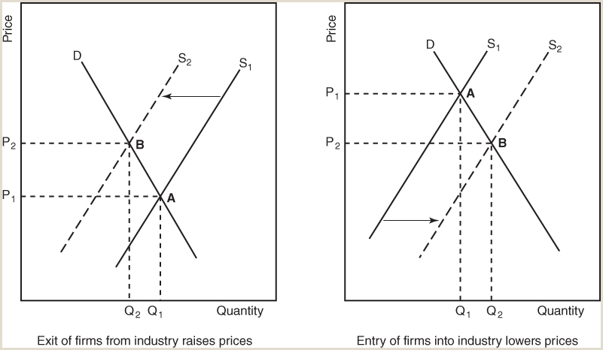
FIGURE 11.4
Exit and entry of firms from and into markets tend to equalize profits.
Low profits will drive some firms out of an initially low-profit industry. This will cause the supply of output in that industry to contract, shown in the left-hand diagram by the leftward shift of the supply curve from S1 to S2. This shift will allow the remaining firms to raise their price from P1 to P2, thus increasing their profits. Exactly the opposite happens in an initially high-profit industry (the right-hand diagram). High profits will induce new firms to enter this industry, increasing total output, so the industry supply curve will shift to the right, showing that there is more supply at each price. The higher output from entry of new firms forces all the firms in the industry to sell their output at a lower price (P2), driving their profit rates down. Thus, exit causes the profit rate to rise in low-profit industries and entry causes the profit rate to fall in high-profit industries, so the profit rates in the two industries will tend to converge.
Samuel Bowles, Frank Roosevelt, Richard Edwards, Mehrene Larudee
Understanding Capitalism, Fourth Edition, Copyright © 2018 Oxford University Press

Slide 7
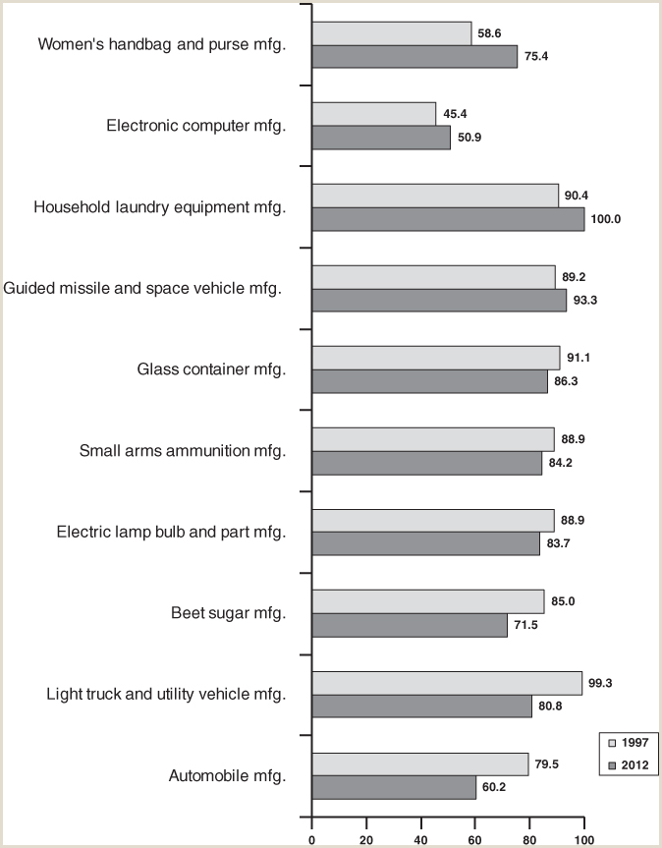
FIGURE 11.5
Diverse trends in industry concentration, 1997-2012
The degree of concentration, as measured by the four-firm concentration ratio, grew in some sectors and fell in others over the period 1997–2012. The four-firm concentration ratio shown here is the share of the top four firms in the total value of goods shipped over the year by U.S. producers in the sector. Trends vary: sectors whose concentration rose are near the top; sectors whose concentration fell are near the bottom. Sectors were selected, among those for which data were reported in the same narrow (6-digit NAICS) category of manufacturing for both 1997 and 2012, to indicate a variety of products and trends. Many sectors have lower four-firm concentration ratios (e.g., apparel industry sectors), but are not shown. Narrowly defined sectors (“Beet sugar manufacturing” but not “Food manufacturing”) tend to have higher concentration ratios.
Source: U.S. Census Bureau, American Factfinder: Download the file “EC1231SR2 - Manufacturing: Subject Series: Concentration Ratios: Share of Value of Shipments Accounted for by the 4, 8, 20, and 50 Largest Companies for Industries: 2012” from https://factfinder.census.gov/faces/nav/jsf/pages/download_center.xhtml; and U.S. Census Bureau, Concentration Ratios in Manufacturing, 1997 Census, Manufacturing, Subject Series, EC97M31S-CR, Issued June 2001, available at https://www.census.gov/prod/ec97/m31s-cr.pdf.
Samuel Bowles, Frank Roosevelt, Richard Edwards, Mehrene Larudee
Understanding Capitalism, Fourth Edition, Copyright © 2018 Oxford University Press

