Slide 1
Wages and Work
Chapter 12
Samuel Bowles, Frank Roosevelt, Richard Edwards, Mehrene Larudee
Understanding Capitalism, Fourth Edition, Copyright © 2018 Oxford University Press

Slide 2
Figures and Tables
Samuel Bowles, Frank Roosevelt, Richard Edwards, Mehrene Larudee
Understanding Capitalism, Fourth Edition, Copyright © 2018 Oxford University Press

Slide 3
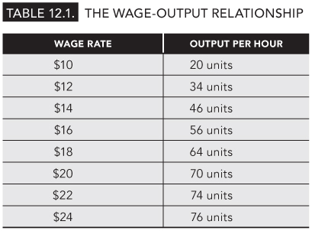
TABLE 12.1
The Wage-Output Relationship
Samuel Bowles, Frank Roosevelt, Richard Edwards, Mehrene Larudee
Understanding Capitalism, Fourth Edition, Copyright © 2018 Oxford University Press

Slide 4
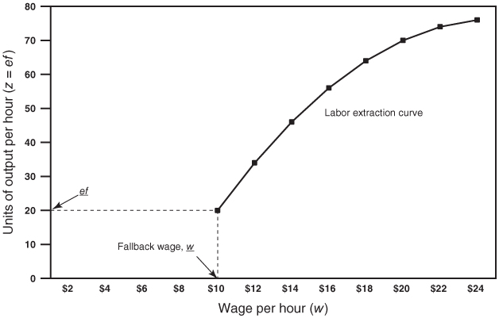
FIGURE 12.1
The wage and the intensity of labor.
The labor extraction curve in this figure shows the amount of output per hour (z) that a worker will produce at each wage rate (w) offered. Output per hour is measured on the vertical axis. Since z = ef, the vertical axis also measures ef. And since f (the efficiency of labor) is constant (no changes in the technology of production are possible in the short time frame of this analysis), any movements up or down the vertical axis are due entirely to changes in the intensity of labor (e).
The horizontal axis shows the hourly wage rate (w). The fallback wage is w (here, $10) and, at this wage rate, the worker’s work effort (e) is at its minimum. This is how hard the worker will choose to work if the wage rate sinks to a level (w) at which he or she is indifferent between keeping the job and losing it. When the wage is at its fallback rate and work effort is at its minimum, the corresponding rate of output per hour (z), shown on the diagram as ef, will also be at a minimum (here, 20 units per hour). Thus, if the employer offers a wage equal to w, the worker’s work effort will be e and the rate of output will be ef
Increases in the wage rate above the fallback wage call forth more output per hour: the levels of output per hour represented by points on the labor extraction curve rise as the wage rises. But beyond a certain point (the point at which the labor extraction curve becomes horizontal), wage increases do not result in additional output per hour because the worker is already putting out as much effort as possible.
Samuel Bowles, Frank Roosevelt, Richard Edwards, Mehrene Larudee
Understanding Capitalism, Fourth Edition, Copyright © 2018 Oxford University Press

Slide 5
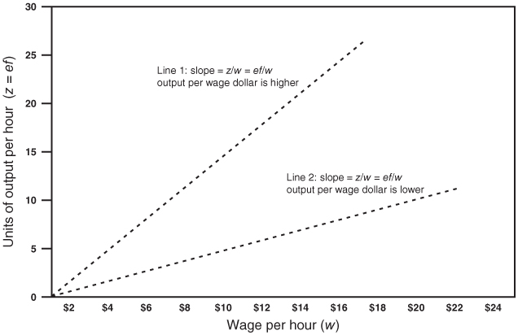
FIGURE 12.2
Output per dollar of wage paid.
This figure shows rays drawn from the origin (at 0 on the vertical axis and $0 on the horizontal one) with different slopes. A ray has the same slope at all points along it, and in this case the slope of the ray indicates how much output per hour can be achieved for each dollar of wage paid. Mathematically, the slope of a ray in this figure is z/w (output per hour divided by the wage rate). The greater the slope of the ray, the higher will be the hourly output per wage dollar paid.
Samuel Bowles, Frank Roosevelt, Richard Edwards, Mehrene Larudee
Understanding Capitalism, Fourth Edition, Copyright © 2018 Oxford University Press

Slide 6
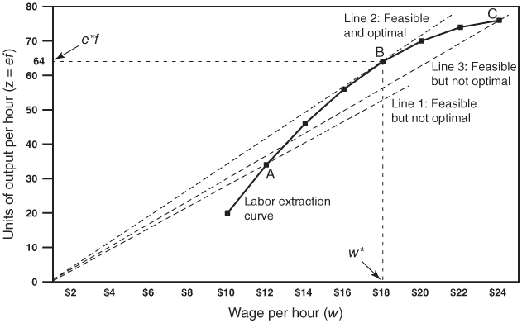
FIGURE 12.3
The labor extraction curve and profit maximization.
The labor extraction curve tells us how much output there is at each wage level (above the fallback wage), and rays show how much output per hour a dollar of wage buys. A profit-maximizing firm wants to be on a steep ray because, the steeper the ray, the more output there is per wage dollar paid. Unit labor cost is lower along a steeper ray since ulc is defined as w/z, the inverse of the slope of a ray (z/w). But no firm can be on a ray that lies above the labor extraction curve. This is because the labor extraction curve indicates how much effort a worker will exert per hour at each wage above the fallback wage. The profit-maximizing firm therefore wants the ray with the steepest slope (highest output per hour for a dollar of wage paid) that touches the labor extraction curve. The ray that is optimal for the firm is the one tangent to the labor extraction curve at point B, and the hourly wage corresponding to point B is w* (here, $18). At a wage of w*, the output per hour will be e*f (here, 64). Thus, w* is the wage rate at which unit labor cost will be minimized and profit maximized, with e*f as the corresponding rate of output per hour. All other rays that pass through some point on the labor extraction curve will have flatter slopes and higher unit labor costs.
Hence, the particular combination of w* and e*f represented by point B offers the employer the lowest possible unit labor cost and the maximum rate of profit.
Samuel Bowles, Frank Roosevelt, Richard Edwards, Mehrene Larudee
Understanding Capitalism, Fourth Edition, Copyright © 2018 Oxford University Press

Slide 7
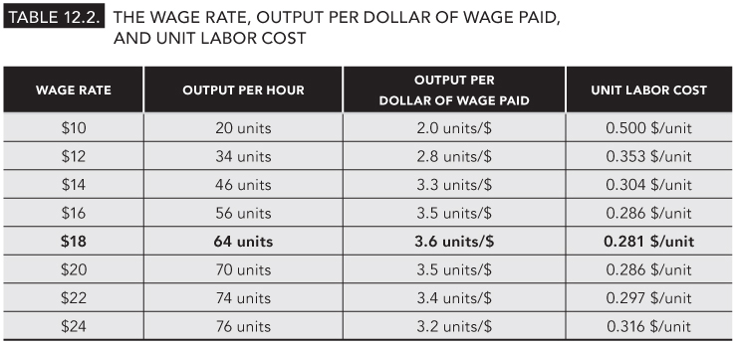
TABLE 12.2
The wage rate, output per dollar of wage paid, and unit labor cost.
Samuel Bowles, Frank Roosevelt, Richard Edwards, Mehrene Larudee
Understanding Capitalism, Fourth Edition, Copyright © 2018 Oxford University Press

Slide 8
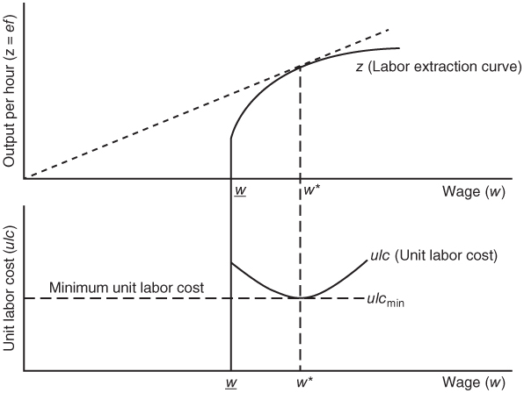
FIGURE 12.4
The wage, labor extraction, unit labor cost, and profit maximization.
This figure illustrates in a different way the idea that the point of tangency between the labor extraction curve and a ray with the slope z/w is indeed where unit labor cost is minimized. The figure makes the same point graphically as was made with numbers in Table 12.2. Both Table 12.2 and this figure show that ulc is minimized when the wage rate is w* ($18 in the table and the example set forth in the text).
Samuel Bowles, Frank Roosevelt, Richard Edwards, Mehrene Larudee
Understanding Capitalism, Fourth Edition, Copyright © 2018 Oxford University Press

Slide 9
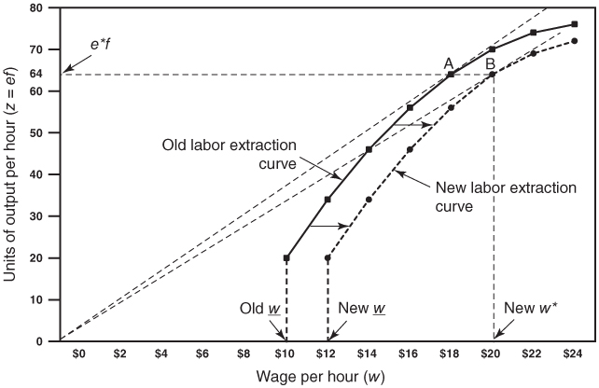
FIGURE 12.5
Effects of more unemployment insurance.
With an increase in the level or availability of unemployment insurance benefits, the worker’s fallback wage rises (in this case by $2 per hour) and the entire labor extraction curve shifts to the right. This is because the cost of job loss at every wage rate is reduced by $2 per hour. Employers must now offer higher wages to extract the amount of work that they had previously been able to extract at lower wage rates. In this case, to get the same rate of output (e*f) as before, the firm must pay a wage of close to $20 an hour in place of the $18 an hour that it used to pay. The slope of the line drawn to point B is lower than that of the line drawn to point A, which means that the unit labor cost at the new profit-maximizing wage offer (new w*) will be higher than before.
Samuel Bowles, Frank Roosevelt, Richard Edwards, Mehrene Larudee
Understanding Capitalism, Fourth Edition, Copyright © 2018 Oxford University Press

