Slide 1
The Mosaic of Inequality
Chapter 14
Samuel Bowles, Frank Roosevelt, Richard Edwards, Mehrene Larudee
Understanding Capitalism, Fourth Edition, Copyright © 2018 Oxford University Press

Slide 2
Figures and Tables
Samuel Bowles, Frank Roosevelt, Richard Edwards, Mehrene Larudee
Understanding Capitalism, Fourth Edition, Copyright © 2018 Oxford University Press

Slide 3
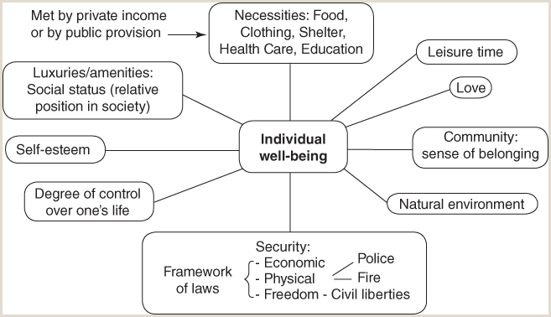
FIGURE 14.1
The determinants of well-being
Without attempting to be comprehensive or to suggest the relative importance of each determinant, this figure displays in graphic form some of the requirements for well-being in any society.
Samuel Bowles, Frank Roosevelt, Richard Edwards, Mehrene Larudee
Understanding Capitalism, Fourth Edition, Copyright © 2018 Oxford University Press

Slide 4
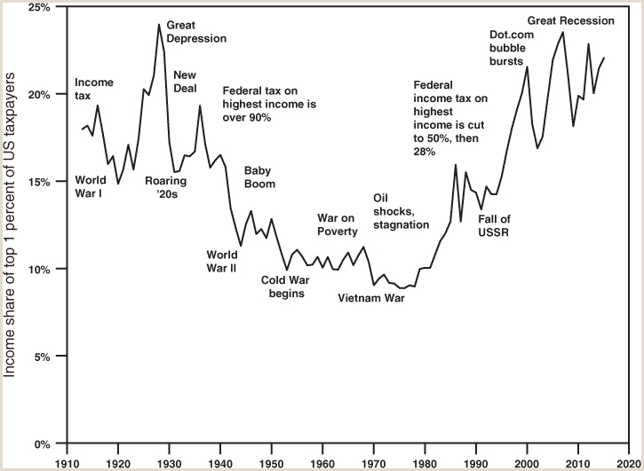
FIGURE 14.2
The lucky few: Income share of the top 1 percent of U.S. taxpayers, 1913-2015
Share is calculated by dividing the total income of the top 1 percent of taxpayers, including capital gains, by the total income of all income earners, including capital gains. Data from the same source are also available to calculate the share if capital gains are excluded; however, the difference is not large.
Source: Data from Emmanuel Saez, “Income Inequality in the United States, 1913–1998,” with Thomas Piketty, Quarterly Journal of Economics, 118, no. 1 (2003): 1–39 (Tables and Figures Updated to 2015 in Excel format, June 2016), Table A3: Top fractiles income shares (including capital gains) in the United States, available from https://eml.berkeley.edu/~saez/.
Samuel Bowles, Frank Roosevelt, Richard Edwards, Mehrene Larudee
Understanding Capitalism, Fourth Edition, Copyright © 2018 Oxford University Press

Slide 5
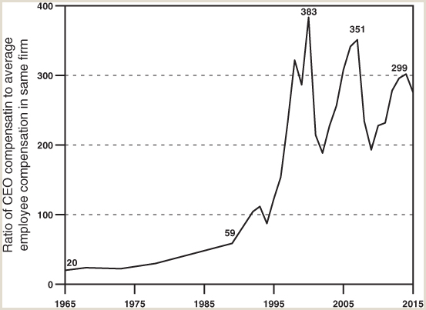
FIGURE 14.3
U.S. CEO pay in relation to the average worker’s pay, 1965-2015
For each corporate CEO, researchers used U.S. Bureau of Labor Statistics and Bureau of Economic Analysis data to estimate the total compensation (wages plus benefits) received by a typical production/nonsupervisory worker in the key industry in which the corporation operated. The CEO compensation was divided by this average worker’s estimated total compensation to get the ratio for that corporation. Then for each year, these ratios for specific firms were averaged to obtain the ratio shown.
Source: Lawrence Mishel and Jessica Schieder, “CEO pay remains high relative to the pay of typical workers and high-wage earners,”, July 26, 2017, available at http://www.epi.org/130554. References to methodology are cited in the paper.
Samuel Bowles, Frank Roosevelt, Richard Edwards, Mehrene Larudee
Understanding Capitalism, Fourth Edition, Copyright © 2018 Oxford University Press

Slide 6
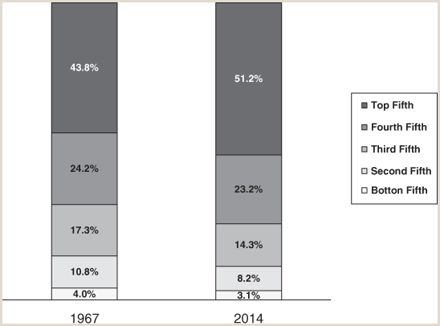
FIGURE 14.4
Income shares by quintile in the U.S., 1967 and 2014
This figure shows increasing income inequality among U.S. households from 1967 to 2014. For each year, households were ranked by income and then divided into five equal groups (quintiles). In 2014, for example, the poorest quintile received 3.1 percent of total income (less than in 1967), while the richest quintile received 51.2 percent of all income, considerably more than in 1967.
Source: U.S. Census Bureau, Historical Income Tables—Households. Table H-2: Share of Aggregate Income Received by Each Fifth and Top 5 Percent of Households, All Races: 1967 to 2014, available at http://www.census.gov/hhes/www/income/data/historical/household/.
Samuel Bowles, Frank Roosevelt, Richard Edwards, Mehrene Larudee
Understanding Capitalism, Fourth Edition, Copyright © 2018 Oxford University Press

Slide 7
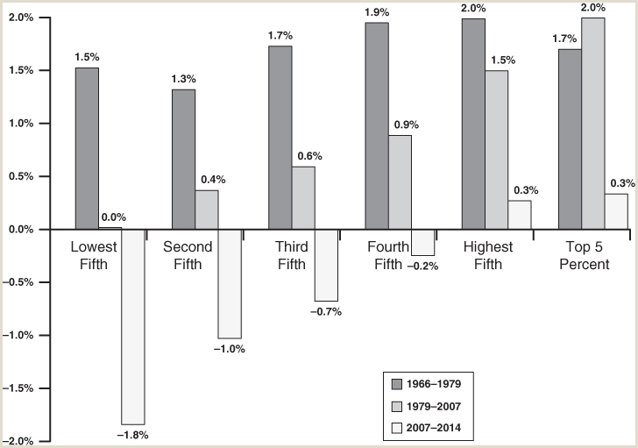
FIGURE 14.5
Growth rate of family income, by quintile, 1966-2014
This figure shows how rapidly the average family income in each fifth (quintile) of all families grew during three distinct time periods between 1966 and 2014. Although each quintile’s income grew at similar rates before 1979, growth rates diverged after that, so that inequality grew, leading to the dramatic changes shown in Figure 14.4.
Source: U.S. Census Bureau, Current Population Survey, Annual Social and Economic Supplement, Table F-3: Mean Income Received by Each Fifth and Top 5 Percent of Families, All Races: 1966 to 2014, available at http://www.census.gov/data/tables/time-series/demo/income-poverty/historical-income-families.html.
Samuel Bowles, Frank Roosevelt, Richard Edwards, Mehrene Larudee
Understanding Capitalism, Fourth Edition, Copyright © 2018 Oxford University Press

Slide 8
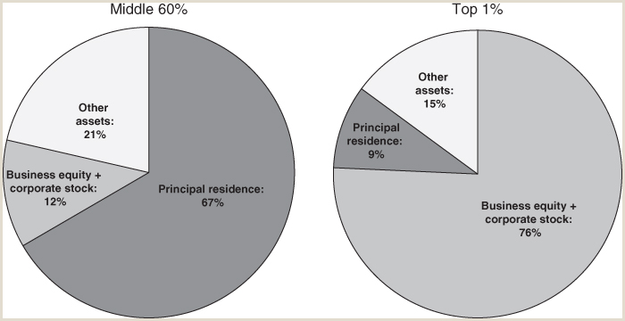
FIGURE 14.6
Composition of wealth holdings at different levels of wealth distribution in the U.S. in 2010
This figure shows how the middle three-fifths of the wealth distribution as a group held its wealth in 2010 (left pie chart) as compared with how wealth was held by the top 1 percent of the wealth distribution in the same year (right pie chart). The three categories of wealth used in this figure are (1) ownership of a residence; (2) ownership of business equity, corporate stock, financial securities, mutual funds, and personal trusts; and (3) all other kinds of assets, including the value of pension funds, liquid assets (bank deposits, money market funds, and cash surrender value of life insurance), and personal possessions such as automobiles, household furniture, and personal items.
Source: Data from Edward N. Wolff, “The Asset Price Meltdown and the Wealth of the Middle Class,” National Bureau of Economics Research (NBER) Working Paper 18559 (2012), Table 5: Composition of Household Wealth by Wealth Class, 2010, available at www.nber.org/papers/w18559
Samuel Bowles, Frank Roosevelt, Richard Edwards, Mehrene Larudee
Understanding Capitalism, Fourth Edition, Copyright © 2018 Oxford University Press

Slide 9
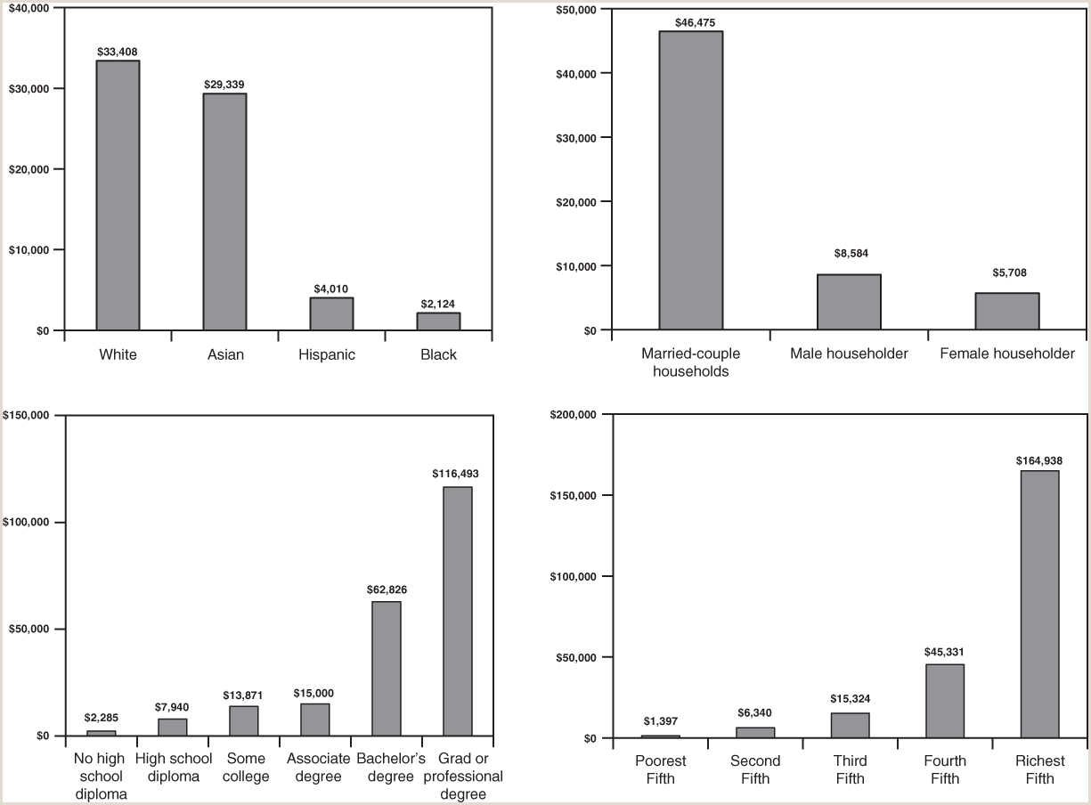
FIGURE 14.7
Distribution of median non-home net worth among U.S. households by race/ethnicity, gender, education, and income, 2011.
This figure shows how net worth, excluding ownership in a residence, was distributed among U.S. households in 2011. A household’s net worth is the value of the assets the household owns minus the value of the debts it owes. The median is the household in the middle of a category of households that have been ranked by non-home net worth.
Source: U.S. Census Bureau, Wealth, Asset, & Debt of Households Detailed Tables: 2011, Wealth and Asset Ownership by Year, Table 1, Median Value of Assets for Households, by Type of Asset Owned and Selected Characteristics: 2011 (from Survey of Income and Program Participation, 2008 Panel, Wave 10), available at https://www.census.gov/data/tables/2011/demo/wealth/wealth-asset-ownership.html.
Samuel Bowles, Frank Roosevelt, Richard Edwards, Mehrene Larudee
Understanding Capitalism, Fourth Edition, Copyright © 2018 Oxford University Press

Slide 10
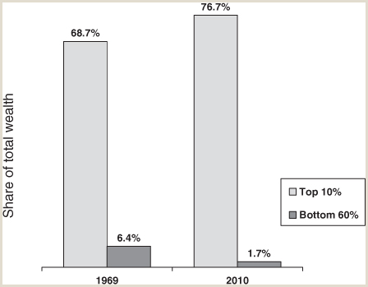
FIGURE 14.8
Increasing concentration of wealth in the U.S. between 1969 and 2010.
The ownership of wealth (net worth, or assets minus debts) among households in the U.S. became more concentrated between 1969 and 2010. The pair of columns on the left show that in 1969 the top 10 percent of American households owned 68.7 percent of the wealth in the U.S., while the bottom 60 percent of households owned 6.4 percent of it. The pair of columns on the right show that by 2010 the share owned by the top 10 percent of households had increased to 76.7 percent, while that of the bottom 60 percent of households had fallen to 1.7 percent.
Source: Data from Edward N. Wolff, “The Asset Price Meltdown and the Wealth of the Middle Class,” National Bureau of Economics Research (NBER) Working Paper 18559 (2012), Table 2: The Size Distribution of Wealth and Income, 1962–2010. Available at http://www.nber.org/papers/w18559.
Samuel Bowles, Frank Roosevelt, Richard Edwards, Mehrene Larudee
Understanding Capitalism, Fourth Edition, Copyright © 2018 Oxford University Press

Slide 11
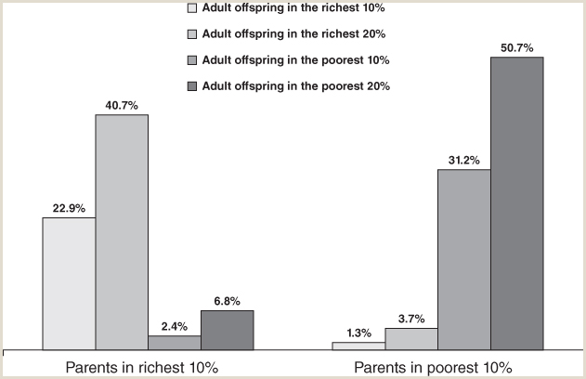
FIGURE 14.9
Unequal chances: Family background and economic success in the U.S.
What percent of the adult offspring of rich parents are poor? What percent of adult offspring of poor parents are rich? This figure uses data collected from a representative sample of individuals and families since 1968 by the University of Michigan Panel Study of Income Dynamics (PSID) to answer these questions.
The four columns grouped on the left side show what happens to the children of parents in the richest 10 percent of the U.S. population. Of these children, 40.7 percent end up, when they are adults, being in the richest 20 percent of the population, with only 2.4 percent ending up in the poorest 10 percent of the population. The four columns grouped on the right side of the figure show that of children who start off life in families in the poorest 10 percent of the population, 31.2 percent end up in the poorest 10 percent of the income distribution as adults; and only 3.7 percent of the children of poor families end up being in the richest 20 percent of the population.
Source: Data from Samuel Bowles and Herbert Gintis, “Intergenerational Inequality,” Journal of Economic Perspectives 16, no. 3 (Summer 2002): 3–30.
Samuel Bowles, Frank Roosevelt, Richard Edwards, Mehrene Larudee
Understanding Capitalism, Fourth Edition, Copyright © 2018 Oxford University Press

Slide 12
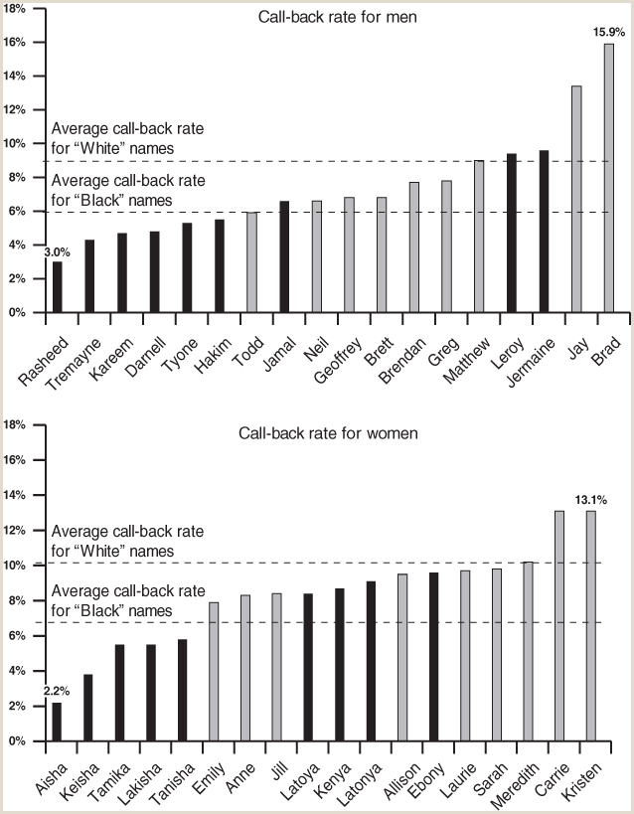
FIGURE 14.10
Racism by any other name: Labor market discrimination in the U.S., 2001-2002.
This figure displays the results of an experiment that was carried out in Chicago and Boston in 2001 and 2002. The two charts here show that for both men and women, a resume with a “white-sounding” name had a much better chance of eliciting a positive response than did a comparable resume with a “black-sounding” name on it. (Please see the text for a fuller description of this experiment.)
Source: Marianne Bertrand and Sendhil Mullainathan, “Are Emily and Greg More Employable than Lakisha and Jamal? A Field Experiment on Labor Market Discrimination,” American Economic Review 94, no. 4 (2003): 991–1013. Available at http://www.jstor.org/stable/3592802
Samuel Bowles, Frank Roosevelt, Richard Edwards, Mehrene Larudee
Understanding Capitalism, Fourth Edition, Copyright © 2018 Oxford University Press

Slide 13
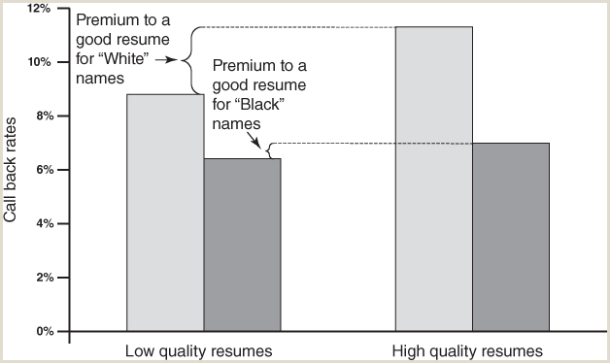
FIGURE 14.11
Good resumes pay off, if your name is OK: Labor market discrimination in the U.S., 2001-2002
The Bertrand/Mullainathan experiment also showed that while qualifications affect one’s opportunities in the labor market, such opportunities are significantly influenced by race. Resumes with “white-sounding” names had callback rates higher by 30 percent if the resumes were of higher quality. For resumes with a “black-sounding” name, having a good resume rather than a bad one did not result in a statistically significant improvement in callback rates.
Source: Marianne Bertrand and Sendhil Mullainathan, “Are Emily and Greg More Employable than Lakisha and Jamal? A Field Experiment on Labor Market Discrimination,” American Economic Review 94, no. 4 (2003): 991–1013. Available at http://www.jstor.org/stable/3592802.
Samuel Bowles, Frank Roosevelt, Richard Edwards, Mehrene Larudee
Understanding Capitalism, Fourth Edition, Copyright © 2018 Oxford University Press

Slide 14
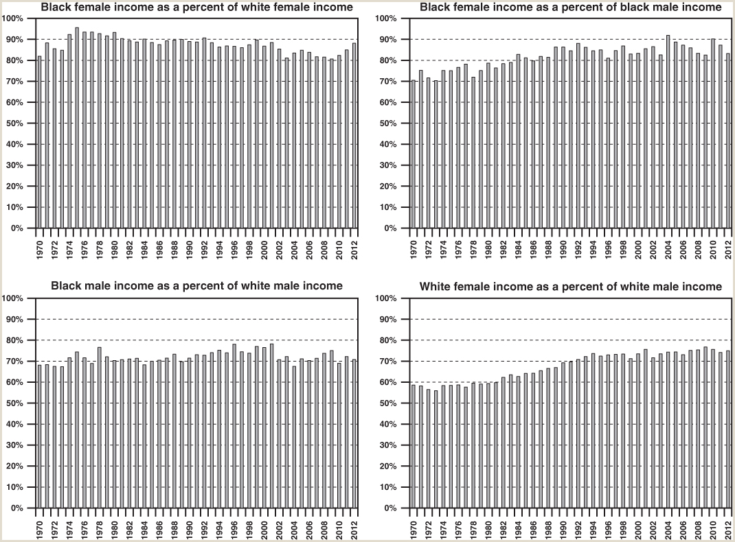
FIGURE 14.12
Slowed progress in the U.S. toward a color-blind and gender-neutral economy, 1971–2011
This figure shows how the incomes of various groups changed in relation to those of other groups over four decades. All incomes on which ratios are based are the median annual incomes of full-time year-round employees. This helps to correct for any differences in the extent to which the different groups are engaged in full-time or part-time work. However, if the lower income group in any pair actually works on average fewer hours per year, because of working less than thirty-five hours a week or less than fifty weeks a year (or both), then the actual income gaps will be larger than those shown here. Comparable data were evidently not gathered before 1970.
Source: U.S. President’s Council of Economic Advisors, Economic Report of the President (ERP), various issues; for 1971: ERP 1993, p. 381: Table B-28, available at https://fraser.stlouisfed.org/docs/publications/ERP/1984/ERP_1993.pdf, and available at http://www.gpo.gov/fdsys/browse/collection.action?collectionCode=ERP&browsePath=2013&isCollapsed=false&leafLevelBrowse=false&isDocumentResults=true&ycord=0; for 1981 and 1991: ERP 1997, Table B-31, and for 2001: ERP 2003, Table B–33, and for 2011: ERP 2014, Table B-9: Median money income (in 2012 dollars) and poverty status of families and people, by race, 2003–2012, all available at https://www.gpo.gov/fdsys/browse/collection.action?collectionCode=ERP&browsePath=2014&isCollapsed=false&leafLevelBrowse=false&isDocumentResults=true&ycord=195
Samuel Bowles, Frank Roosevelt, Richard Edwards, Mehrene Larudee
Understanding Capitalism, Fourth Edition, Copyright © 2018 Oxford University Press

Slide 15
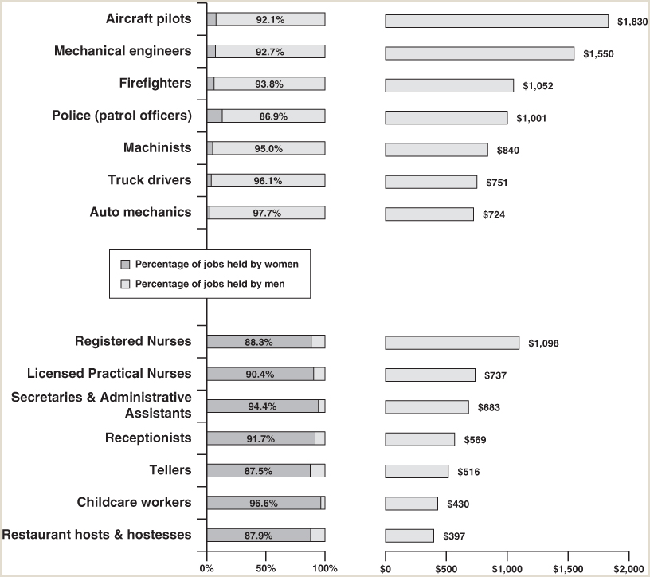
FIGURE 14.13
Women’s work, women’s wages: Gendered occupations and unequal earnings in the U.S., in 2015.
In certain occupations almost all the workers are women, while in certain others almost all are men. The occupations displayed here include some of the most “gendered” occupations. Median weekly earnings are listed for each occupation, for full-time wage and salary workers, for the gender that dominates the occupation. (Data for the other gender were in many cases not reported in the data source.)
Source: U.S. Bureau of Labor Statistics, “Labor Force Statistics from the Current Population Survey,” Household Data, Annual Averages, Table 39: Median weekly earnings of full-time wage and salary workers by detailed occupation and sex, available at http://www.bls.gov/cps/cpsaat39.htm.
Samuel Bowles, Frank Roosevelt, Richard Edwards, Mehrene Larudee
Understanding Capitalism, Fourth Edition, Copyright © 2018 Oxford University Press

Slide 16
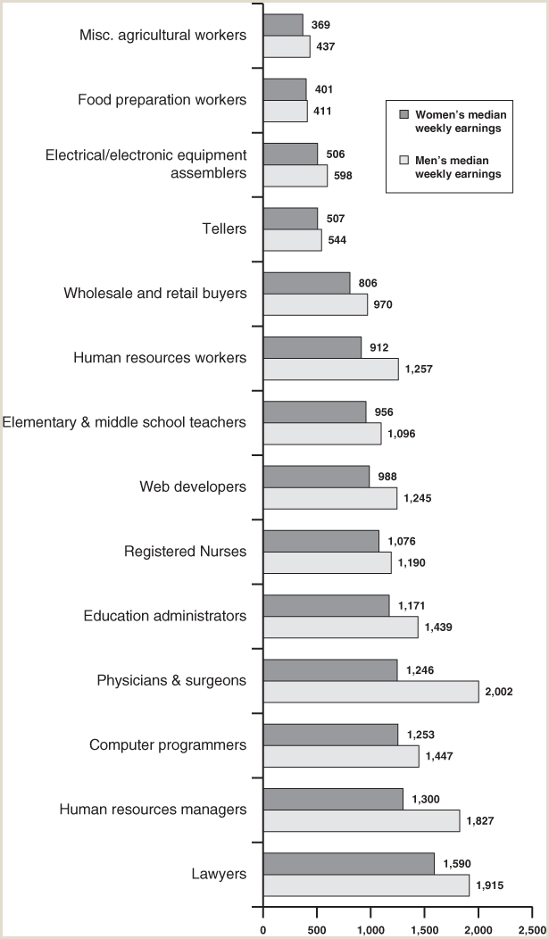
FIGURE 14.14
Men’s and women’s median weekly earnings in selected occupations in the U.S., 2015.
This figure illustrates the fact that with very few exceptions, in nearly all occupations the median weekly earnings for men exceed those for women. This includes jobs overwhelmingly held by women, such as registered nurses. Note the large gender pay gap for human resource personnel.
Source: U.S. Bureau of Labor Statistics, “Labor Force Statistics from the Current Population Survey,” Household Data, Annual Averages, Table 39: Median weekly earnings of full-time wage and salary workers by detailed occupation and sex, available at http://www.bls.gov/cps/cpsaat39.htm.
Samuel Bowles, Frank Roosevelt, Richard Edwards, Mehrene Larudee
Understanding Capitalism, Fourth Edition, Copyright © 2018 Oxford University Press

