Slide 1
Progress and Poverty on a World Scale
Chapter 15
Samuel Bowles, Frank Roosevelt, Richard Edwards, Mehrene Larudee
Understanding Capitalism, Fourth Edition, Copyright © 2018 Oxford University Press

Slide 2
Figures and Tables
Samuel Bowles, Frank Roosevelt, Richard Edwards, Mehrene Larudee
Understanding Capitalism, Fourth Edition, Copyright © 2018 Oxford University Press

Slide 3
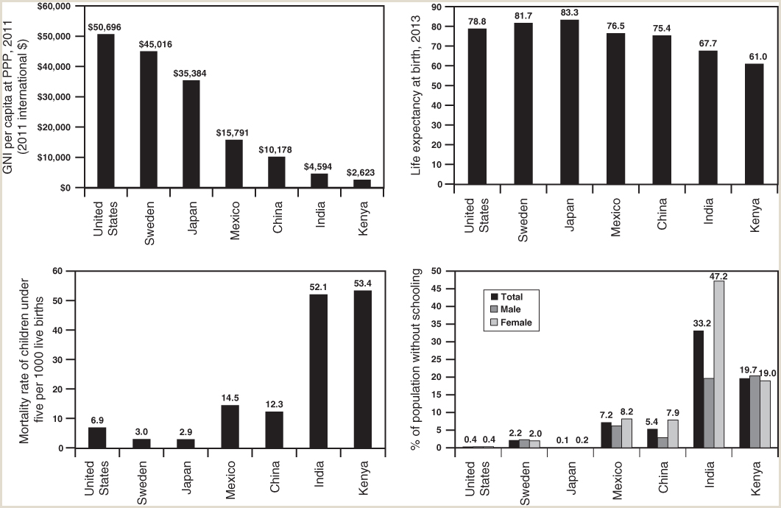
FIGURE 15.1
Income, life expectancy, child mortality, and schooling in seven countries.
The four panels in this figure compare countries with a wide range of income levels, life expectancy, child health, and schooling, using data from years ranging from 2010 to 2013. Notice that there is no exact correspondence between income per capita and the social indicators. For example, India had nearly twice the Gross National Income per capita (at purchasing power parity) that Kenya had in 2011, yet in 2010 nearly half of Indian women fifteen or older had no schooling, compared to Kenya, where less than 20 percent of such women had never been to school. The same two countries are nearly equal in child mortality, which is the number of children under five who die during a year out of every one thousand who were born alive.
Sources: World Bank: World Development Indicators 2015; Robert J. Barro and Jong-Wha Lee, “A New Data Set of Educational Attainment in the World, 1950–2010,” Journal of Development Economics 104 (September 2013): 184–98, available at www.barrolee.com.
Samuel Bowles, Frank Roosevelt, Richard Edwards, Mehrene Larudee
Understanding Capitalism, Fourth Edition, Copyright © 2018 Oxford University Press

Slide 4
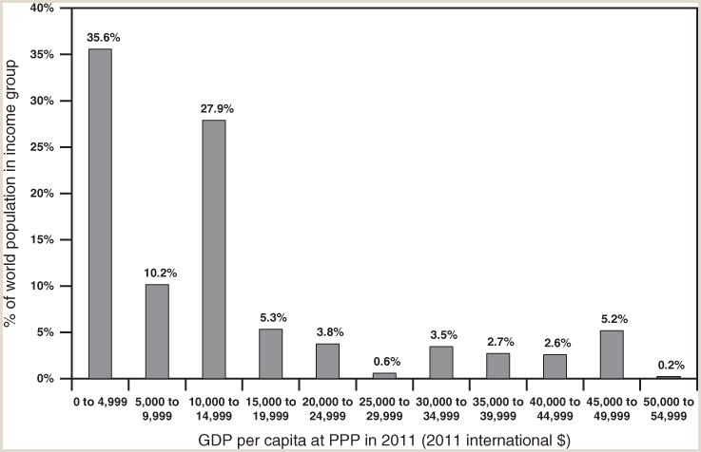
FIGURE 15.2
The income distribution of the world, 2011.
This figure uses data on the average income of each country (GDP per capita) in 2011. The numbers are adjusted for differences in purchasing power across countries (see box “What’s a Hamburger Worth?” in this chapter). The height of each bar shows the percent of the world’s population that had the annual income (in 2011 international dollars) in the range indicated on the horizontal axis. The fact that India’s average income was between $0 and $4,999, and that China’s was between $10,000 and $14,999, account for the tall columns for both these income ranges. In 2011, China and India each had close to 1.3 billion people, or nearly one-fifth of the world’s population each. In this figure, all residents of a country are treated as if their income were the average income of that country.
Source: World Bank: World Development Indicators 2015.
Samuel Bowles, Frank Roosevelt, Richard Edwards, Mehrene Larudee
Understanding Capitalism, Fourth Edition, Copyright © 2018 Oxford University Press

Slide 5
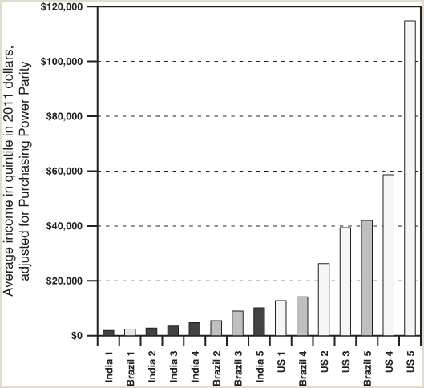
FIGURE 15.3
Comparative inequality: Incomes by quintile in India, Brazil, and the U.S., 2011.
This figure compares the income levels of three countries, showing the income by quintile (fifth) of each country’s income distribution and placing the various quintiles—no matter from which country—on the horizontal axis in order of each quintile’s income. The labels refer to quintiles: “US 5” refers to the highest-income quintile of the U.S. population, and “Brazil 1” refers to the poorest quintile of the Brazilian population. The height of each bar reflects real income (corrected for inflation) adjusted additionally (by the purchasing power parity method) for the relative buying power of a unit of each nation’s currency (see box “What’s a Hamburger Worth?” in this chapter). Data for the U.S. are for 2010 rather than 2011.
Source: World Bank: World Development Indicators 2015.
Samuel Bowles, Frank Roosevelt, Richard Edwards, Mehrene Larudee
Understanding Capitalism, Fourth Edition, Copyright © 2018 Oxford University Press

Slide 6
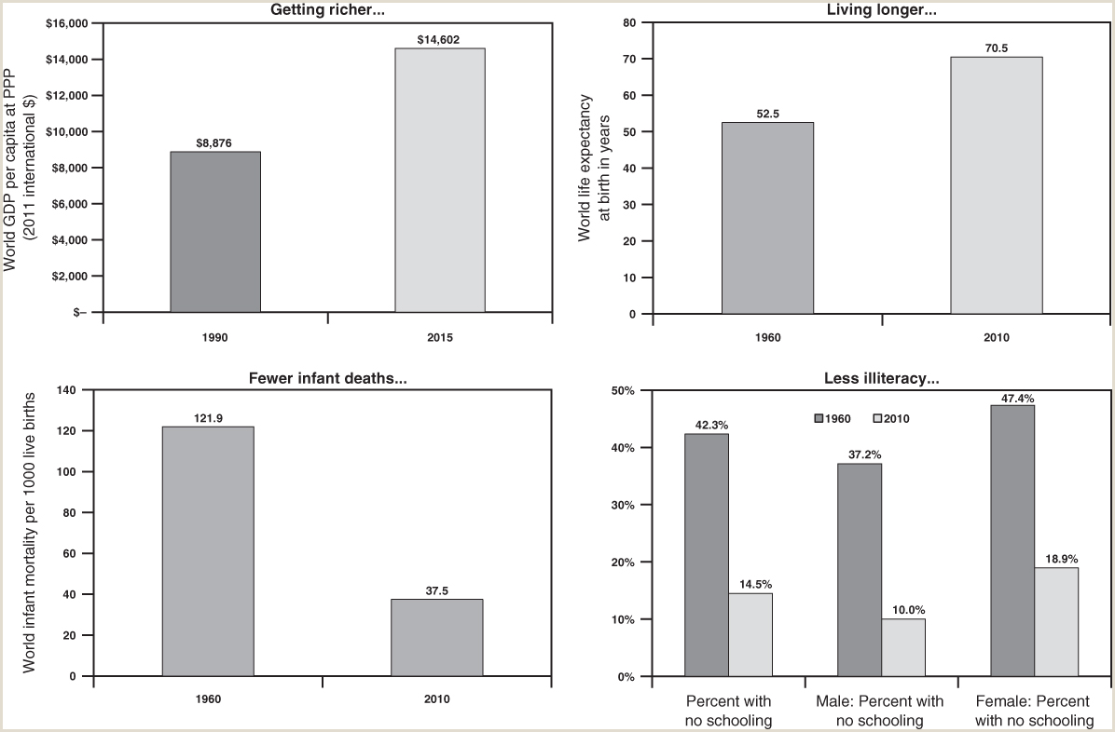
FIGURE 15.4
Progress on a global scale.
The numbers in this figure are averages for all the countries reporting the relevant information, and these countries contain the vast majority of the world’s people. As the figure shows, dramatic gains in health and education have been made in the last fifty years.
Sources: World Bank: World Development Indicators 2015; Robert J. Barro and Jong-Wha Lee, “A New Data Set of Educational Attainment in the World, 1950–2010,” Journal of Development Economics 104 (September 2013): 184–98, www.barrolee.com.
Samuel Bowles, Frank Roosevelt, Richard Edwards, Mehrene Larudee
Understanding Capitalism, Fourth Edition, Copyright © 2018 Oxford University Press

Slide 7
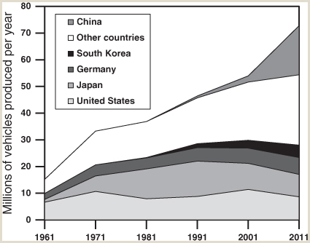
FIGURE 15.5
Global vehicle production, 1961-2011
U.S. vehicle production, the bottom light-gray region, has been roughly level since about 1971, as U.S.-based auto makers have shifted some of their production to other countries. Japan’s production increased initially, but was declining by the 1990s, when it also shifted some of its production abroad, including to the United States. Other auto makers did the same thing. South Korea’s production grew rapidly until the twenty-first century, and it too began increasingly producing in other countries, including the United States. China’s production, and production in other countries (Brazil, Mexico, India, and others) have grown rapidly for similar reasons.
Source: U.S. Department of Transportation, Office of the Assistant Secretary for Research and Technology, Bureau of Transportation Statistics, Table 1–23: World Motor Vehicle Production, Selected Countries, available at http://www.rita.dot.gov/bts/sites/rita.dot.gov.bts/files/publications/national_transportation_statistics/html/table_01_23.html_mfd; data from WardsAuto.com, Motor Vehicle Facts & Figures (Southfield, MI: Annual Issues), 14 and similar pages in earlier editions.
Samuel Bowles, Frank Roosevelt, Richard Edwards, Mehrene Larudee
Understanding Capitalism, Fourth Edition, Copyright © 2018 Oxford University Press

Slide 8
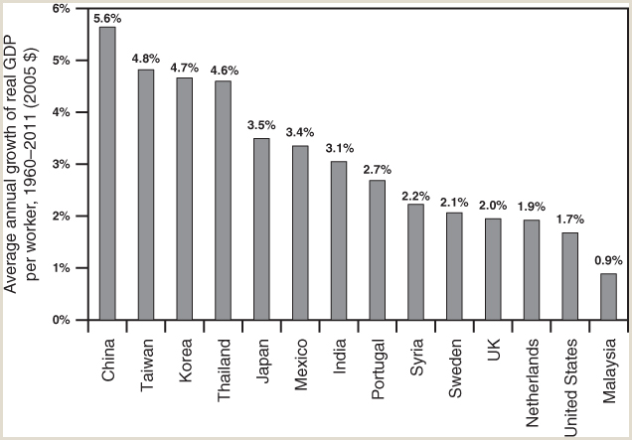
FIGURE 15.6
Average annual growth of real GDP per worker, 1960-2011
This figure shows how rapidly productivity grew, in real terms, in various capitalist economies in about the last half century. “Real” means that “nominal” values, that is, values in “current” dollars, have been adjusted for inflation, in this case by calculating each country’s GDP as if it had been priced each year in “constant” 2005 dollars. Productivity is usually defined as the amount of output produced per hour of labor, but data on hours of work are not available for all nations. An alternative measure is the total output of an economy (GDP) divided by the number of people employed in a given year. This is the measure used here, so the productivity growth of each country shown in the figure is the percent change in this variable from year to year, averaged for the years from 1960 to 2011.
Source: Penn World Table, Version 8.1, University of Groningen, April 13, 2015, available at http://www.rug.nl/ggdc/productivity/pwt/pwt-releases/pwt8.1 (DOI: 10.15141/S5NP4S); Feenstra, Robert C., Robert Inklaar and Marcel P. Timmer (2015), “The Next Generation of the Penn World Table,” American Economic Review 105(10): 3150-3182, available for download at www.ggdc.net/pwt.
Samuel Bowles, Frank Roosevelt, Richard Edwards, Mehrene Larudee
Understanding Capitalism, Fourth Edition, Copyright © 2018 Oxford University Press

Slide 9
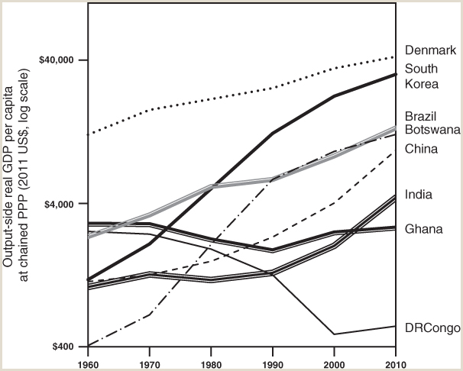
FIGURE 15.7
Average annual growth of real GDP per worker, 1960-2011
Three-fourths of the eight countries shown here experienced increasing average output per person over the half century shown. DRCongo’s sharply declining growth was largely the result of fierce civil conflict.
Source: Penn World Tables—International Comparisons of Production, Income, and Prices 9.0, Feenstra, Robert C., Robert Inklaar and Marcel P. Timmer, “The Next Generation of the Penn World Table,” American Economic Review 105, no. 10 (2015): 3150–82, available for download at http://www.ggdc.net/pwt. Author’s calculations from Table CGDPo (2011): Output-side real GDP at current PPPs (in mil. 2011 US$), divided by population. See also http://www.rug.nl/research/ggdc/data/pwt/.
Samuel Bowles, Frank Roosevelt, Richard Edwards, Mehrene Larudee
Understanding Capitalism, Fourth Edition, Copyright © 2018 Oxford University Press

Slide 10
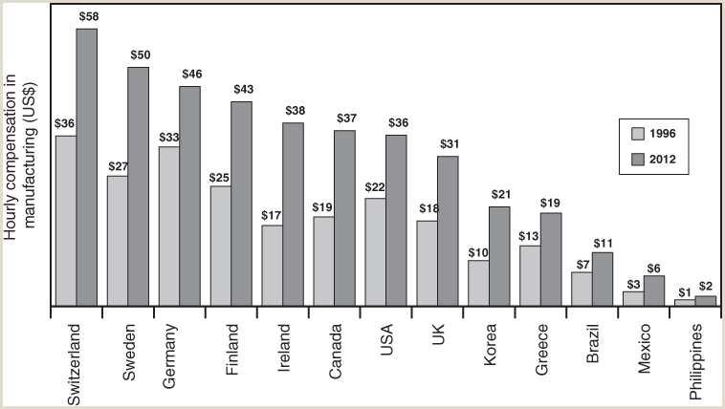
FIGURE 15.8
Hourly wages and benefits in the manufacturing sector in selected countries, 1996 and 2012/\.
This figure compares the total hourly compensation of manufacturing sector workers in sixteen countries in 1996 and 2012. Compensation in each country is first measured in units of the country’s own currency and then converted into U.S. dollars at market exchange rates in each year. This measure is good for comparing the hourly labor cost to employers in different countries. It is not appropriate for comparing the relative purchasing power of labor earnings in manufacturing in different countries, since conversion to dollar values uses market exchange rates, not purchasing power parity.
Source: U.S. Bureau of Labor Statistics, International Labor Comparisons, August 2013, Hourly Compensation Costs (Wages and Benefits), in the Manufacturing Sector, Report through 2012, Table 1: Hourly Compensation Costs in Manufacturing, U.S. Dollars, and as a Percent of Costs in the United States, ichcc.xls, available at: http://www.bls.gov/fls/#compensation
Samuel Bowles, Frank Roosevelt, Richard Edwards, Mehrene Larudee
Understanding Capitalism, Fourth Edition, Copyright © 2018 Oxford University Press

Slide 11
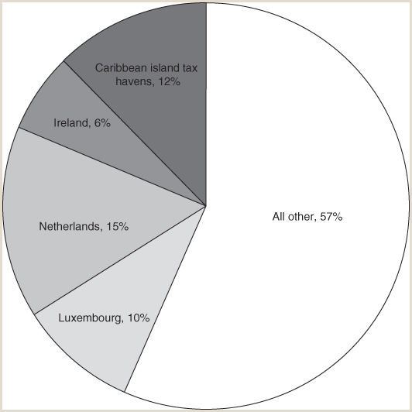
FIGURE 15.9
U.S. Direct Investment Abroad, 2014.
This figure emphasizes the importance of tax havens as sites for U.S. direct investment outside the United States. “Caribbean island tax havens” include Barbados, Bermuda, the Bahamas, the Cayman Islands, the British Virgin Islands, and others. Ireland, Luxembourg, and the Netherlands are also tax havens, as is Switzerland. A few additional tax havens are not shown, but account for only a very small percent of the total. The term “direct investment” refers to ownership of at least 10 percent of the stock in an affiliate, which usually gives full control.
Source: U.S. Bureau of Economic Analysis, “U.S. Direct Investment Abroad for 2012–2014: Detailed Historical-Cost Positions and Related Financial Transactions and Income Flows,” Survey of Current Business, September 2015, 1-36, Table 14: U.S. Direct Investment Abroad: Selected Items by Detailed Country, 2010–2014.
Samuel Bowles, Frank Roosevelt, Richard Edwards, Mehrene Larudee
Understanding Capitalism, Fourth Edition, Copyright © 2018 Oxford University Press

