Slide 1
Aggregate Demand, Employment, and Unemployment
Chapter 16
Samuel Bowles, Frank Roosevelt, Richard Edwards, Mehrene Larudee
Understanding Capitalism, Fourth Edition, Copyright © 2018 Oxford University Press

Slide 2
Figures and Tables
Samuel Bowles, Frank Roosevelt, Richard Edwards, Mehrene Larudee
Understanding Capitalism, Fourth Edition, Copyright © 2018 Oxford University Press

Slide 3
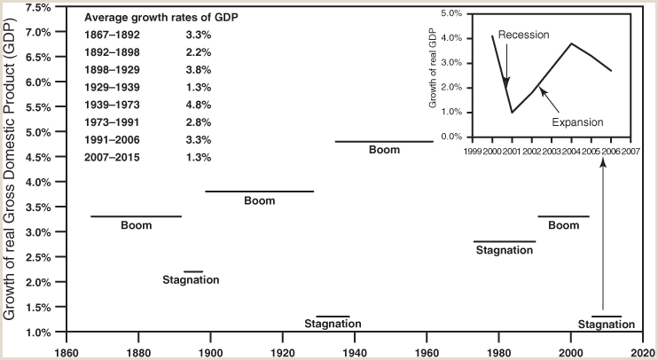
FIGURE 16.1
Long swings and business cycles.
A long swing is a boom followed by a period of stagnation; it typically extends over a period of thirty to fifty years. Business cycles are shorter ups and downs of the economy, normally over less than ten years (from peak to peak). This figure shows that the U.S. economy passed through three long swings from 1867 to 1991, and seems to be near the end of a fourth. The first (the stage of competitive capitalism) lasted from the 1860s to 1898, with a boom period from 1867 to 1892 and stagnation from 1892 to 1898. The second (corporate capitalism) was 1898–1939, with good times until 1929 and then the Great Depression of the 1930s. The third long swing (regulated capitalism) covered about 1939–1991. Around 1991 we entered into a fourth long swing (which we refer to as transnational capitalism), with a boom until 2007 and stagnation afterward.
Sources: U.S. Bureau of Economic Analysis, National Income and Product Accounts, Table 1.1.1: Percent Change from Preceding Period in Real Gross Domestic Product, available at http://www.bea.gov/iTable/iTable.cfm?ReqID=9&step=1#reqid=9&step=1&isuri=1
Samuel Bowles, Frank Roosevelt, Richard Edwards, Mehrene Larudee
Understanding Capitalism, Fourth Edition, Copyright © 2018 Oxford University Press

Slide 4
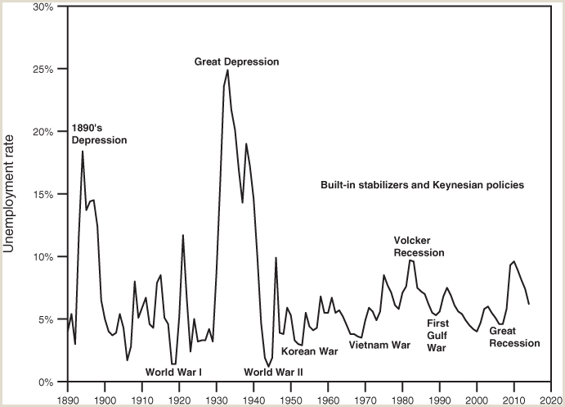
FIGURE 16.2
The U.S. unemployment rate, 1890 to 2014.
The unemployment rate presented in the figure is the ratio of the number of people officially counted as unemployed to the number officially counted in the civilian labor force. The unemployment rate reached about 18 percent in the 1890s and peaked at 25 percent during the Great Depression of the 1930s. Note that the rate of unemployment was held to less than 10 percent in the half-century after World War II by means of Keynesian policies and built-in stabilizers such as unemployment insurance and other social insurance programs established as part of the “New Deal” in the 1930s.
Sources: U.S. Bureau of Labor Statistics: Databases, Calculators, and Subjects, Labor Force Statistics from the Current Population Survey, series LNU04000000, available at http://data.bls.gov/timeseries/LNU04000000?years_option=all_years&periods_option=specific_periods&periods=Annual+Data.
Samuel Bowles, Frank Roosevelt, Richard Edwards, Mehrene Larudee
Understanding Capitalism, Fourth Edition, Copyright © 2018 Oxford University Press

Slide 5
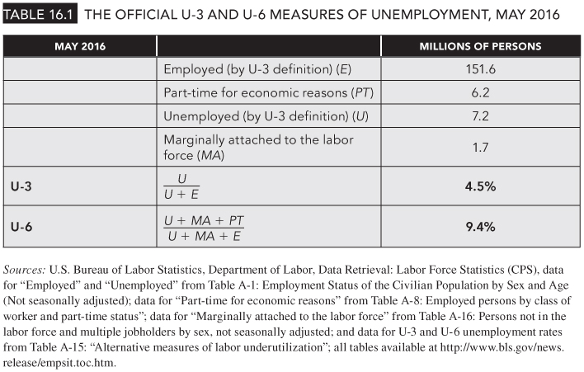
TABLE 6.1
The official U-3 and U-6 measures of unemployment, May 2016.
Samuel Bowles, Frank Roosevelt, Richard Edwards, Mehrene Larudee
Understanding Capitalism, Fourth Edition, Copyright © 2018 Oxford University Press

Slide 6
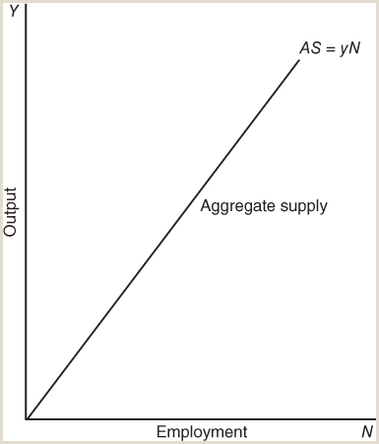
FIGURE 16.3
Aggregate supply.
The aggregate supply curve (AS) shows the total amount of goods and services (at their current market value) that can be produced with any given number of labor hours (N). The measure of output Y is net output or value added; in fact, the label “Output” on the vertical axis (here and in the rest of figures in this chapter) refers to net output. The value of AS is equal to yN, which is the net output of goods and services per labor hour employed (y) multiplied by N, the total number of labor hours employed. For simplicity, we assume that each hour of labor produces the same number of dollars worth of net output y. Since y is constant as N changes, this makes AS a straight line with slope y. AS is the same as Y.
Samuel Bowles, Frank Roosevelt, Richard Edwards, Mehrene Larudee
Understanding Capitalism, Fourth Edition, Copyright © 2018 Oxford University Press

Slide 7
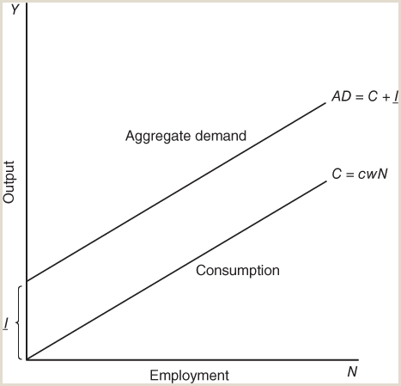
FIGURE 16.4
Aggregate demand with investment constant.
The total demand for goods and services (aggregate demand, AD) is the demand for consumer goods (C) plus the demand for investment goods (I). For simplicity, we assume that the demand for consumer goods is a constant fraction (c) of wage and salary income. If the wage rate (w) does not vary, total wage income will be wN (with N being the level of employment). The total demand for consumer goods at any level of employment (N) (measured in hours) will be cwN, the fraction of wage and salary income spent on consumer goods (c) times the wage rate per hour (w) times the total number of hours employed (N). The total demand for consumer goods at any level of N can then be represented by a straight line whose slope is cw. Finally, since we assume here that investment (I) is constant, aggregate demand (AD = C + I) appears as a line parallel to the C line and a distance I above it at all levels of employment (N). The slope of the AD line is also cw.
Samuel Bowles, Frank Roosevelt, Richard Edwards, Mehrene Larudee
Understanding Capitalism, Fourth Edition, Copyright © 2018 Oxford University Press

Slide 8
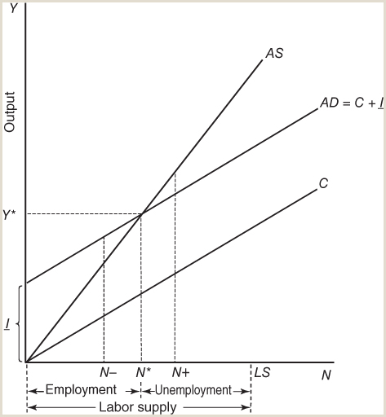
FIGURE 16.5
Macroeconomic equilibrium.
This figure shows the interaction of aggregate demand (AD) with aggregate supply (AS). It uses exactly the same AS, AD, and C curves as in Figures 16.3 and 16.4 and it is again based on the assumption that investment I is the same at all levels of employment (N), in fact the same level as in Figures 16.3 and 16.4. Aggregate supply equals aggregate demand where the AS and AD curves intersect, at the N* level of employment and the corresponding Y* amount of output. The intersection occurs where AS = yN = cwN + I =AD (see Equation 16.5). The result is that N* and Y* are the equilibrium levels of employment and output. When employment is N+ some goods that are produced are not sold: AS > AD, which means there is excess supply in the product market. When employment is N– more goods are demanded than are being produced: AS < AD, which means there is excess demand in product markets. LS is the total labor supply: the total number of hours people would work if they had a chance. The difference between N* and LS is unemployment, and is drawn larger on the diagram (for clarity) than it would normally be in reality.
Samuel Bowles, Frank Roosevelt, Richard Edwards, Mehrene Larudee
Understanding Capitalism, Fourth Edition, Copyright © 2018 Oxford University Press

Slide 9
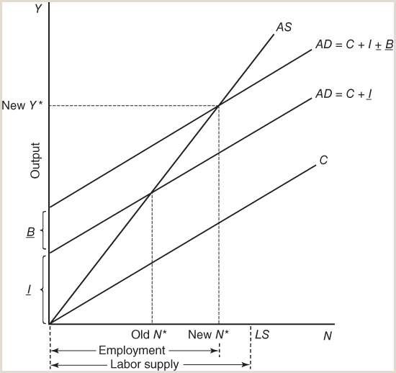
FIGURE 16.6
Macroeconomic equilibrium with deficit spending.
The only difference between this figure and Figure 16.5 is that it adds government deficit spending (B) to aggregate demand (AD). With this addition, AD = C + I + B. If the level of government deficit spending is B, then the new AD curve will be above the old one by this amount at every level of employment. The effect will be to shift the AD curve upward by the amount B and so to increase the equilibrium level of employment from “old N*” to “new N*.” The figure shows that when employment is below the desired level (say, at “old N*”), deliberate government fiscal policies involving deficit spending can raise the level of employment (say, to “new N*”), thereby reducing the amount of unemployment.
Samuel Bowles, Frank Roosevelt, Richard Edwards, Mehrene Larudee
Understanding Capitalism, Fourth Edition, Copyright © 2018 Oxford University Press

Slide 10
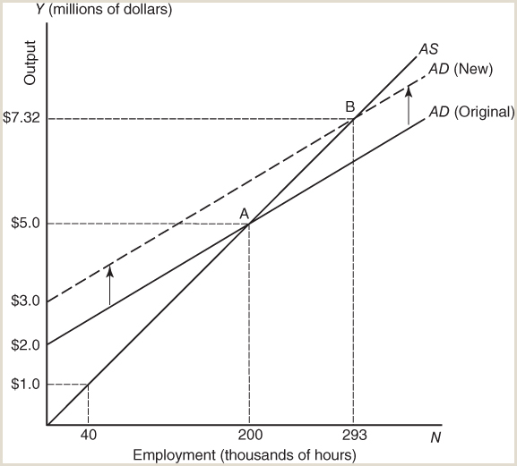
FIGURE 16.7
The employment multiplier.
How much will a $1 million increase in aggregate demand, such as from a rise in investment spending, boost employment? In this diagram, it increases equilibrium employment by 93,000 hours, as the economy moves from the equilibrium at point A before the increase to the new equilibrium at point B after the increase. Employment increases from 200,000 hours to 293,000 hours.
Samuel Bowles, Frank Roosevelt, Richard Edwards, Mehrene Larudee
Understanding Capitalism, Fourth Edition, Copyright © 2018 Oxford University Press

Slide 11
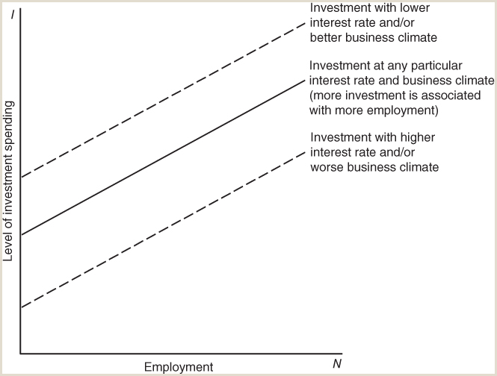
FIGURE 16.8
How investment responds to changes in employment, the interest rate, and the business climate.
This diagram shows that investment spending actually tends to increase as employment N increases. In earlier diagrams, to keep matters simple, we assumed that investment spending would stay at the same level regardless of employment N, and this assumption would make investment a horizontal line as a function of employment. But investment actually tends to increase as employment N increases (see box “What Determines Investment?”). This is because rising employment uses more of existing production capacity, and profits rise, and these changes motivate a good manager or owner to invest in expanding production capacity in order to be able to meet growing demand. The shape in the diagram reflects Equation 16.10. The investment spending function also shifts in response to changes in the interest rate or the business climate. A fall in the interest rate or an improvement in the business climate will encourage investment spending, shifting the investment function upward to the upper dashed line. A rise in the interest rate or a worsening of the business climate will have the opposite effect, shifting the curve downward to the lower dashed line and lowering investment spending at every level of employment.
Samuel Bowles, Frank Roosevelt, Richard Edwards, Mehrene Larudee
Understanding Capitalism, Fourth Edition, Copyright © 2018 Oxford University Press

Slide 12
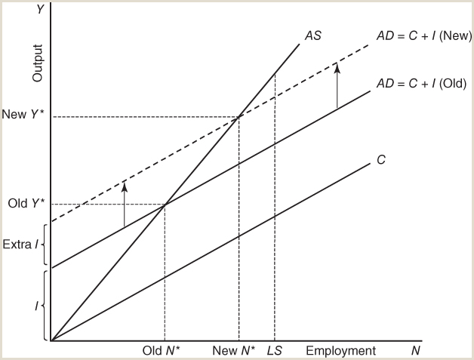
FIGURE 16.9
Effect of an increase in investment due either to a decline in the interest rate or an improvement in the business climate.
A decline in the interest rate or an improvement in the business climate (or both), will increase investment and therefore both aggregate demand (AD) and the number of labor hours employed (N). We ignore deficit spending here just for simplicity. Then since AD = C + I, an increase in I shifts the AD curve upward and raises the equilibrium level of employment (N*). The new AD curve is the dashed line, and the equilibrium level of employment moves from “old N*” to “new N*.” Thus lowering the interest rate or improving the business climate can reduce the unemployment rate.
Samuel Bowles, Frank Roosevelt, Richard Edwards, Mehrene Larudee
Understanding Capitalism, Fourth Edition, Copyright © 2018 Oxford University Press

Slide 13
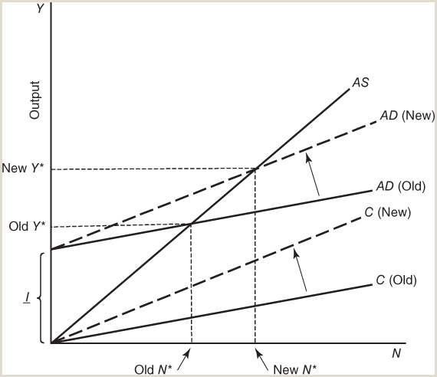
FIGURE 16.10
A wage-led employment situation with investment constant.
This diagram shows how an increase in the wage can increase equilibrium employment under some conditions. The amount of investment is assumed constant here, meaning it is unaffected by changes in profits. This means that it is the vertical intercept of the AD curve (both “old” and “new”). An increase in the wage (w) increases the slope of the C curve from cw (old) to cw (new), but the AD curve continues to have the same vertical intercept as before—so the AD curve simply rotates counterclockwise from AD (old), the solid line, to AD (new), the dashed line. Its intersection with the AS curve travels up to the new intersection of the AD (new) and AS curves, and the new equilibrium employment level N* (new) is higher than the old. The level of output and income also increases from old Y* to new Y*.
Samuel Bowles, Frank Roosevelt, Richard Edwards, Mehrene Larudee
Understanding Capitalism, Fourth Edition, Copyright © 2018 Oxford University Press

