Slide 1
The Dilemmas of Macroeconomic Policy
Chapter 17
Samuel Bowles, Frank Roosevelt, Richard Edwards, Mehrene Larudee
Understanding Capitalism, Fourth Edition, Copyright © 2018 Oxford University Press

Slide 2
Figures and Tables
Samuel Bowles, Frank Roosevelt, Richard Edwards, Mehrene Larudee
Understanding Capitalism, Fourth Edition, Copyright © 2018 Oxford University Press

Slide 3
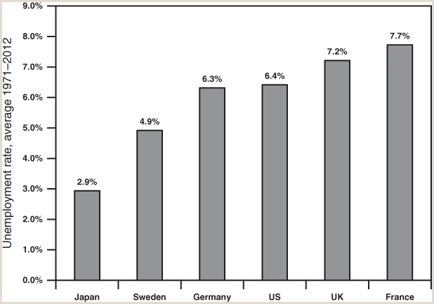
FIGURE 17.1
Average unemployment rates for six countries, 1971-2012.
This figure shows that there are significant and persistent differences among the unemployment rates of advanced capitalist nations. Each country defines its labor force, employment, and unemployment statistics in its own way, but the U.S. Bureau of Labor Statistics has recalculated the unemployment rates for these countries, using U.S. definitions.
Source: U.S. Department of Labor, Bureau of Labor Statistics, ILC Tables: Labor Force, Employment, and Unemployment, Annual labor force statistics, 1970–2012, Full series and underlying levels, By indicator (XLS), “International Comparisons of Annual Labor Force Statistics, 1970–2012,” June 7, 2013: Table 1-2: Unemployment Rates, available at http://www.bls.gov/ilc/#laborforce.
Samuel Bowles, Frank Roosevelt, Richard Edwards, Mehrene Larudee
Understanding Capitalism, Fourth Edition, Copyright © 2018 Oxford University Press

Slide 4
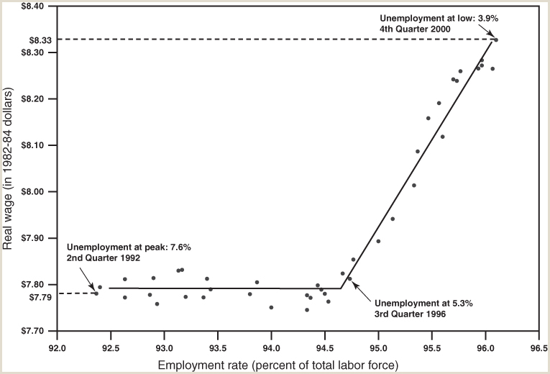
FIGURE 17.2
Employment and real wages during the 1900s boom in the U.S. economy.
This figure illustrates that a “high-employment wage push” took place in the last decade of the twentieth century. The data show that when unemployment fell below about 5.3 percent after the third quarter of 1996, the real wage began to rise steadily.
The figure plots the average real wage of U.S. production workers (in 1982 dollars) on the vertical axis from the second quarter of 1992 (when unemployment peaked at 7.6 percent and the average real wage was $7.79), to the fourth quarter of 2000 (when unemployment reached its cyclical low of 3.9 percent and the real wage was $8.33). The 7.6 percent unemployment rate in the second quarter of 1992 implies that the employment rate then was 100% – 7.6% = 92.4%, and similar calculations apply to the other statements in the graph about the unemployment rates in particular quarters.
Source: U.S. Department of Labor, Bureau of Labor Statistics, detailed statistics on “Employment & Unemployment,” “CPI-Urban Wage Earners and Clerical Workers (CPI-W),” and “Compensation & Working Conditions,” available at http://www.bls.gov/data/home.htm. Calculations by Arjun Jayadev, University of Massachusetts, Boston.
Samuel Bowles, Frank Roosevelt, Richard Edwards, Mehrene Larudee
Understanding Capitalism, Fourth Edition, Copyright © 2018 Oxford University Press

Slide 5
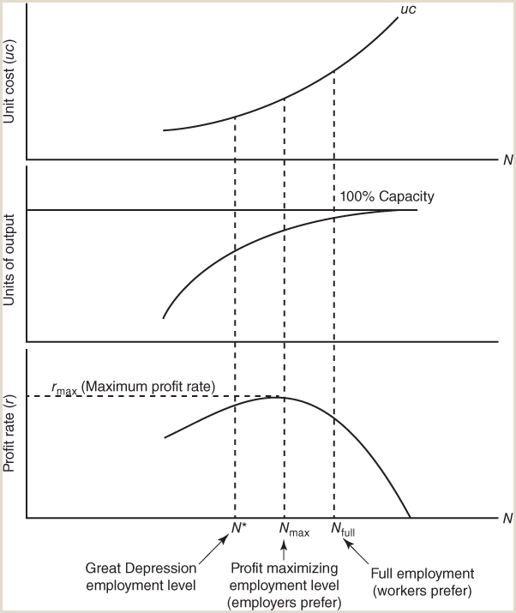
FIGURE 17.3
Unit cost, output, and profit rate.
This figure illustrates how a rising number of labor hours employed (N) affects the number of units of output and the cost per unit, and how these in turn affect the profit rate of a firm. Moving from left to right in the figure, the bottom panel shows that the rate of profit rises as long as the positive contribution to profit resulting from producing and selling more output (middle panel) outweighs the negative effect on the profit rate resulting from rising unit cost of production (top panel). At the point where these positive and negative effects are just in balance, the level of employment will be the one (Nmax) where the profit rate is at its maximum. As employment increases beyond that point, unit cost will start rising more rapidly than before, while output will start to rise less rapidly than before as the enterprise reaches its maximum productive capacity, and cannot quickly expand that capacity. Rising unit cost begins to drive down the profit rate, which is not what the employer wants. Thus the Nmax level of employment—the one that maximizes profit—is the one the employer prefers, but it most likely is not full employment (Nfull); some people will still be unemployed. Workers would prefer a higher level of employment, but have no easy way to reach it. The N* level of employment shown in the bottom panel simply reminds the reader that the equilibrium level of employment varies depending on how much demand is coming from households, businesses, government, and foreigners. In principle, depending on these factors, N* could be at almost any level of employment, although it is usually below Nmax.
Samuel Bowles, Frank Roosevelt, Richard Edwards, Mehrene Larudee
Understanding Capitalism, Fourth Edition, Copyright © 2018 Oxford University Press

Slide 6
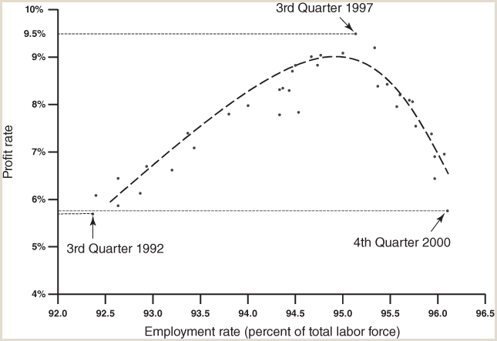
FIGURE 17.4
The employment rate and the profit rate during the 1900s boom in the U.S.
This figure charts the rise and fall of the profit rate during the economic boom of the 1990s, covering almost exactly the same period as Figure 17.2. In both figures, the data show that a high-employment profit squeeze happened in the U.S. economy during the 1990s, following the pattern described in Figure 17.3. Figure 17.2 plots real wages against the employment rate, while this one plots the profit rate against the employment rate. The profit data are for the U.S. nonfinancial business sector; this excludes banks but represents more than 85 percent of the U.S. corporate business sector.
Source: U.S. Department of Commerce, Bureau of Economic Analysis, National Income and Product Accounts (NIPA), Table 1.14: Gross Value Added of Domestic Corporate Business in Current Dollars and Gross Value Added of Nonfinancial Domestic Corporate Business in Current and Chained Dollars, available at https://www.bea.gov/iTable/iTable.cfm?ReqID=9&step=1#reqid=9&step=3&isuri=1&903=55. Calculations by Arjun Jayadev, University of Massachusetts, Boston.
Samuel Bowles, Frank Roosevelt, Richard Edwards, Mehrene Larudee
Understanding Capitalism, Fourth Edition, Copyright © 2018 Oxford University Press

Slide 7
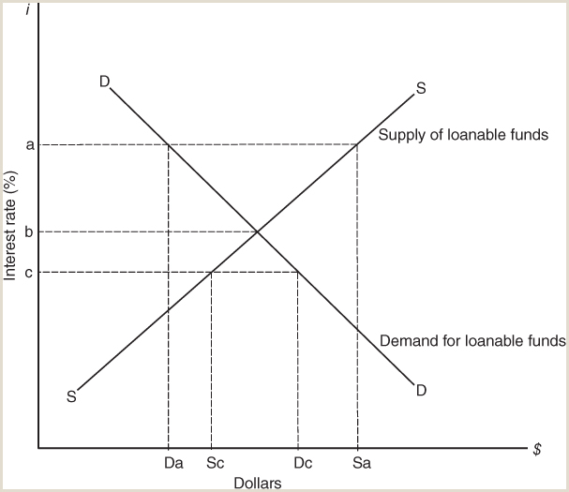
FIGURE 17.5
The determination of the interest rate.
This figure shows how the rate of interest (i) is determined by the interaction of supply and demand in the market for loanable funds. Like the supply curves for most goods and services, the loanable funds supply curve is upward sloping to the right, indicating that a rise in the interest rate will call forth a greater supply of loanable funds (people, businesses, and government will be interested in lending more money), while a fall in the interest rate will bring about a contraction in the supply of loanable funds. The loanable funds demand curve is downward sloping to the right, indicating that when the interest rate falls the demand for loanable funds will increase (people, businesses, and governments will seek to borrow more money), and conversely, when the interest rate rises the demand for loanable funds will contract.
Samuel Bowles, Frank Roosevelt, Richard Edwards, Mehrene Larudee
Understanding Capitalism, Fourth Edition, Copyright © 2018 Oxford University Press

