Slide 1
Financial and Economic Crisis
Chapter 18
Samuel Bowles, Frank Roosevelt, Richard Edwards, Mehrene Larudee
Understanding Capitalism, Fourth Edition, Copyright © 2018 Oxford University Press

Slide 2
Figures and Tables
Samuel Bowles, Frank Roosevelt, Richard Edwards, Mehrene Larudee
Understanding Capitalism, Fourth Edition, Copyright © 2018 Oxford University Press

Slide 3
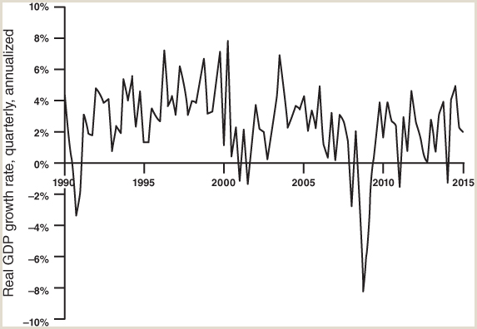
FIGURE 18.1
Real quarterly GDP, growth rate.
A recession is defined as two quarters of declining GDP. However, the National Bureau of Economic Research, which dates recessions, does not always follow this definition, but considers a variety of indicators in making its decisions.
Source: U.S. Bureau of Economic Analysis, National Income and Product Accounts Table 1.1.1; available at http://www.bea.gov/.
Samuel Bowles, Frank Roosevelt, Richard Edwards, Mehrene Larudee
Understanding Capitalism, Fourth Edition, Copyright © 2018 Oxford University Press

Slide 4
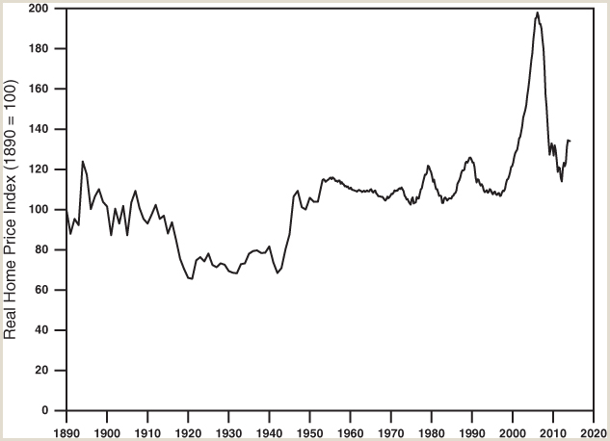
FIGURE 18.2
Real Home Price index, national, Case-Shiller, 1890-2014.
A nominal home price index, which in recent decades is one compiled by the Federal Housing Finance Agency, is deflated by the CPI-U, the urban Consumer Price Index. The base year is chosen as 1890.
Source: The data are for part of Figure 2.1 in Robert Shiller, Irrational Exuberance, 2nd edition (Broadway Books, 2005). Available updated by Shiller at http://www.econ.yale.edu/~shiller/data.htm.
Samuel Bowles, Frank Roosevelt, Richard Edwards, Mehrene Larudee
Understanding Capitalism, Fourth Edition, Copyright © 2018 Oxford University Press

Slide 5
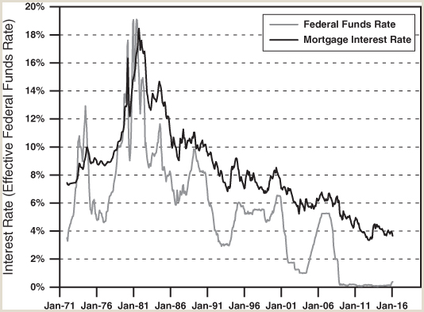
FIGURE 18.3
Interest rates, 1971-2016.
The bottom line is the federal funds rate, the rate at which banks lend to one another; the top line is the interest rate on conventional thirty-year mortgages.
Source: Federal Reserve Economic Data, FEDFUNDS: Effective federal funds rate, monthly (first day of the month), not seasonally adjusted; MORTG: mortgage interest rate, monthly (first day of the month). Available at https://research.stlouisfed.org/fred2/series/FEDFUNDS and https://research.stlouisfed.org/fred2/series/MORTG
Samuel Bowles, Frank Roosevelt, Richard Edwards, Mehrene Larudee
Understanding Capitalism, Fourth Edition, Copyright © 2018 Oxford University Press

Slide 6
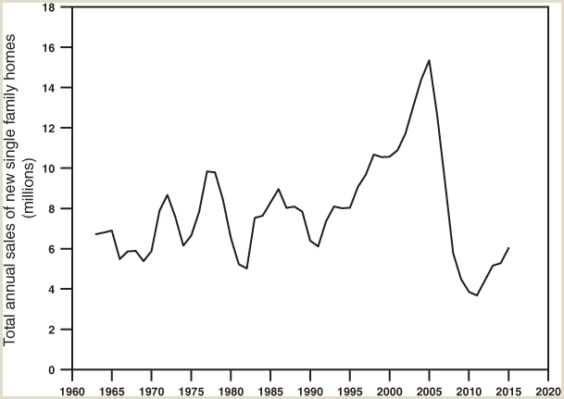
FIGURE 18.4
Annual sales of new single-family homes.
Home sales are pro-cyclical: they grow in an economic boom, and they often decline shortly before a recession and during the recession. The 2007–2009 Great Recession was no different, except that the slump in home buying was worse than at any time since at least 1963, and by early 2016 had already lasted for at least six years after the recession officially ended in 2009. Sales of new single-family homes did start rising in 2012, but by 2015 had barely even reached their previous (1991) low. Of course, existing homes were also being sold, but it is sales of new homes that stimulate the economy, by stimulating employment in the construction sector and economic activity in sectors that supply construction industry inputs.
Source: Federal Reserve Economic Data, annual data aggregated from HSN1F: New One Family Houses Sold: United States, Thousands, Monthly, Seasonally Adjusted Annual Rate. Available at https://fred.stlouisfed.org/series/HSN1F.
Samuel Bowles, Frank Roosevelt, Richard Edwards, Mehrene Larudee
Understanding Capitalism, Fourth Edition, Copyright © 2018 Oxford University Press

Slide 7
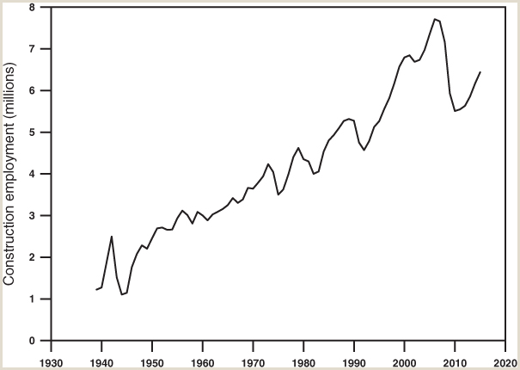
FIGURE 18.5
Total employment in the construction sector.
There was a surge in sales of new homes in the late 1990s and in the early 2000s. This was partly due to easing the criteria for qualifying for home loans, and partly to new types of mortgages, such as Adjustable Rate Mortgages (ARMs) that offered low monthly payments for a few years before the payments jumped up to higher levels. All these increased construction of new homes and therefore employment in the construction industry. Data shown are for July 1 in each year.
Source: FRED, series USCONS: “All Employees: Construction, Thousands of Persons, Monthly, Seasonally Adjusted,” available at https://fred.stlouisfed.org/series/USCONS.
Samuel Bowles, Frank Roosevelt, Richard Edwards, Mehrene Larudee
Understanding Capitalism, Fourth Edition, Copyright © 2018 Oxford University Press

Slide 8
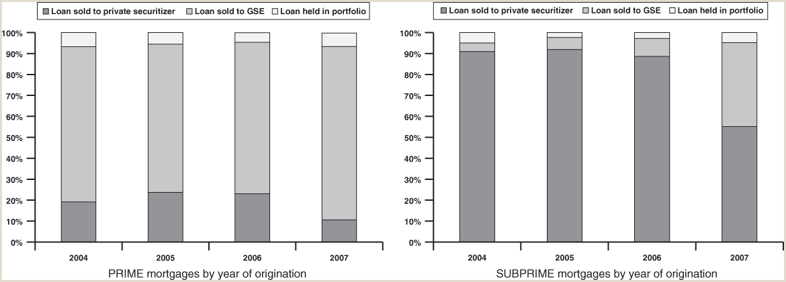
FIGURE 18.6
Prime and subprime mortgages sold to other financial institutions by twelve months after origination.
A 2010 study found that mortgage originators sold off nearly all the mortgages they made during 2004–2007 within the first year after the mortgages were originated—well over 90 percent (the dark gray and light gray portions of the columns shown). However, they sold prime mortgages mainly to government-sponsored enterprises (GSEs) Fannie Mae and Freddie Mac (light gray), while they sold subprime mortgages mainly to private securitizers (dark gray), probably because the GSEs were not willing to buy most subprime mortgages because of their riskiness or lack of documentation. From 2006 to 2007 the number of subprime loans originated fell by more than half, probably in large part because the private securitizers greatly reduced their purchases of subprime mortgages.
Source: Gene Amromin and Anna L. Paulson, “Default Rates on Prime and Subprime Mortgages: Differences and Similarities,” Profitwise News and Views, September 2010, Consumer and Community Affairs Division, Federal Reserve Bank of Chicago. Available at https://www.chicagofed.org/publications/profitwise-news-and-views/2010/pnv-september2010.
Samuel Bowles, Frank Roosevelt, Richard Edwards, Mehrene Larudee
Understanding Capitalism, Fourth Edition, Copyright © 2018 Oxford University Press

Slide 9
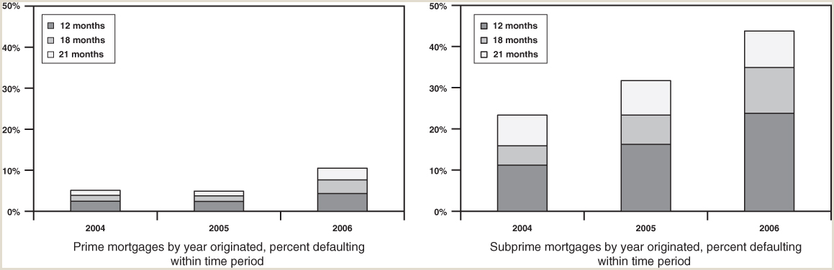
FIGURE 18.7
Increasing default rates on both prime and subprime mortgages, 2004-2006.
For both prime and subprime mortgages, each stacked column shows, for the year of origination, what percent of mortgages were in default twelve months after origination (darkest gray segment), what additional percent of mortgages originating in the same year were in default eighteen months after origination (lighter gray segment), and what additional percent of mortgages originating in the same year were in default twenty-one months after origination (lightest segment). The database included only loans serviced by the large mortgage servicers.
Source: Gene Amromin and Anna L. Paulson, “Default Rates on Prime and Subprime Mortgages: Differences and Similarities,” Profitwise News and Views, September 2010, Consumer and Community Affairs Division, Federal Reserve Bank of Chicago. Available at https://www.chicagofed.org/publications/profitwise-news-and-views/2010/pnv-september2010.
Samuel Bowles, Frank Roosevelt, Richard Edwards, Mehrene Larudee
Understanding Capitalism, Fourth Edition, Copyright © 2018 Oxford University Press

Slide 10
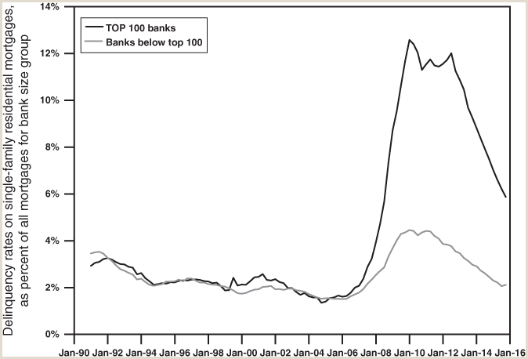
FIGURE 18.8
Mortgage delinquency rates on single-family residences, by bank size.
This figure shows delinquency rates on single-family residential mortgages, as a percent of all outstanding mortgages for the bank size group. The heavy line shows delinquency rates for the top 100 banks, and the thin line for banks below the top 100. After home prices stopped rising in 2005, mortgage delinquency rates grew for all mortgages. But mortgages held by the biggest 100 banks had much larger increases in delinquency rates than mortgages held by smaller banks.
Source: Federal Reserve Economic Data (FRED), “Delinquency Rate On Single-Family Residential Mortgages, Booked In Domestic Offices, Top 100 Banks Ranked By Assets, Percent, Quarterly, Seasonally Adjusted,” available at https://fred.stlouisfed.org/series/DRSFRMT100S; and “Delinquency Rate on Single-Family Residential Mortgages, Booked in Domestic Offices, Banks Not Among the 100 Largest in Size (By Assets) (DRSFRMOBS),” available at https://fred.stlouisfed.org/series/DRSFRMOBS.
Samuel Bowles, Frank Roosevelt, Richard Edwards, Mehrene Larudee
Understanding Capitalism, Fourth Edition, Copyright © 2018 Oxford University Press

Slide 11
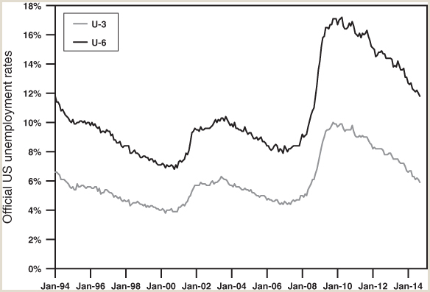
FIGURE 18.9
Two official U.S. unemployment rates.
The Bureau of Labor Statistics computes six different unemployment rates. The one usually cited is the U-3 (the lower thin line), which counts persons as unemployed if they are able and willing to work, not working, but have sought work in the last four weeks. The higher U-6 unemployment rate also includes among the unemployed those who with part-time work who want full-time, and those “marginally attached to the labor force,” including those who have sought work in the last year but not the last four weeks—a group that the U-3 measures counts as “not in the labor force” (and so not unemployed).
Source: Vernon Brundage, “Trends in Unemployment and Other Labor Market Difficulties,” Department of Labor, Bureau of Labor Statistics, Employment & Unemployment 3, no. 25 (Nov. 2014). Available at http://www.bls.gov/opub/btn/volume-3/trends-in-unemployment-and-other-labor-market-difficulties.htm.
Samuel Bowles, Frank Roosevelt, Richard Edwards, Mehrene Larudee
Understanding Capitalism, Fourth Edition, Copyright © 2018 Oxford University Press

Slide 12
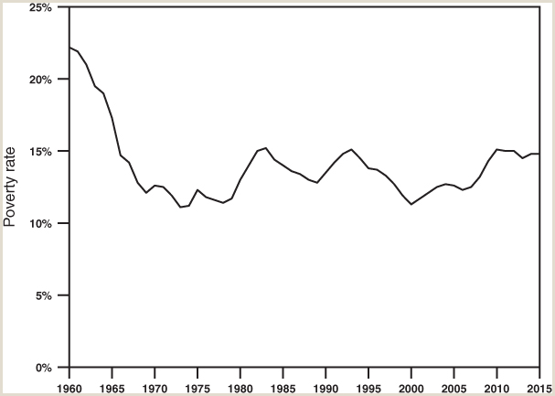
FIGURE 18.10
The poverty rate in the United States. Pensions in poverty as a percent of all persons.
The poverty rate rose leading up to the deep 1982–1983 recession, and was rising during the 1990–1991 recession as well, though it peaked in 1993 after the recession had ended. What is striking is that following each of these two peaks in the poverty rate, there was an immediate decline as the economy recovered. But when the poverty rate rose during the 2007–2009 Great Recession, and hit 15 percent in 2010, it remained nearly at that level for the following four years.
Source: U.S. Census Bureau, Income and Poverty in the United States, 2014, P60–252, p. 44, Appendix Table B-1: Poverty Status of People by Family Relationship, Race, and Hispanic Origin, 1959 to 2014. Available at www.census.gov/content/dam/Census/library/publications/2015/demo/p60-252.pdf.
Samuel Bowles, Frank Roosevelt, Richard Edwards, Mehrene Larudee
Understanding Capitalism, Fourth Edition, Copyright © 2018 Oxford University Press

Slide 13
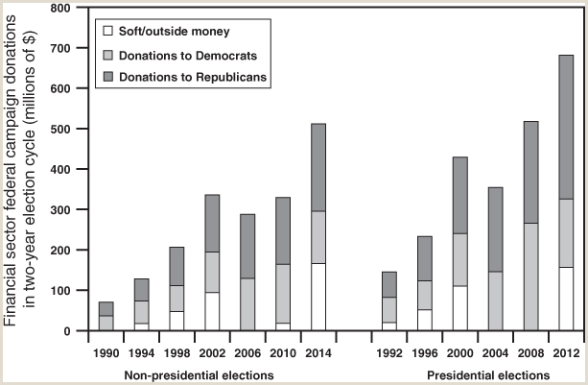
FIGURE 18.11
Financial sector campaign donations to federal candidates and soft/outside money organizations, by two-year election cycle
Source: Center for Responsive Politics, Finance/Insurance/Real Estate: Long-Term Contribution Trends, available at http://www.opensecrets.org/industries/indus.php?Ind=F; https://www.opensecrets.org/industries/totals.php?ind=F; House Financial Services Committee, 114th Congress, 2014 election cycle, available at https://www.opensecrets.org/cmteprofiles/overview.php?cmteid=H05&cmte=HFIN&congno=114&chamber=H; and Senate Banking, Housing, and Urban Affairs Committee, 114th Congress, 2014 election cycle, available at https://www.opensecrets.org/cmteprofiles/overview.php?cmteid=S06&cmte=SBAN&congno=114&chamber=S.
Samuel Bowles, Frank Roosevelt, Richard Edwards, Mehrene Larudee
Understanding Capitalism, Fourth Edition, Copyright © 2018 Oxford University Press

Slide 14
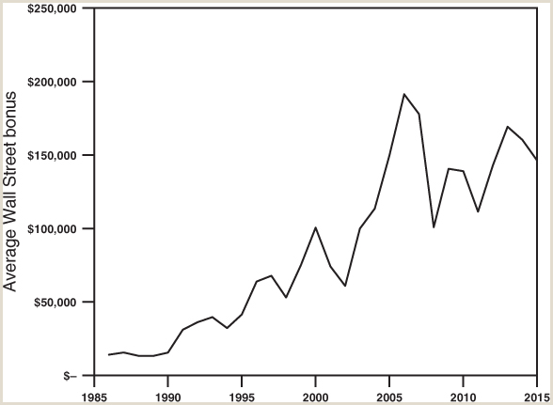
FIGURE 18.12
Average Wall Street bonuses, by year.
All employees are included in averaging the total pool of bonuses, but many top executives actually receive bonuses in the millions or tens of millions of dollars, and sometimes more.
Source: New York State Comptroller, “New York City Securities Industry Bonus Pool.” Available at http://www.osc.state.ny.us/press/releases/mar16/nyc_security_bonus_pool.pdf.
Samuel Bowles, Frank Roosevelt, Richard Edwards, Mehrene Larudee
Understanding Capitalism, Fourth Edition, Copyright © 2018 Oxford University Press

