Slide 1
Government and the Economy in Transnational Capitalism
Chapter 19
Samuel Bowles, Frank Roosevelt, Richard Edwards, Mehrene Larudee
Understanding Capitalism, Fourth Edition, Copyright © 2018 Oxford University Press

Slide 2
Figures and Tables
Samuel Bowles, Frank Roosevelt, Richard Edwards, Mehrene Larudee
Understanding Capitalism, Fourth Edition, Copyright © 2018 Oxford University Press

Slide 3
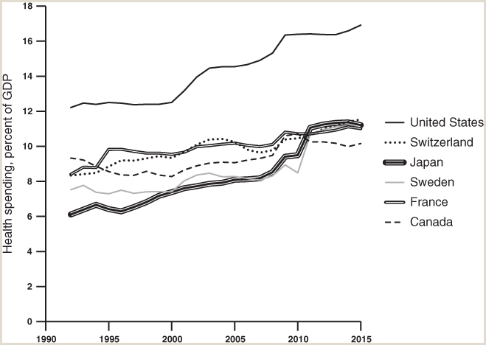
FIGURE 19.1
Health spending as percent of GDP, six countries.
The U.S. spends a far greater share of GDP on health care (including both public and private spending) than any other OECD country. In 1970 it was also tops, but only by a little, spending just over 6 percent of GDP on health. Its lead has grown, decade by decade. In 2015 the U.S. spent 16.9 percent of GDP on health, while the next four highest spending countries in 2015, as shown, all spent between 11.1 and 11.5 percent of GDP on health. In that year Canada, which is also shown, spent just 10.2 percent of GDP on health care.
Source: OECD Health Statistics 2016, Frequently Requested Data, available at http://www.oecd.org/els/health-systems/health-statistics.htm.
Samuel Bowles, Frank Roosevelt, Richard Edwards, Mehrene Larudee
Understanding Capitalism, Fourth Edition, Copyright © 2018 Oxford University Press

Slide 4
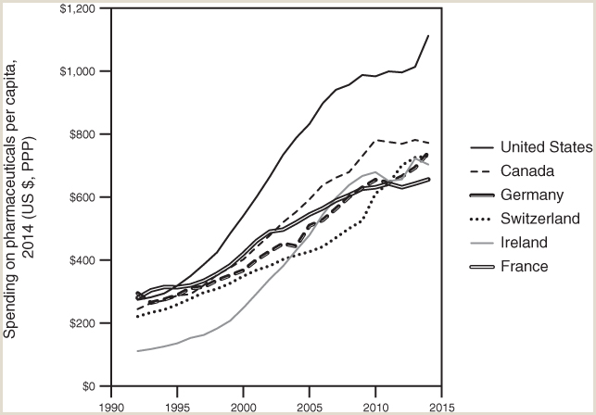
FIGURE 19.2
Expenditure on pharmaceuticals per capita, in U.S. dollars at PPP.
The six countries in which spending on pharmaceuticals per capita is highest are shown. In 1992, U.S. spending per person was about the same as most of the countries shown, except Ireland; but since 1996 it has been the highest spender. One possible contributing factor is that the U.S. is one of the few countries that has permitted direct-to-consumer advertising of pharmaceutical products on television, beginning in 1997. In 2014 the U.S. spent $1,112 per capita; Canada spent about $772, and France, the lowest one shown, spent $656.
Source: OECD Health Statistics 2016, Current expenditure on pharmaceuticals (prescribed and over-the-counter medicines) and other medical non-durables, per capita, US$ purchasing power parities (current prices, current PPPs), available at http://stats.oecd.org/Index.aspx?DataSetCode=SHA
Samuel Bowles, Frank Roosevelt, Richard Edwards, Mehrene Larudee
Understanding Capitalism, Fourth Edition, Copyright © 2018 Oxford University Press

Slide 5
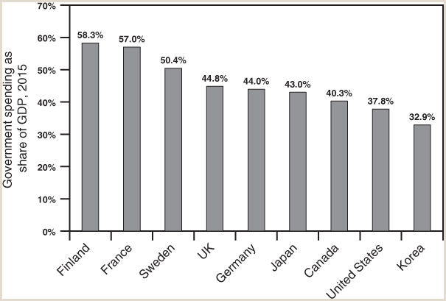
FIGURE 19.3
Government outlays as a share of GDP, 2015.
Government spending in the U.S., including federal, state, and local spending, was a lower share of GDP than in twenty-six of thirty-two OECD countries that reported this statistic for 2015. Only in Latvia, Australia, Ireland, Switzerland, and Korea was government spending a lower percent of GDP in 2015 than in the U.S.
Source: Organization for Economic Co-operation and Development, Economic Outlook 2015, Table 29: General Government Outlays as a Percent of GDP (variable YPGTQ), available at http://stats.oecd.org/Index.aspx?DataSetCode=EO#.
Samuel Bowles, Frank Roosevelt, Richard Edwards, Mehrene Larudee
Understanding Capitalism, Fourth Edition, Copyright © 2018 Oxford University Press

Slide 6
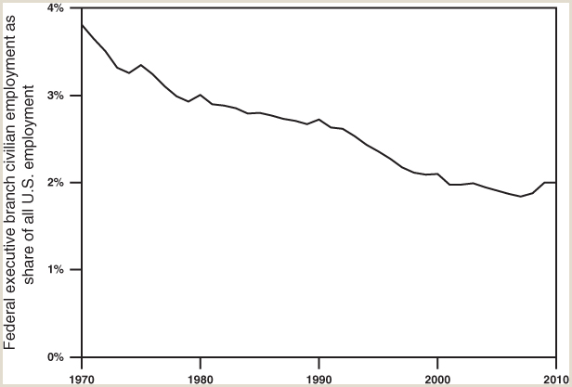
FIGURE 19.4
Federal government civilian executive branch employment as percent of total U.S. employment, 1970-2010.
The total number of civilian federal employees peaked in 1970 and 1989 at just over 3 million, but as a percent of all employment declined steadily from 3.8 percent to just 2.0 percent in 2010. One important reason for this trend is the contracting out of federal government services; another is that federal funds have been granted to state governments to operate many programs.
Source: U.S. Statistical Abstract 2012 (131st edition), Table 496: Federal Civilian Employment and Annual Payroll by Branch: 1970 to 2010. Available at https://www.census.gov/library/publications/2011/compendia/statab/131ed/federal-govt-finances-employment.html
Samuel Bowles, Frank Roosevelt, Richard Edwards, Mehrene Larudee
Understanding Capitalism, Fourth Edition, Copyright © 2018 Oxford University Press

Slide 7
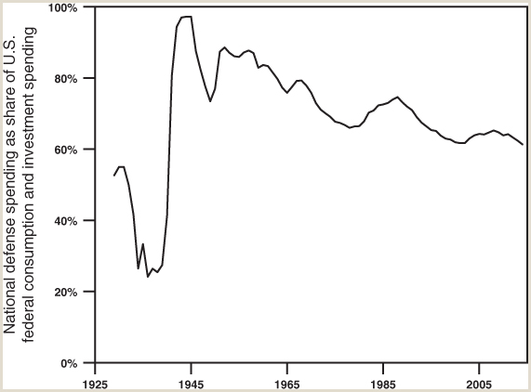
FIGURE 19.5
U.S. National defense spending as a percent of federal consumption and investment spending, 1929-2014.
The share of U.S. defense spending in all federal discretionary spending was 97 percent in 1943–1944, and since World War II this share has been consistently greater than 60 percent. In 2014, federal consumption and investment spending was $1,220 billion and national defense spending was $748 billion, according to the U.S. Bureau of Economic Analysis. The ratio of the second to the first was 61 percent. These categories differ somewhat from the categories presented in the official federal budget.
Source: U.S. Bureau of Economic Analysis, National Income and Product Accounts, Table 1.1.5: Gross Domestic Product (national defense spending divided by all federal consumption and investment spending), available at http://www.bea.gov.
Samuel Bowles, Frank Roosevelt, Richard Edwards, Mehrene Larudee
Understanding Capitalism, Fourth Edition, Copyright © 2018 Oxford University Press

Slide 8
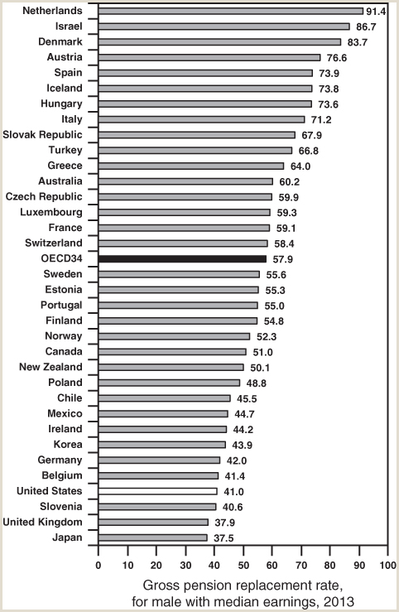
FIGURE 19.6
Percent of earnings replaced by pension, OECD countries, 2013.
In the average OECD country, the old-age pension replaced 57.9 percent of the earnings of a male with median earnings in 2013. In the United States, it replaced 41.0 percent. Only three countries (Slovenia, the UK, and Japan) replaced a smaller portion of earnings.
Source: Pensions at a Glance 2013: OECD and G20 Indicators, OECD Publishing, Paris, Chapter 4, Table 4.1, Gross Pension Replacement Rates by Earnings, available at http://dx.doi.org/10.1787/pension_glance-2013-en. Data table alone is available at http://dx.doi.org/10.1787/888932907224
Samuel Bowles, Frank Roosevelt, Richard Edwards, Mehrene Larudee
Understanding Capitalism, Fourth Edition, Copyright © 2018 Oxford University Press

Slide 9
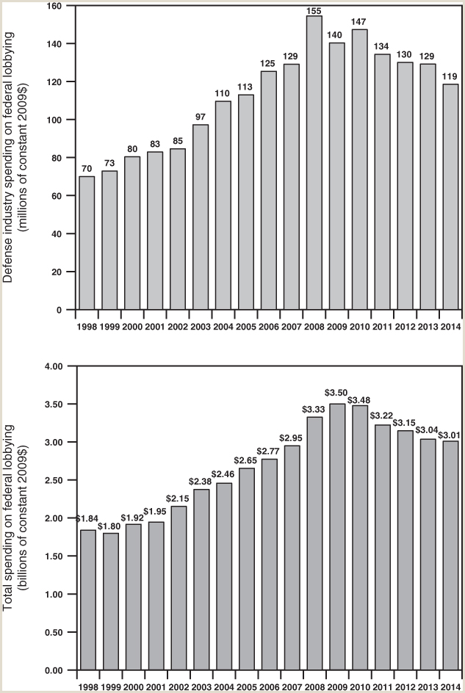
FIGURE 19.7
Annual spending on federal lobbying, defense industry (top) and total (bottom), 1998-2014.
The Center for Responsive Politics compiles these data, based on the information that lobbyists have been required to submit to the U.S. Senate.
Source: Center for Responsive Politics, Lobbying Database, available at https://www.opensecrets.org/lobby/.
Samuel Bowles, Frank Roosevelt, Richard Edwards, Mehrene Larudee
Understanding Capitalism, Fourth Edition, Copyright © 2018 Oxford University Press

Slide 10
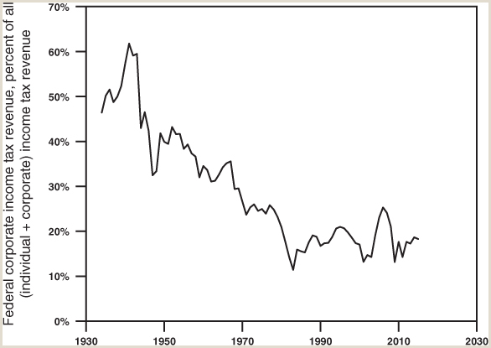
FIGURE 19.8
Federal corporate income tax revenue as a share of all federal income tax revenue (individual and corporate), 1934-2015.
Source: U.S. Office of Management and Budget, Historical Tables, Table 2.2: Percentage Composition of Receipts by Source: 1934–2021, available at https://www.whitehouse.gov/omb/budget/Historicals.
Samuel Bowles, Frank Roosevelt, Richard Edwards, Mehrene Larudee
Understanding Capitalism, Fourth Edition, Copyright © 2018 Oxford University Press

Slide 11
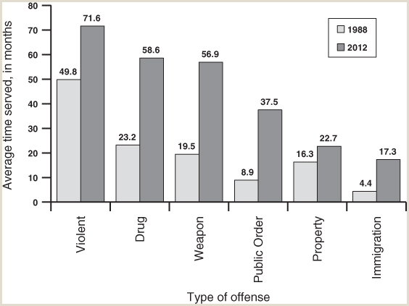
FIGURE 19.9
Increase in average federal prison time served, 1988-2012.
The Federal Bureau of Prisons reports that the length of time actually spent in federal prison for those released in 2012 was on average twice what it was for prisoners released in 1988. For all categories of offenses combined, this number rose from an average of 17.9 months in 1988 to 37.5 months in 2012. In four of the six categories (drug, weapon, public order, and immigration) the length of incarceration was from 2.5 to 4.2 times as great for those released in 2012 as in 1988; for those convicted of violent crimes and property crimes, it less than doubled between the two years. Included in “Public order” offenses are violations of tax law, racketeering, extortion, bribery, perjury, and more.
Source: “Prison Time Surges for Federal Inmates: Average period of confinement doubles, costing taxpayers $2.7 billion a year,” Issue Brief, November 15, 2015, Public Safety Performance Project, Pew Trusts, available at http://www.pewtrusts.org/en/research-and-analysis/issue-briefs/2015/11/prison-time-surges-for-federal-inmates. Based on Bureau of Justice data sources.
Samuel Bowles, Frank Roosevelt, Richard Edwards, Mehrene Larudee
Understanding Capitalism, Fourth Edition, Copyright © 2018 Oxford University Press

Slide 12
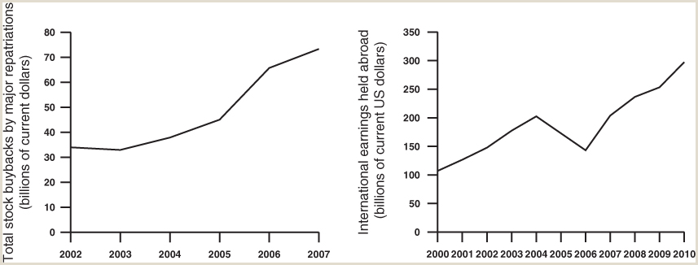
FIGURE 19.10
Transnational corporations’ response to the tax holiday in 2005.
The federal American Jobs Creation Act of 2004 allowed U.S. transnational firms that were holding unrepatriated profit earnings abroad to bring those funds back to the U.S. and pay 15 percent of the taxes they owed. Congress thought the money would be used for investment and job creation. Instead, many firms laid off workers and, as the left hand panel shows, spent large amounts to buy back their own stock. Afterward, U.S. TNCs increased the dollar amount of their global profit earnings that they held abroad, as the right hand panel shows.
Sources: U.S. Senate Permanent Subcommittee on Investigations, Committee on Homeland Security and Governmental Affairs, Majority Staff Report, “Repatriating Offshore Funds: Tax Windfall for Select Multinationals,” United States Permanent Subcommittee on Investigations, Committee on Homeland Security and Governmental Affairs, Majority Staff Report, October 11, 2011, available at http://www.gpo.gov/fdsys/pkg/CPRT-112SPRT70710/pdf/CPRT-112SPRT70710.pdf
Samuel Bowles, Frank Roosevelt, Richard Edwards, Mehrene Larudee
Understanding Capitalism, Fourth Edition, Copyright © 2018 Oxford University Press

Slide 13
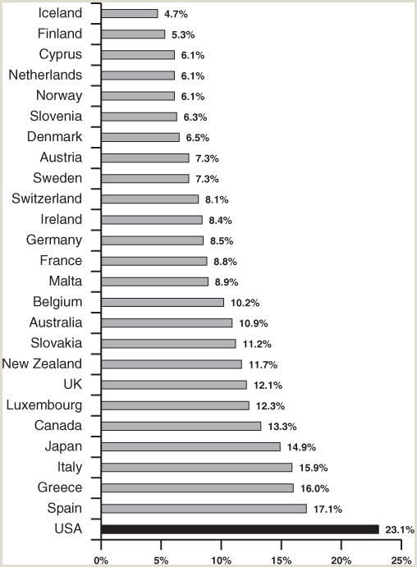
FIGURE 19.11
Child poverty rate, comparison of selected OECD countries, 2009.
The U.S. child poverty rate in 2009 far exceeded that in countries of similar, and even lower, income levels. In the data, a child is defined as in poverty if the income of the household in which the child lives is below 50 percent of the median household income, after adjusting for household size. Countries with productivity less than half that of the United States were excluded from the data.
Source: Economic Policy Institute, The State of Working America, 2012, from UNICEF Innocenti Research Centre Report Card 10 (Adamson 2012), Figure 1b, “Child Poverty Rate.”
Samuel Bowles, Frank Roosevelt, Richard Edwards, Mehrene Larudee
Understanding Capitalism, Fourth Edition, Copyright © 2018 Oxford University Press

