Slide 1
Chapter 4
Real Econometrics
Second Edition
Michael A. Bailey

Slide 2
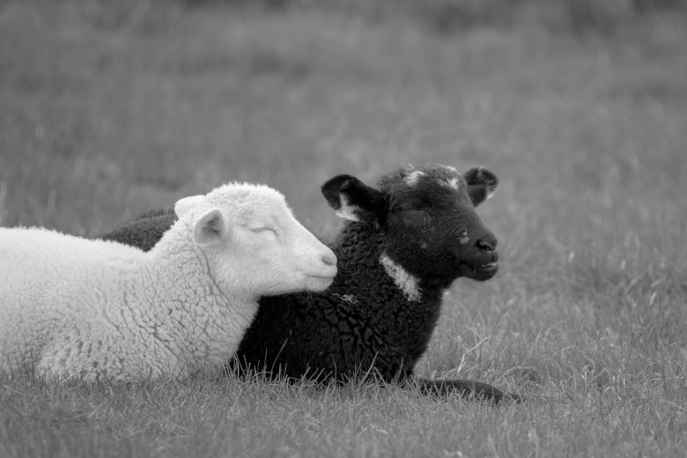

Slide 3
Figures
Chapter 4

Slide 4
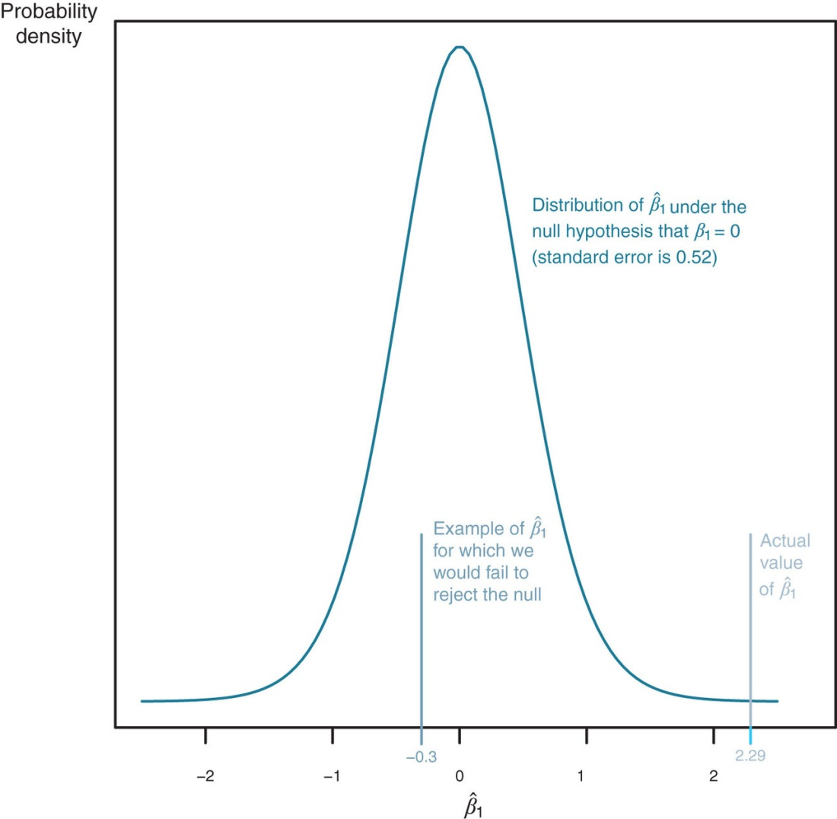
Figure 4.1

Slide 5
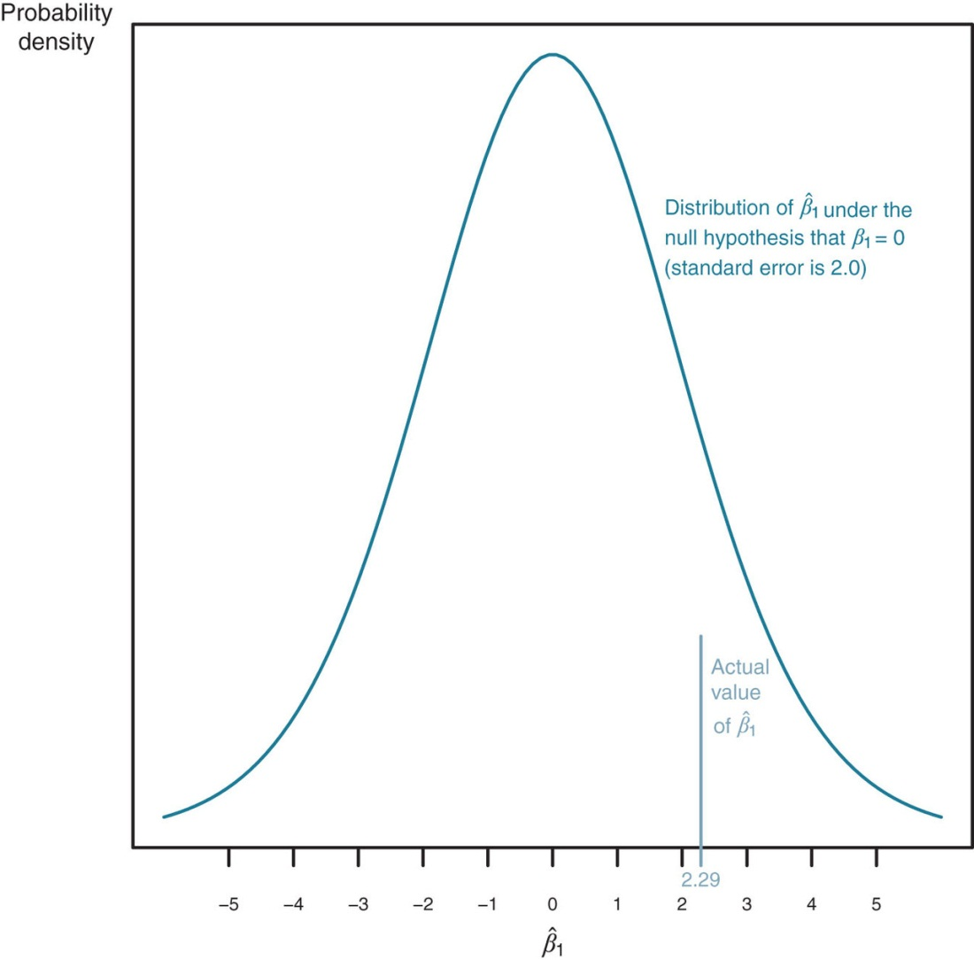
Figure 4.2

Slide 6
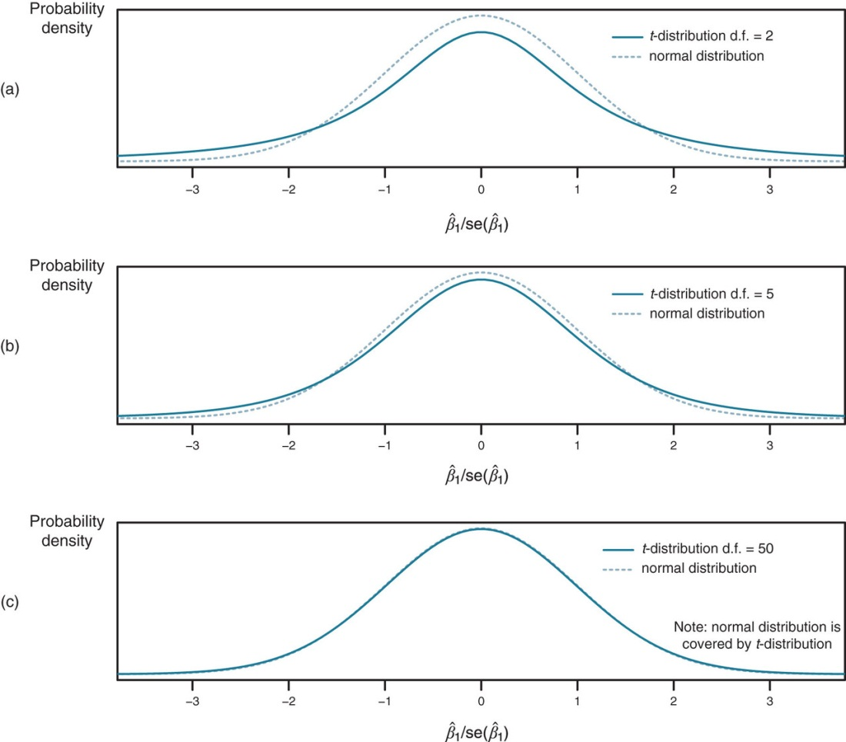
Figure 4.3

Slide 7
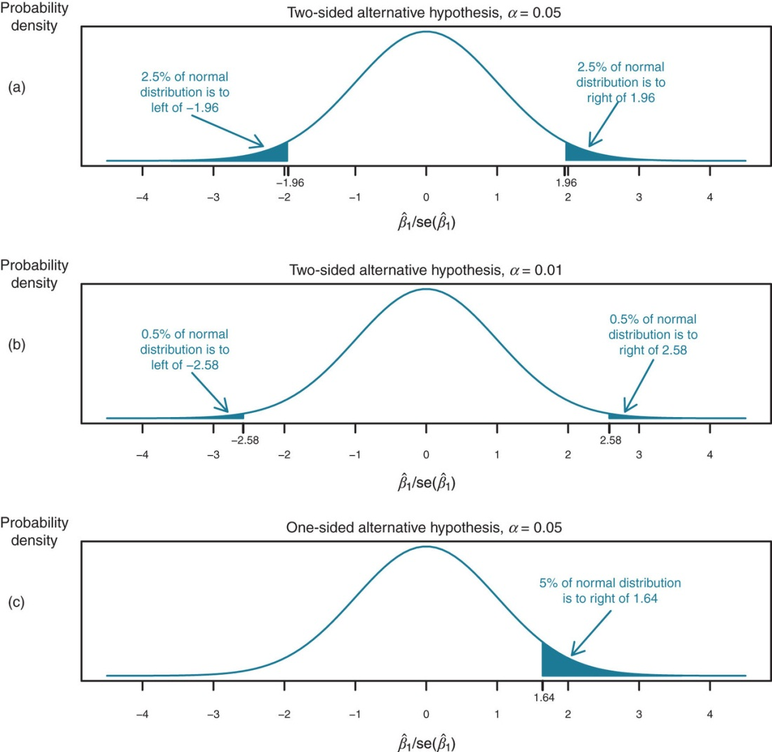
Figure 4.4

Slide 8
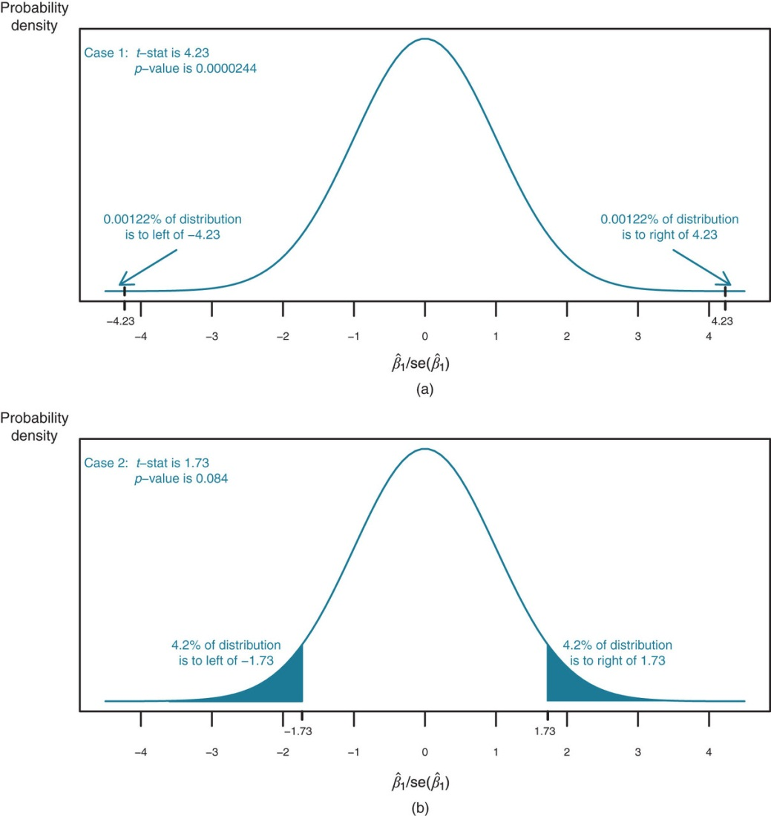
Figure 4.5

Slide 9
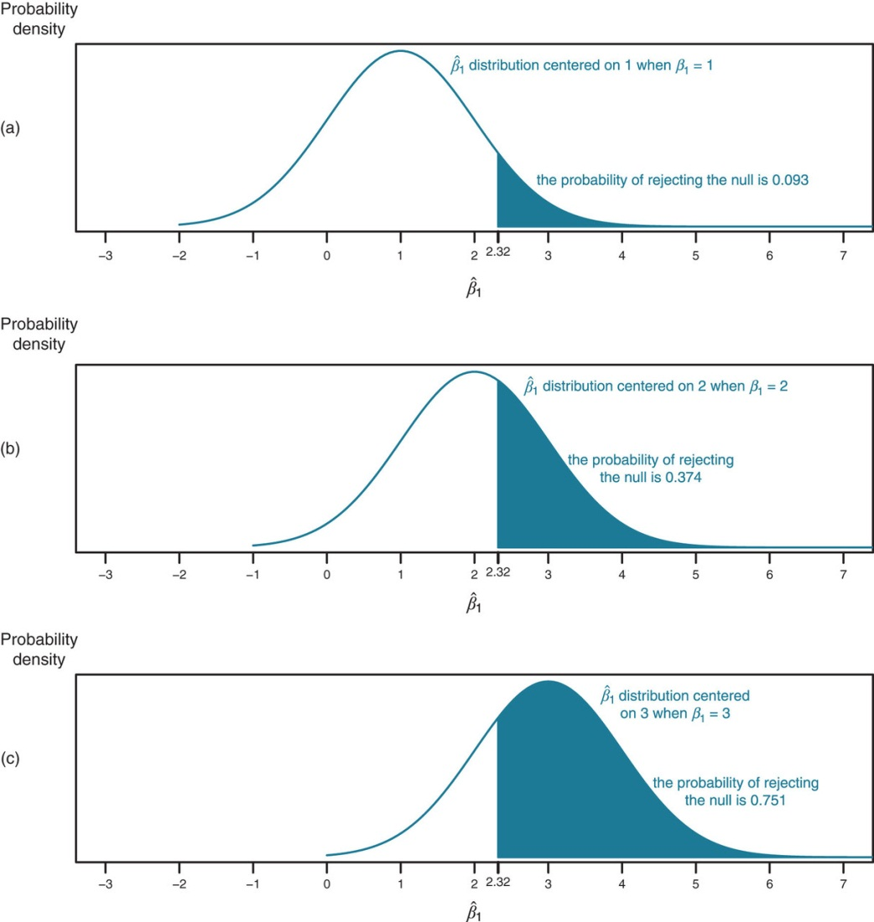
Figure 4.6

Slide 10
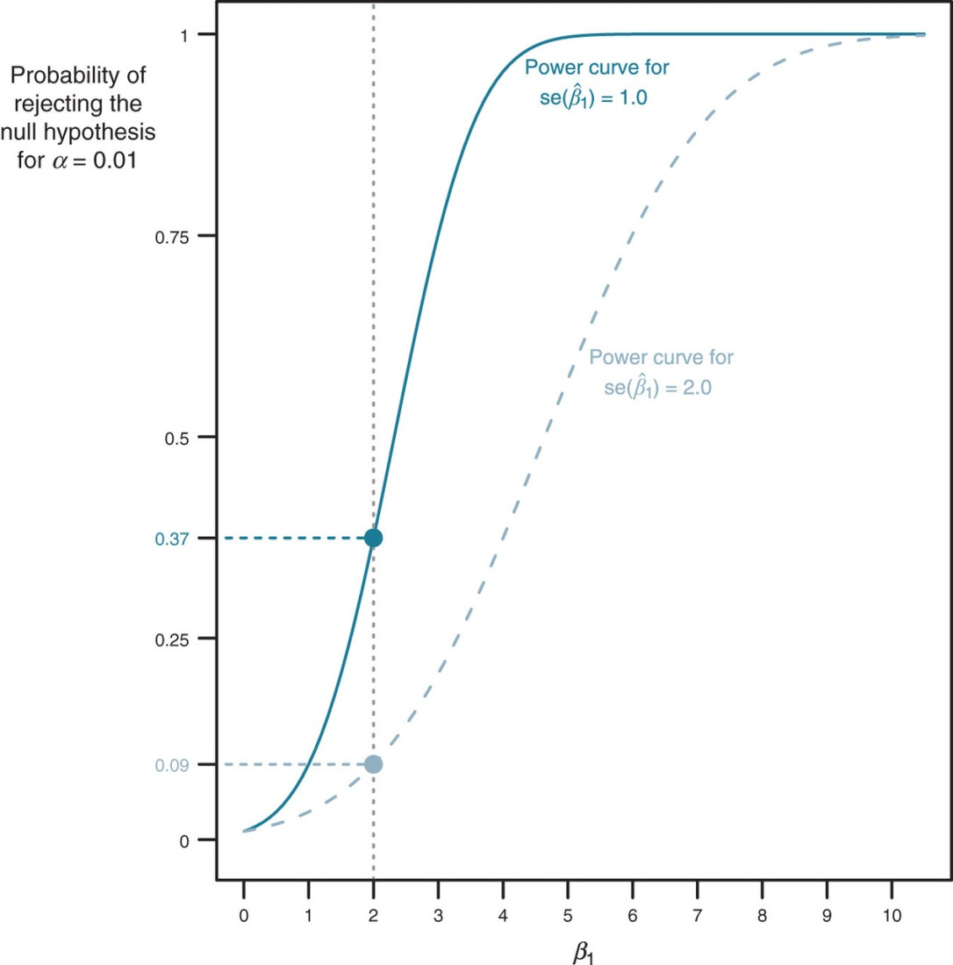
Figure 4.7

Slide 11
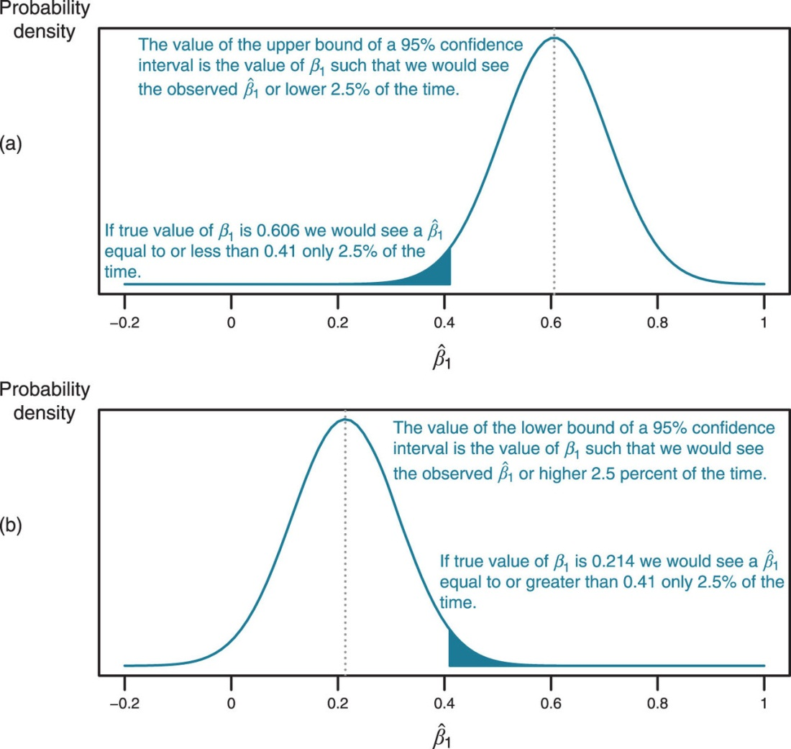
Figure 4.8

Slide 12
Tables
Chapter 4

Slide 13
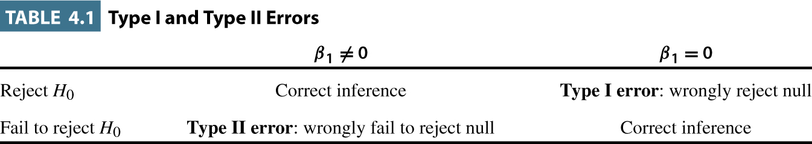
Table 4.1

Slide 14
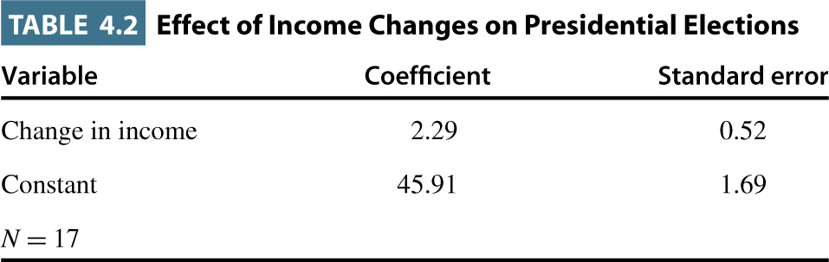
Table 4.2

Slide 15
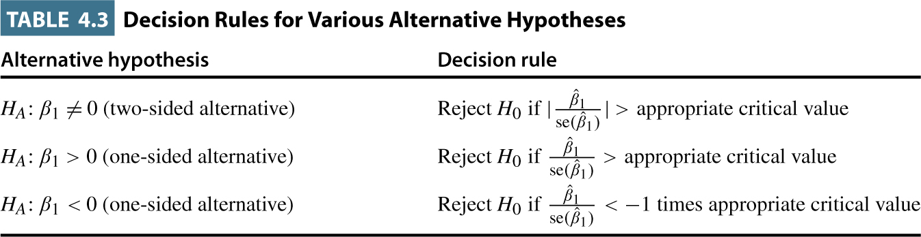
Table 4.3

Slide 16
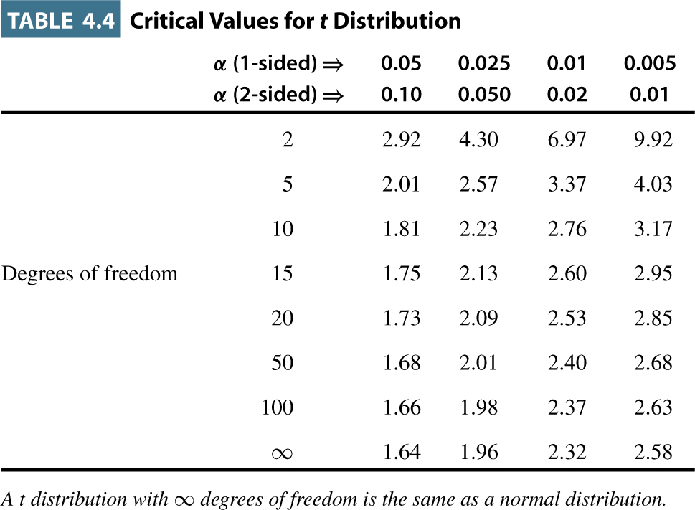
Table 4.4

Slide 17
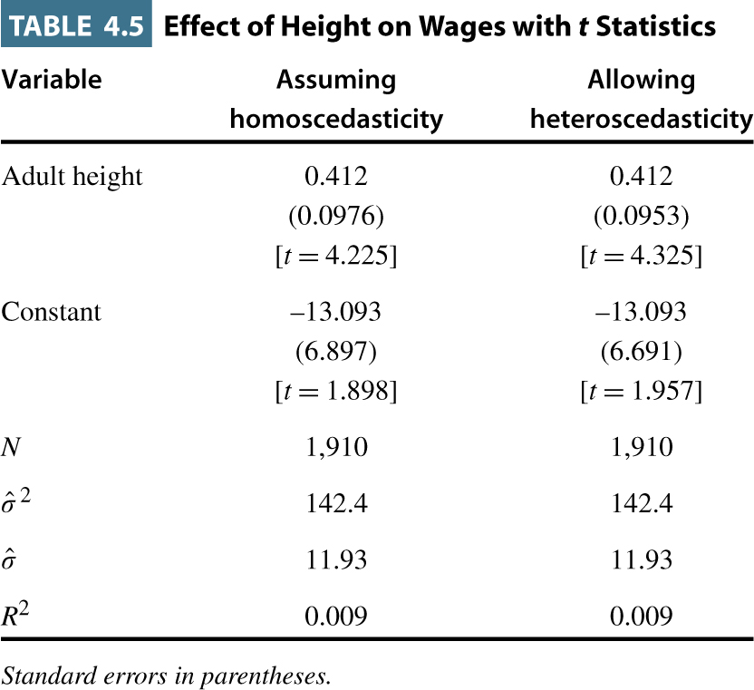
Table 4.5

Slide 18
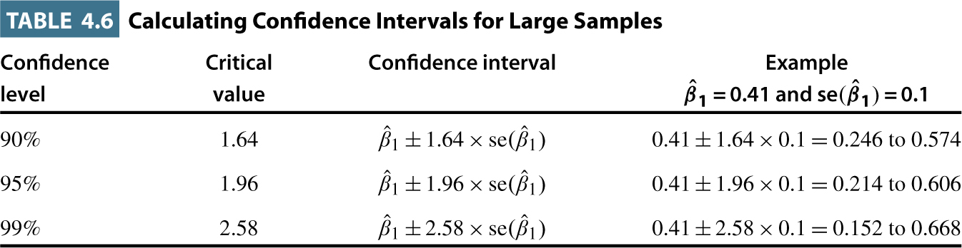
Table 4.6

Slide 19
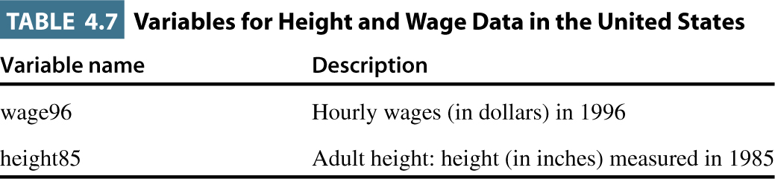
Table 4.7

