Slide 1
Chapter 5
Real Econometrics
Second Edition
Michael A. Bailey

Slide 2


Slide 3
Case Study Photos
Chapter 5

Slide 4

Case Study 1

Slide 5

Case Study 2

Slide 6

Case Study 3

Slide 7
Figures
Chapter 5

Slide 8
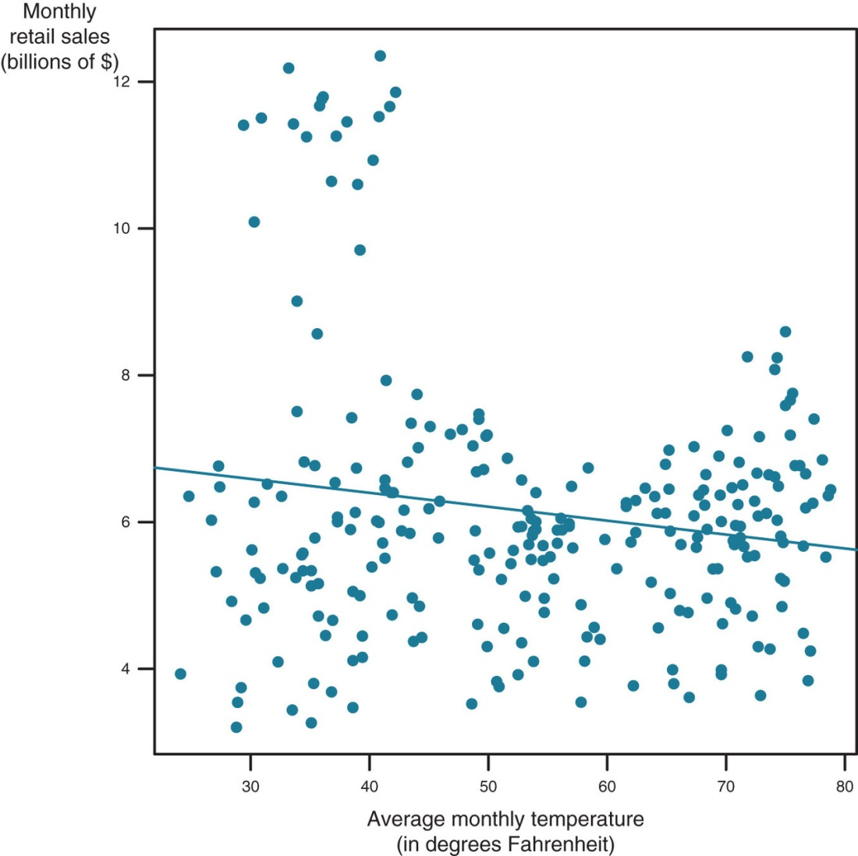
Figure 5.1

Slide 9
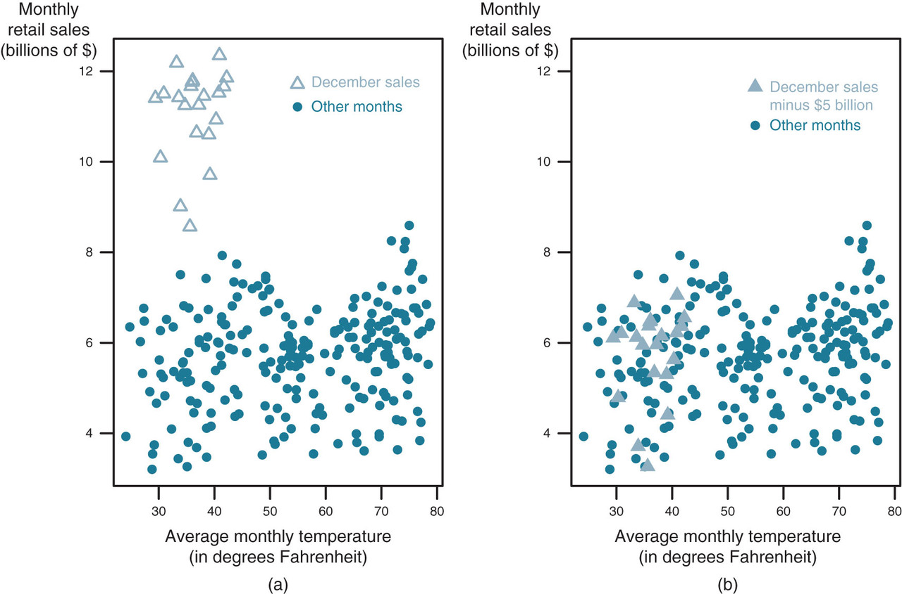
Figure 5.2

Slide 10
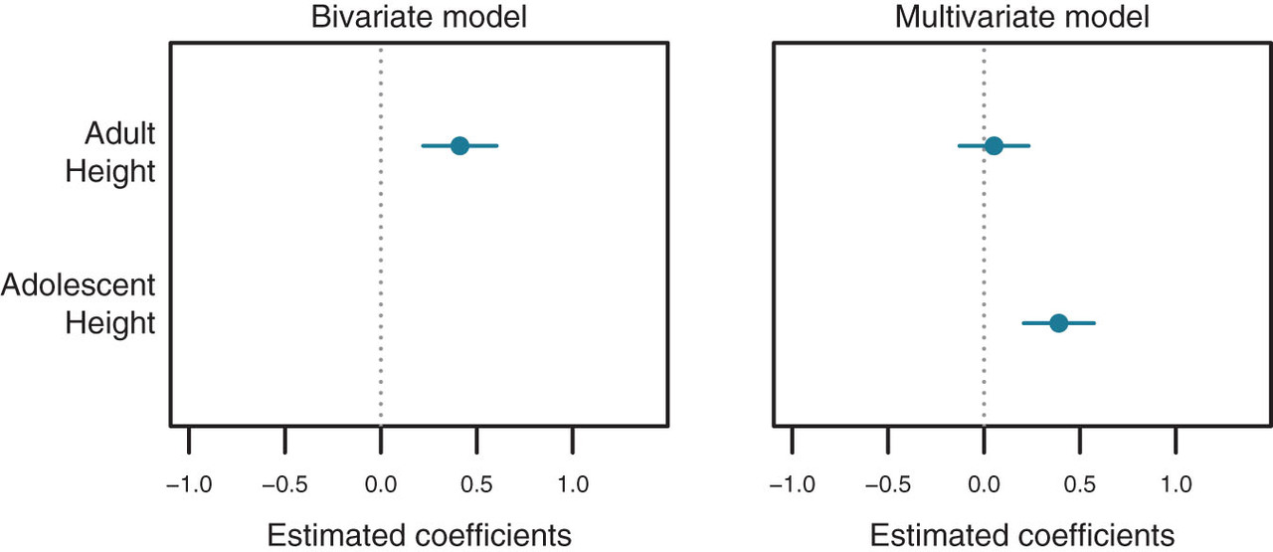
Figure 5.3

Slide 11
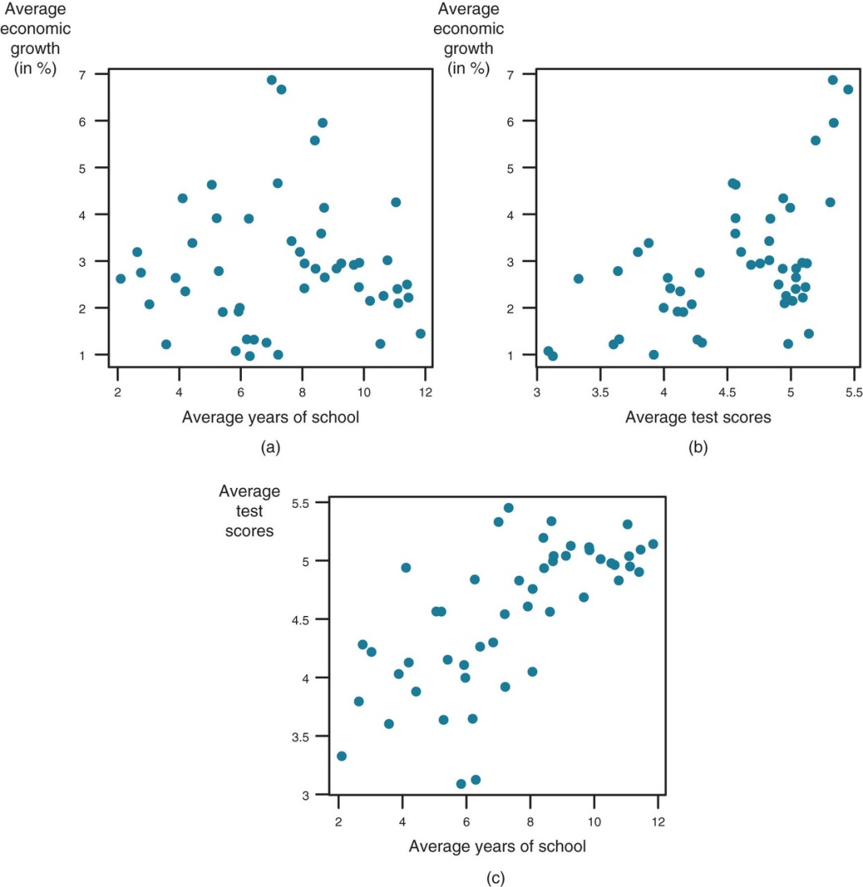
Figure 5.4

Slide 12
Tables
Chapter 5

Slide 13
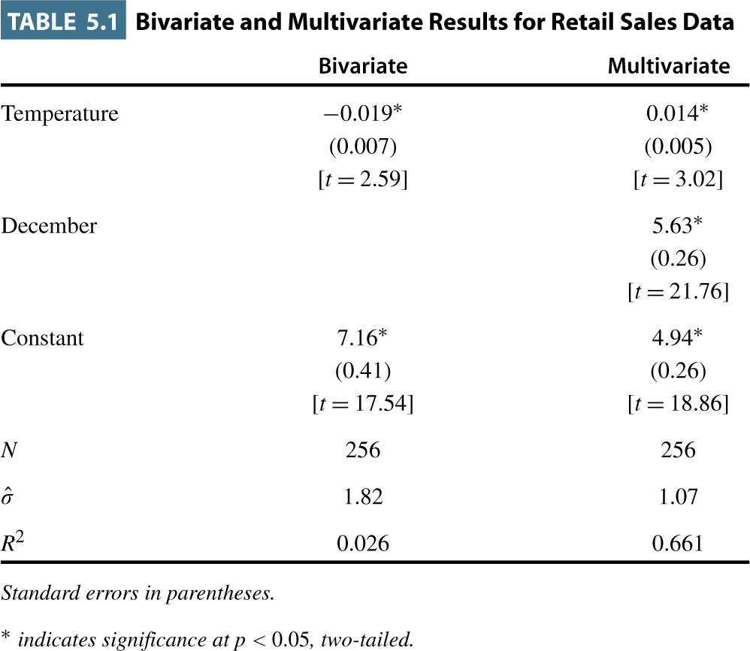
Table 5.1

Slide 14
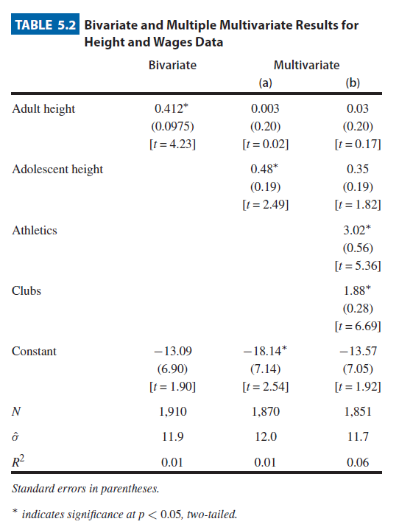
Table 5.2

Slide 15
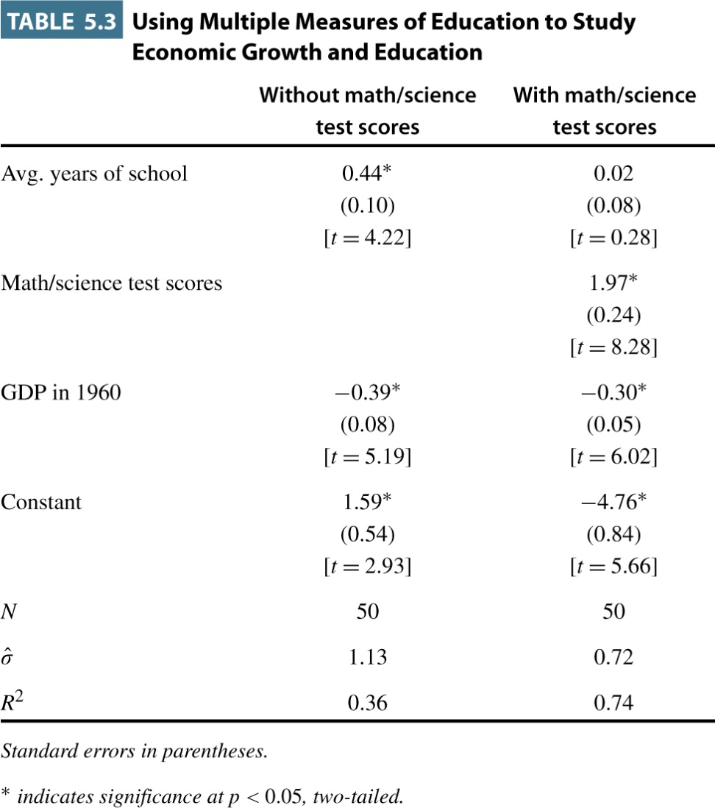
Table 5.3

Slide 16
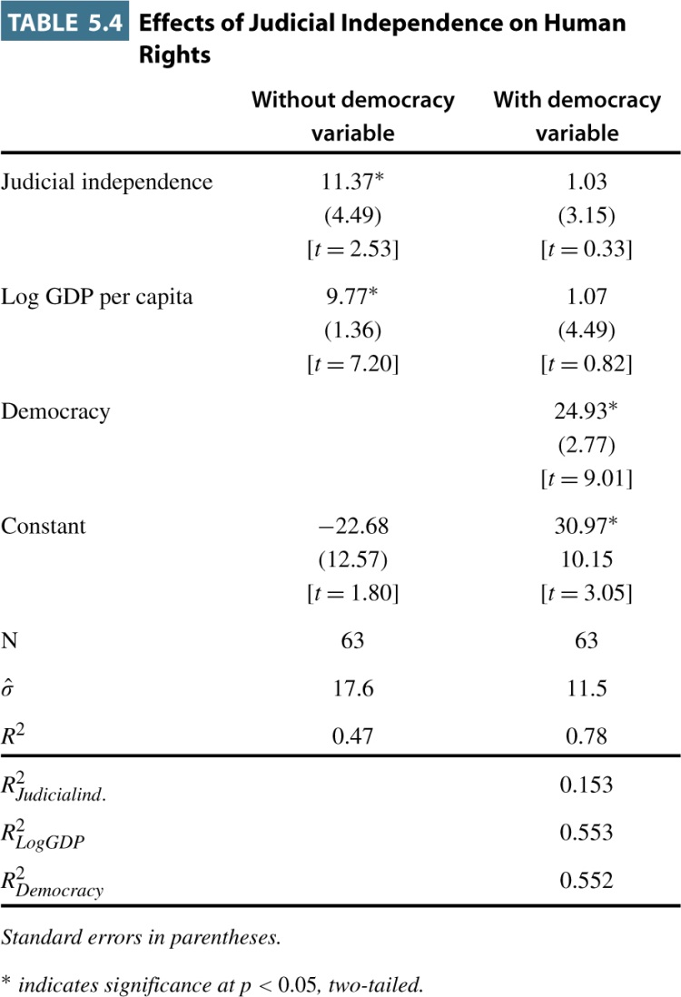
Table 5.4

Slide 17
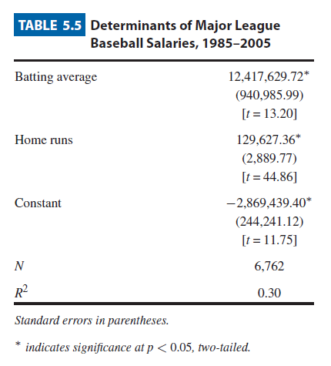
Table 5.5

Slide 18
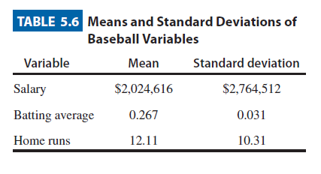
Table 5.6

Slide 19
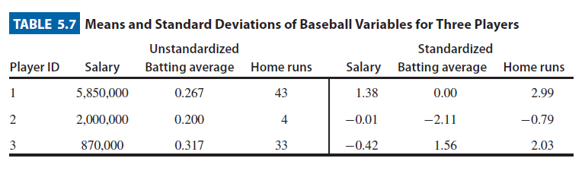
Table 5.7

Slide 20
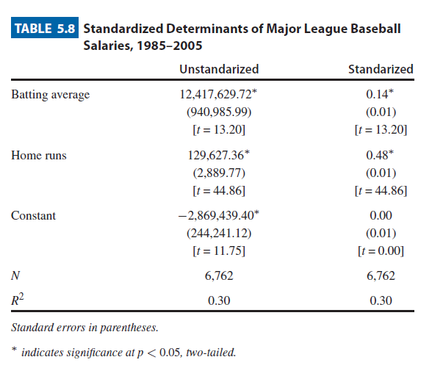
Table 5.8

Slide 21
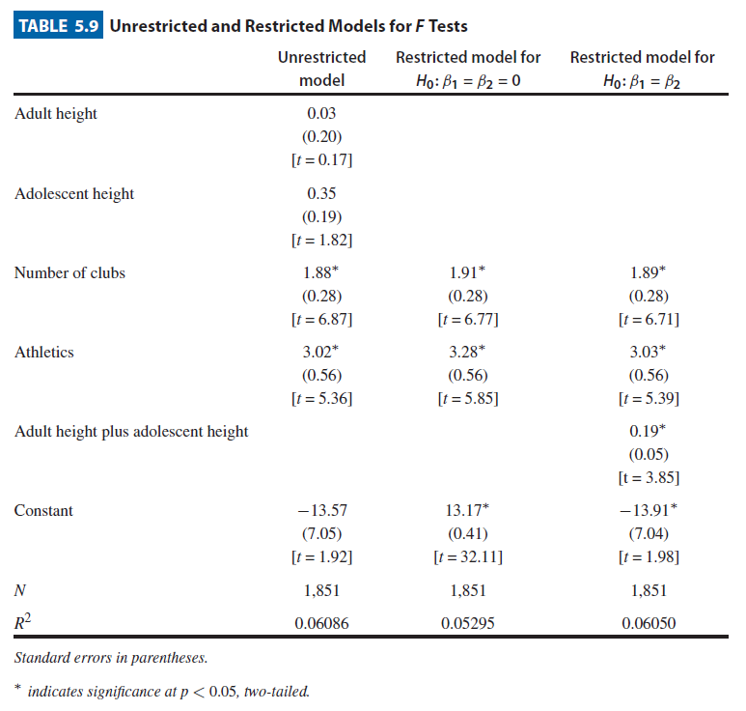
Table 5.9

Slide 22
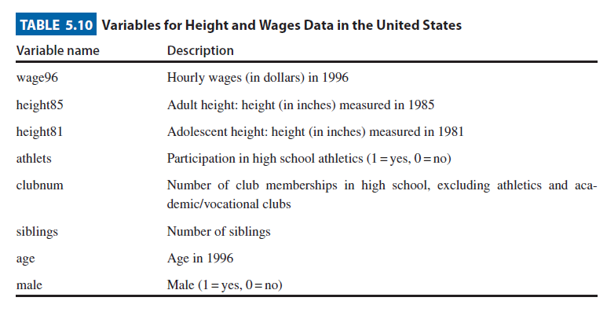
Table 5.10

Slide 23
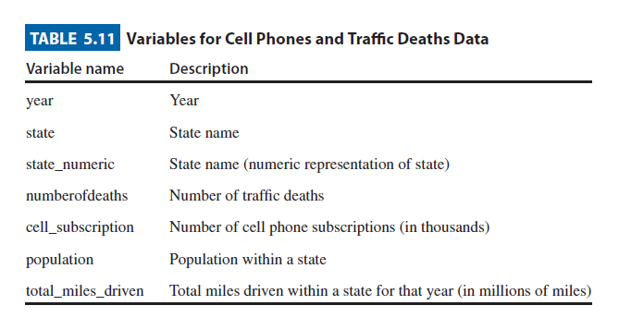
Table 5.11

Slide 24
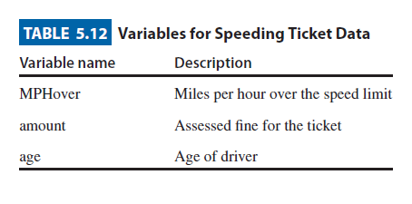
Table 5.12

Slide 25
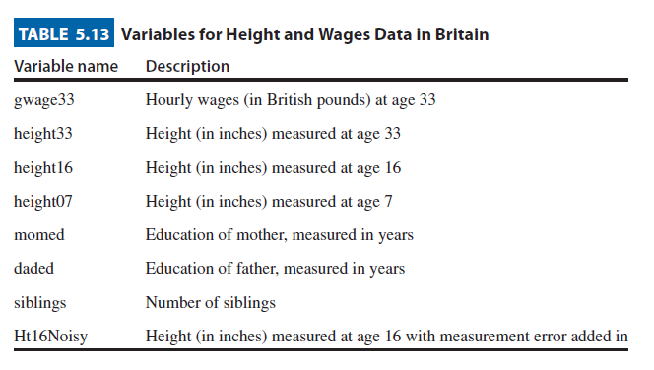
Table 5.13

Slide 26
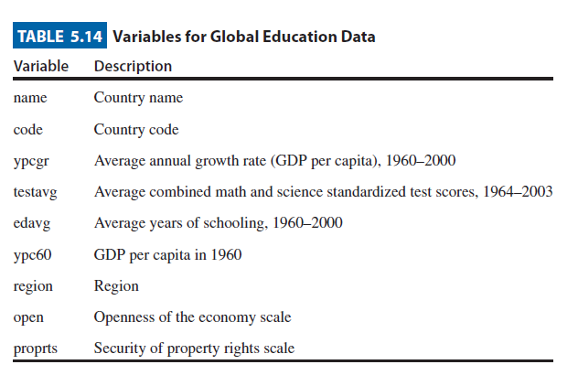
Table 5.14

