Slide 1
Chapter 10
Real Econometrics
Second Edition
Michael A. Bailey

Slide 2


Slide 3
Case Study Photos
Chapter 10

Slide 4
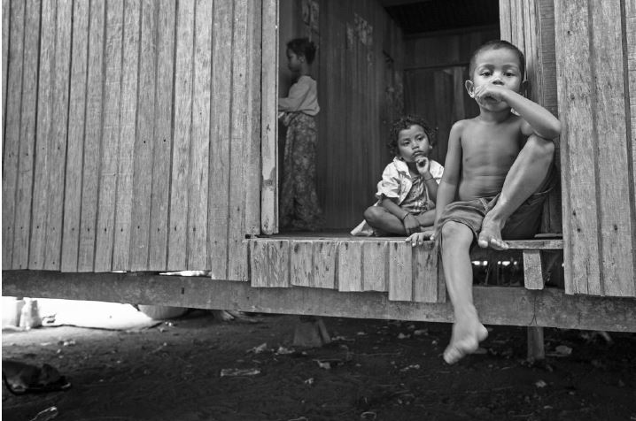
Case Study 1

Slide 5

Case Study 2

Slide 6

Case Study 3

Slide 7

Case Study 4

Slide 8
Figures
Chapter 10

Slide 9
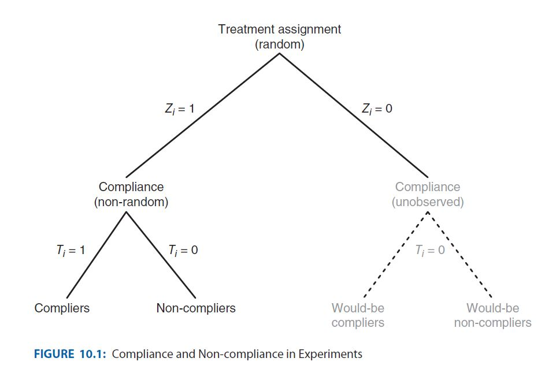
Figure 10.1

Slide 10
Tables
Chapter 10

Slide 11
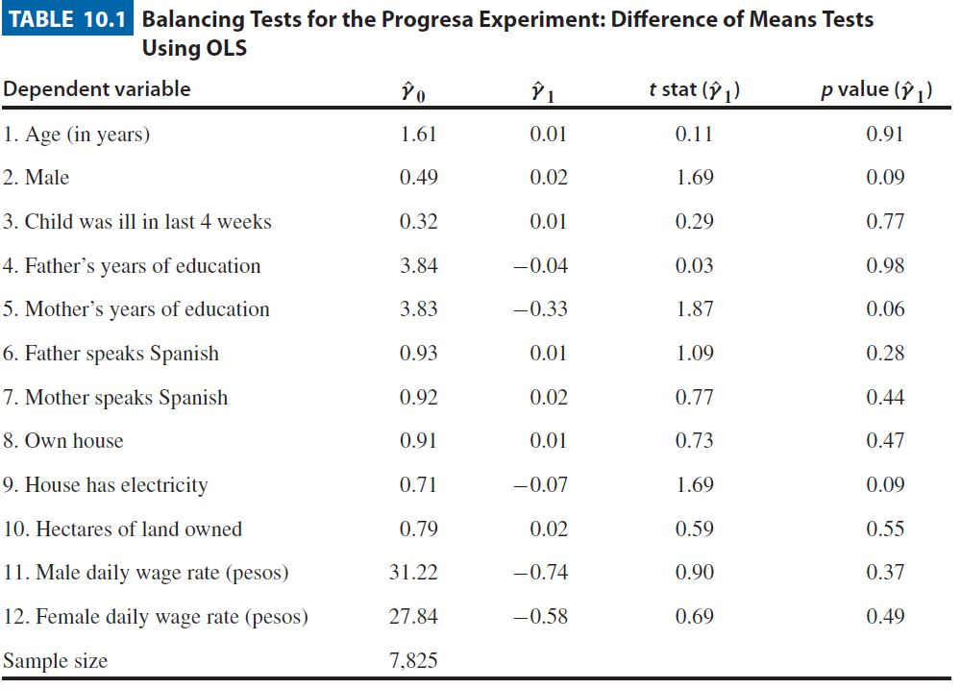
Table 10.1

Slide 12
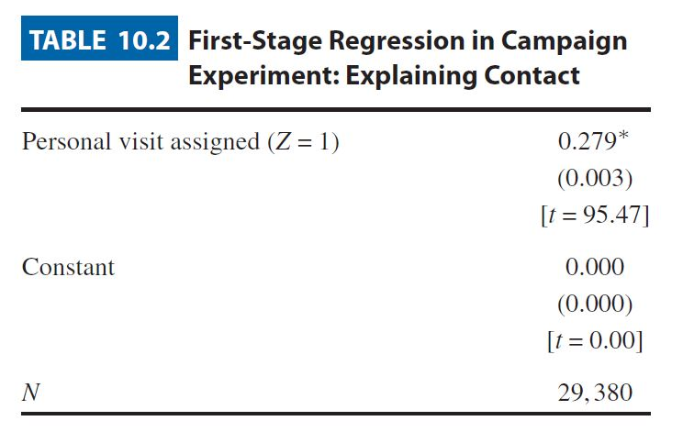
Table 10.2

Slide 13
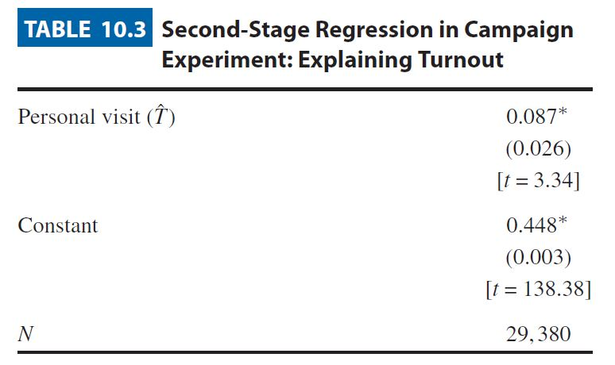
Table 10.3

Slide 14
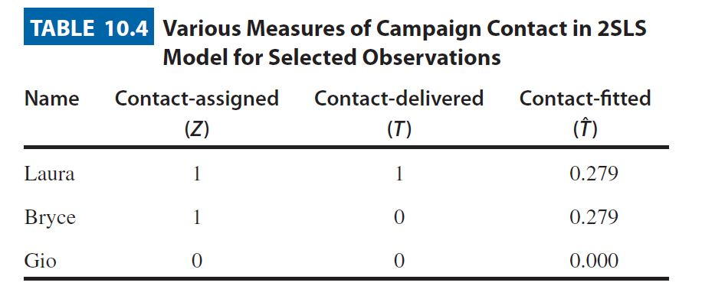
Table 10.4

Slide 15
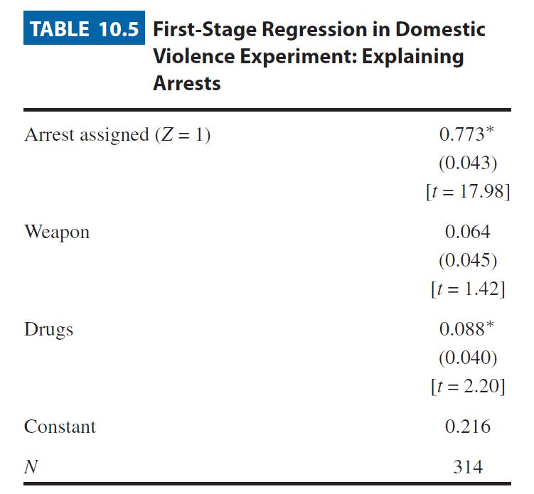
Table 10.5

Slide 16
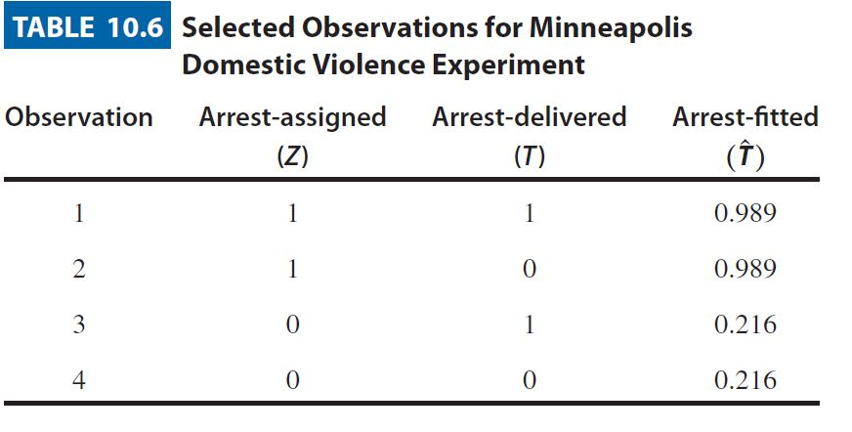
Table 10.6

Slide 17
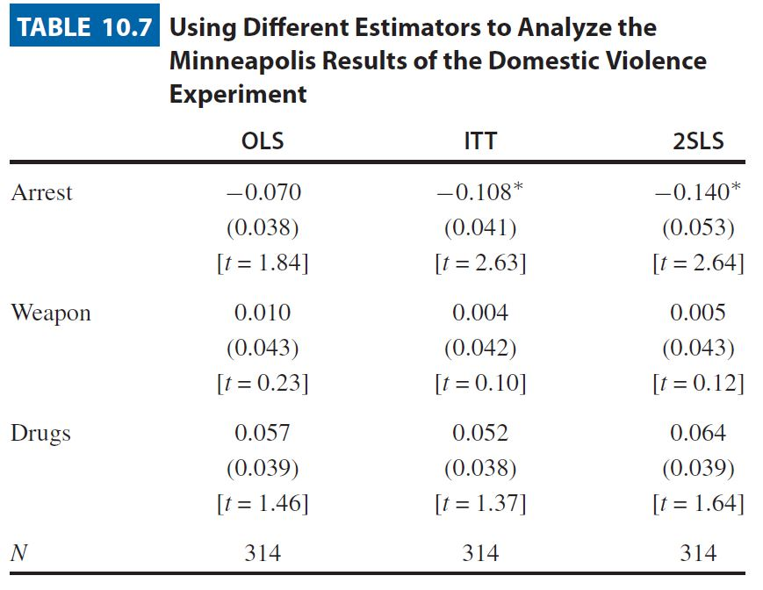
Table 10.7

Slide 18
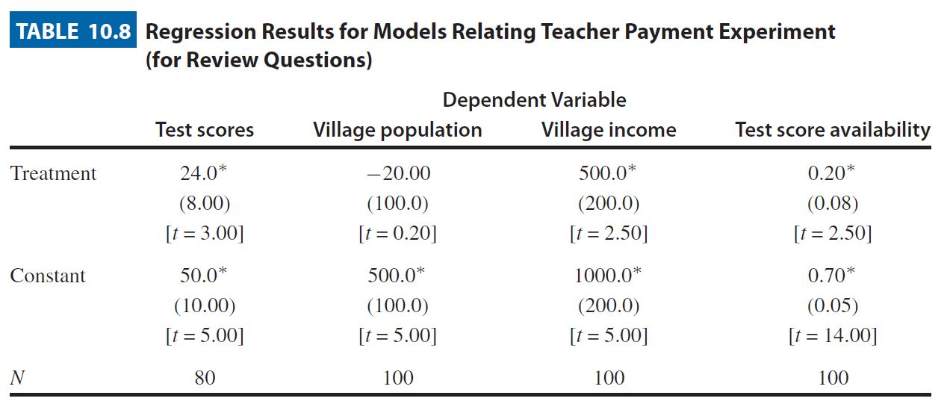
Table 10.8

Slide 19
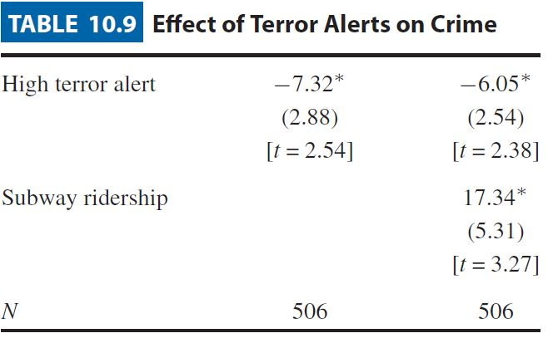
Table 10.9

Slide 20
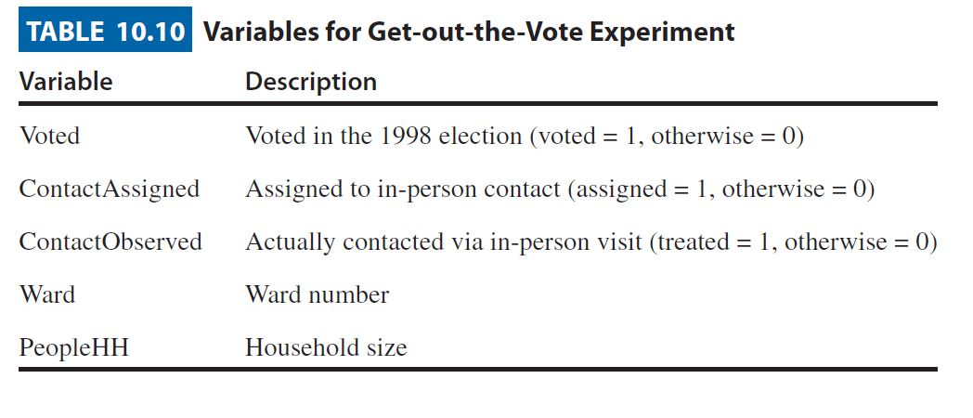
Table 10.10

Slide 21
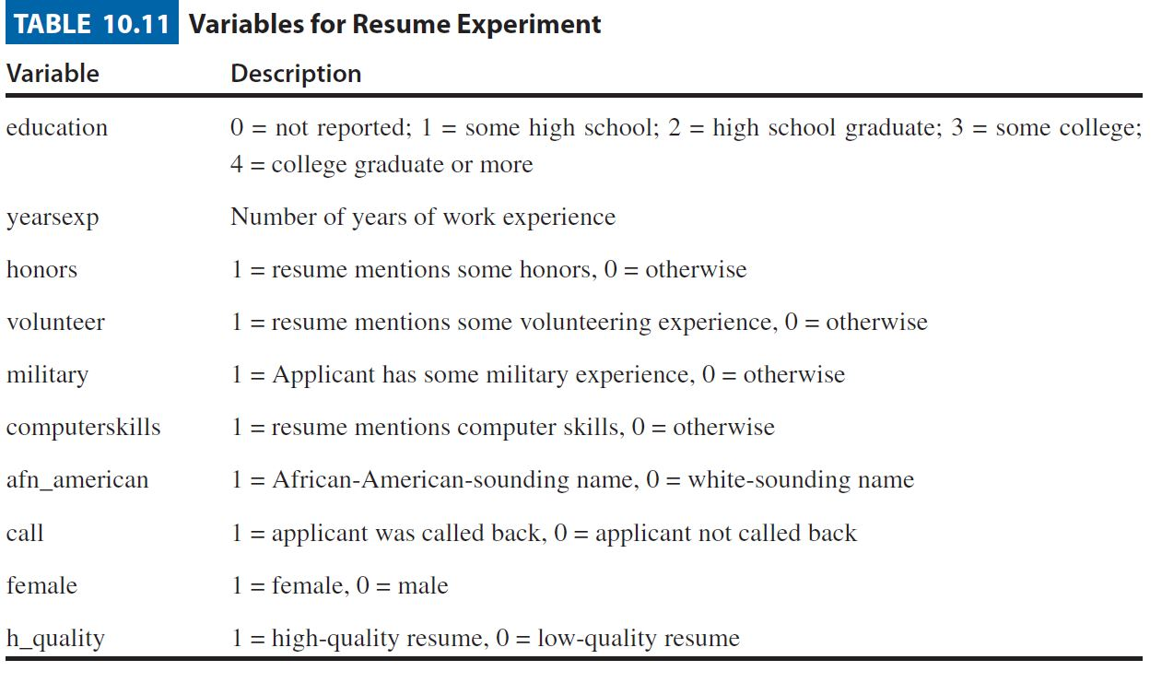
Table 10.11

Slide 22
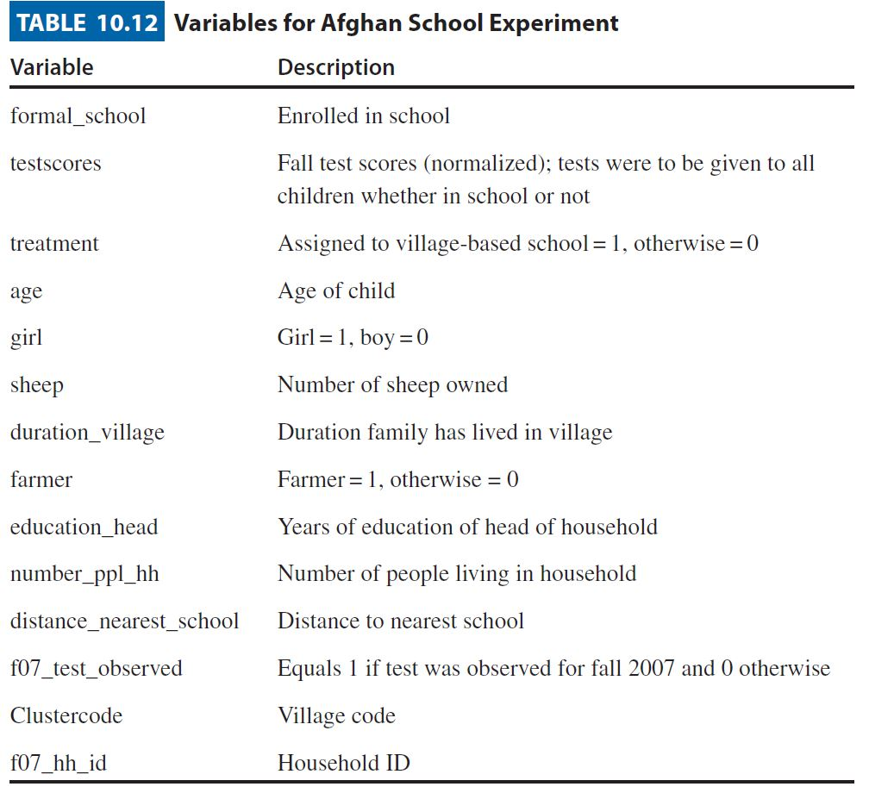
Table 10.12

