Slide 1
Chapter 11
Real Econometrics
Second Edition
Michael A. Bailey

Slide 2


Slide 3
Case Study Photos
Chapter 11

Slide 4

Case Study 1

Slide 5

Case Study 2

Slide 6
Figures
Chapter 11

Slide 7
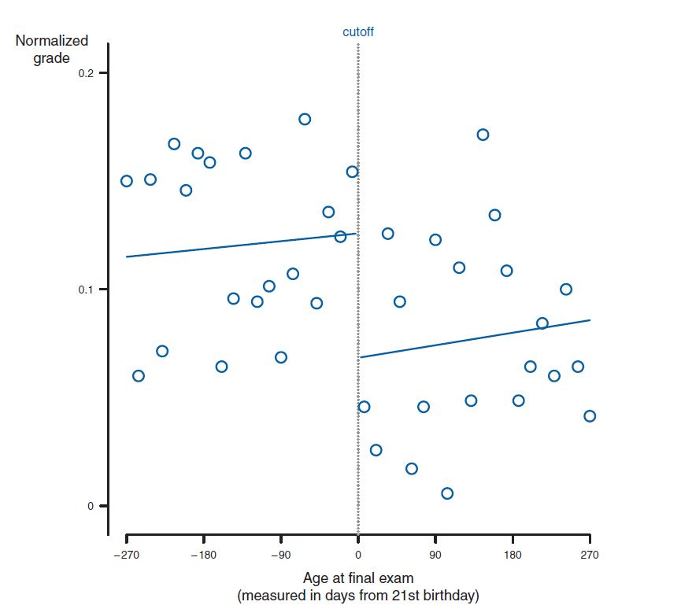
Figure 11.1

Slide 8
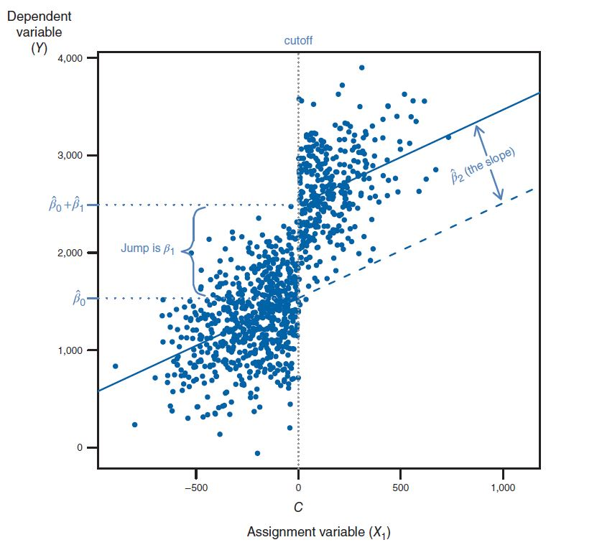
Figure 11.2

Slide 9
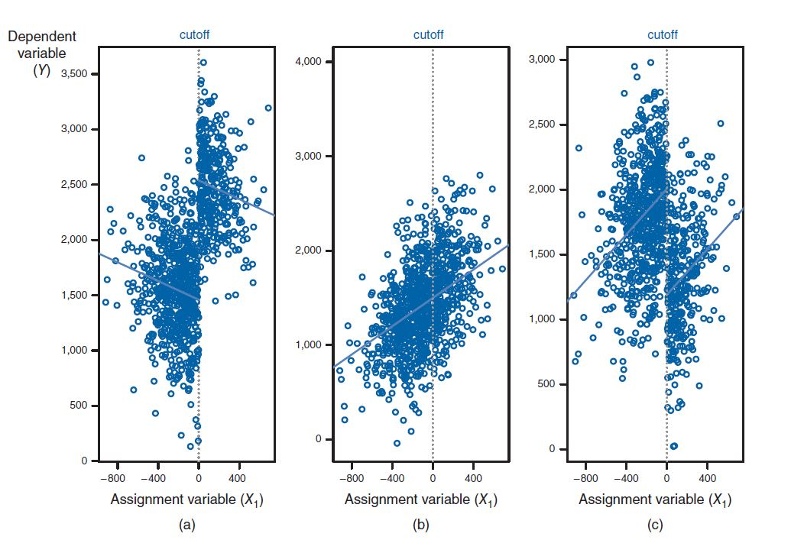
Figure 11.3

Slide 10
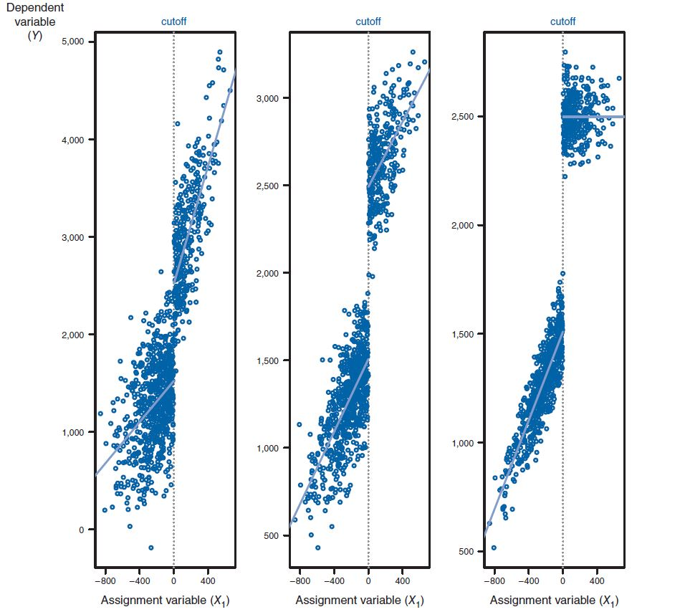
Figure 11.4

Slide 11
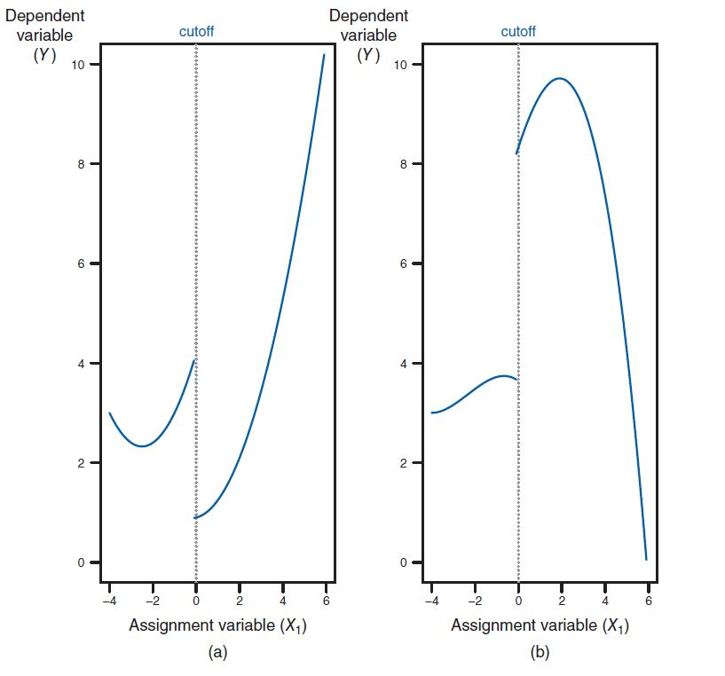
Figure 11.5

Slide 12
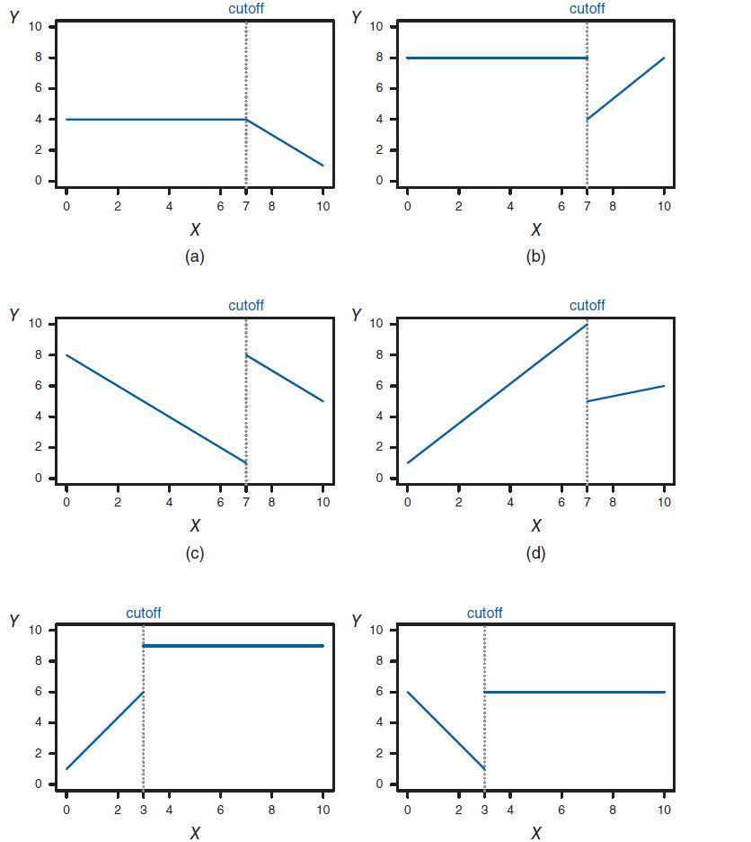
Figure 11.6

Slide 13
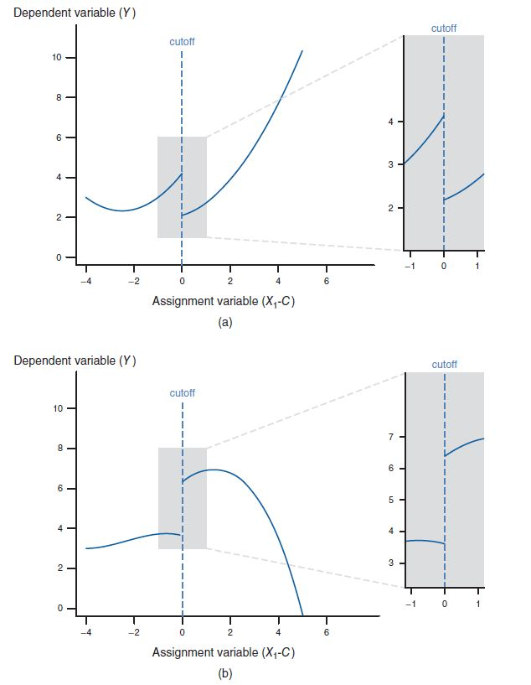
Figure 11.7

Slide 14
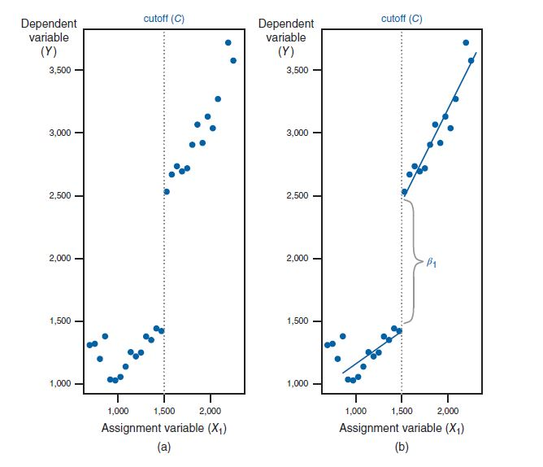
Figure 11.8

Slide 15
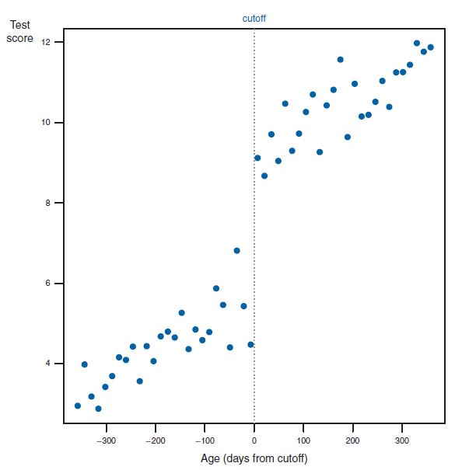
Figure 11.9

Slide 16
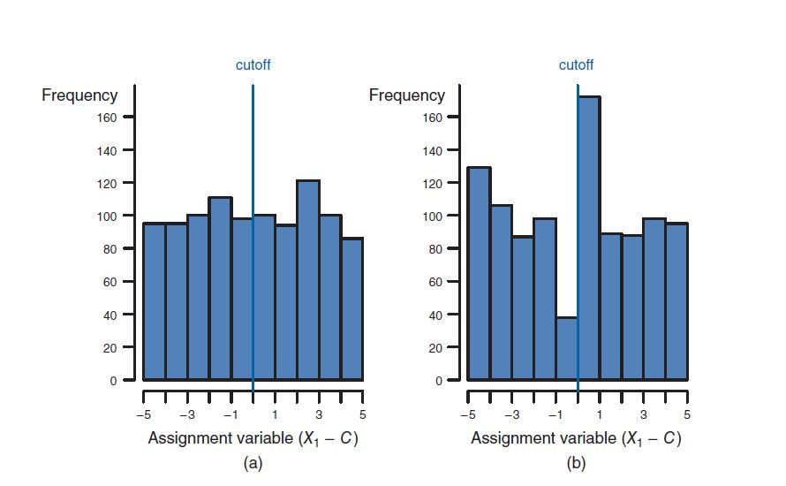
Figure 11.10

Slide 17
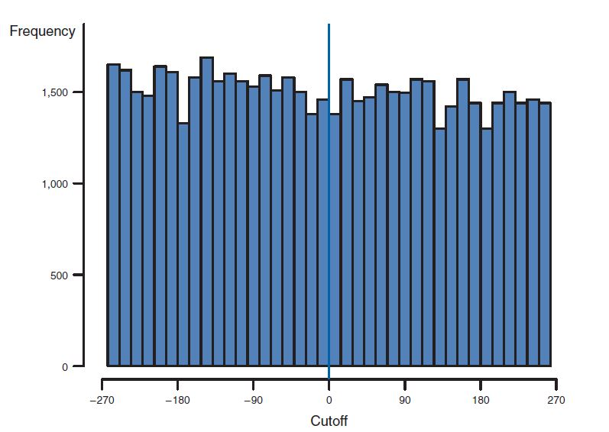
Figure 11.11

Slide 18
Tables
Chapter 11

Slide 19
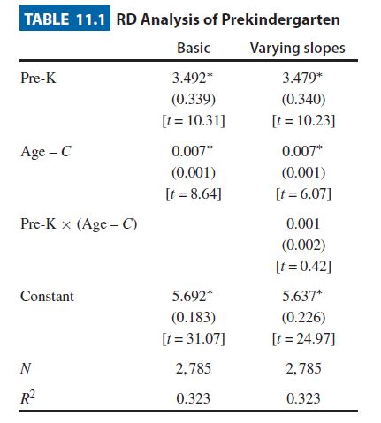
Table 11.1

Slide 20
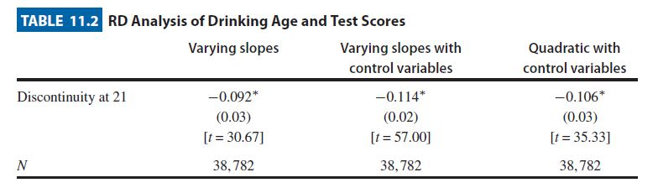
Table 11.2

Slide 21
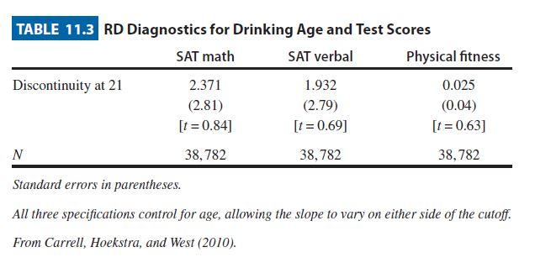
Table 11.3

Slide 22
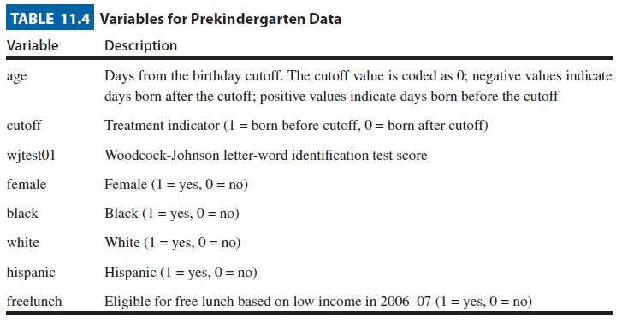
Table 11.4

Slide 23
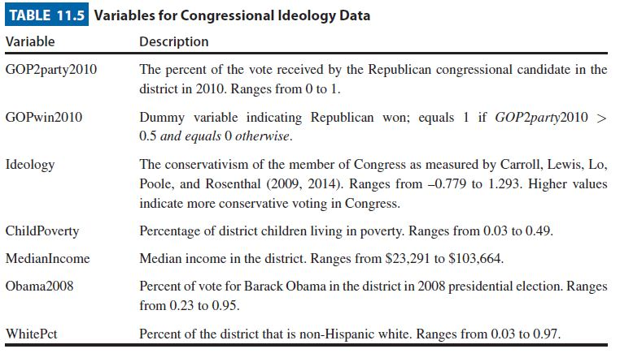
Table 11.5

Slide 24
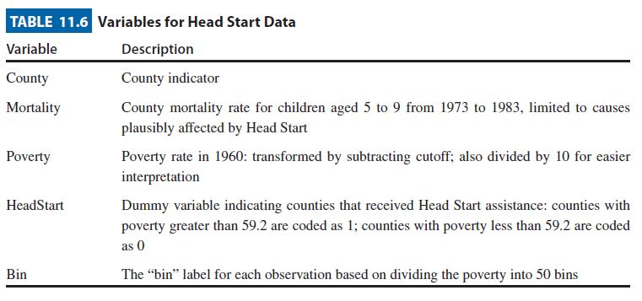
Table 11.6

