Slide 1
Chapter 15
Real Econometrics
Second Edition
Michael A. Bailey

Slide 2
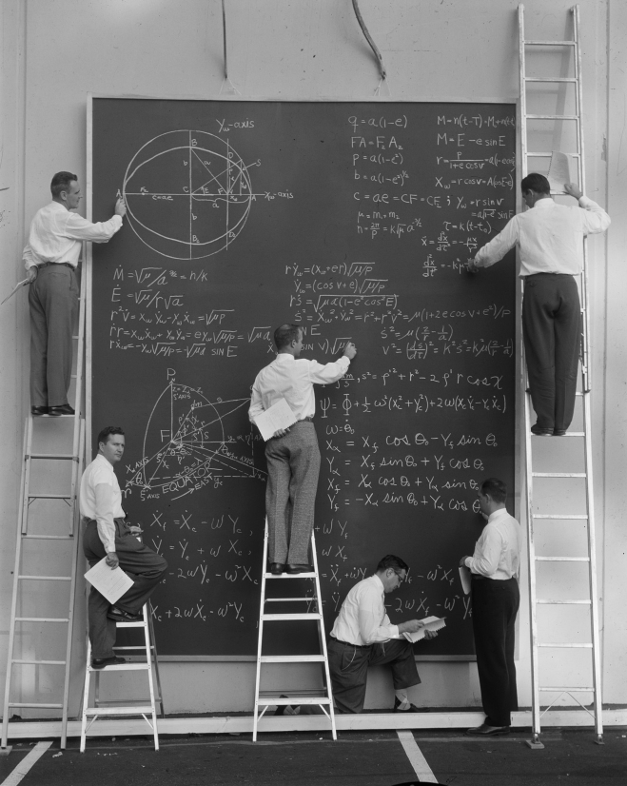

Slide 3
Tables
Chapter 15

Slide 4
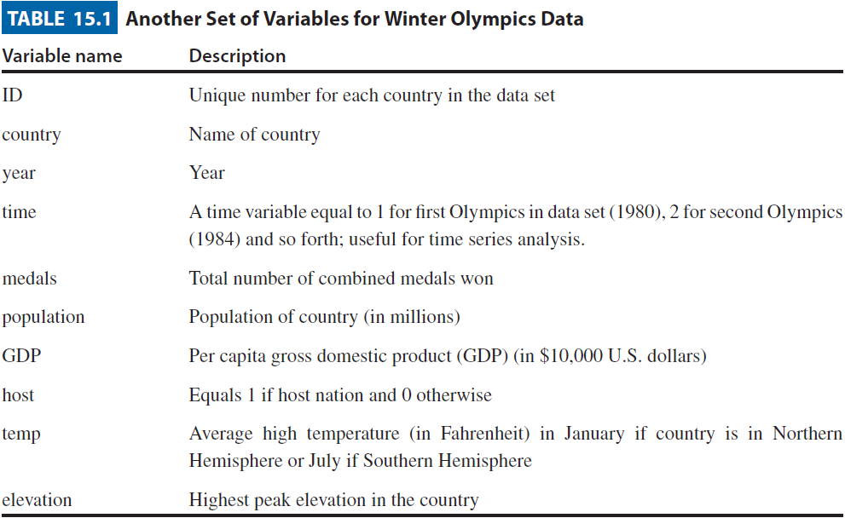
Table 15.1

