Slide 1
Chapter 12
Real Econometrics
Second Edition
Michael A. Bailey

Slide 2


Slide 3
Case Study Photos
Chapter 12

Slide 4

Case Study 1

Slide 5
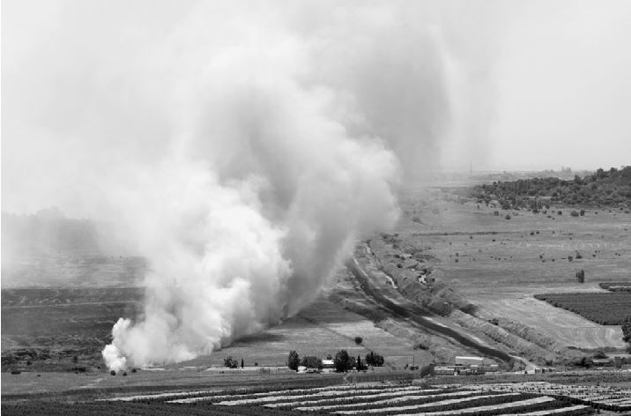
Case Study 2

Slide 6
Figures
Chapter 12

Slide 7
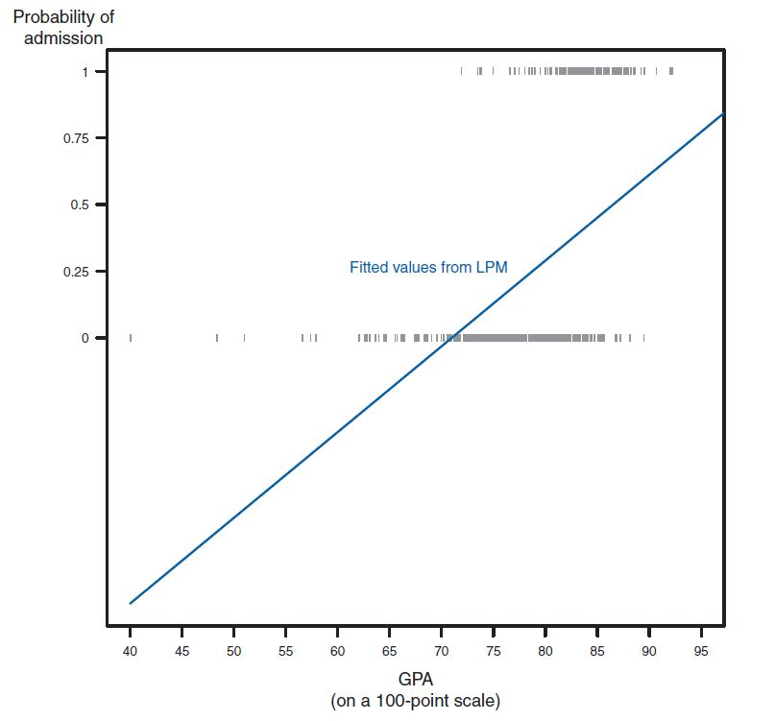
Figure 12.1

Slide 8
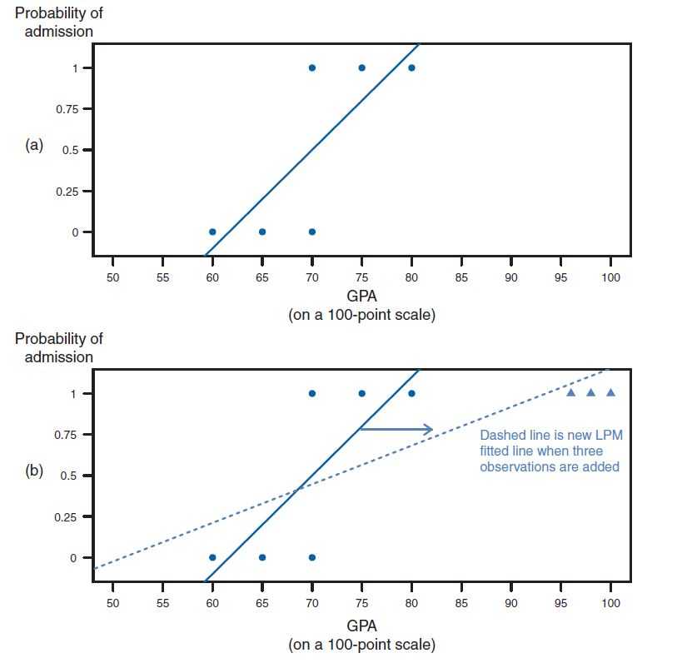
Figure 12.2

Slide 9
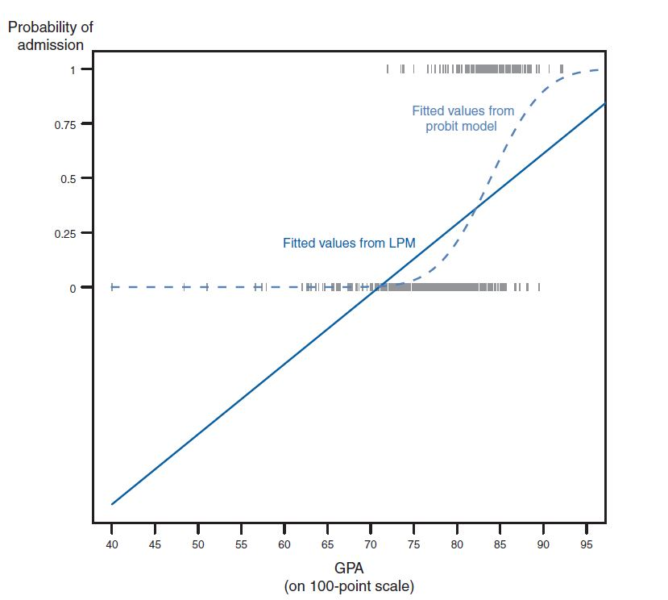
Figure 12.3

Slide 10
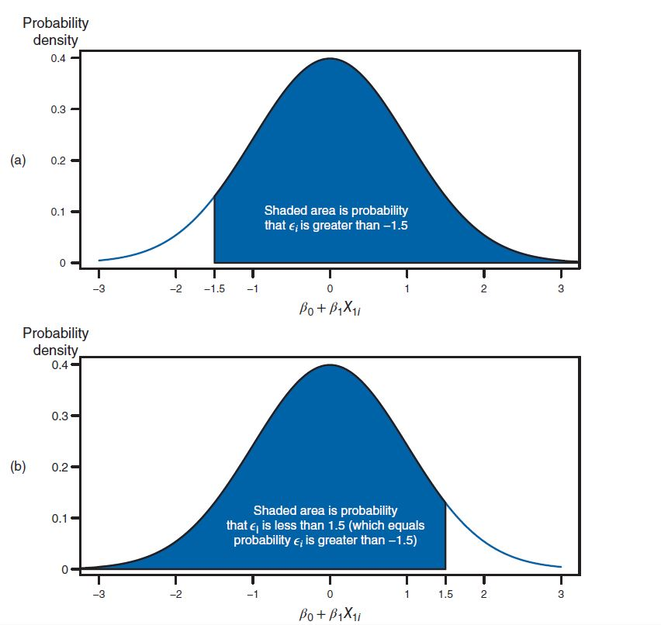
Figure 12.4

Slide 11
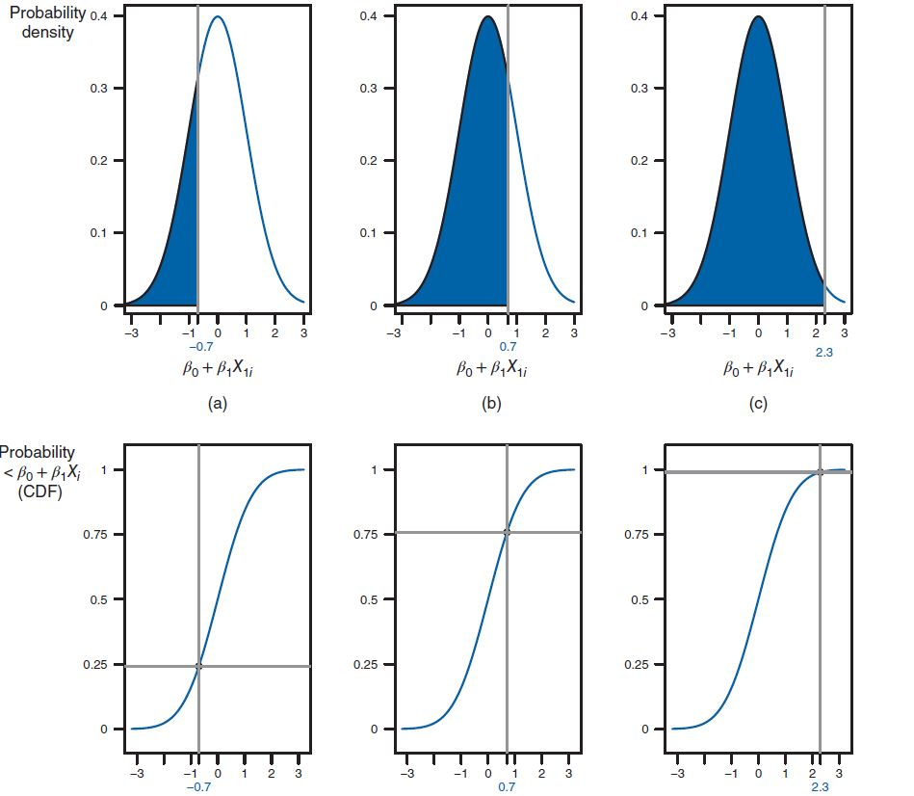
Figure 12.5

Slide 12
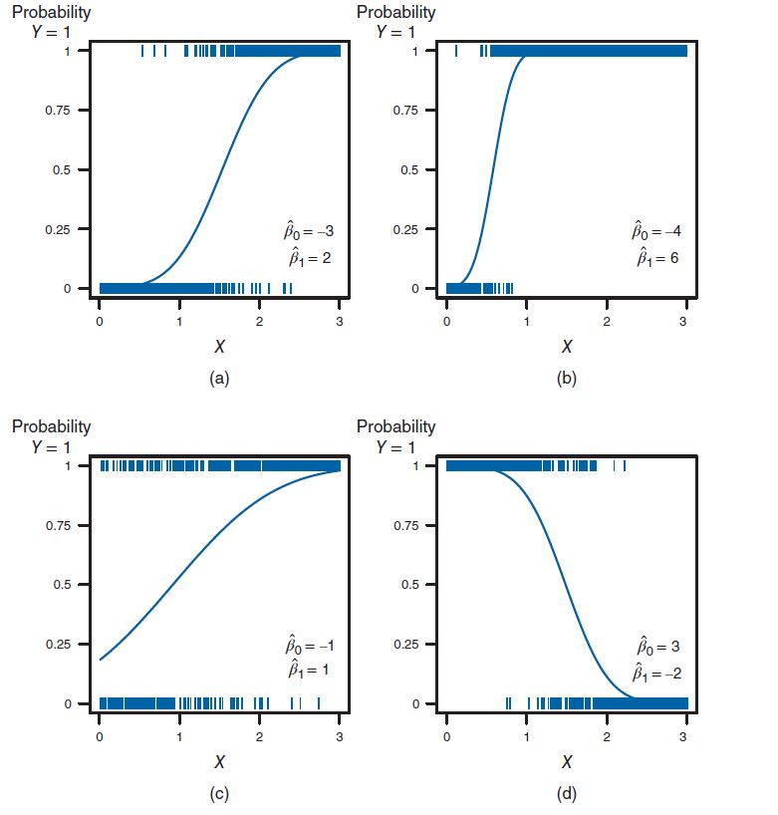
Figure 12.6

Slide 13
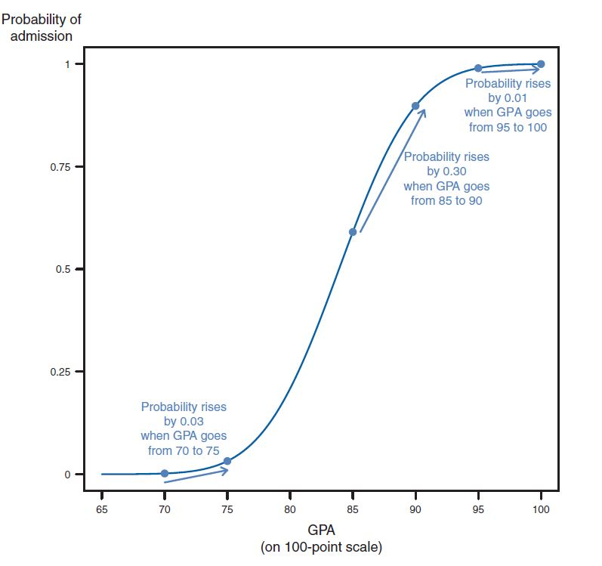
Figure 12.7

Slide 14
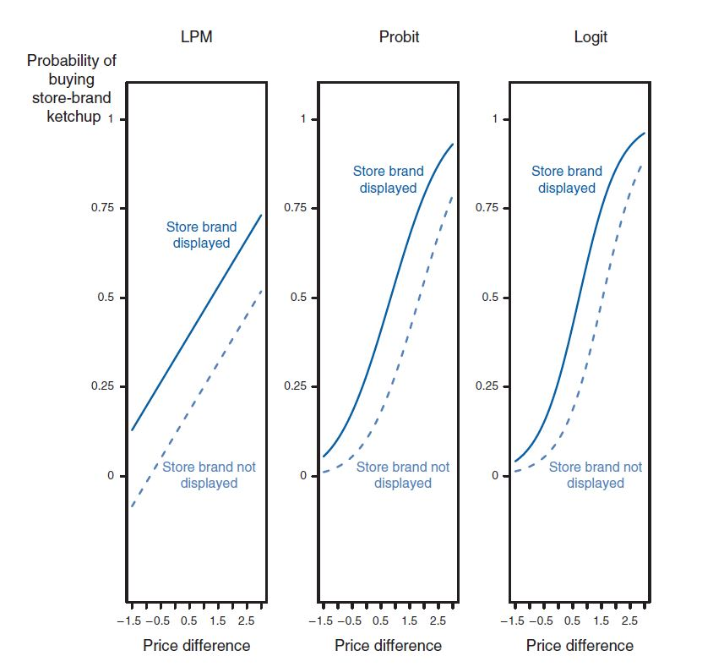
Figure 12.8

Slide 15
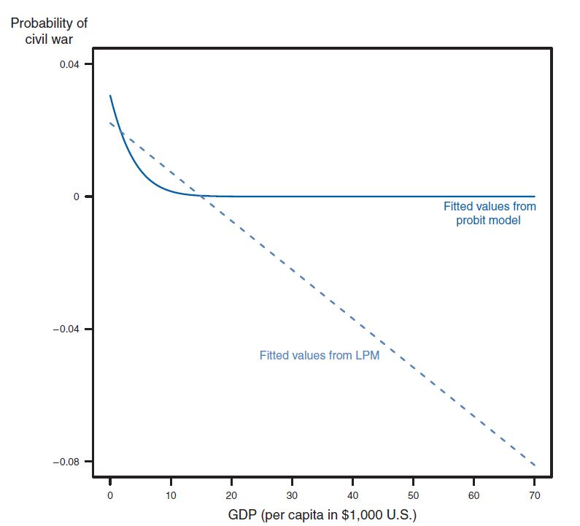
Figure 12.9

Slide 16
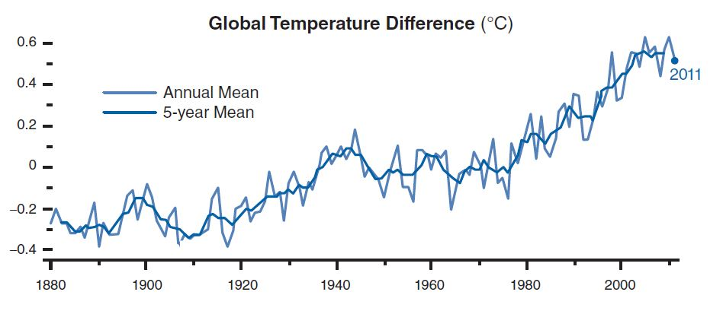
Figure 12.10

Slide 17
Tables
Chapter 12

Slide 18
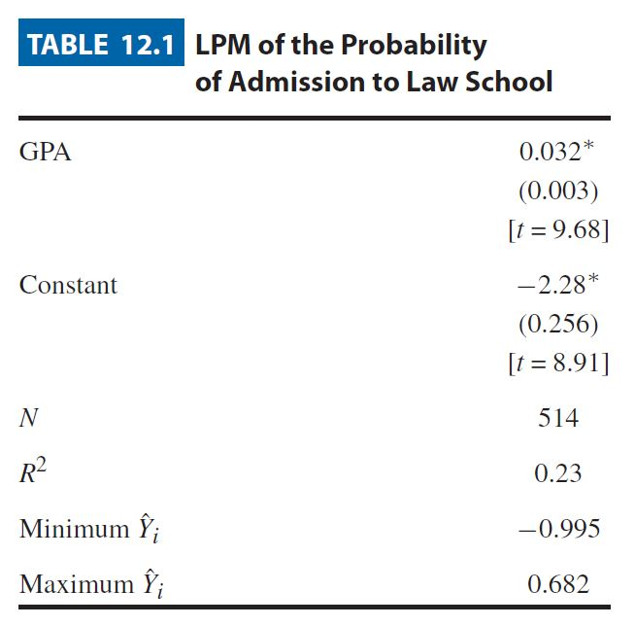
Table 12.1

Slide 19
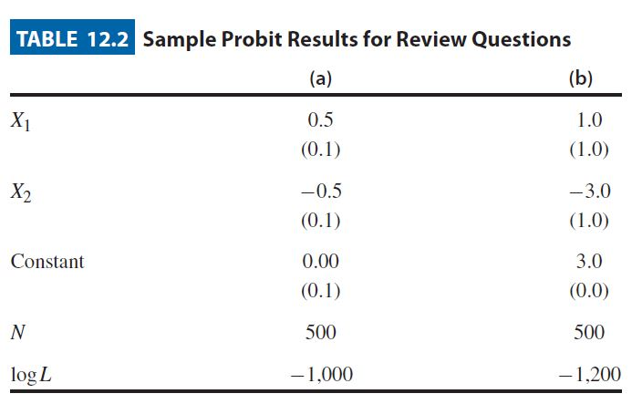
Table 12.2

Slide 20
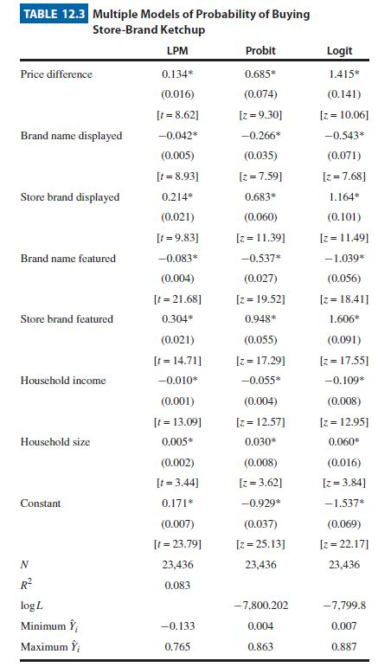
Table 12.3

Slide 21
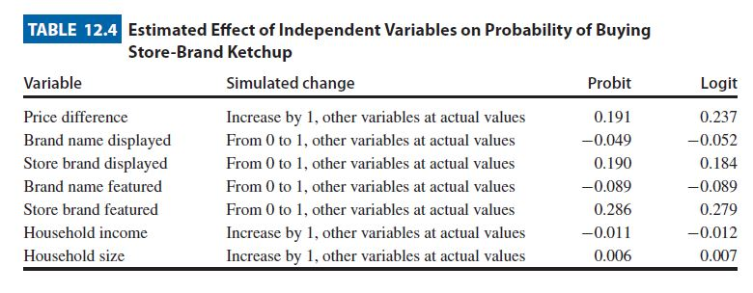
Table 12.4

Slide 22
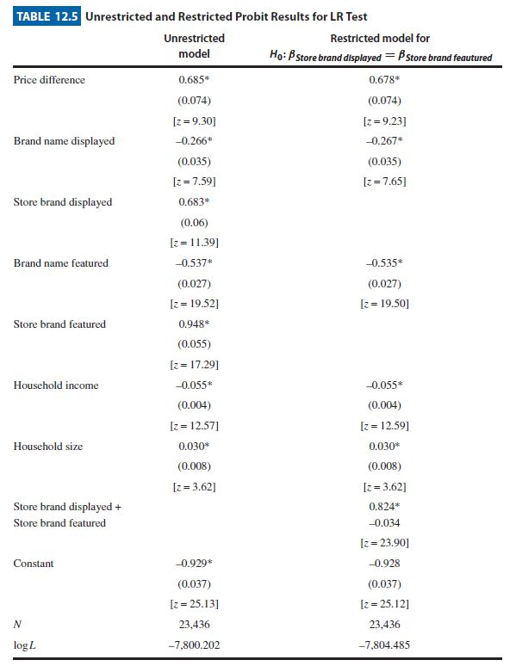
Table 12.5

Slide 23
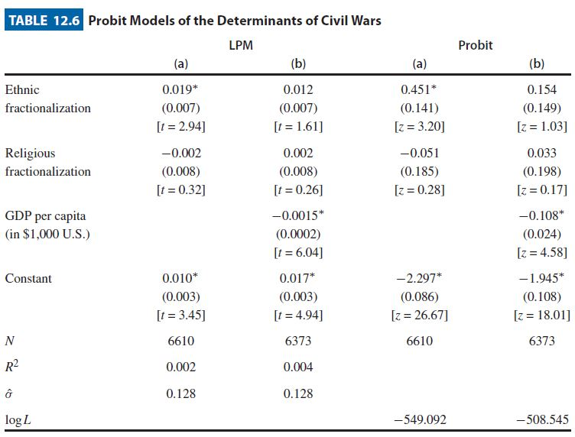
Table 12.6

Slide 24
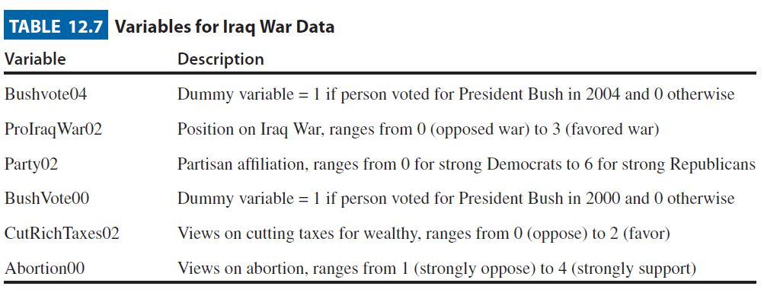
Table 12.7

Slide 25
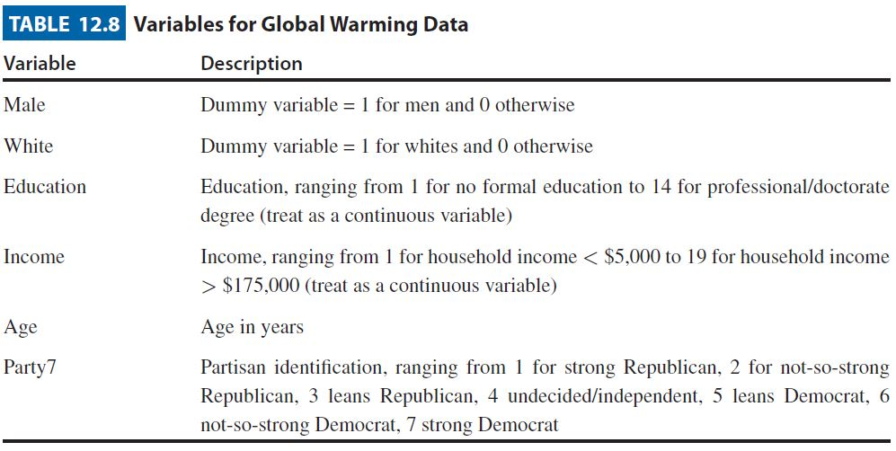
Table 12.8

Slide 26
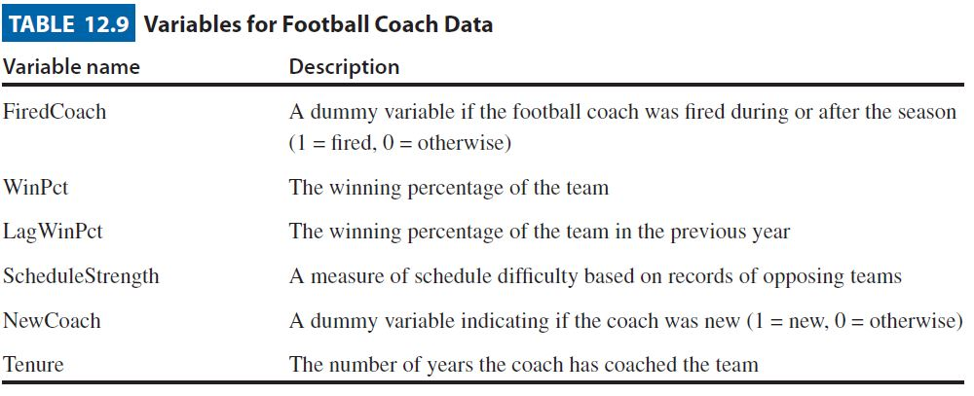
Table 12.9

Slide 27
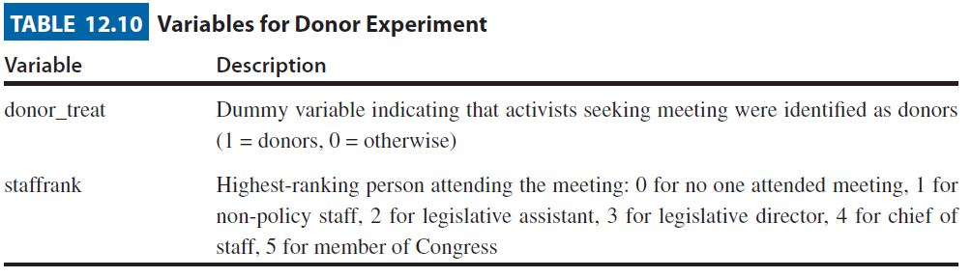
Table 12.10

Slide 28
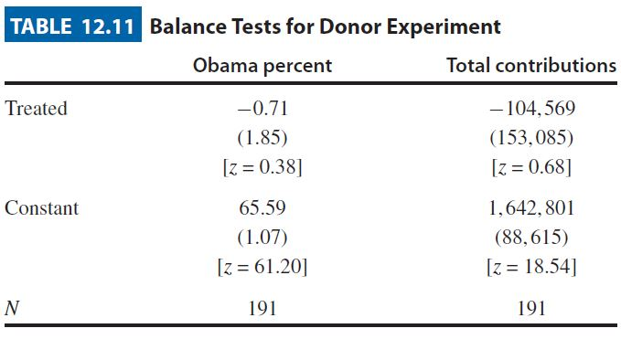
Table 12.11

