Slide 1
Chapter 3
Real Econometrics
Second Edition
Michael A. Bailey

Slide 2


Slide 3
Case Study Photos
Chapter 3

Slide 4

Case Study 1

Slide 5
Figures
Chapter 3

Slide 6
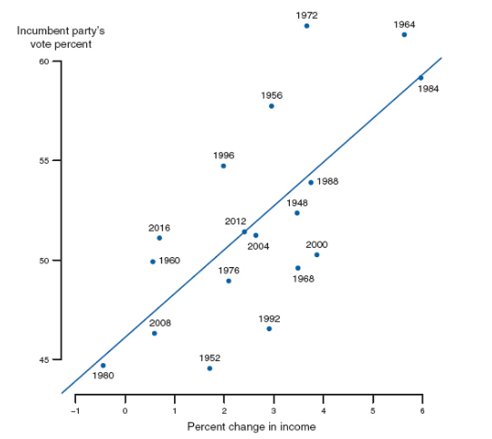
Figure 3.1

Slide 7
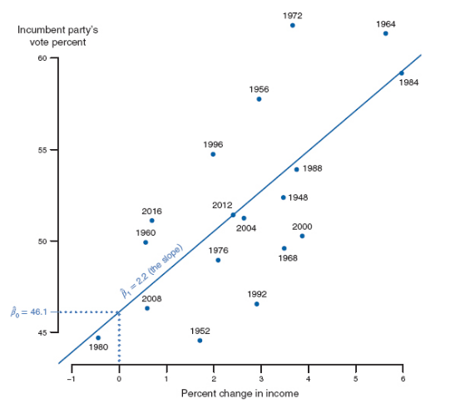
Figure 3.2

Slide 8
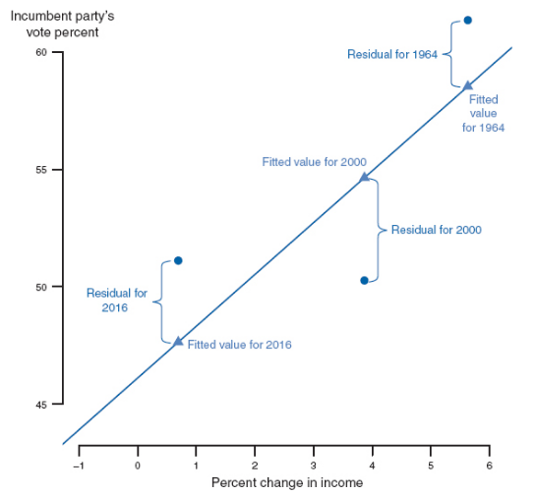
Figure 3.3

Slide 9
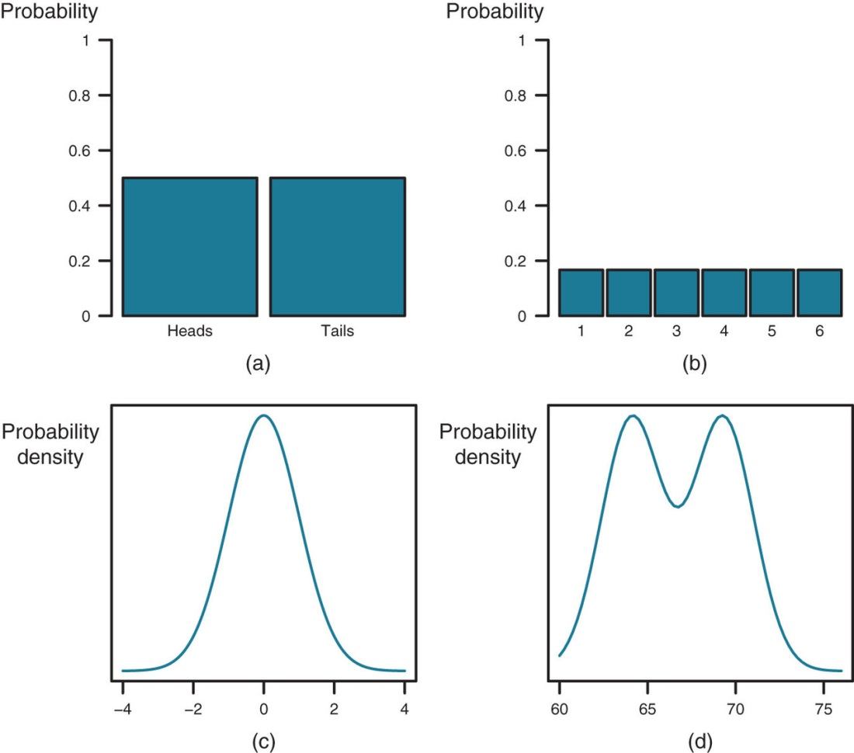
Figure 3.4

Slide 10
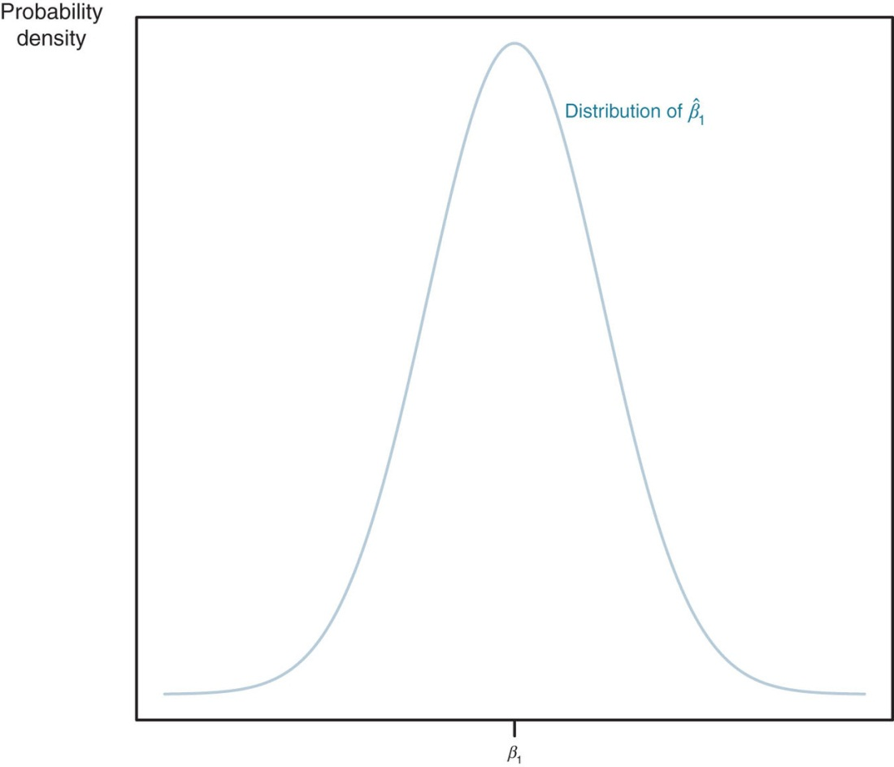
Figure 3.5

Slide 11
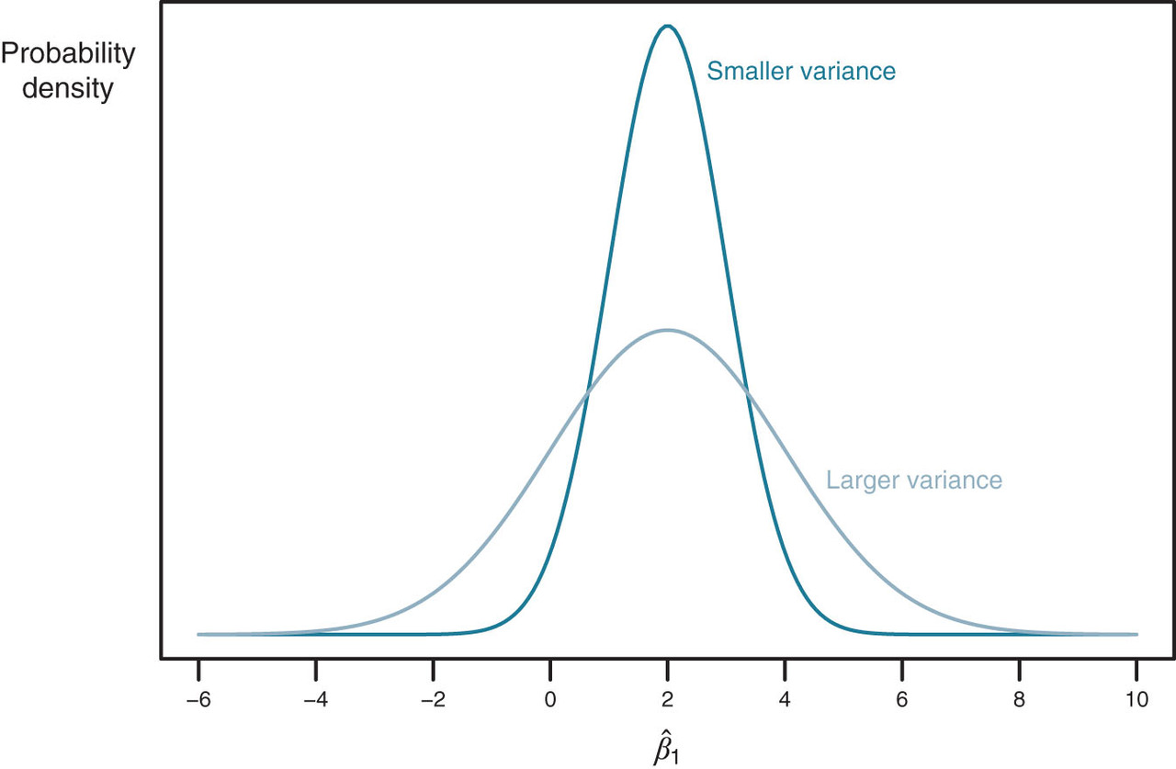
Figure 3.6

Slide 12
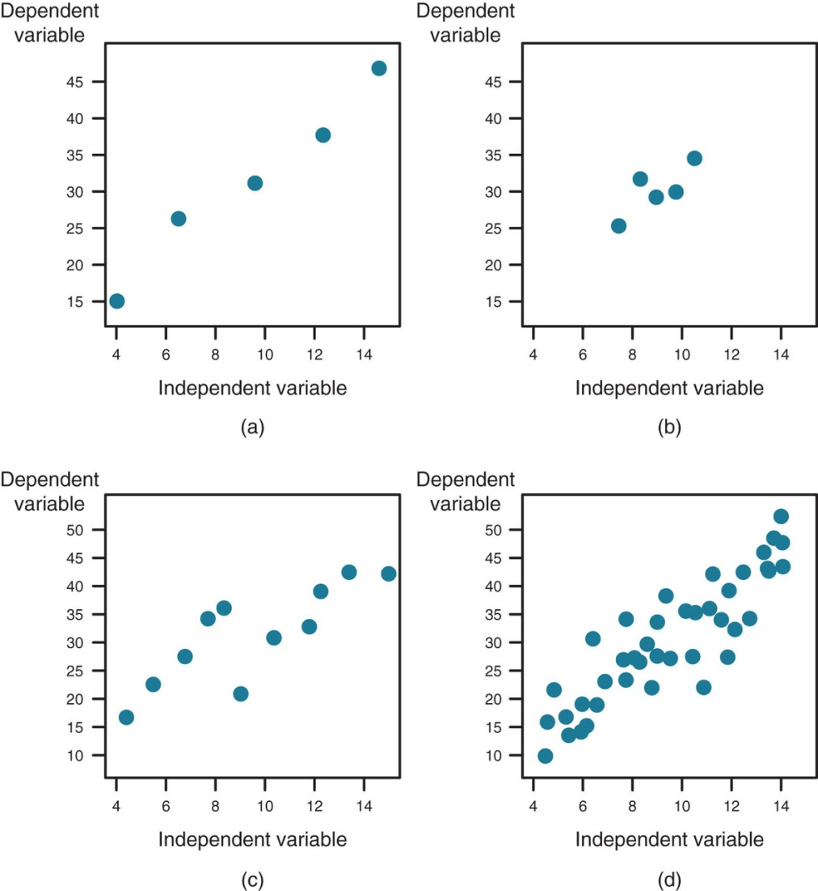
Figure 3.7

Slide 13
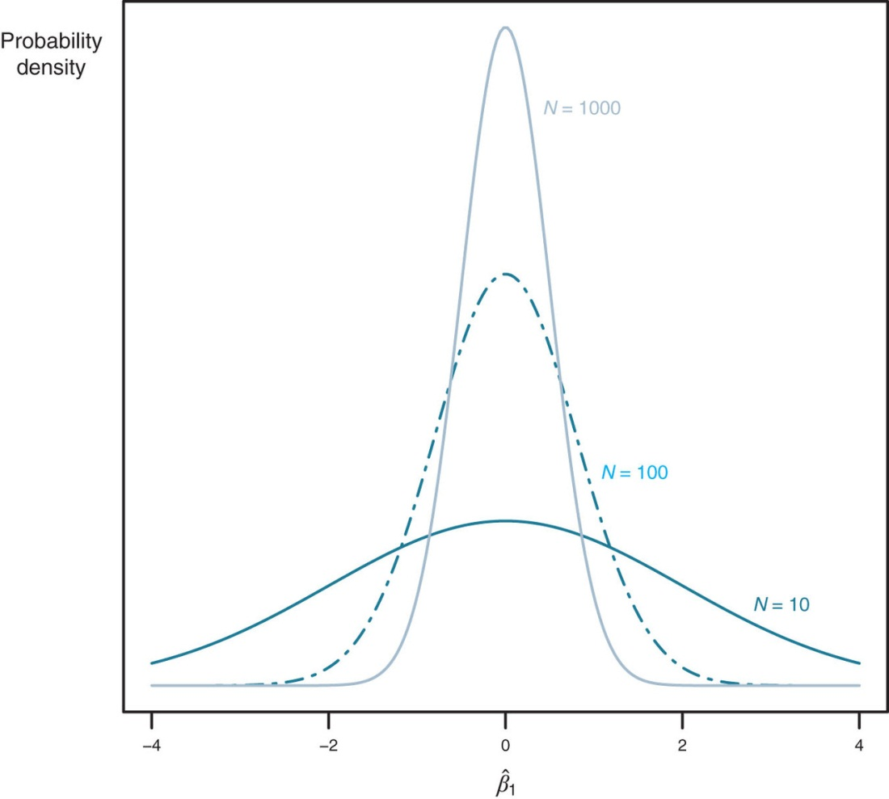
Figure 3.8

Slide 14
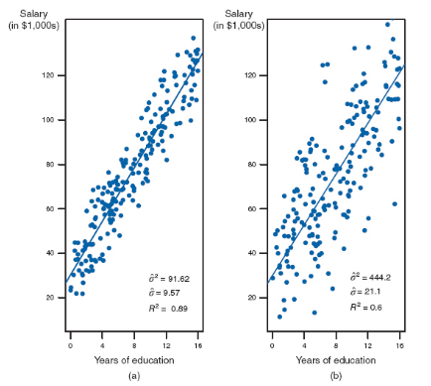
Figure 3.9

Slide 15
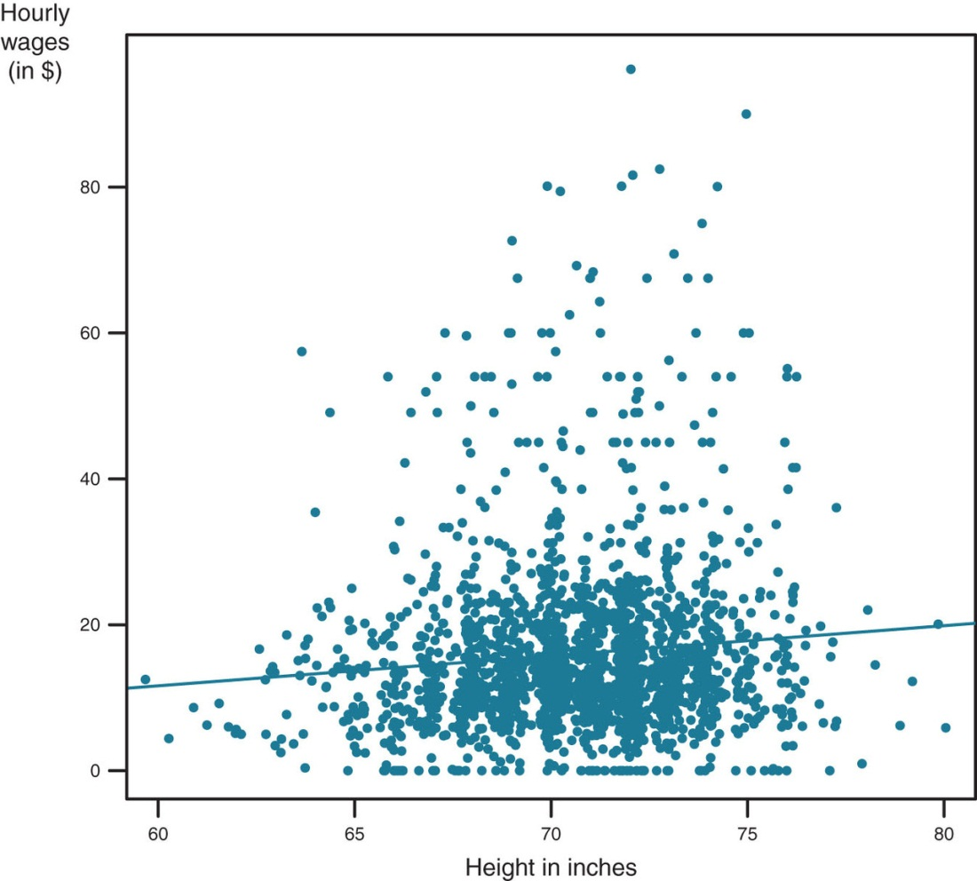
Figure 3.10

Slide 16
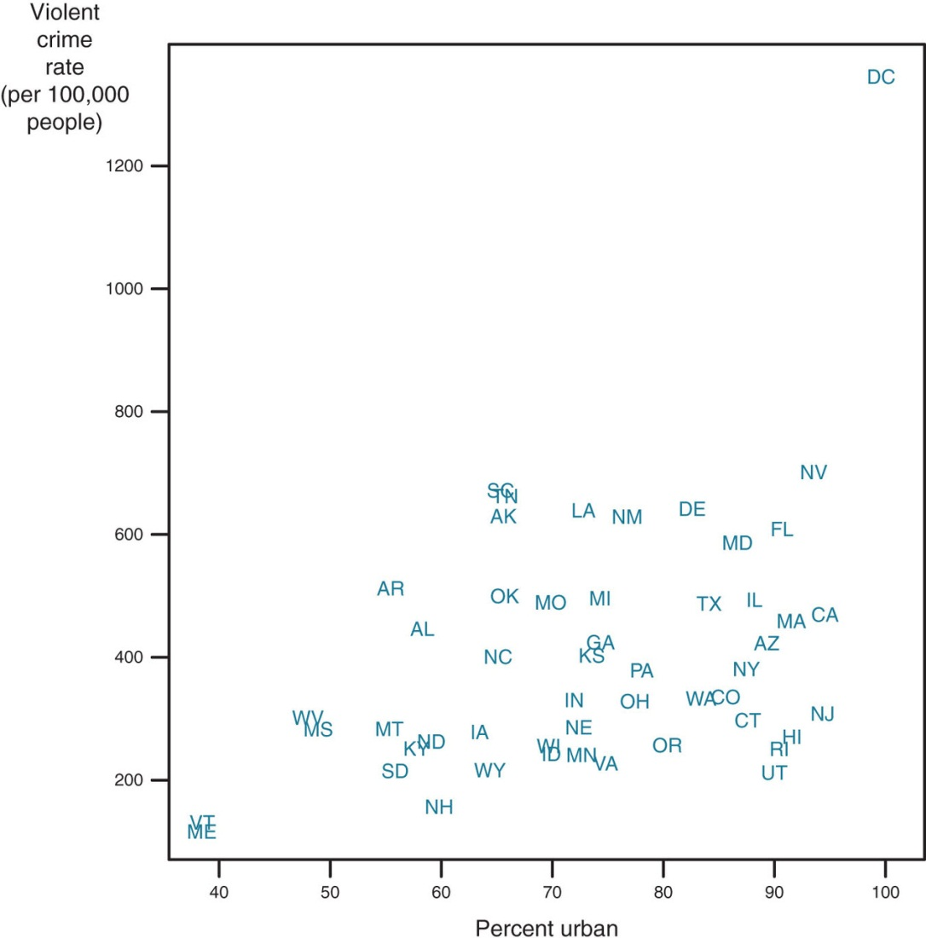
Figure 3.11

Slide 17
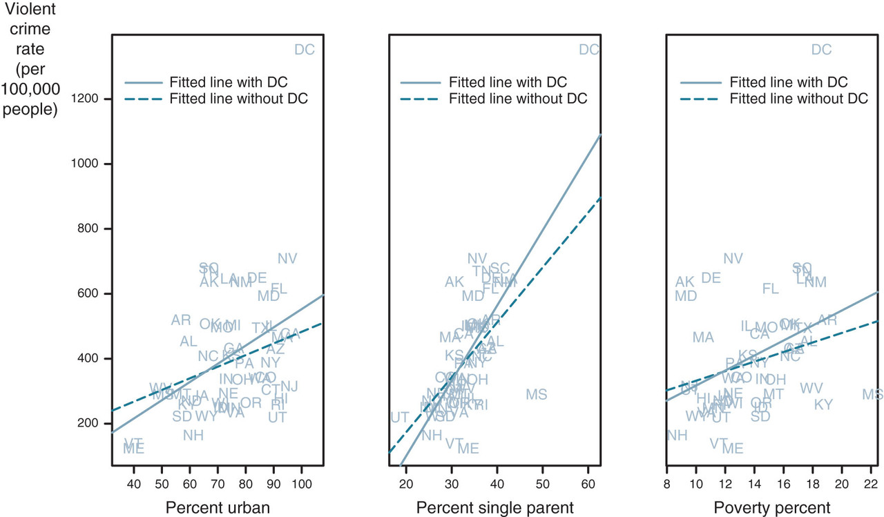
Figure 3.12

Slide 18
Tables
Chapter 3

Slide 19
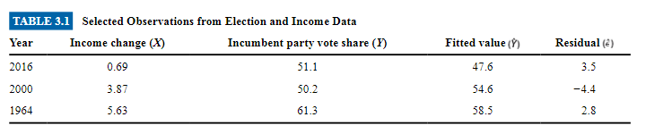
Table 3.1

Slide 20
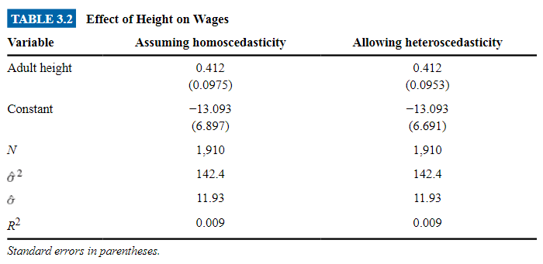
Table 3.2

Slide 21
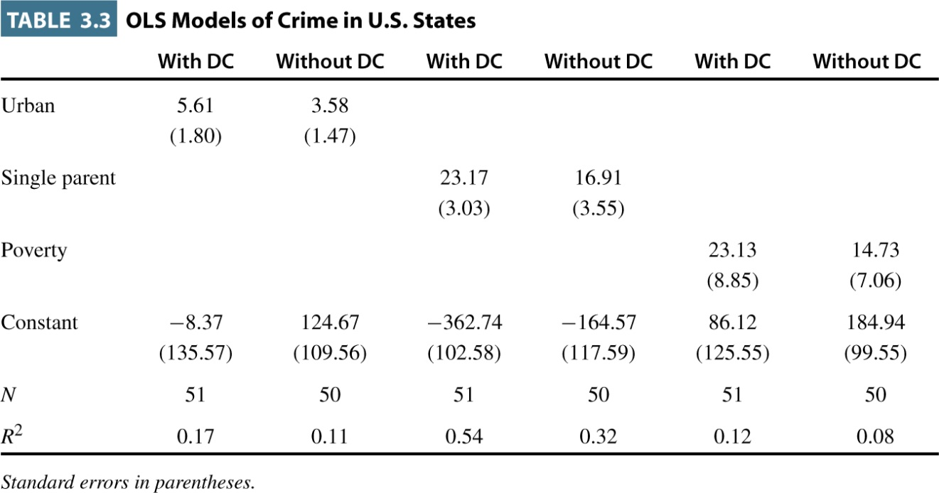
Table 3.3

Slide 22
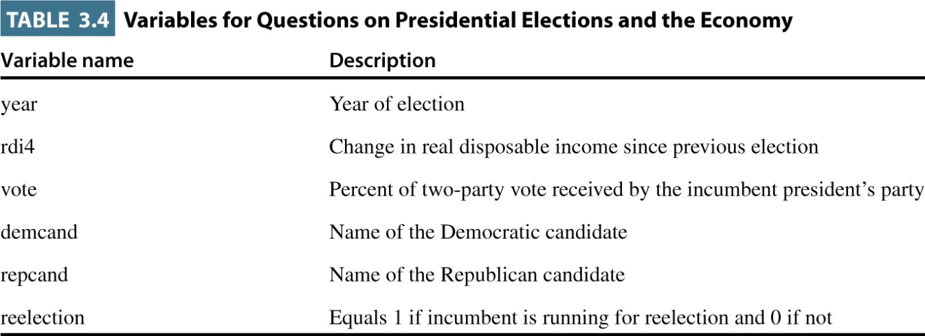
Table 3.4

Slide 23
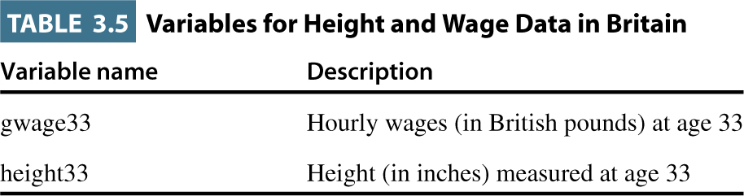
Table 3.5

Slide 24
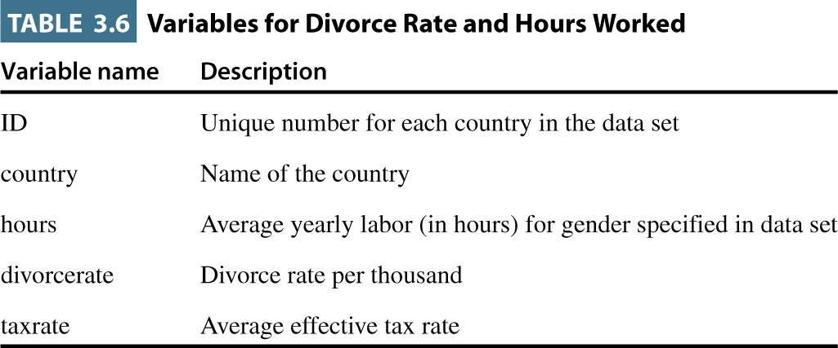
Table 3.6

