Slide 1
Chapter 9
Real Econometrics
Second Edition
Michael A. Bailey

Slide 2


Slide 3
Case Study Photos
Chapter 9

Slide 4

Case Study 1

Slide 5
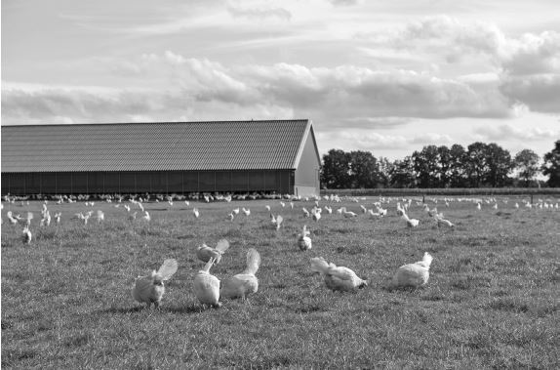
Case Study 2

Slide 6
Figures
Chapter 9

Slide 7
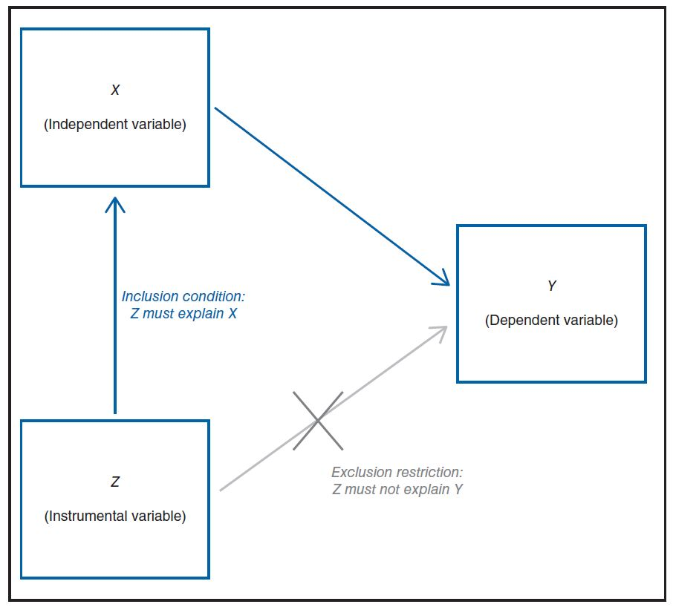
Figure 9.1

Slide 8
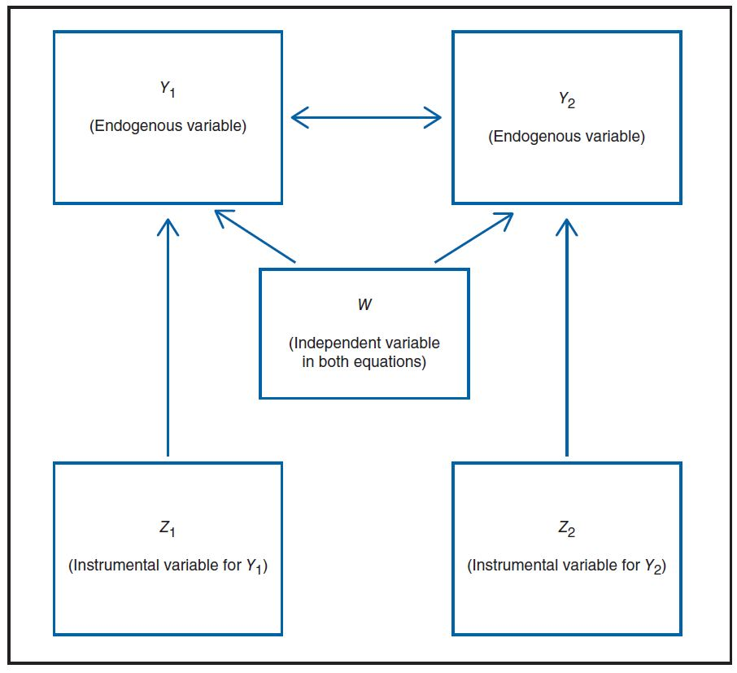
Figure 9.2

Slide 9
Tables
Chapter 9

Slide 10
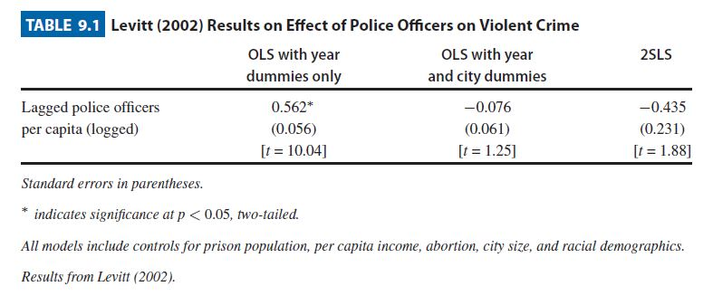
Table 9.1

Slide 11
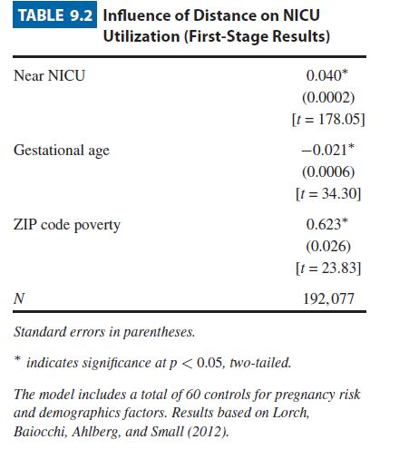
Table 9.2

Slide 12
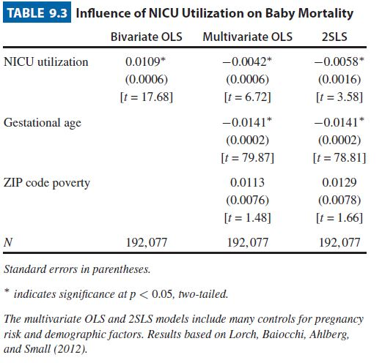
Table 9.3

Slide 13
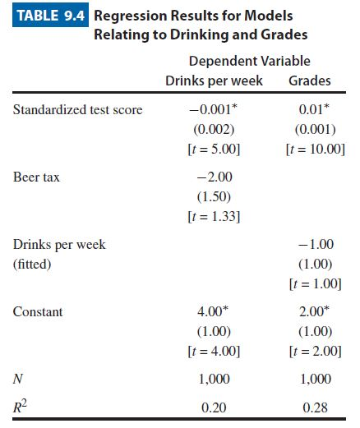
Table 9.4

Slide 14
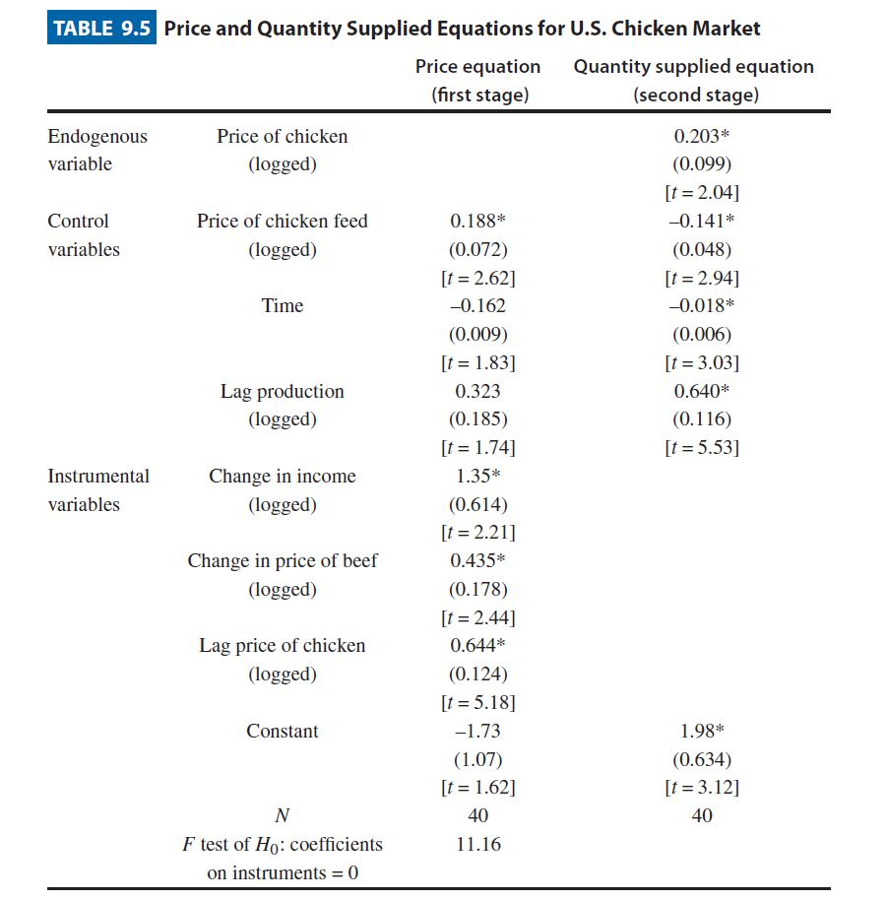
Table 9.5

Slide 15
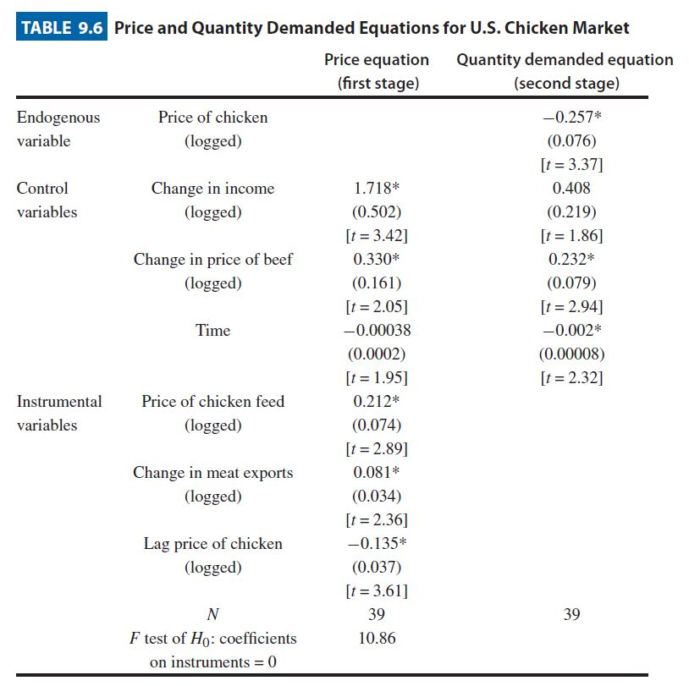
Table 9.6

Slide 16
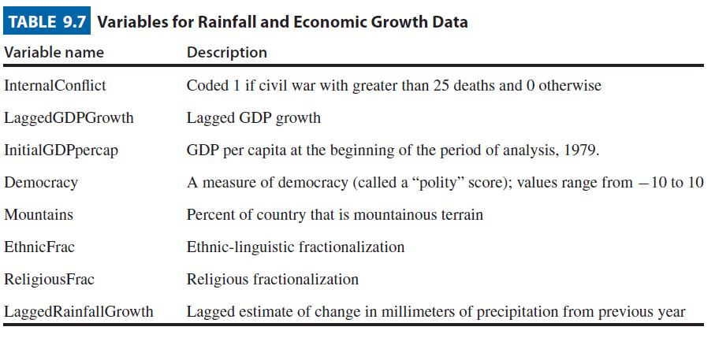
Table 9.7

Slide 17
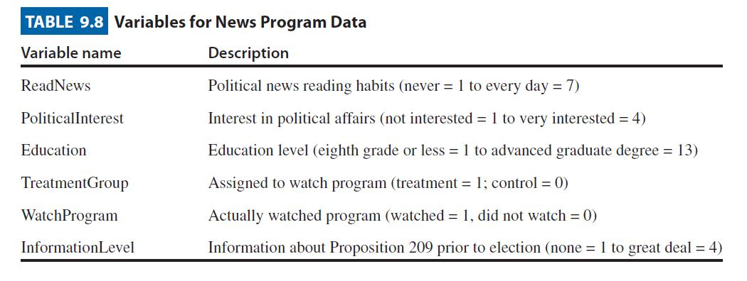
Table 9.8

Slide 18
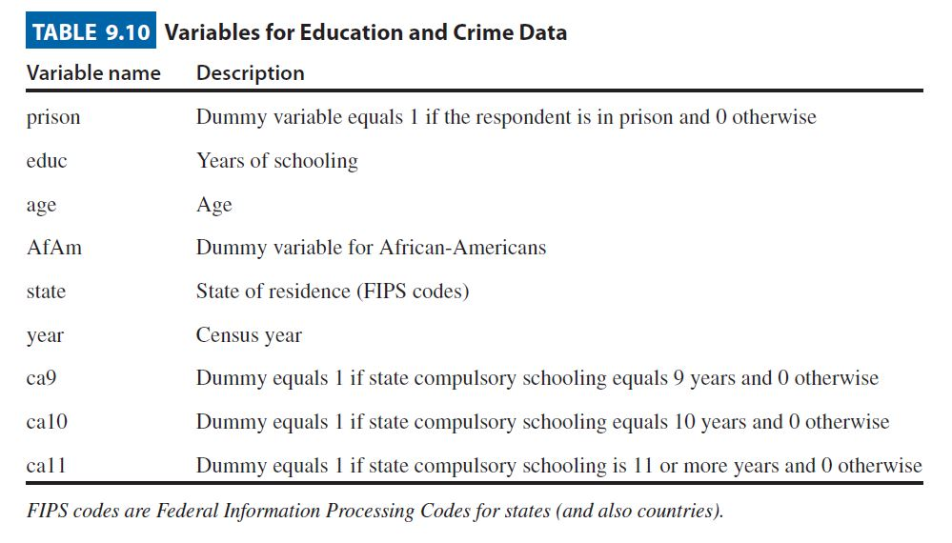
Table 9.10

Slide 19
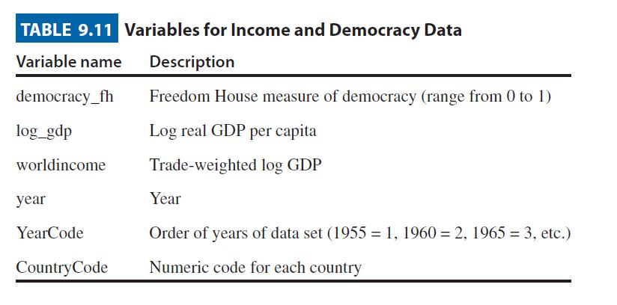
Table 9.11

