Slide 1
Chapter 7
Real Econometrics
Second Edition
Michael A. Bailey

Slide 2


Slide 3
Case Study Photos
Chapter 7

Slide 4
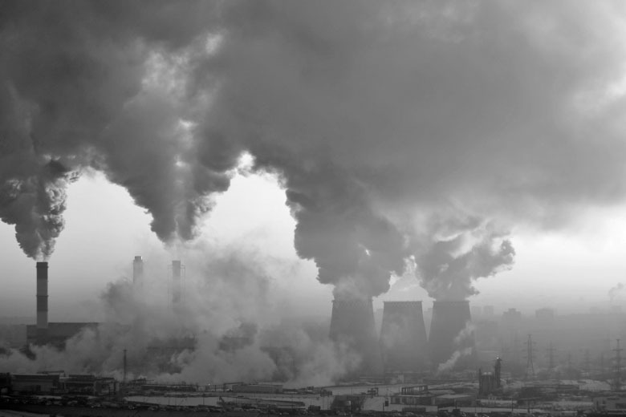
Case Study 1

Slide 5
Figures
Chapter 7

Slide 6
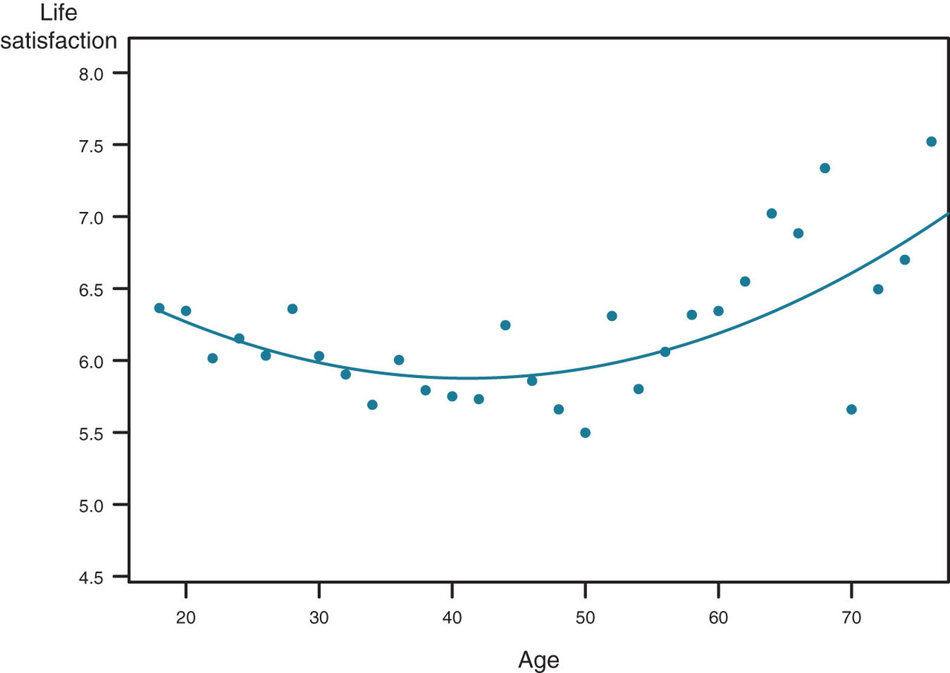
Figure 7.1

Slide 7
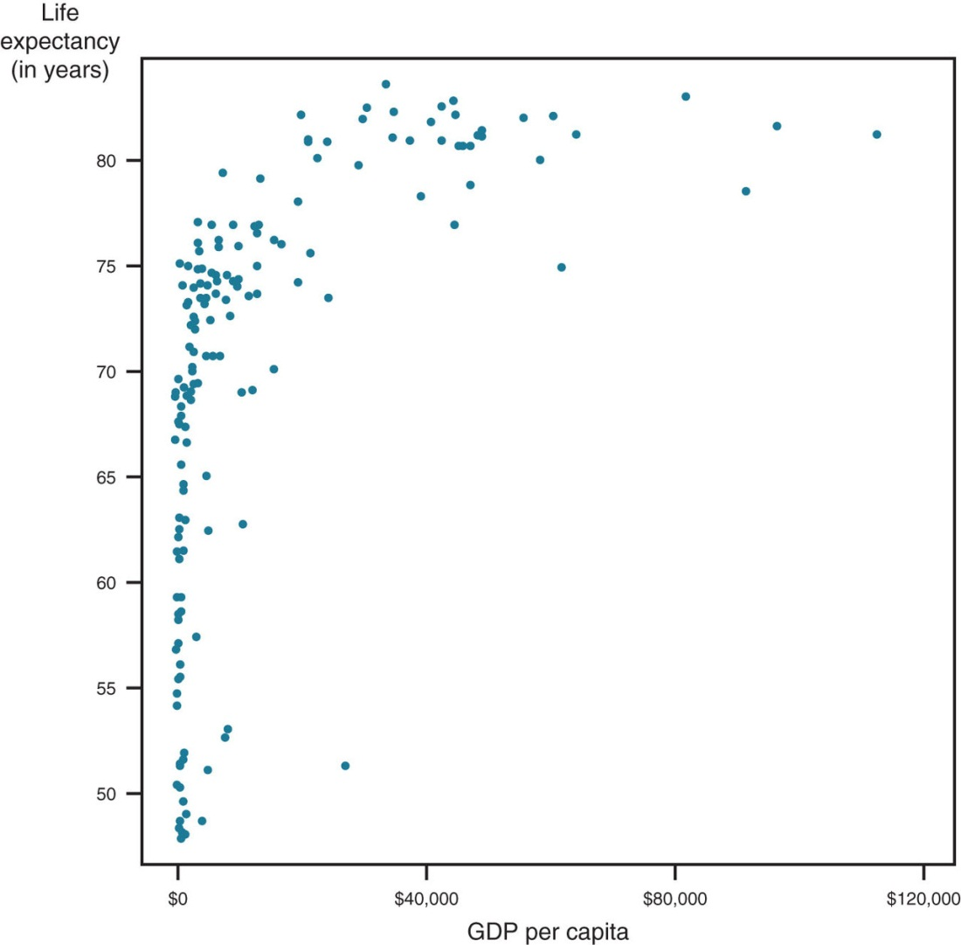
Figure 7.2

Slide 8
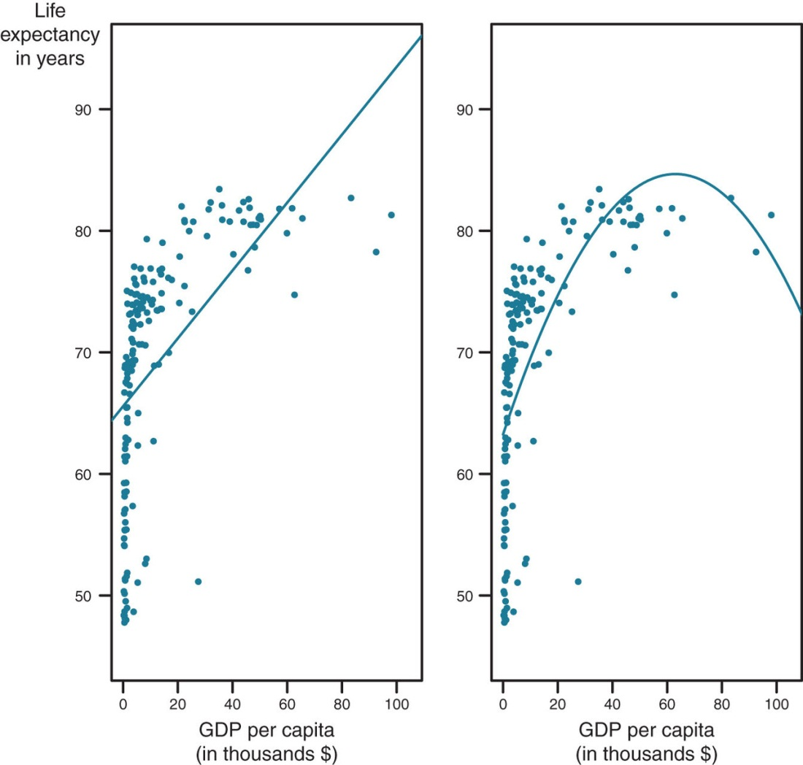
Figure 7.3

Slide 9
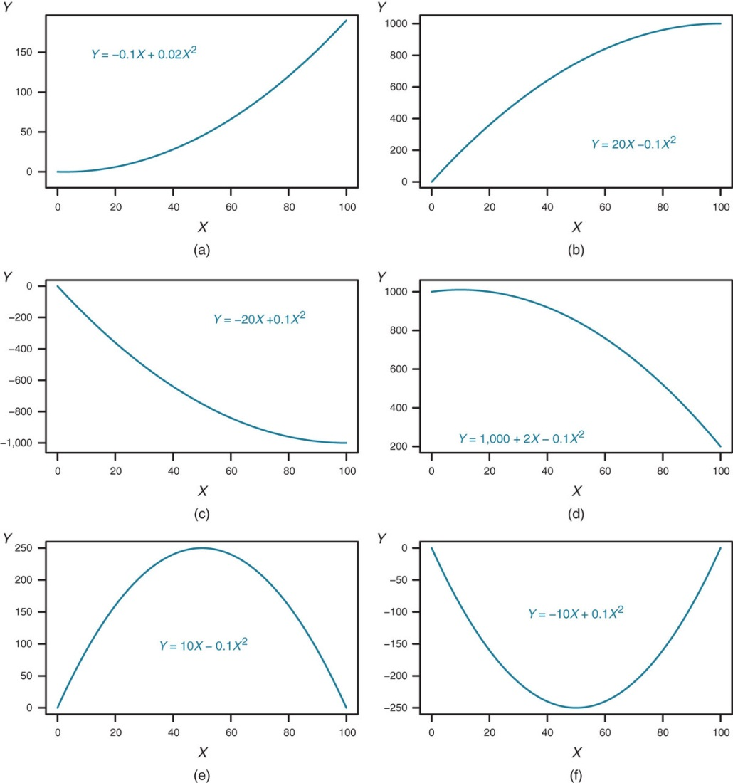
Figure 7.4

Slide 10
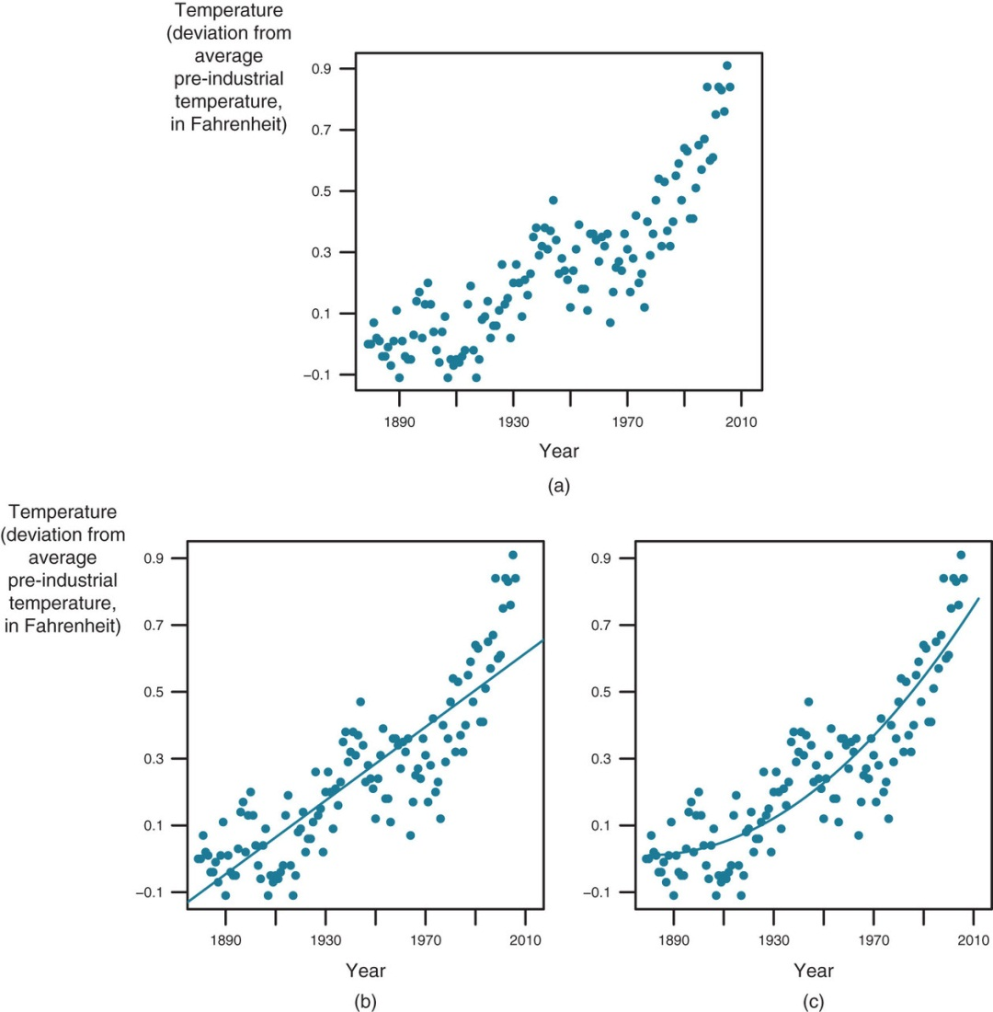
Figure 7.5

Slide 11
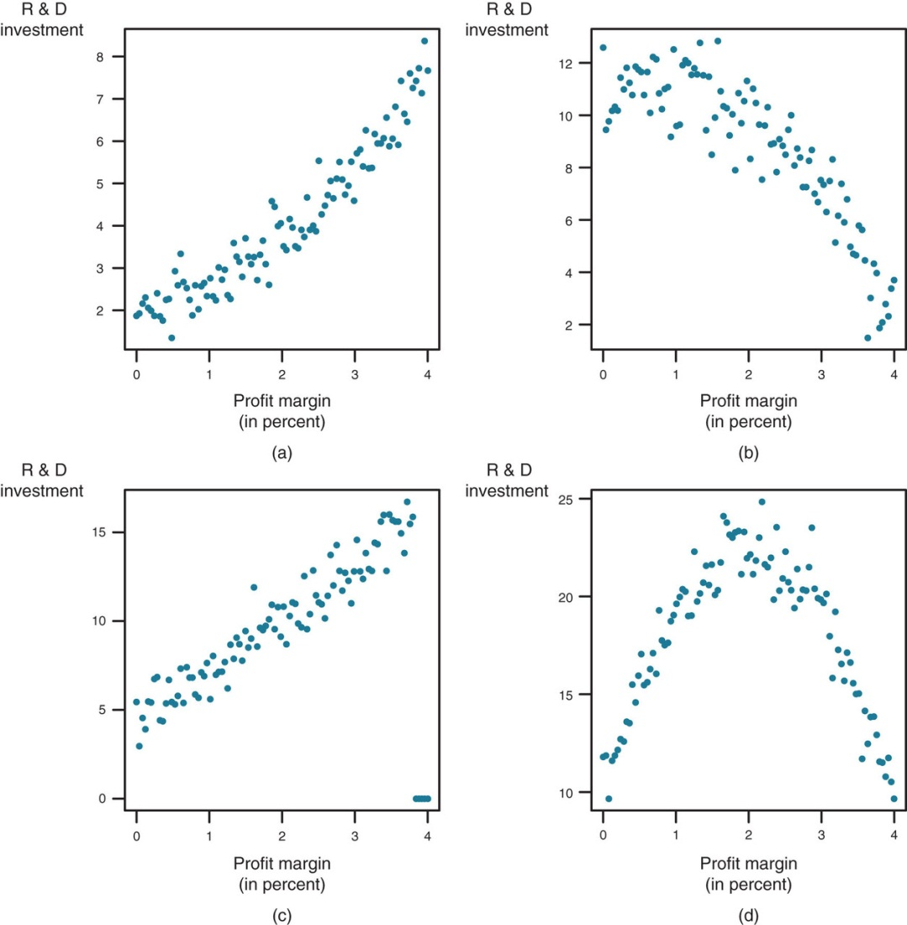
Figure 7.6

Slide 12
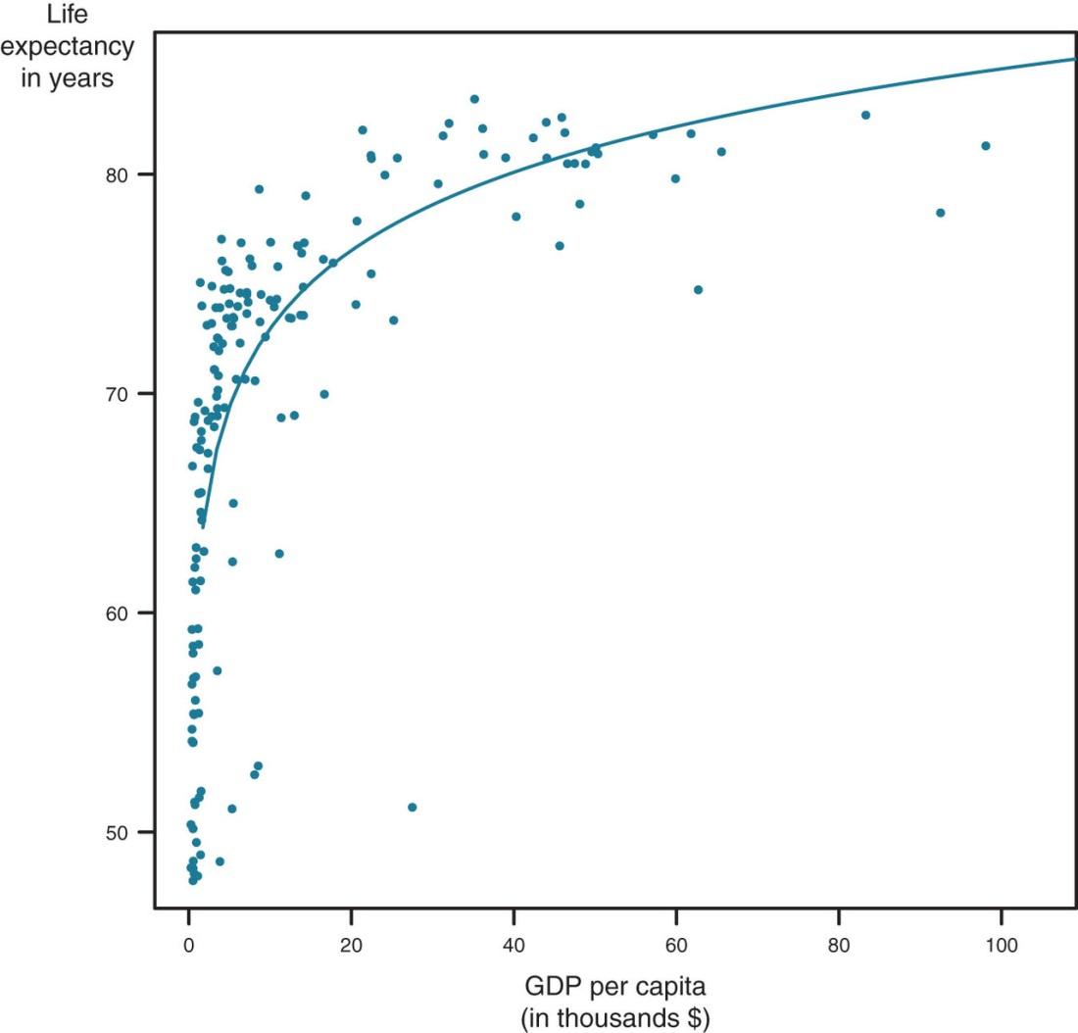
Figure 7.7

Slide 13
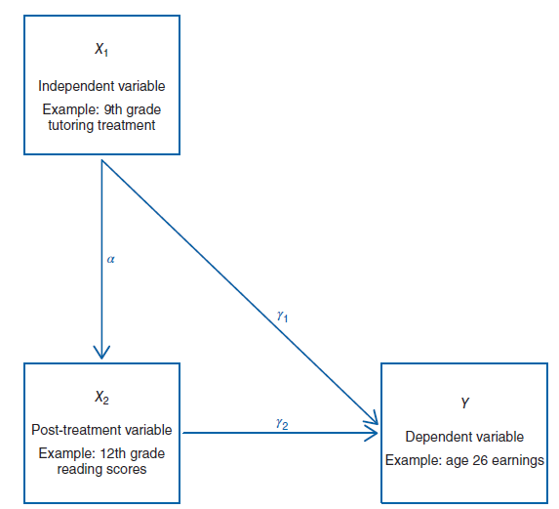
Figure 7.8

Slide 14
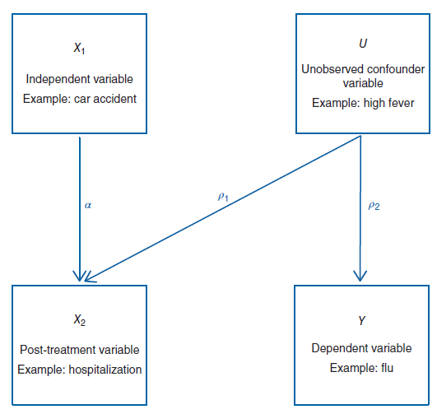
Figure 7.9

Slide 15
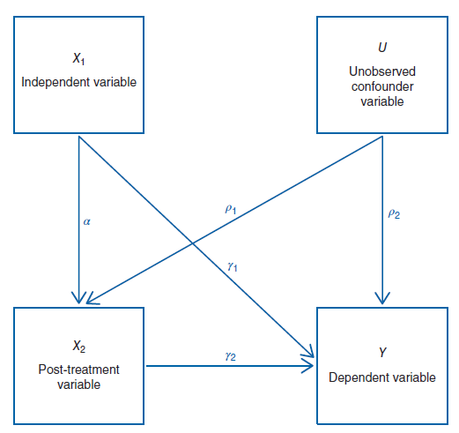
Figure 7.10

Slide 16
Tables
Chapter 7

Slide 17
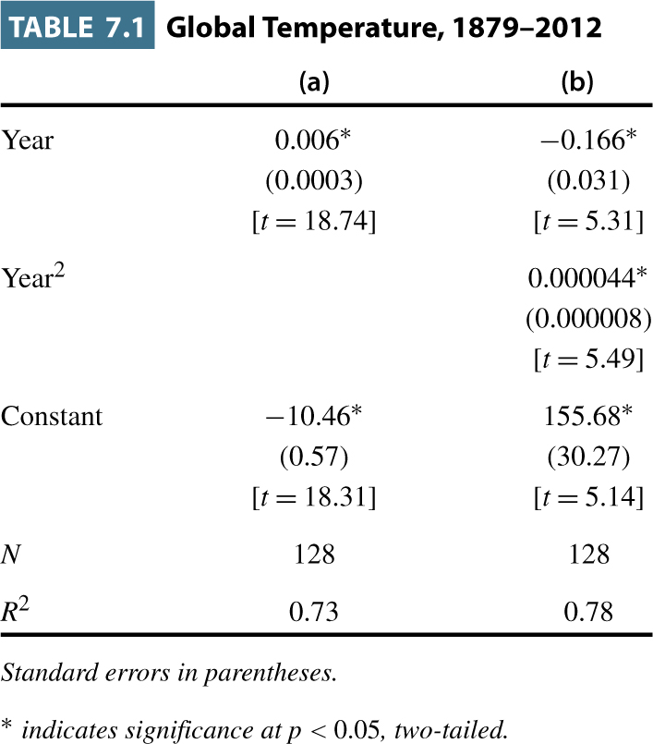
Table 7.1

Slide 18
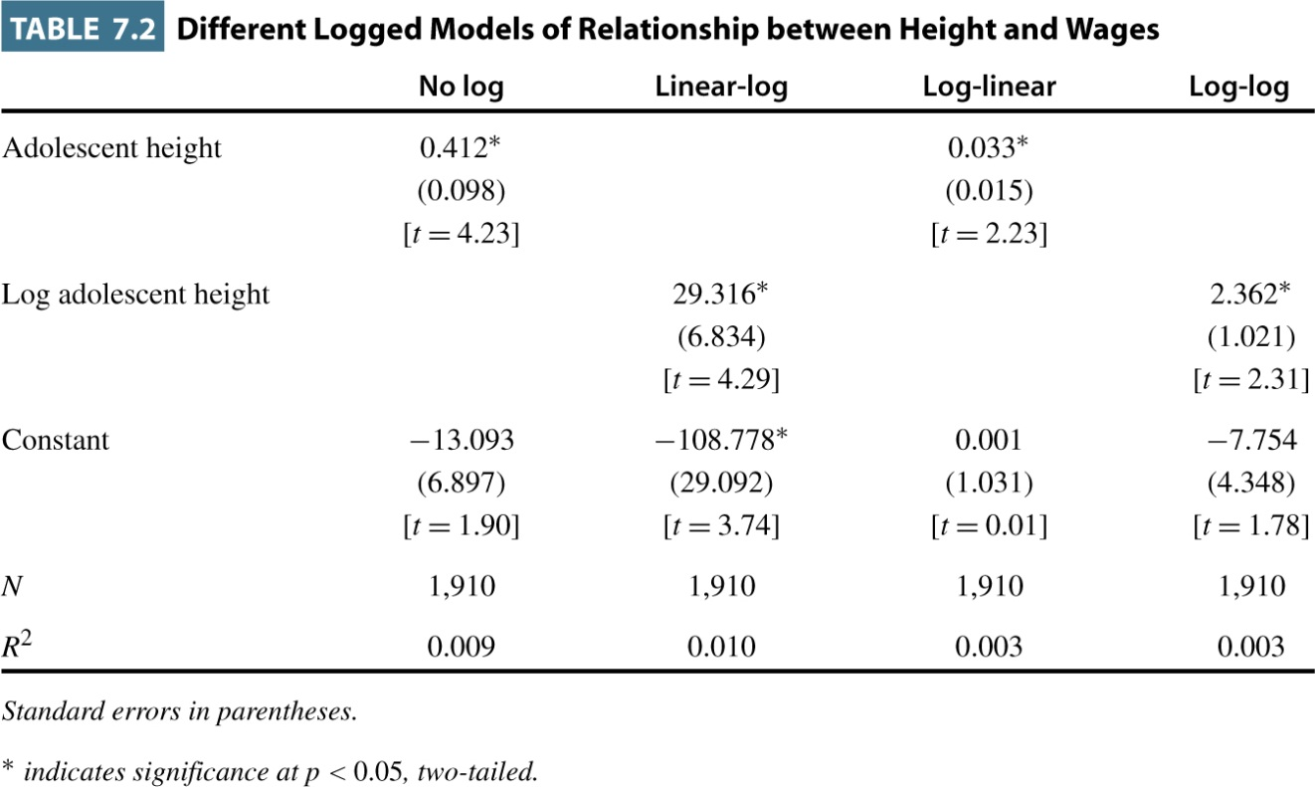
Table 7.2

Slide 19
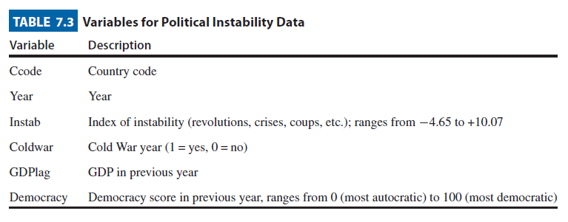
Table 7.3

Slide 20
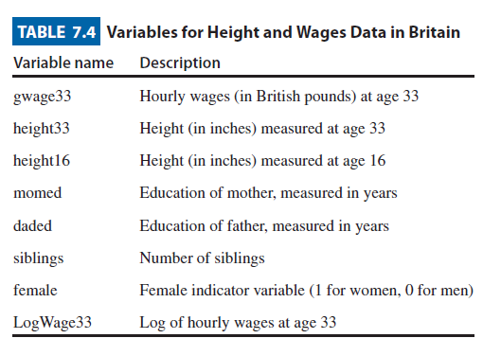
Table 7.4

Slide 21
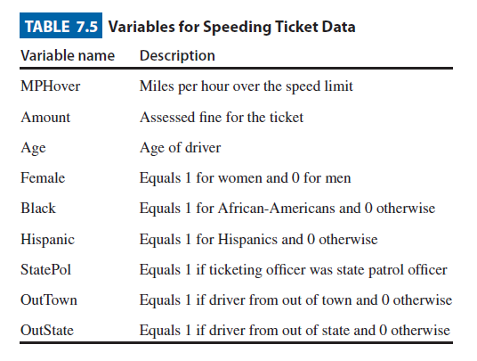
Table 7.5

