Slide 1
Chapter 2
Real Econometrics
Second Edition
Michael A. Bailey

Slide 2
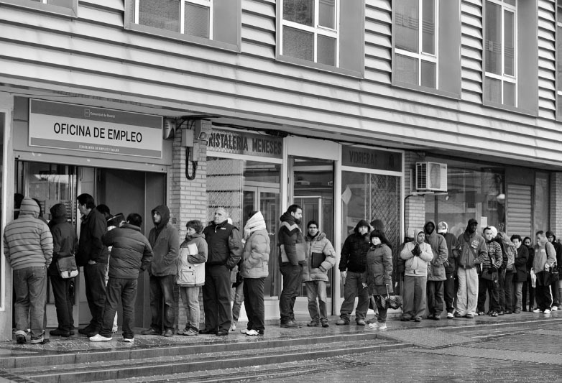

Slide 3
Case Study Photos
Chapter 2

Slide 4

Case Study 1

Slide 5
Figures
Chapter 2

Slide 6
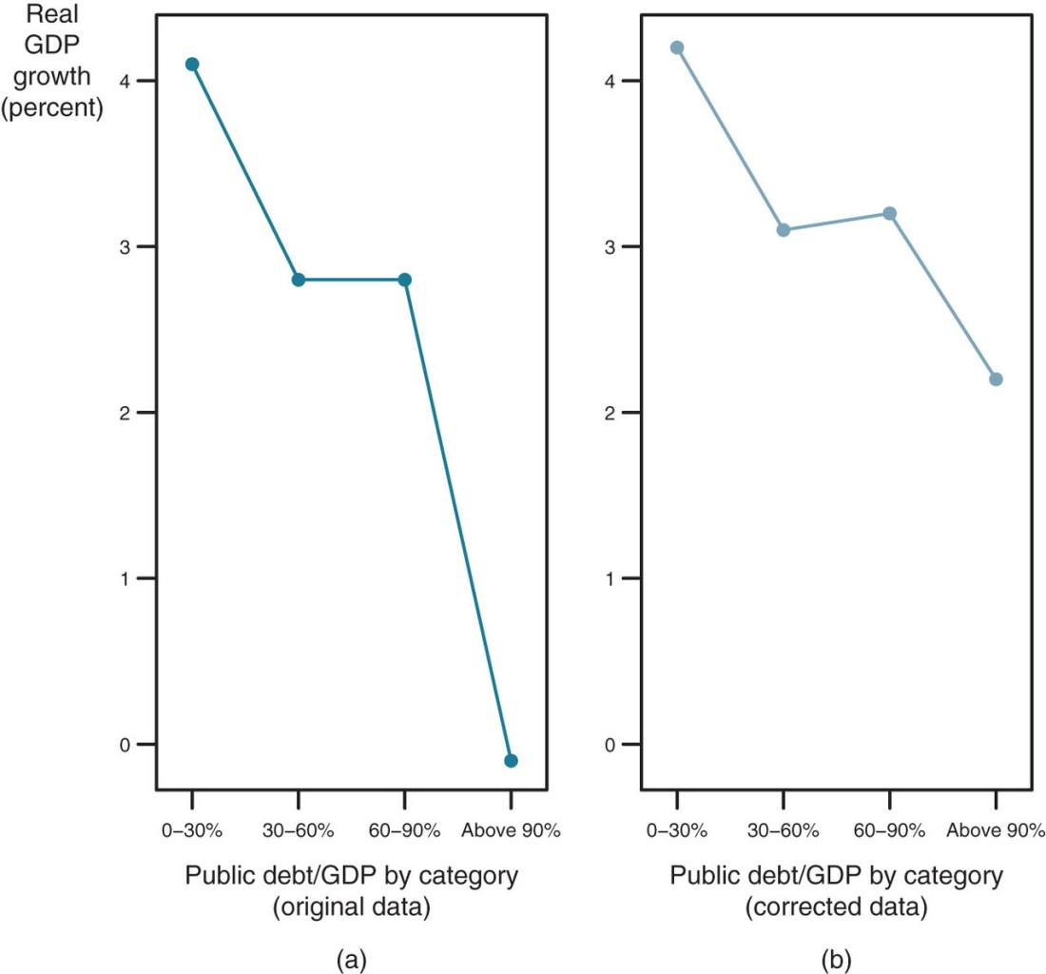
Figure 2.1

Slide 7
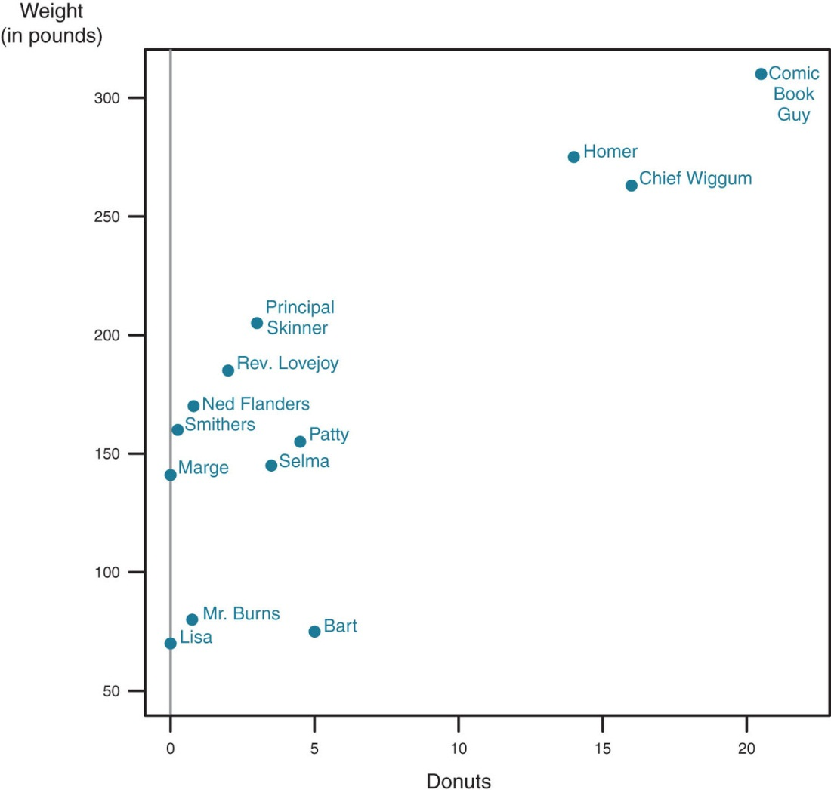
Figure 2.2

Slide 8
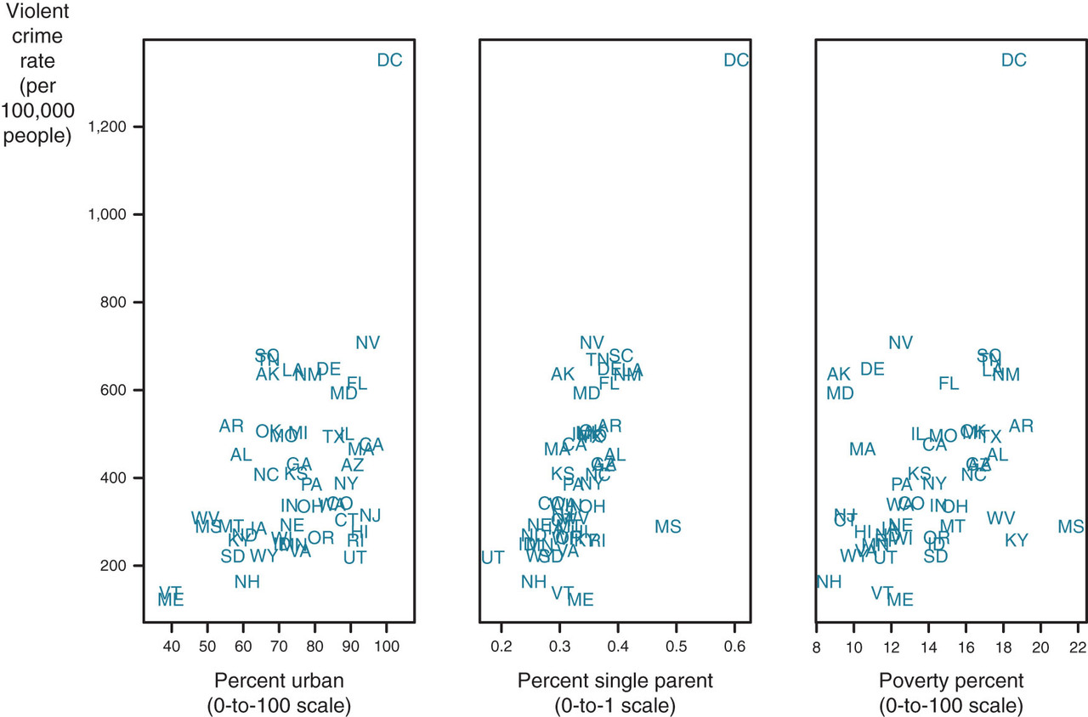
Figure 2.3

Slide 9
Tables
Chapter 2

Slide 10
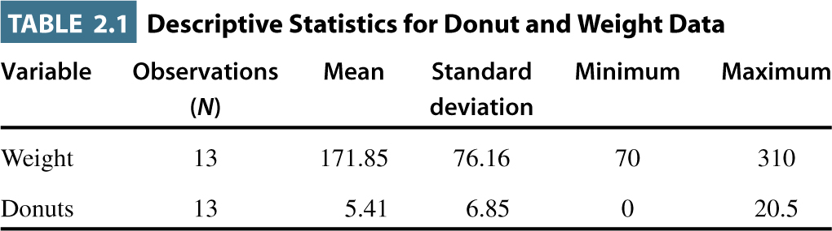
Table 2.1

Slide 11
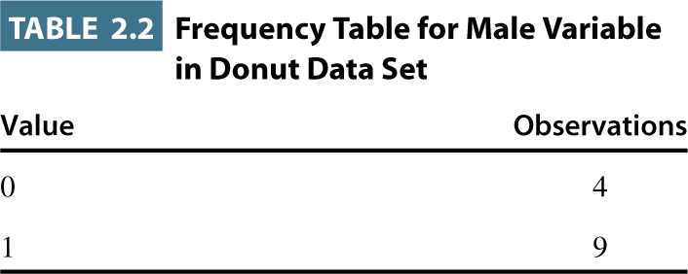
Table 2.2

Slide 12
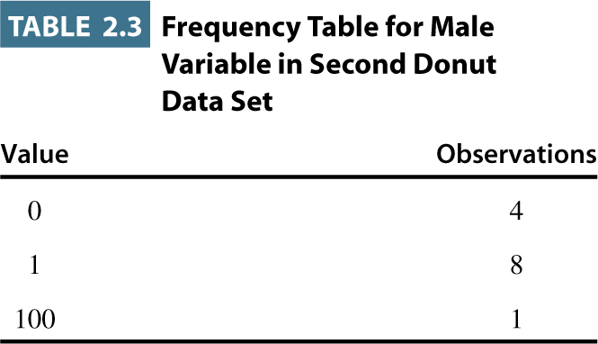
Table 2.3

Slide 13
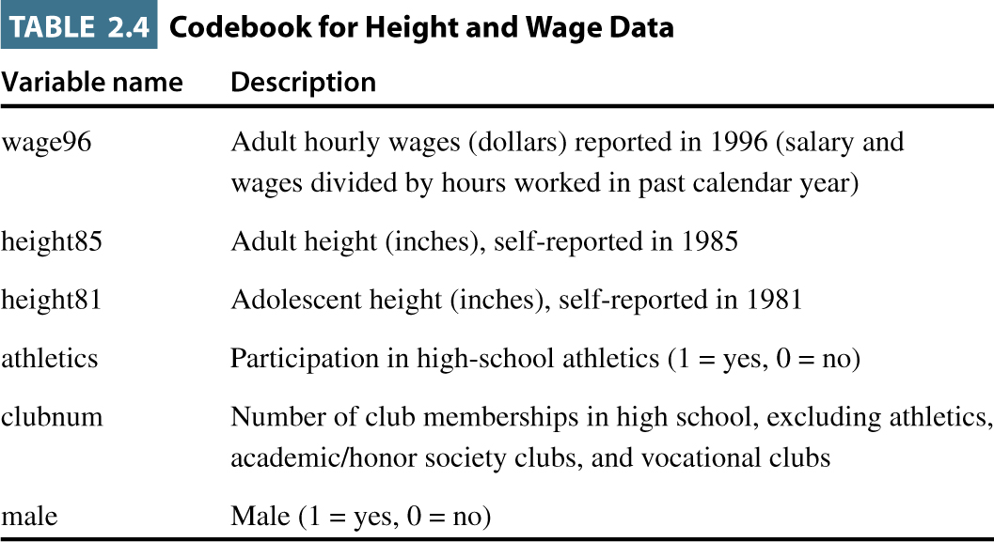
Table 2.4

Slide 14
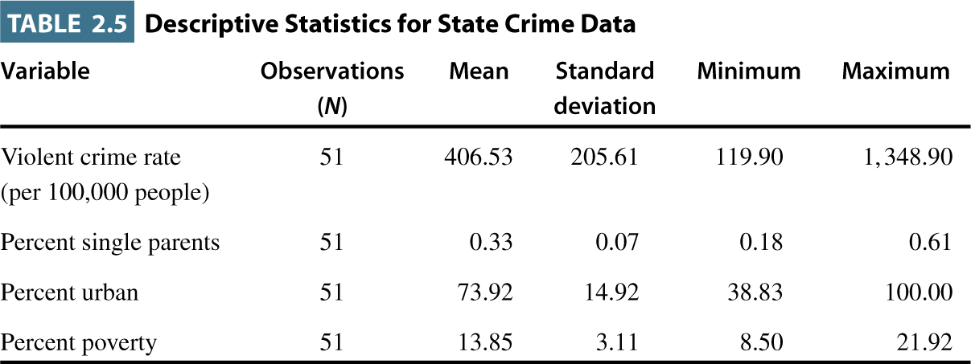
Table 2.5

Slide 15
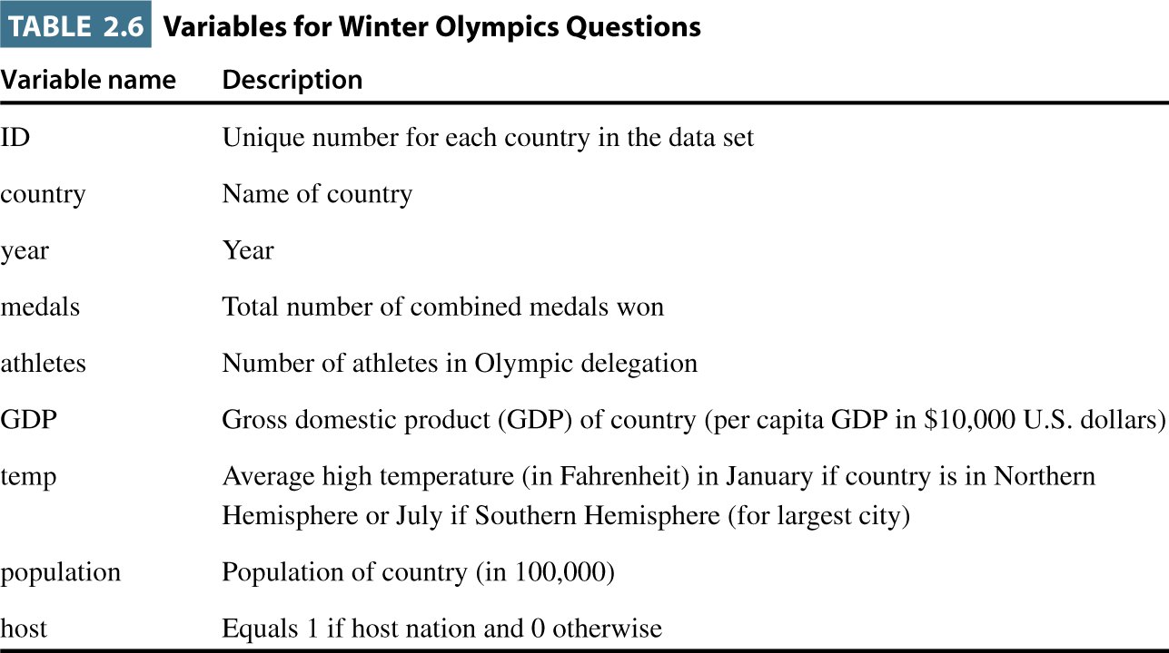
Table 2.6

Slide 16
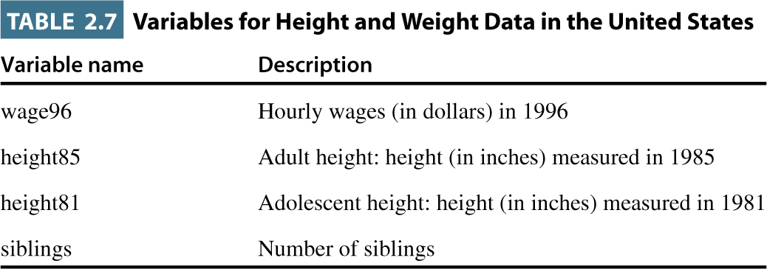
Table 2.7

