Slide 1
Appendix A
INTRODUCTION TO
SPREADSHEETS

Slide 2
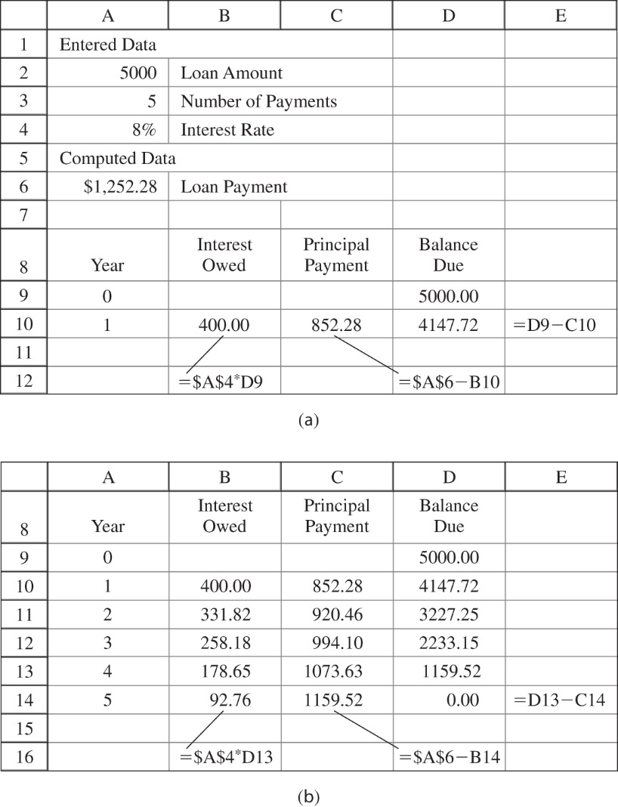
FIGURE A–1 (a) Year 1 amortization schedule. (b) Completed amortization schedule

