Slide 1

How to do Your Social Research Project Or Dissertation
by Tom Clark, Liam Foster and Alan Bryman

Slide 2
Chapter 12
Collecting Qualitative Data
© Tom Clark, Liam Foster, and Alan Bryman, 2019

Slide 3
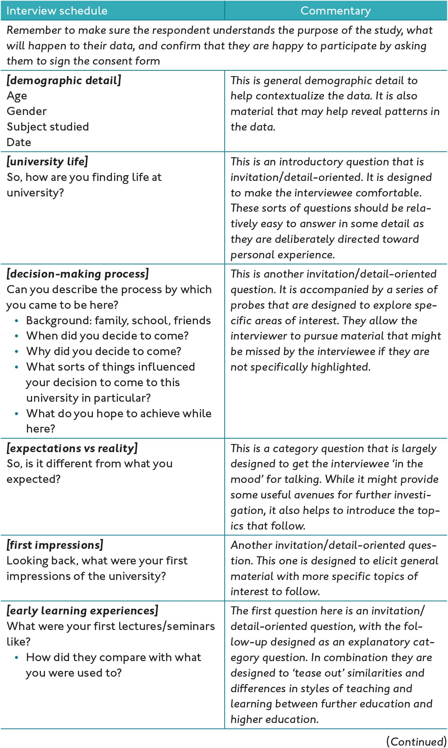
Figure 12.1 An example interview schedule
© Tom Clark, Liam Foster, and Alan Bryman, 2019

Slide 4
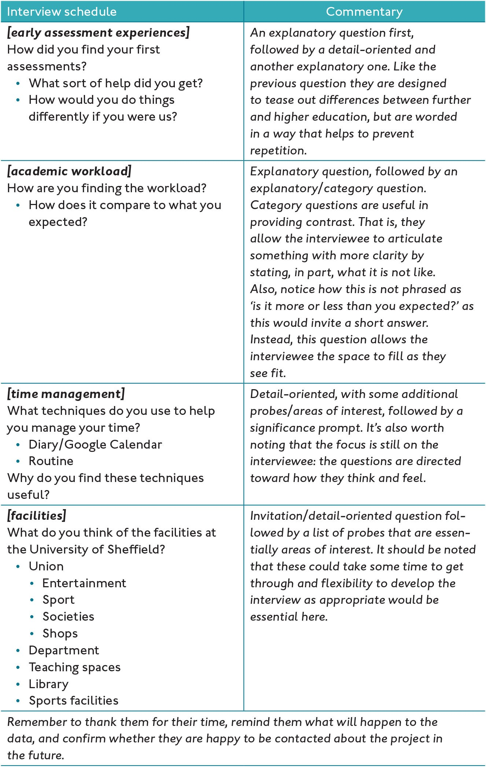
Figure 12.1 (Continued)
© Tom Clark, Liam Foster, and Alan Bryman, 2019

Slide 5
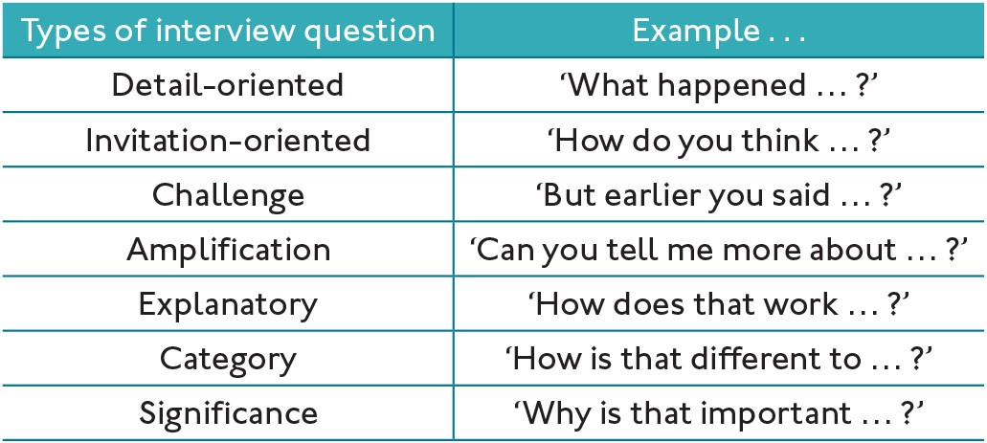
Table 12.1 Types of interview question
© Tom Clark, Liam Foster, and Alan Bryman, 2019

