Slide 1

How to do Your Social Research Project Or Dissertation
by Tom Clark, Liam Foster and Alan Bryman

Slide 2
Chapter 13
Analysing Quantitative Data
© Tom Clark, Liam Foster, and Alan Bryman, 2019

Slide 3
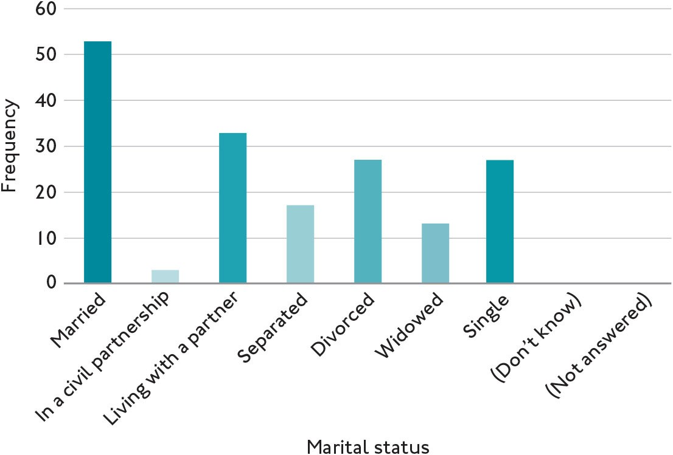
Figure 13.01 Bar chart showing the frequency of current marital status
© Tom Clark, Liam Foster, and Alan Bryman, 2019

Slide 4
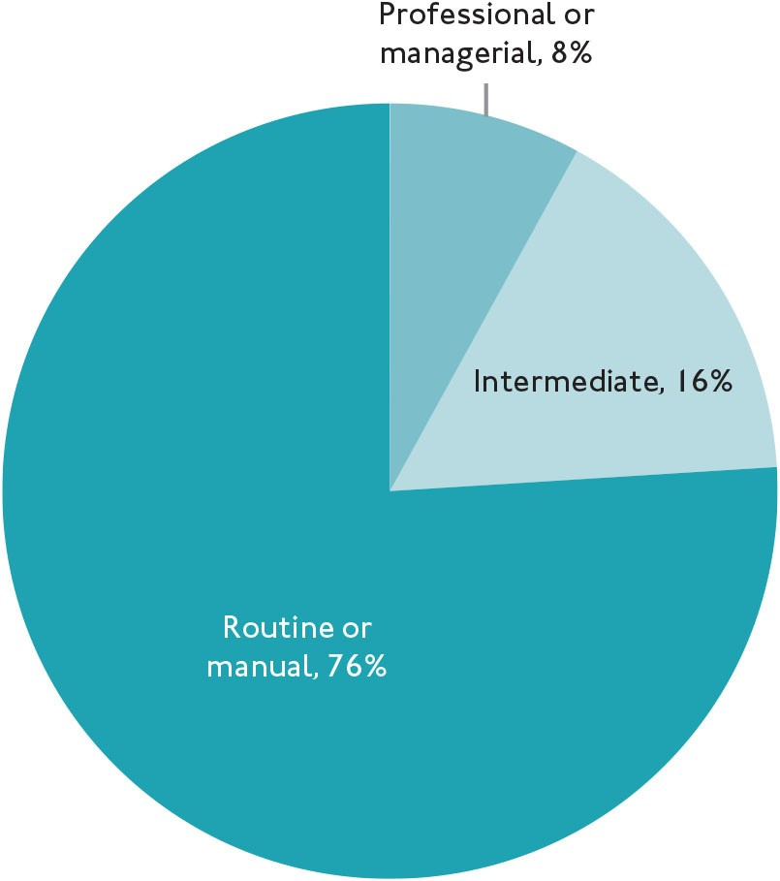
Figure 13.02 Pie chart showing the socio-economic class in percentages
© Tom Clark, Liam Foster, and Alan Bryman, 2019

Slide 5
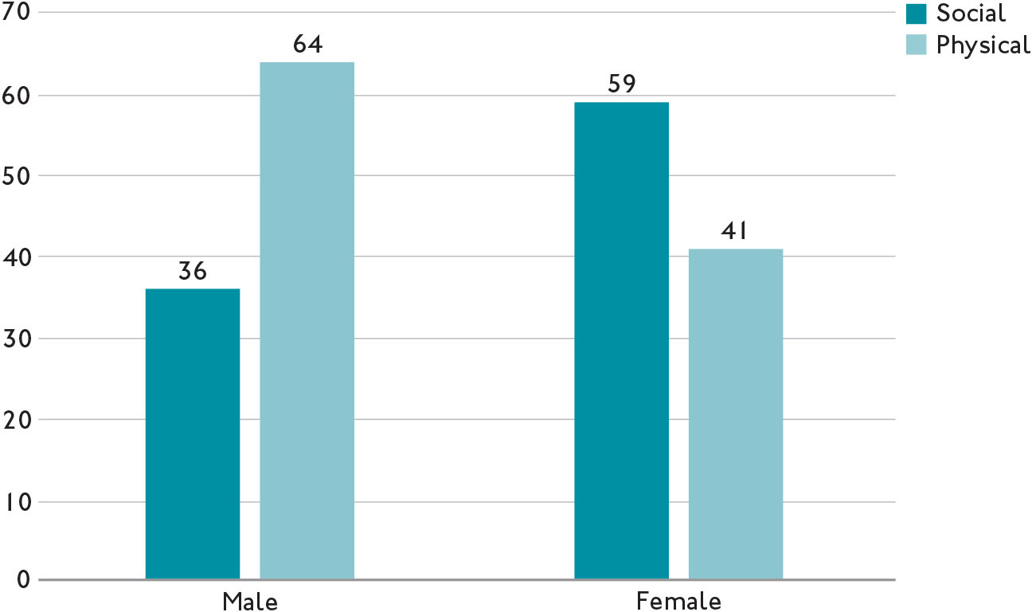
Figure 13.03 Clustered bar chart showing reasons for visiting the gym by gender (proportions)
© Tom Clark, Liam Foster, and Alan Bryman, 2019

Slide 6
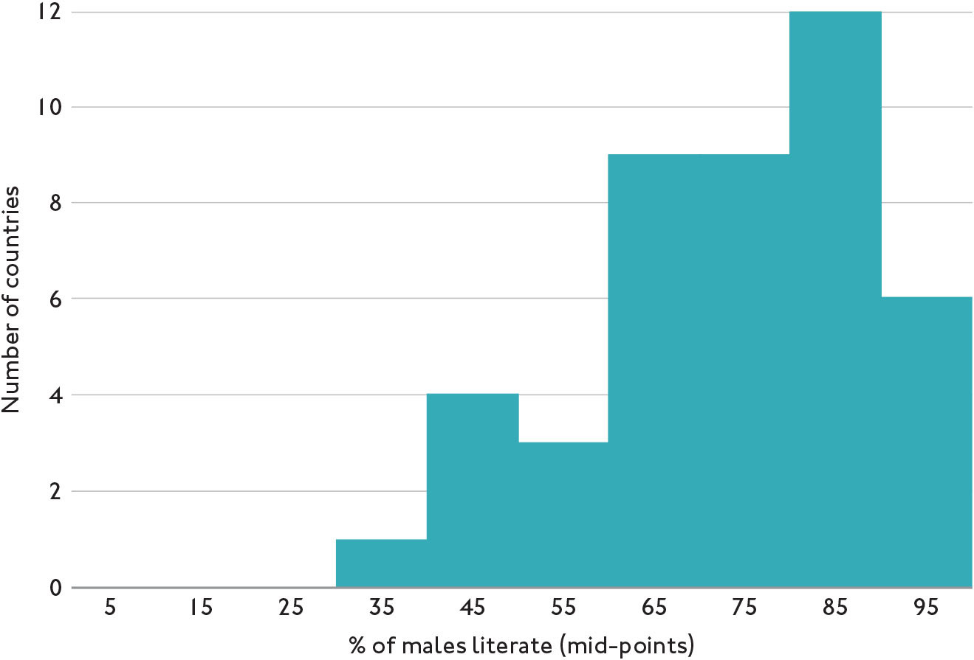
Figure 13.04 Histogram showing literacy rate among males aged over 15 years in 44 African countries for which figures are available, 2005–10
© Tom Clark, Liam Foster, and Alan Bryman, 2019

Slide 7
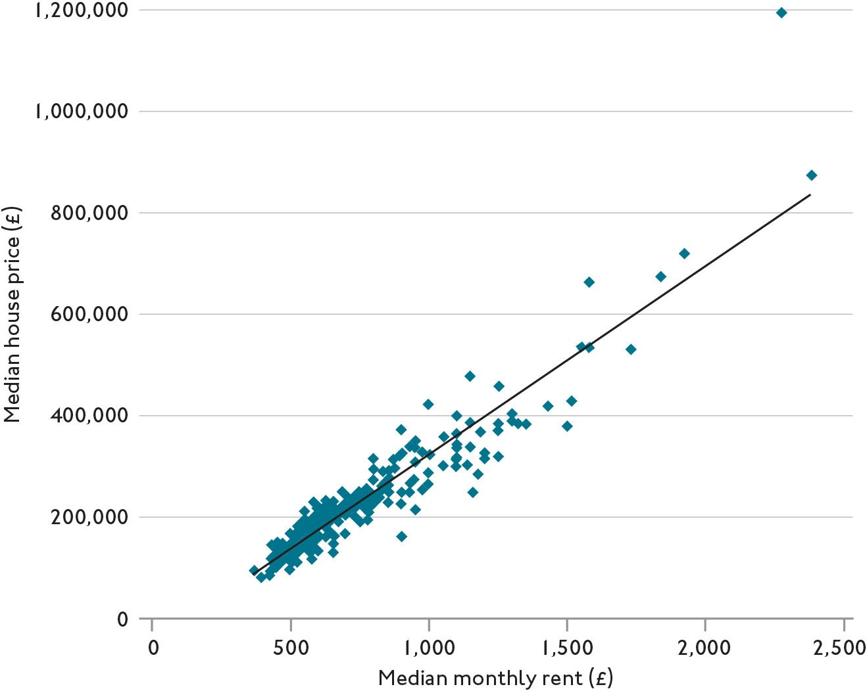
Figure 13.05 Scatterplot showing the median monthly private rent and median house price by local authority
© Tom Clark, Liam Foster, and Alan Bryman, 2019

Slide 8
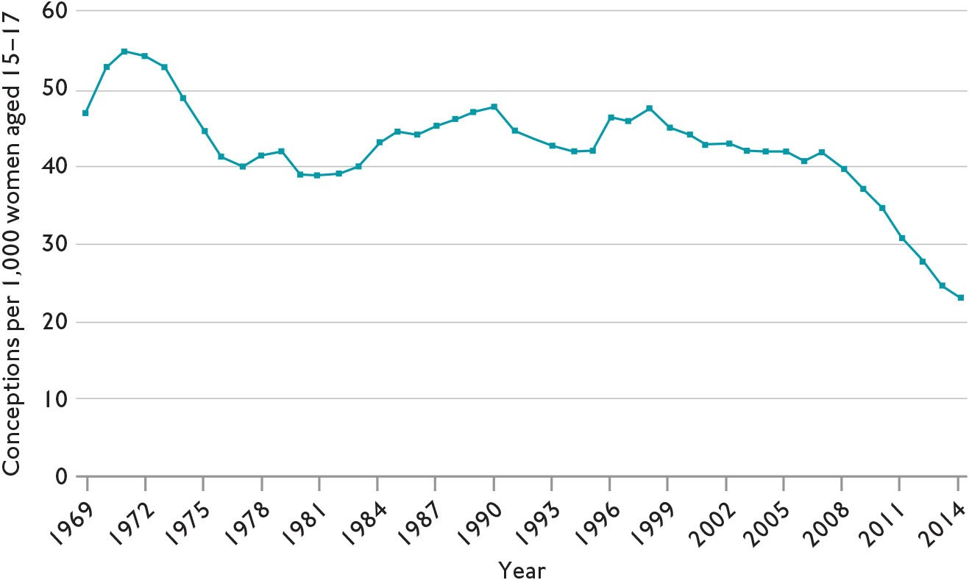
Figure 13.06 Line graph showing under-18 conception rate, 1969 to 2014
© Tom Clark, Liam Foster, and Alan Bryman, 2019

Slide 9
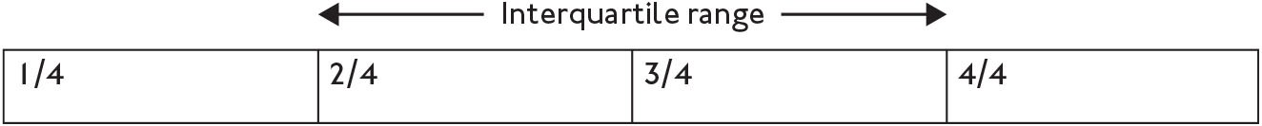
Figure 13.07 Example showing interquartile range
© Tom Clark, Liam Foster, and Alan Bryman, 2019

Slide 10
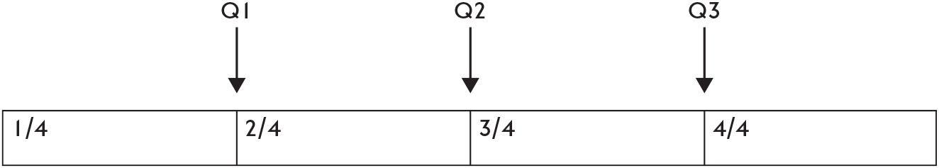
Figure 13.08 Example highlighting each quartile of the distribution
© Tom Clark, Liam Foster, and Alan Bryman, 2019

Slide 11
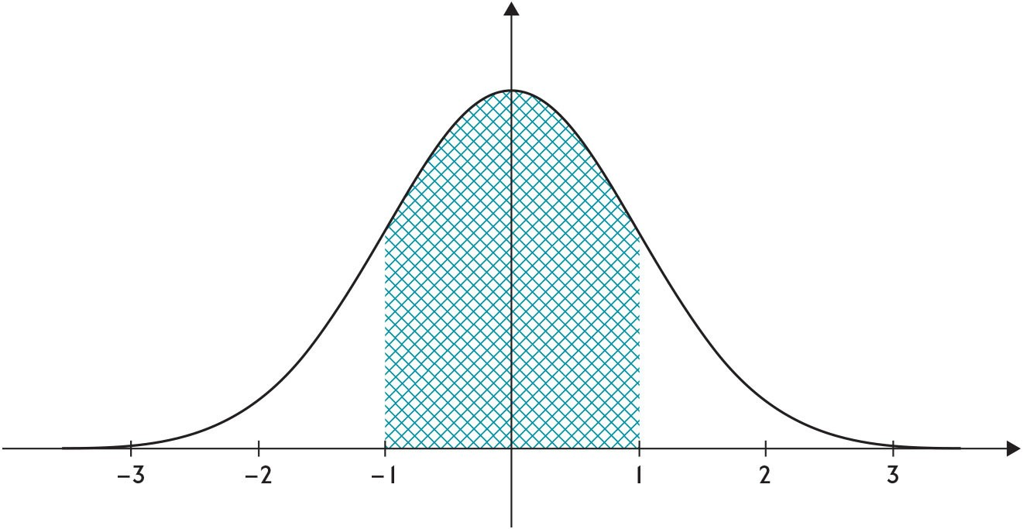
Figure 13.09 Example of the bell curve
© Tom Clark, Liam Foster, and Alan Bryman, 2019

Slide 12
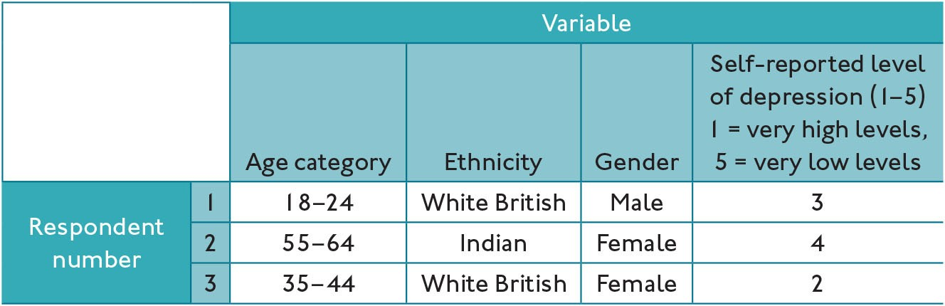
Table 13.01 An example of how data could be coded
© Tom Clark, Liam Foster, and Alan Bryman, 2019

Slide 13
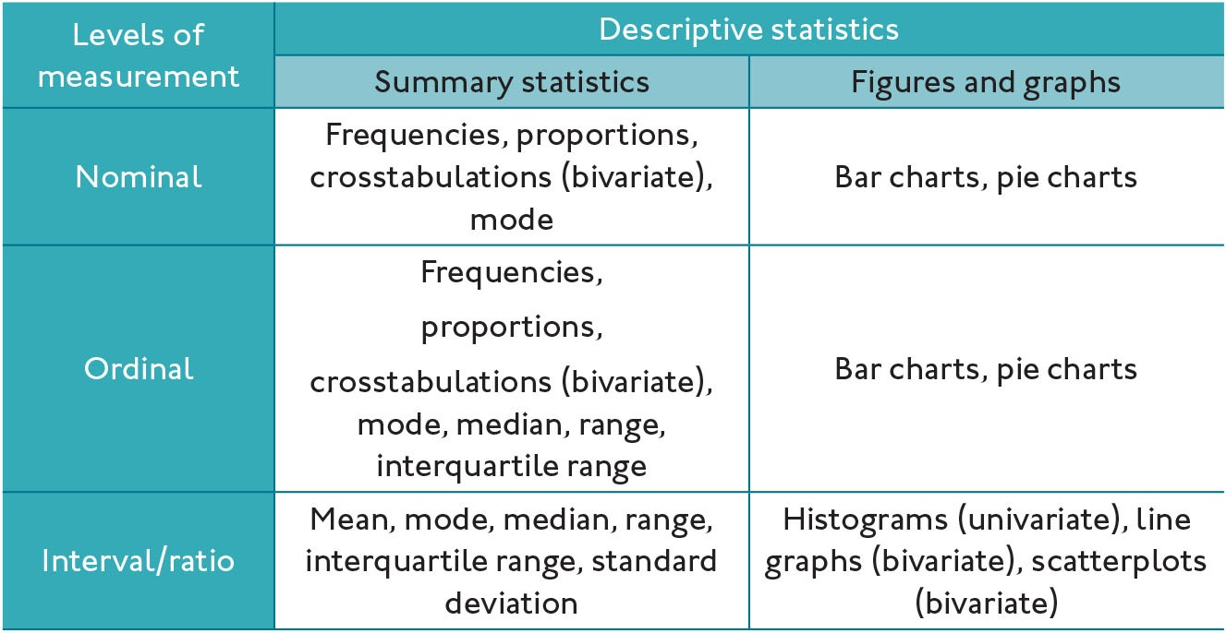
Table 13.02 Guide to which summary statistics, graphs, and figures are associated with each level of measurement
© Tom Clark, Liam Foster, and Alan Bryman, 2019

Slide 14
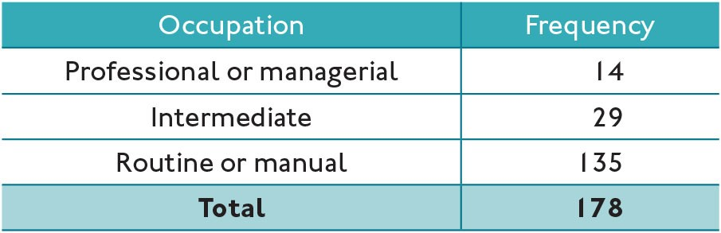
Table 13.03 Frequency table of socio-economic class
© Tom Clark, Liam Foster, and Alan Bryman, 2019

Slide 15
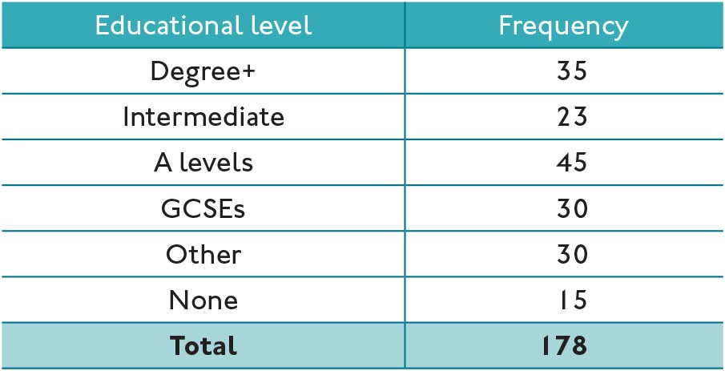
Table 13.04 Frequency table showing the highest educational attainment
© Tom Clark, Liam Foster, and Alan Bryman, 2019

Slide 16
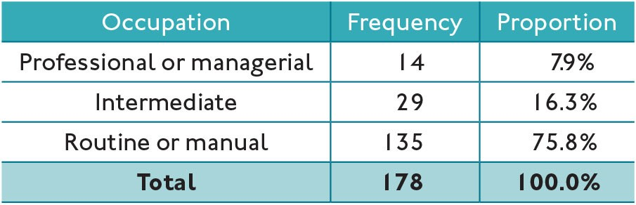
Table 13.05 Frequency and proportion showing the socio-economic class
© Tom Clark, Liam Foster, and Alan Bryman, 2019

Slide 17
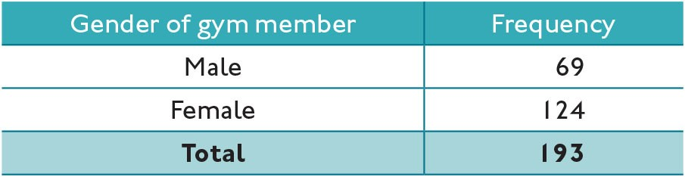
Table 13.06 Frequency of membership by gender
© Tom Clark, Liam Foster, and Alan Bryman, 2019

Slide 18
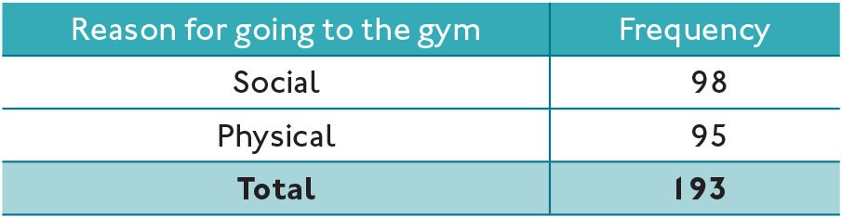
Table 13.07 Frequency of reasons for attending the gym
© Tom Clark, Liam Foster, and Alan Bryman, 2019

Slide 19
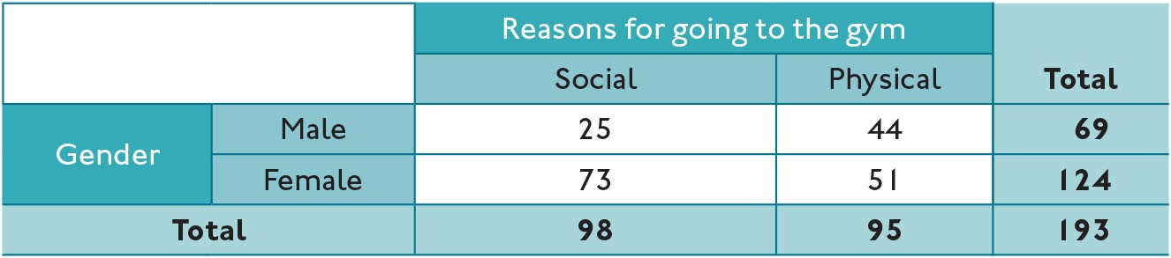
Table 13.08 Reason for visiting the gym by gender
© Tom Clark, Liam Foster, and Alan Bryman, 2019

Slide 20
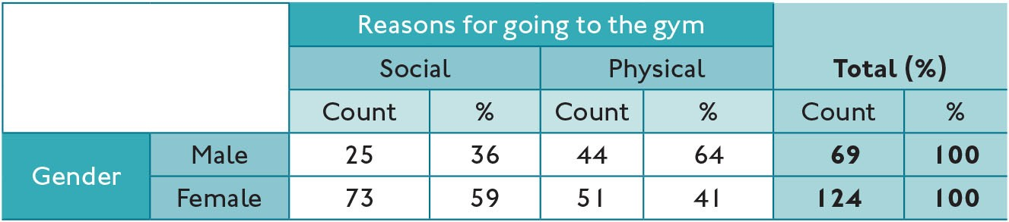
Table 13.09 Reason for visiting the gym by gender (%)
© Tom Clark, Liam Foster, and Alan Bryman, 2019

Slide 21
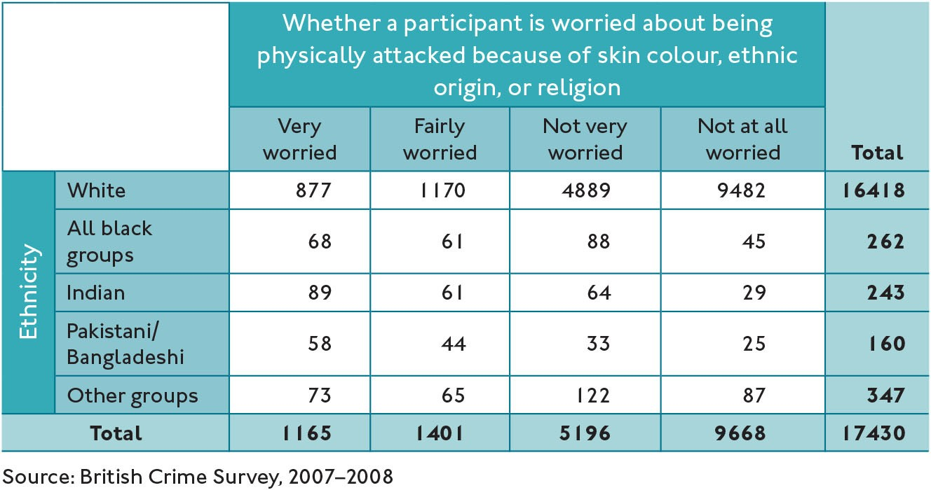
Table 13.10 Worried about being physically attacked because of skin colour, ethnic origin, or religion, by ethnicity
© Tom Clark, Liam Foster, and Alan Bryman, 2019

Slide 22
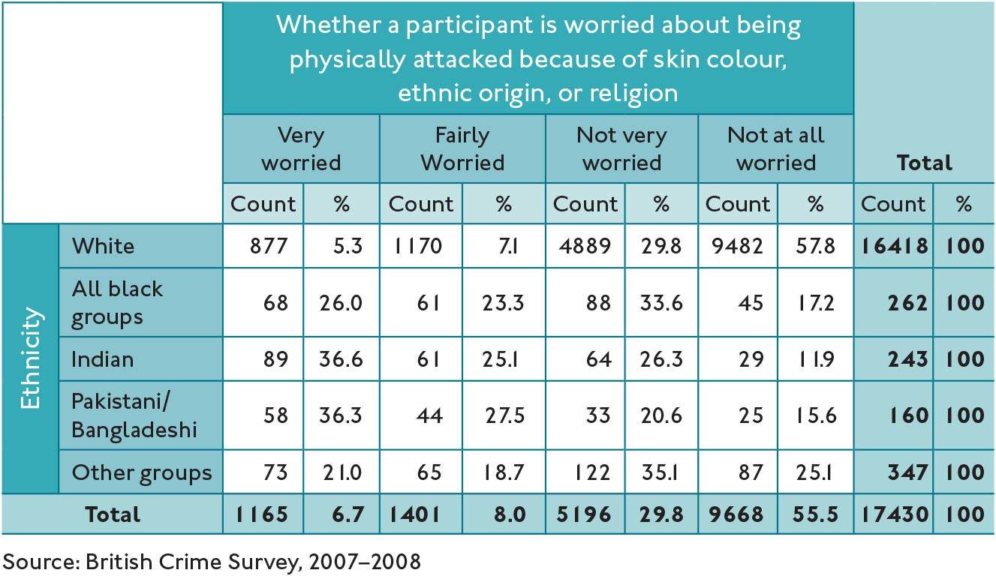
Table 13.11 Worried about being physically attacked because of skin colour, ethnic origin, or religion, by ethnicity (with proportions)
© Tom Clark, Liam Foster, and Alan Bryman, 2019

Slide 23
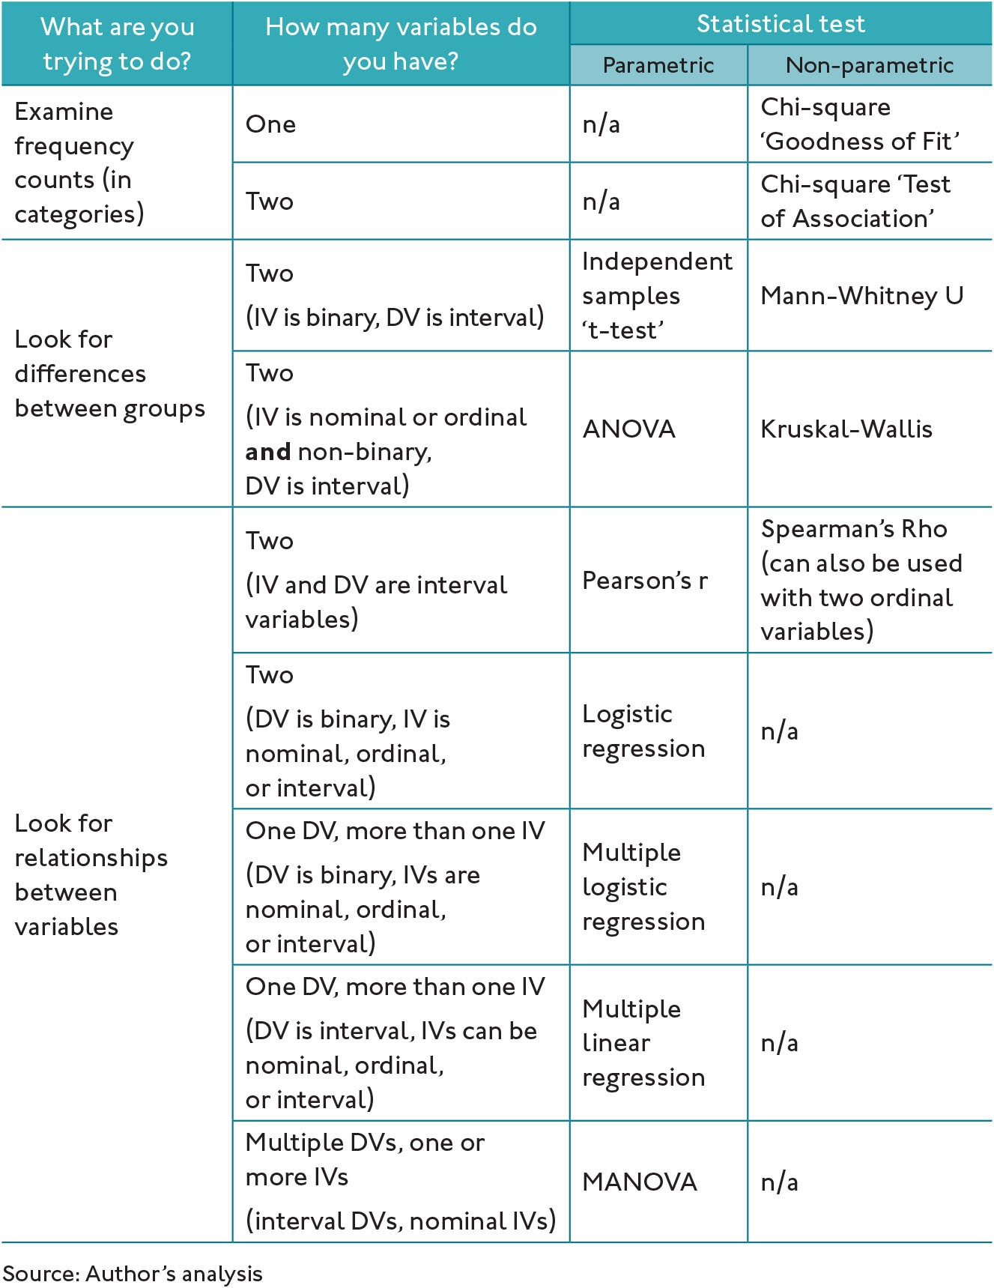
Table 13.12 Common tests used for social science dissertations
© Tom Clark, Liam Foster, and Alan Bryman, 2019

